Slide 1

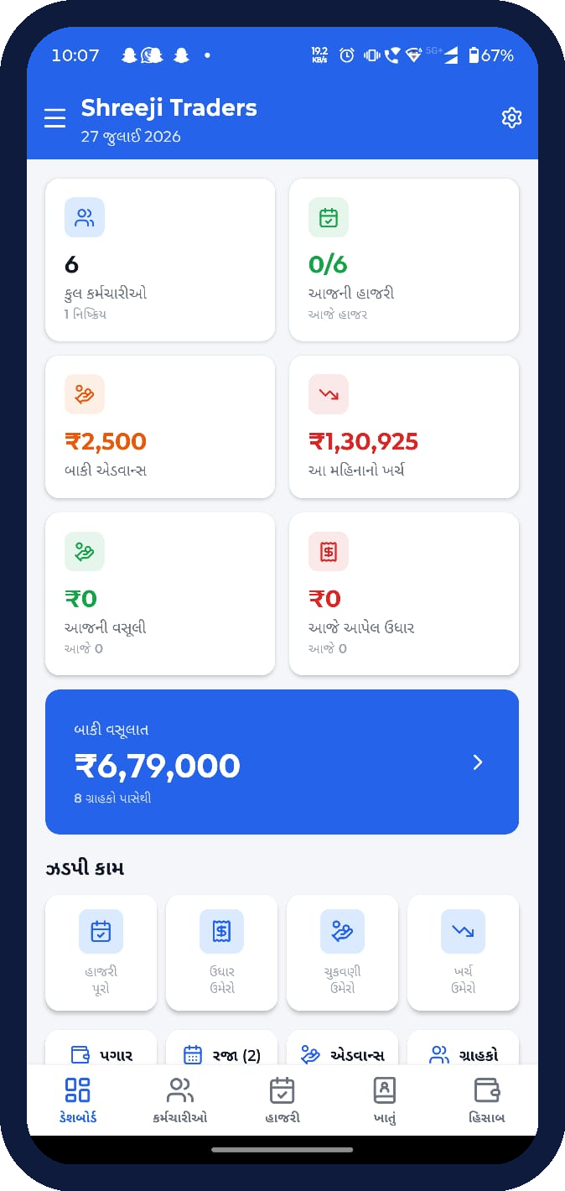
HR & BUSINESS MANAGEMENT SYSTEM
HRMS
Staff, Attendance, Salary & Ledger — in one app
A bilingual (Gujarati / Hindi / English) React Native app that runs a small
business end to end — employees and daily-wage attendance, salary and
advances, customer dues and full income–expense accounting.
OWNER + EMPLOYEE
OFFLINE-READY
GUJARATI-FIRST
HRMS • SHREEJI TRADERS
1

Slide 2
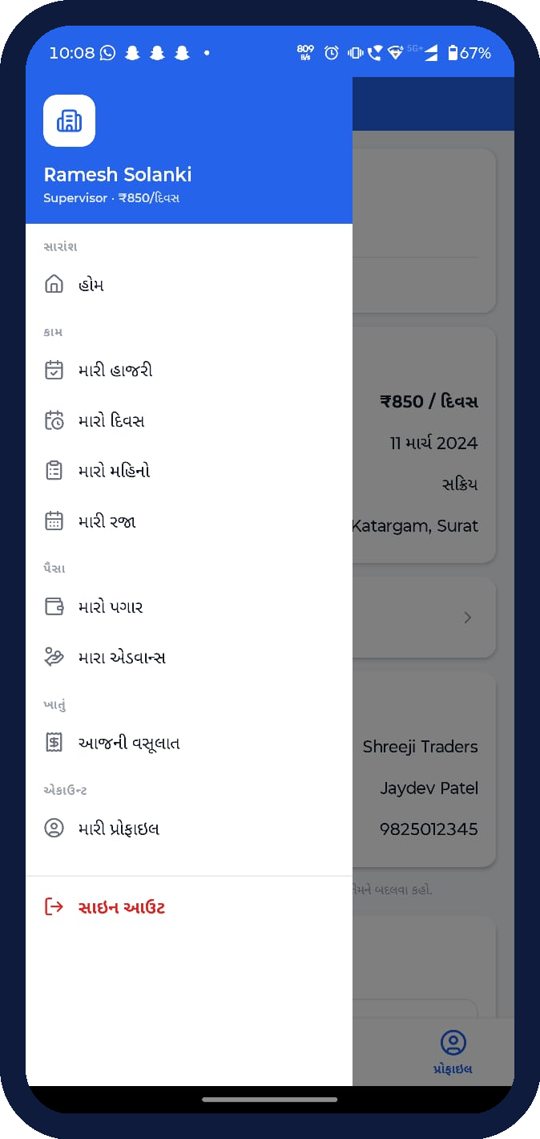
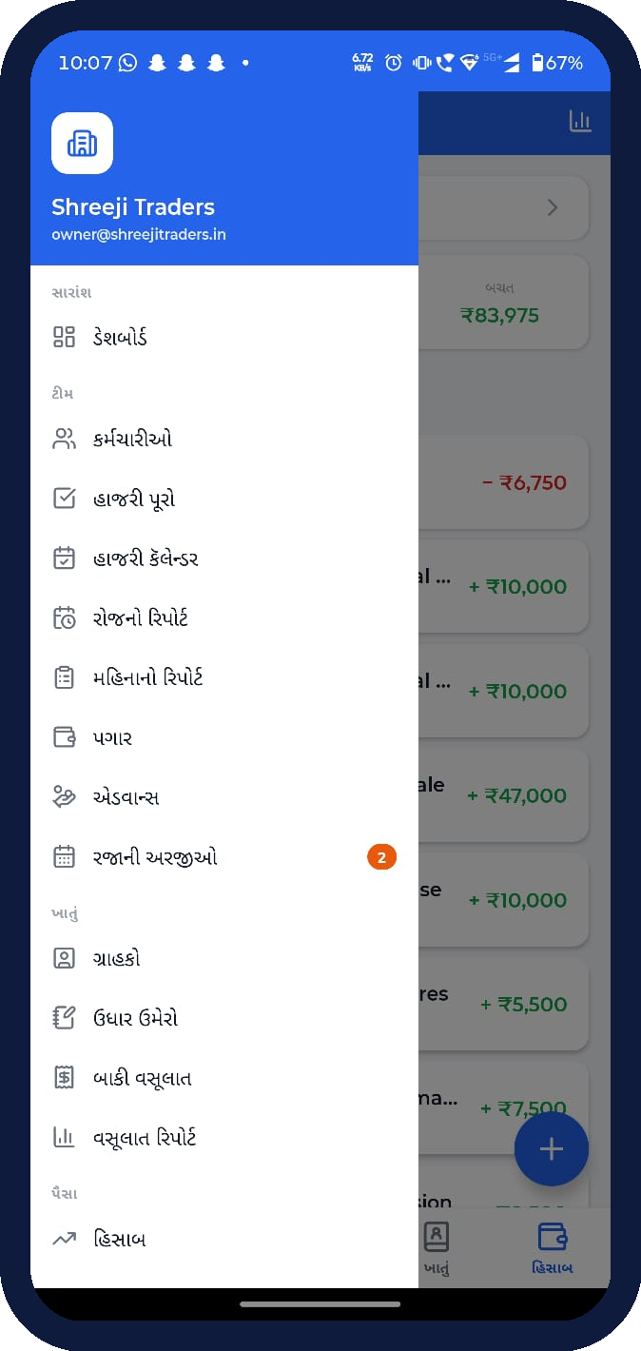
Two Sign-ins, One Business
The login screen splits into Owner and Employee — each role gets its own tailored app.
OWNER
EMPLOYEE
Signs in with Email + password
Signs in with Name + 4-digit PIN
Dashboard: staff count, dues, monthly spend
Manage employees & daily-wage rates
Attendance calendar & one-tap approval
Customer ledger (khatu) & receivables
Full income–expense accounting + reports
Mark today's attendance in one tap
Personal attendance calendar
Estimated salary for the month
Payment history & advances taken
Own profile & employer details
HRMS • SHREEJI TRADERS
2

Slide 3
The Owner's Cockpit
Open the app and the whole business is on one screen.
6
₹6.79L
₹2,500
₹1.31L
Employees
Receivable dues
Advances out
Month's expense
Quick Actions, front and centre
Mark attendance, add udhaar (credit) or a payment
Log an expense — all from the home screen
Big ₹6.79L receivables card jumps straight to the ledger
HRMS • SHREEJI TRADERS
3

Slide 4
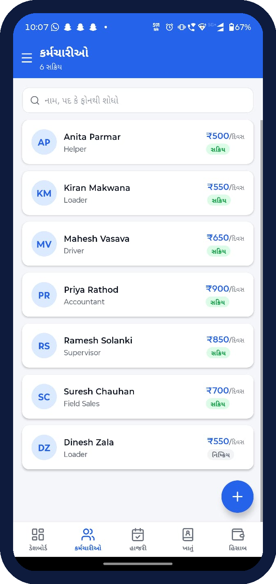
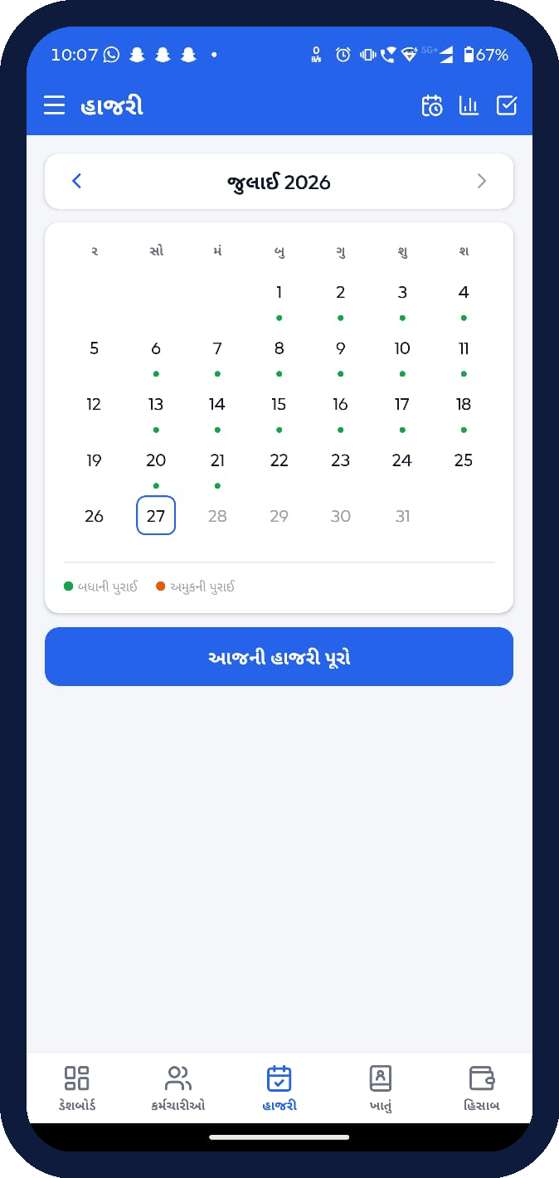
People & Attendance
Track a daily-wage team without paperwork.
Employee directory
Every worker with role and per-day wage (₹500–₹900), active/inactive status, and search.
Daily-wage model
Salary = daily rate × payable days, with half-days counted as 0.5 — set once in Settings.
Attendance calendar
Month grid marks fully-present vs partial days; “Complete today's attendance” in one tap.
Leave requests
Employees raise leave; pending requests badge the owner's menu (e.g. 2 waiting).
HRMS • SHREEJI TRADERS
4

Slide 5
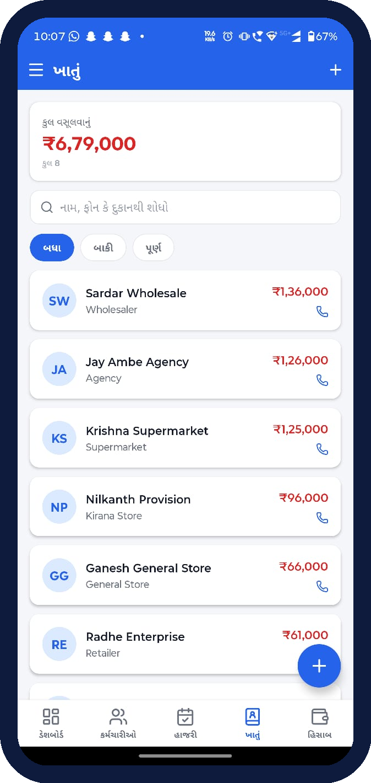
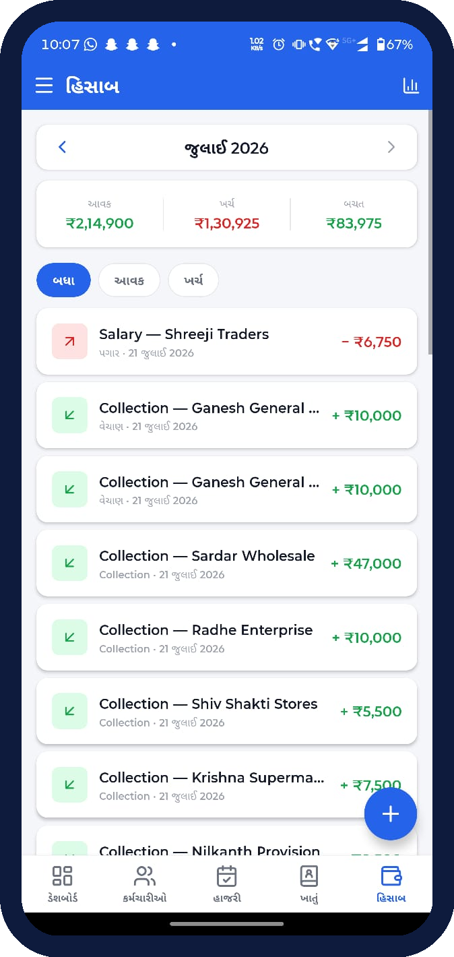
Dues & Accounting
Khatu for customer credit, Hisaab for the full money picture.
Customer Ledger (Khatu)
₹6.79L outstanding across 8 customers — wholesalers, agencies, kirana stores — filterable by All / Pending / Cleared, each with a call button.
Income & Expense (Hisaab)
Monthly आवक / खर्च / बचत summary (e.g. ₹2.15L in, ₹1.31L out, ₹83,975 saved) with a colour-coded transaction feed.
Salary & Advances
Payroll runs off attendance; advances are tracked per employee and auto-deducted at payout.
HRMS • SHREEJI TRADERS
5

Slide 6
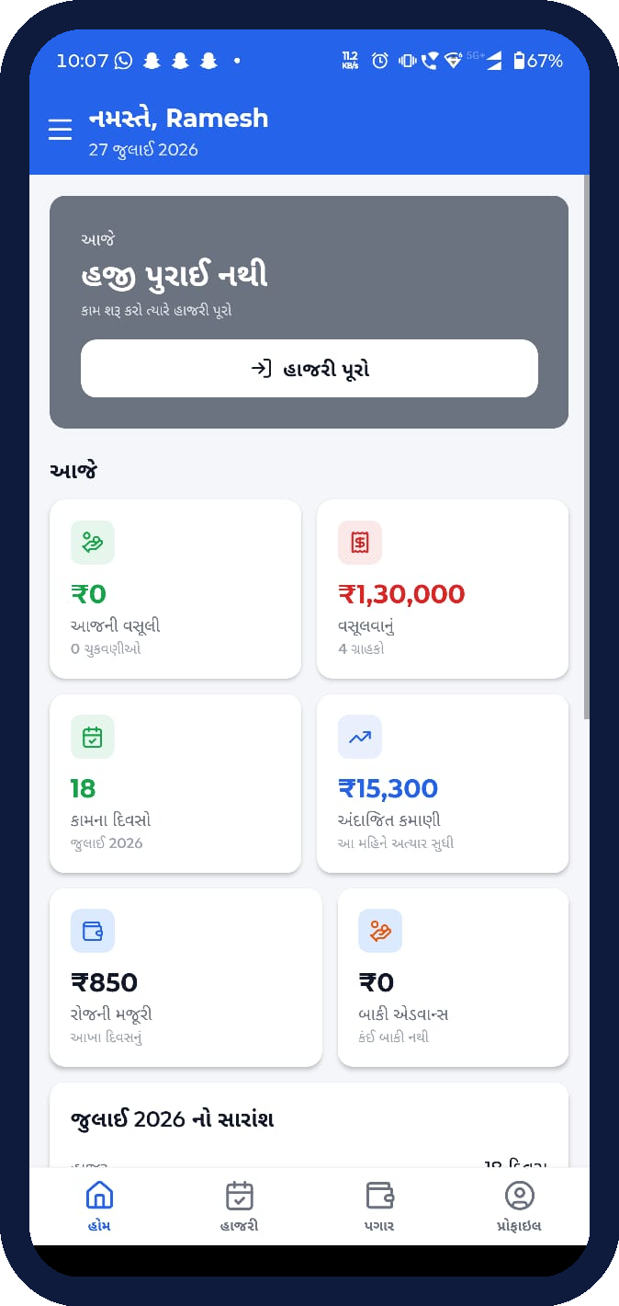
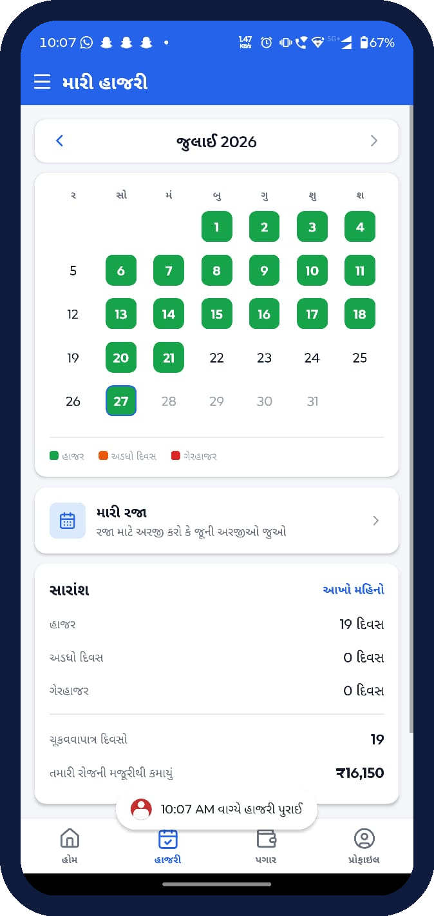
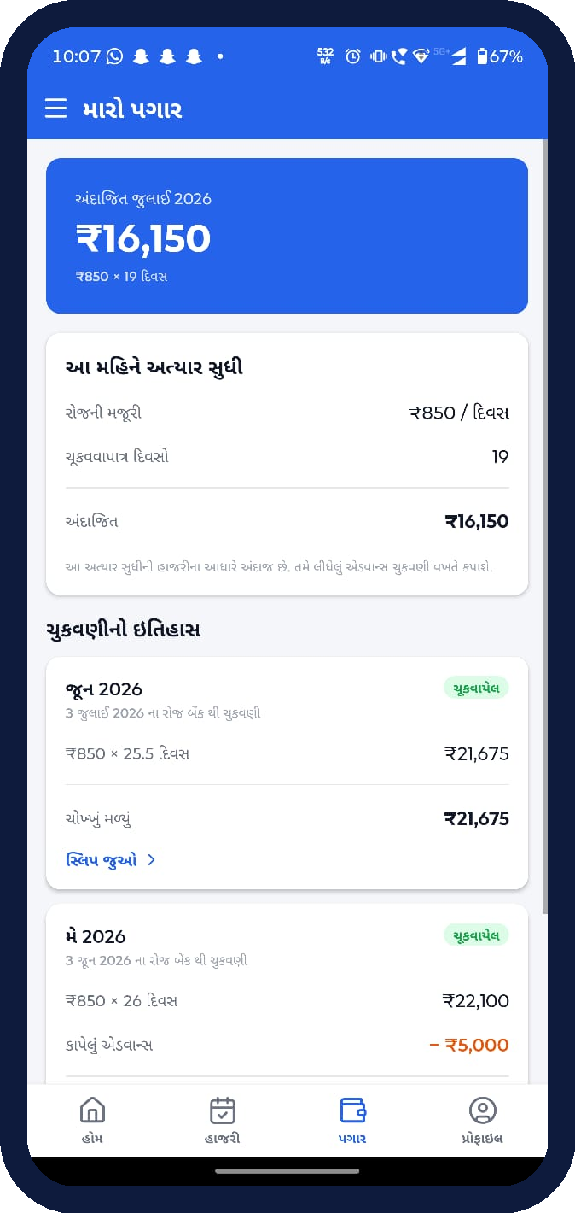
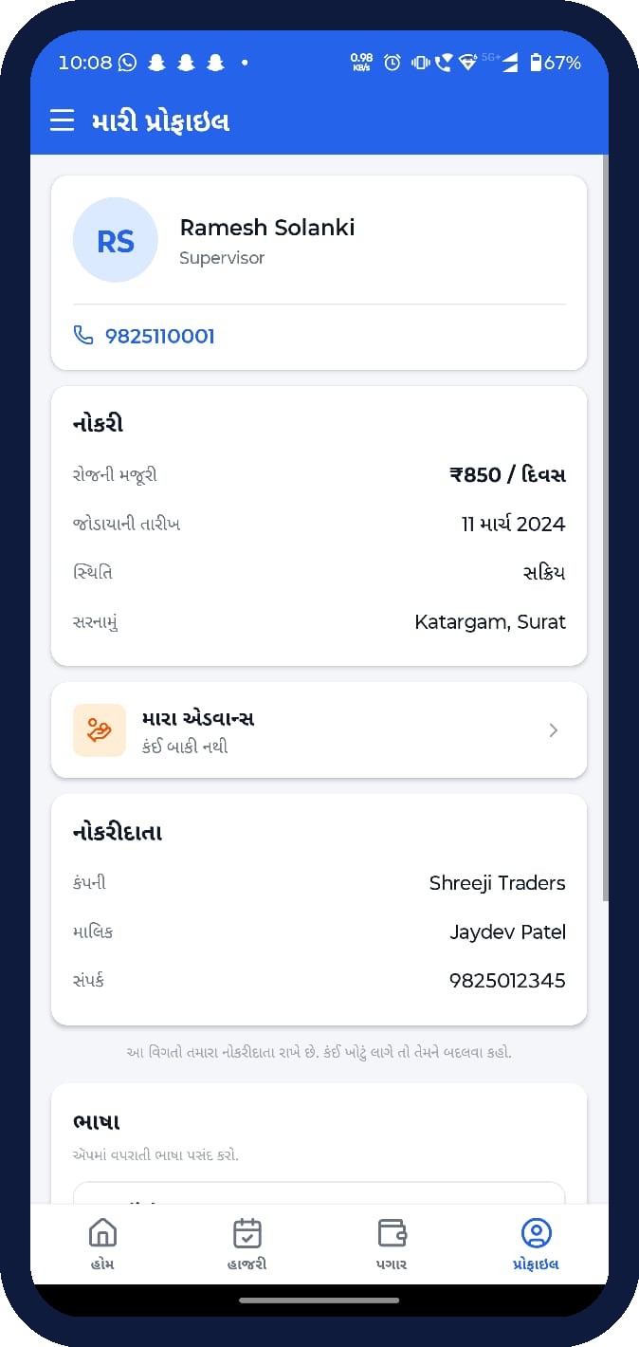
The Employee's View
A focused, four-tab app so workers see exactly what matters to them.
Home
Attendance
Salary
Profile
HRMS • SHREEJI TRADERS
6
Greeting, today's attendance & month earnings so far
Personal calendar; present days, payable count, leave
Estimated pay (₹850×19 days) + full payment history
Job details, join date, employer & language switch

Slide 7
Why HRMS
One app, whole business
Staff, attendance, payroll, customer dues and accounting — no more separate registers.
Built for the local shop
Gujarati-first UI, rupee formatting (lakh/crore), daily-wage logic that matches how they actually pay.
Role-appropriate access
Owners get control and oversight; employees get a simple, private view of their own work and pay.
Clear money trail
Every collection, expense, salary and advance is logged and summarised month by month.
HRMS • Shreeji Traders • Staff • Attendance • Salary • Ledger

