Slide 1
CSE 703 : Deep Learning Seminar
Jay Bakshi 50206954 jaybaksh@buffalo.edu

Slide 2
Delving Deep Into Rectifiers
https://arxiv.org/abs/1502.01852

Slide 3
Brief Overview
The paper focuses on experiments and studies done by the authors on Rectifier Neural Networks for Image Classification
They do this in 2 stages –
Propose a PReLU – Parametric Rectified Linear Unit
Derive a robust initialization method considering rectifier non-linearities
Notes:
PReLU generalizes the traditional Rectified Unit.
This method makes it possible train extremely deep rectified models directly from scratch and to investigate deeper or wider network architectures.
Tremendous improvements in this activity has been pushed by 2 technical ideas – more powerful models and designing effective strategies against overfitting.

Slide 4
PReLU – Parametric Rectified Linear Unit
Definition: PReLU are learned parametric activation units
The paper proposes to replace parameter-free ReLU units with these PReLU units.
Advantages :
Better model fitting
Negligible additional computational cost and overfitting risk
In experiments, this model achieved a 5.71% top-5 error (single-model) and a 4.94% top-5 error (multi-model)
That is a whooping 26% relative improvement compared to GoogLeNet (ILSVRC 2014 winner)
It is 1st to report results that surpass human-level performance
Notes:
ImageNet 2012 classification is a visual recognition challenge.
Top-5 error results is adhered to when ranking the different experiments and methods at image classification.

Slide 5
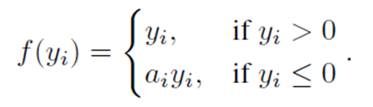
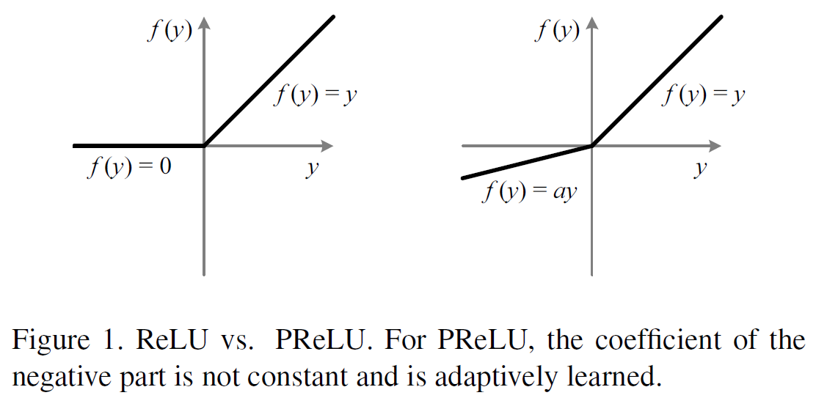
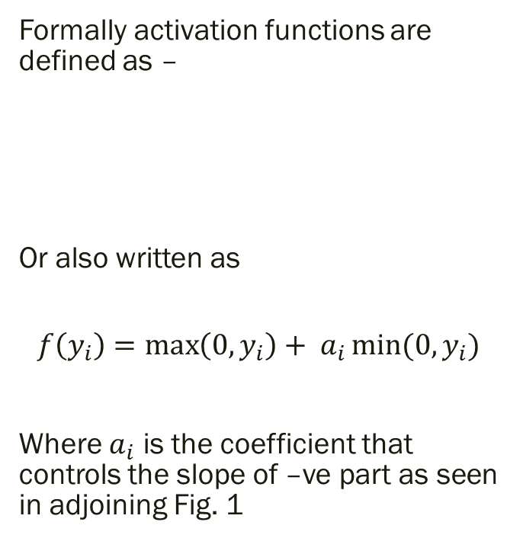
What are PReLU’s?
Formally activation functions are defined as –
Or also written as
$$f\left(y_{i}\right)=\max\left(0, y_{i}\right)+ a_{i}\min{(0, y_{i})}$$
Where $a_{i}$ is the coefficient that controls the slope of –ve part as seen in adjoining Fig. 1
Notes:
Rectified Linear Unit (ReLU) expedites the convergence of the training procedure and leads to better solutions.
PReLU is the new generalization of ReLU activation function that adaptively learns the parameter of the rectifiers.
In the equation and figure here f(y) is the activation function and for PReLU case coefficient ‘a’ represents how this function optimizes.

Slide 6
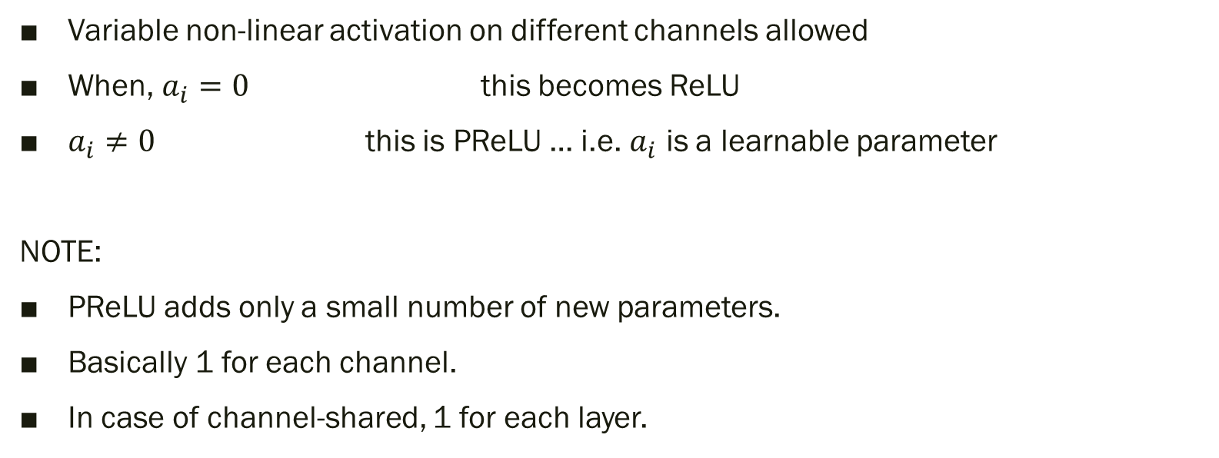
More on PReLU’s
Variable non-linear activation on different channels allowed
When, $a_{i}=0$ this becomes ReLU
$a_{i}≠0$ this is PReLU … i.e. $a_{i}$ is a learnable parameter
NOTE:
PReLU adds only a small number of new parameters.
Basically 1 for each channel.
In case of channel-shared, 1 for each layer.
Notes:
Another point to note here is about Leaky ReLU (LReLU) occurs when value of a is small and fixed i.e. a zero gradient is avoided by the PReLU.

Slide 7
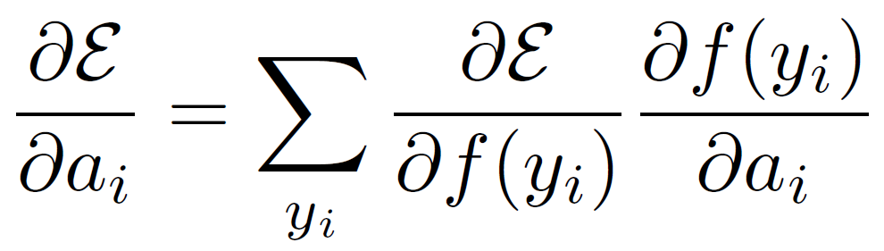


PReLU Optimization
Trained using backpropagation, and
Optimized simultaneously with other layers
Gradient for 1 layer ➔
Where is objective function, and
gradient propagated from the deeper layer

Slide 8
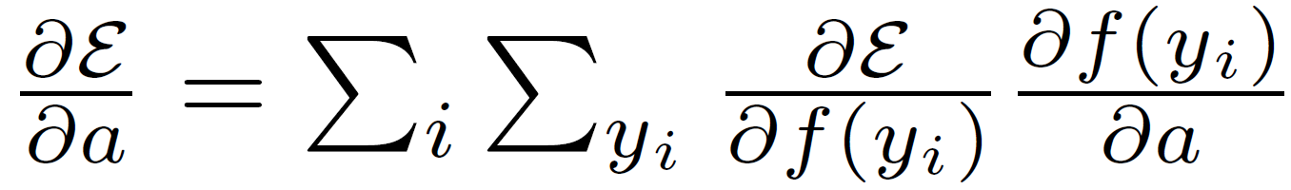
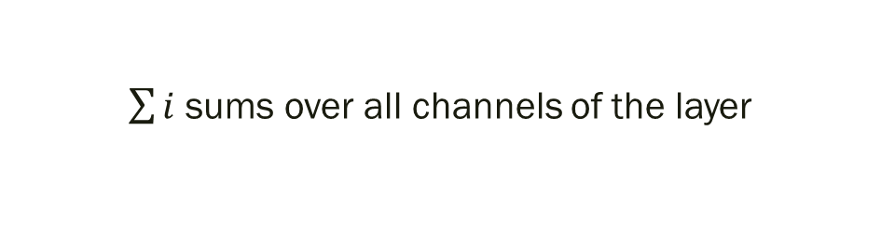
Channel-shared variant
$\sum{i}$ sums over all channels of the layer

Slide 9
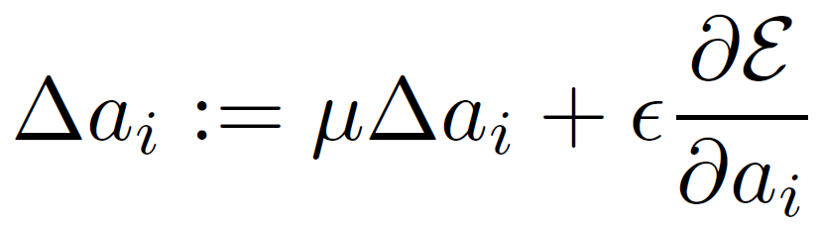

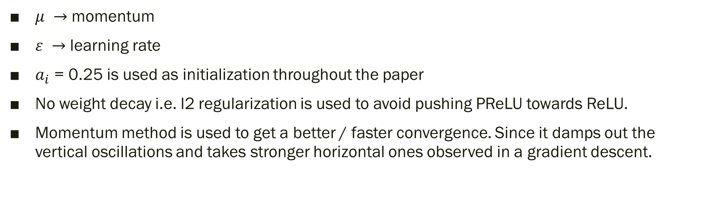
Updating $a_{i}$ using momentum method
$μ →$ momentum
$ε →$ learning rate
$a_{i}$ = 0.25 is used as initialization throughout the paper
No weight decay i.e. l2 regularization is used to avoid pushing PReLU towards ReLU.
Momentum method is used to get a better / faster convergence. Since it damps out the vertical oscillations and takes stronger horizontal ones observed in a gradient descent.

Slide 10
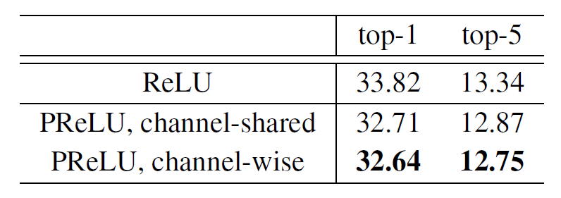
Comparing Results
These comparisons are on a smaller model for ImageNet 2012 using 10-view testing with each view is 224x224.
All models are trained using 75 epochs.

Slide 11
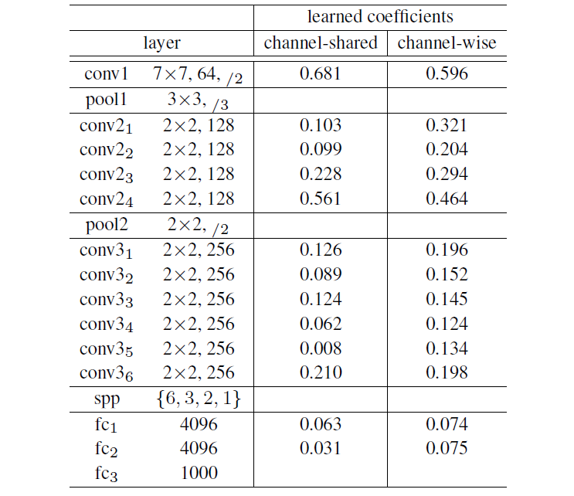
Table 1
Notes:
The above table show values recorded for a small but deep 14-layer model.
The filter size and filter number are indicated on the left column of layer.
The learned coefficients of PReLU are shown for both channel-shared and channel-wise case.
Looking at the values, it is certain that both perform comparably.
The only difference being that channel-shared uses only 13 extra free parameters than ReLU, giving a 1.1% gain on the baseline.

Slide 12
More takeaways from Table 1 data
+ve and –ve responses of the filters
More discriminative in deeper stages
Notes:
Both +ve and –ve responses of the filters are respected. This can be seen by the 1st convolution layer conv1 having coefficients as 0.681 and 0.596 which are significantly higher than 0. So, Gabor-like filters i.e. edge or texture detectors work more economically to exploiting the low-level information given the limited number of filters.
For channel-wise version, the deeper convolution layers in general have smaller coefficients. Model gets more discriminative in deeper stages. The activations hence become more non-linear i.e. retaining more information in earlier stages and discriminative in deeper stages.

Slide 13
Robust Initialization The 2nd stage
Fixed std. deviation values for initialization have convergence issues.
Pre-training. Usually 8 conv layers → Training time issue.
Glorot and Bengio → “Xavier” initialization
Assuming activations are linear → invalid for ReLU and PReLU
For PReLU experiment, initialization method helps converge for very deep models too (e.g. 30 conv/fc layers)
Notes:
A bad initialization is known to hamper the learning of a highly non-linear system.
This has been an generic obstacle of training extremely deep rectifier networkks.
Fixed standard deviations have difficulties to converge very deep networks, as has been reported by VGG experiment team. A solution to that was pre-training say 8 conv layers. But that lead to more training time.
Glorot and Bengio in their paper proposed to adopt a properly scaled uniform distribution for initialization, considering that activations are linear. Invalid for ReLU and PReLU

Slide 14
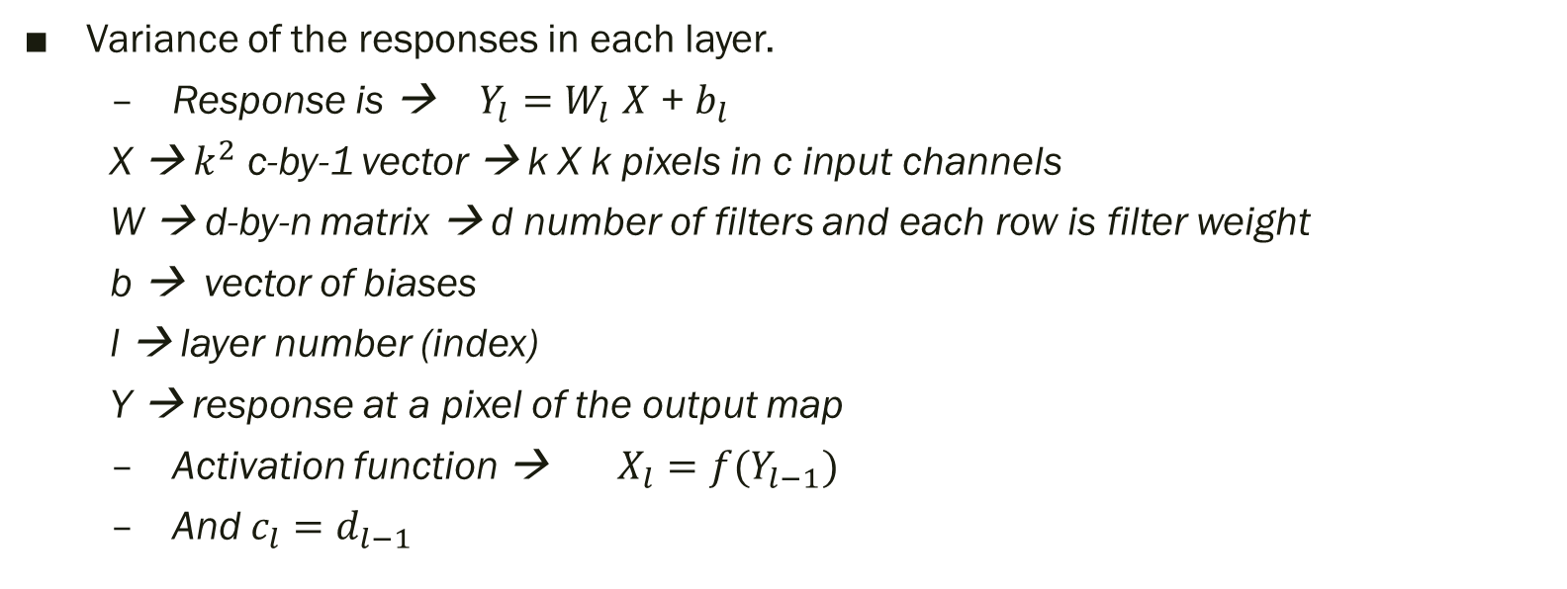
Deriving the Initialization values
Variance of the responses in each layer.
Response is → $Y_{l}=W_{l}$ $X$ + $b_{l}$
X → $k^{2}$ c-by-1 vector → k X k pixels in c input channels
W → d-by-n matrix → d number of filters and each row is filter weight
b → vector of biases
l → layer number (index)
Y → response at a pixel of the output map
Activation function → $X_{l}={f(Y}_{l−1})$
And $c_{l}=d_{l−1}$
Notes:
The central idea is to investigate the variance of the responses in each layer.

Slide 15


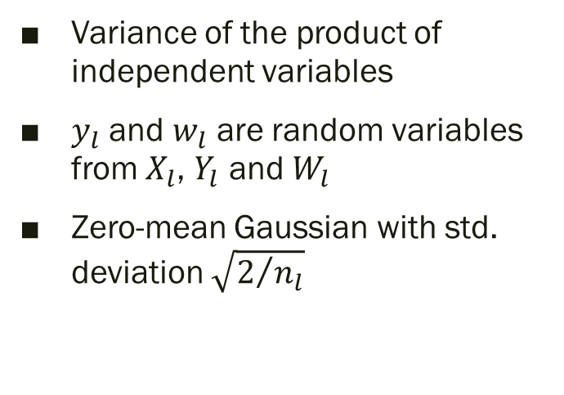
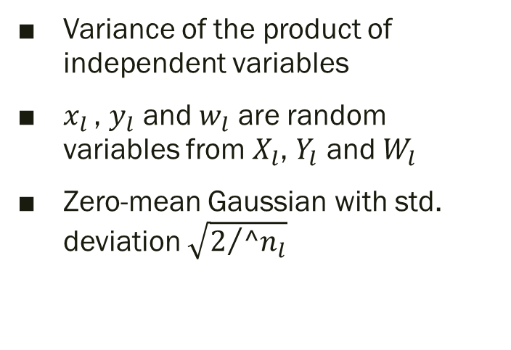
Derivation continued ..
Forward Propagation
Backward Propagation
Variance of the product of independent variables
$y_{l}$ and $w_{l}$ are random variables from $X_{l}$, $Y_{l}$ and $W_{l}$
Zero-mean Gaussian with std. deviation $\sqrt{2/{n_{l}}}$
Variance of the product of independent variables
$x_{l }$, $y_{l}$ and $w_{l}$ are random variables from $X_{l}$, $Y_{l}$ and $W_{l}$
Zero-mean Gaussian with std. deviation $\sqrt{2/{{^n}_{l}}}$
Notes:
For the experiment purpose they arrived on the initialization values and results as seen in the slide.

Slide 16
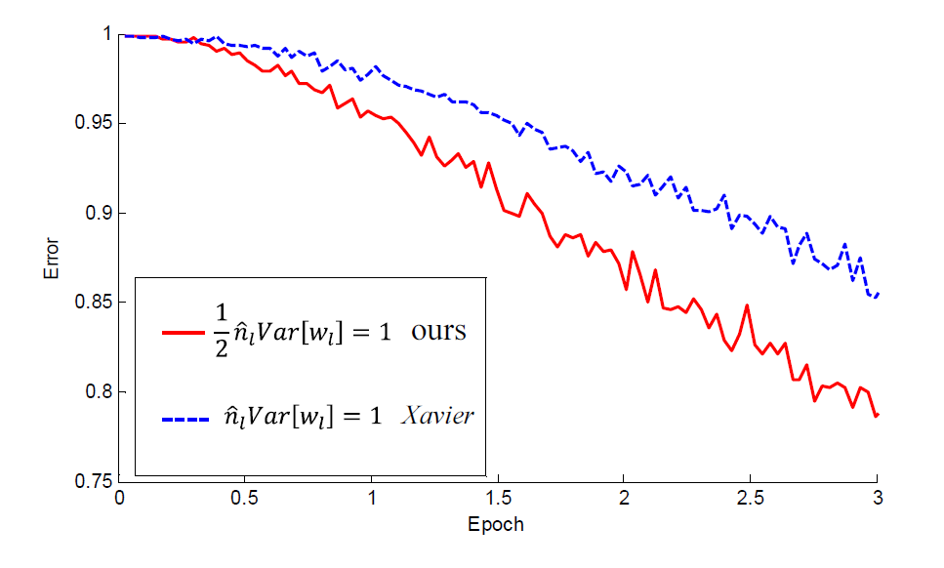
Comparison with Xavier initialization Accuracy
Xavier error
Top-1 → 33.90
Top-5 → 13.44
PReLU error
Top-1 → 33.82
Top-5 → 13.34
Notes:
The convergence of a 22-layer large model .
The x-axis is the number of training epochs. The y-axis is the top-1 error of 3,000 random val samples, evaluated on the center crop. We use ReLU as the activation for both cases. Both our initialization (red) and “Xavier” (blue) [7] lead to convergence, but ours starts reducing error earlier.
No clear superiority observed between the 2 on the counts of accuracy alone.

Slide 17
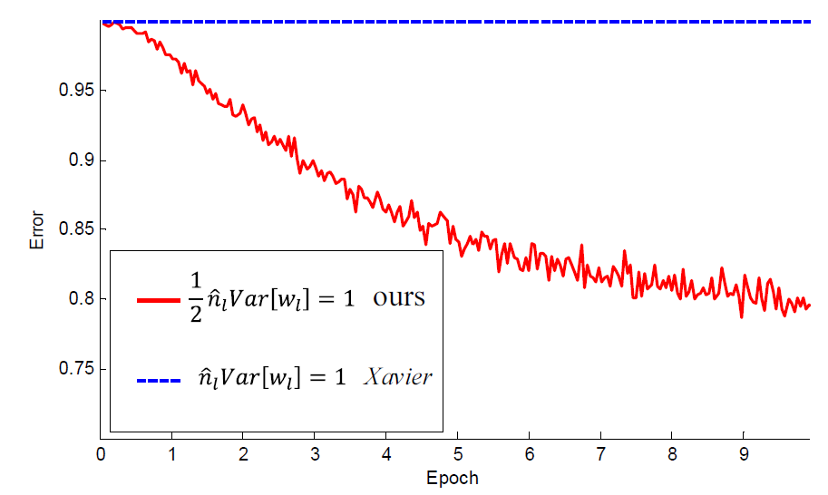
Comparison with Xavier initialization Extreme Deep Model
Xavier stalls completely on such deep-model (30 layer). Even after given more epochs.
PReLU model converges.
Notes:
The convergence of a 30-layer small model. We use ReLU as the activation for both cases. Our initialization (red) is able to make it converge. But “Xavier” (blue) completely stalls - we also verify that its gradients are all diminishing. It does not converge even given more epochs.

Slide 18
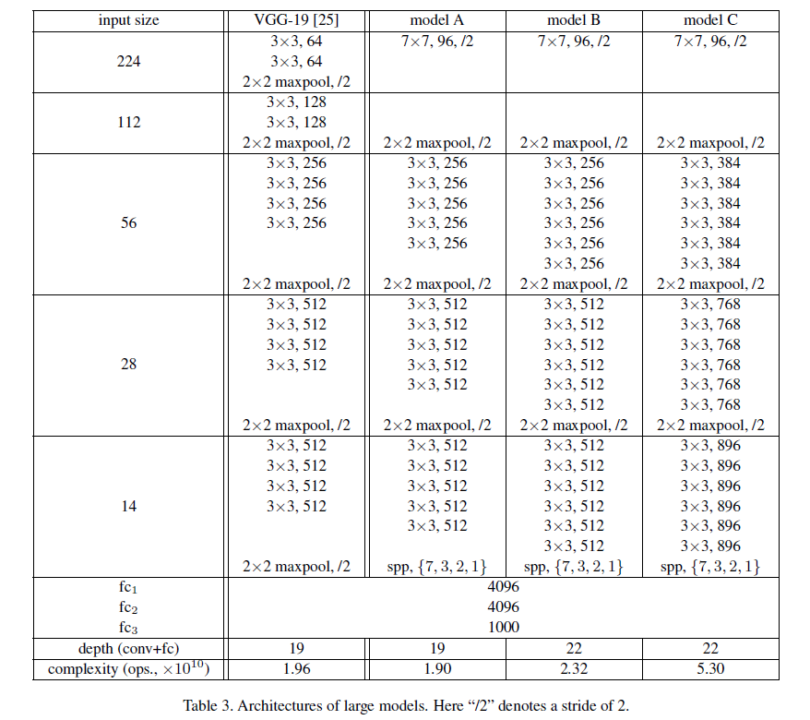
Architecture & Implementation
Baseline is 19-layer model
Model A is Modified version of VGG-19 model
Model A takes 2.6sec per mini-batch (128) and VGG-19 takes 3.0sec over 4 NVIDIA K20 GPUs
Model B is deeper version of Model A
Model C is wider version of Model B, time complexity 2.3 x B
Training A/B on four K20 GPUs, or training C on eight K40 GPUs, takes about 3-4 weeks.
Notes:
VGG-19 model modified as follows :
1st layer has a size of 7x7 and stride of 2 (2) Conv layers on largest feature maps are moved to smaller feature maps (3) Spatial pyramid pooling used for 1st fc layer
Choice to increase the model width instead of depth, because deeper models have only diminishing improvement or even degradation on accuracy. E.g. In the speech recognition research of the deep models degrade when using more than 8 hidden layers similar degradation was predicted for ImageNet classification too and found both training and testing error rates degraded in the first 20 epochs.
Other implementation details –
Resized image whose shorter side is s, a 224x224 crop is randomly sampled, with the per-pixel mean subtracted.
One half of the random samples are flipped horizontally.
Random color altering used
Scale jittering applied at the beginning of the training
Mini-batch size is 128 – fixed
Total number of epochs for each model is 80

Slide 19
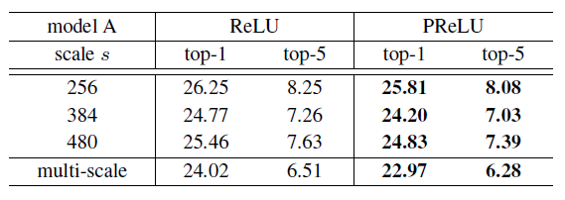
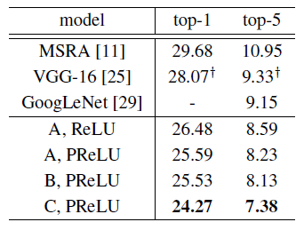
Experiments on ImageNet
Table 4. Comparisons between ReLU/PReLU on model A in ImageNet 2012 using dense testing.
Table 5. The single-model 10-view results for ImageNet 2012 val set. y: Based on our tests.
Notes:
Table 4 both ReLU and PReLU are trained using the same total number of epochs, and the learning rates are also switched after running the same number of epochs.
The best single scale is 384, possibly because it is in the middle of the jittering range [256; 512].
Table 4 consistently show that PReLU improves both small and large models. This improvement is obtained with almost no computational cost.
We first show 10-view testing results [16] in Table 5. Here, each view is a 224-crop.
Best 10-view result is 7.38%

Slide 20
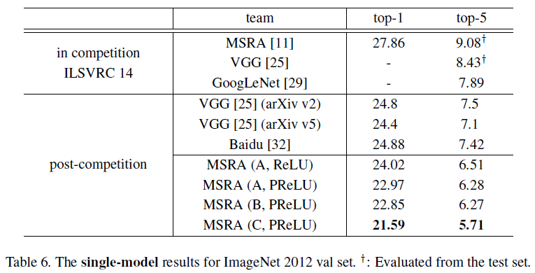
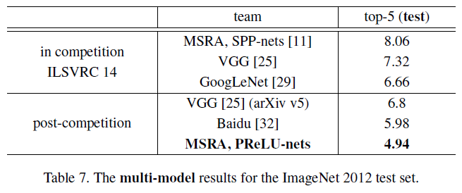
Notes:
Table 6 Baseline model (A+ReLU, 6.51%) is already substantially better than the best existing single-model result of 7.1% reported for VGG-19 in the latest update.
Best single model (C, PReLU) has 5.71% top-5 error. This result is even better than all previous multi-model results. The 19-layer model and the 22-layer model perform comparably. On the other hand, increasing the width (C vs. B, Table 6) can still improve accuracy.
The multi-model results are in Table 7. Our result is 4.94% top-5 error on the test set. This number is evaluated by the ILSVRC server.
Our result is 1.7% better than the ILSVRC 2014 winner (GoogLeNet, 6.66% [29]), which represents a 26% relative improvement. This is also a 17% relative improvement over the latest result Baidu. 5.98%

Slide 21
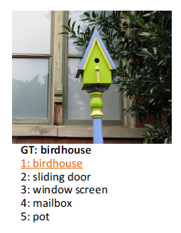
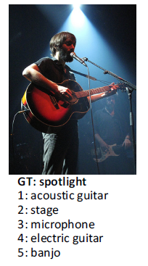
Comparisons with Human Performance
Russakovsky et al. [22] recently reported that human performance yields a 5.1% top-5 error on the ImageNet dataset.
While our algorithm produces a superior result on this particular dataset, this does not indicate that machine vision outperforms human vision on object recognition in general.
Notes:
This number is achieved by a human annotator who is well trained on the validation images to be better aware of the existence of relevant classes. The reported human performance is estimated on a random subset of 1500 test images.
Result (4.94%) exceeds the reported human-level performance.
Algorithms can do a better job on fine-grained recognition

Slide 22
Aggregated Residual Transformations for Deep Neural Networks
https://arxiv.org/abs/1611.05431

Slide 23
A brief overview
Present a simple, highly modularized network architecture for image classification
Network is constructed by repeating a building block that aggregates a set of transformations with the same topology
“Cardinality”
increasing cardinality is able to improve classification accuracy.
ResNeXt
Notes:
This strategy exposes a new dimension, which we call “cardinality” (the size of the set of transformations), as an essential factor in addition to the dimensions of depth and width.
Models named ResNeXt, are presented that in ILSVRC 2016 classification task secured 2nd place.
Further investigate ResNeXt on an ImageNet-5K set and the COCO detection set, also showing better results than its ResNet counterpart.

Slide 24
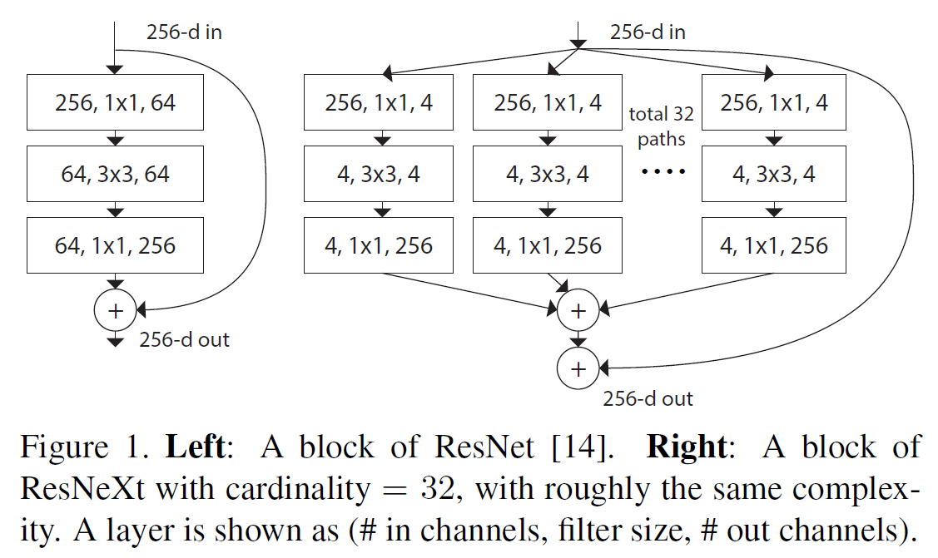
ResNet, Inception Models and ResNeXt
ResNet stacks modules of the same topology.
The Inception models is a split-transform-merge strategy.
ResNeXt adopts VGG/ResNets’ strategy of repeating layers, while exploiting the split-transform-merge strategy in an easy, extensible way.
Notes:
Research on visual recognition is undergoing a transition from “feature engineering” to “network engineering”. Human effort has been shifted to designing better network architectures for learning representations.
ResNet’s simple rule reduces the free choices of hyperparameters, and depth is exposed as an essential dimension in neural networks.
the family of Inception models have demonstrated that carefully designed topologies are able to achieve compelling accuracy with low theoretical complexity.
In an Inception module, the input is split into a few lower-dimensional embeddings (by 11 convolutions), transformed by a set of specialized filters (33, 55, etc.), and merged by concatenation.
It is in general unclear how to adapt the Inception architectures to new datasets/tasks, especially when there are many factors and hyper-parameters to be designed.
A module in our network performs a set of transformations, each on a low-dimensional embedding, whose outputs are aggregated by summation.

Slide 25

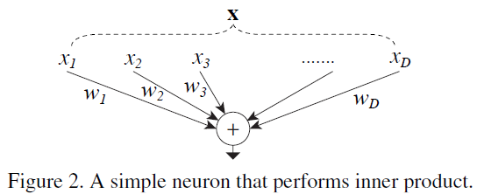
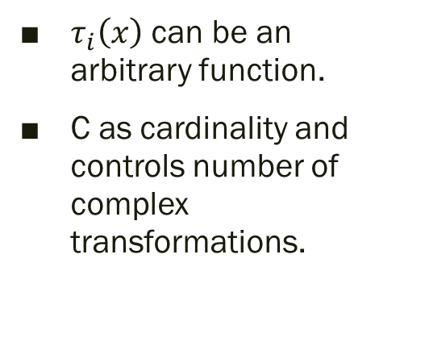
Method
Revisiting Simple Neuron
Aggregated Transformations
Template
Rules
Same size spatial maps → same hyper-parameters shared
(Spatial map) /2 → width * 2
The simplest neurons in artificial neural networks perform inner product.
combination of splitting, transforming, and aggregating.
$τ_{i}\left(x\right)$ can be an arbitrary function.
C as cardinality and controls number of complex transformations.

Slide 26
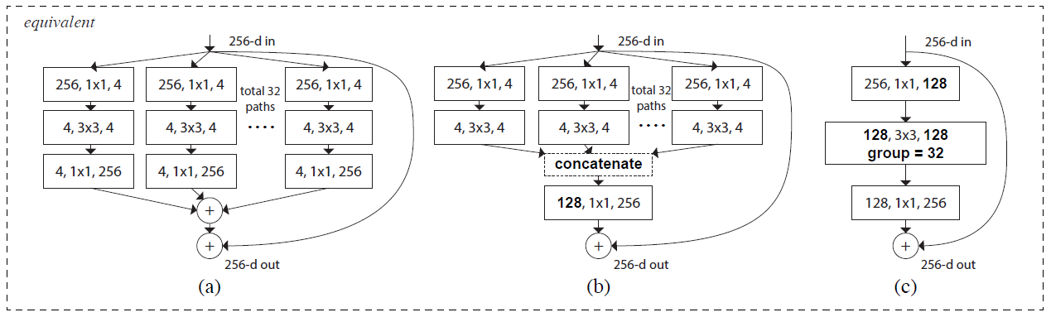
Figure 3. Equivalent building blocks of ResNeXt.
(a): Aggregated residual transformations, the same as Fig. 1 right.
(b): A block equivalent to (a), implemented as early concatenation.
(c): A block equivalent to (a,b), implemented as grouped convolutions. Notations in bold text highlight the reformulation changes. A layer is denoted as (# input channels, filter size, # output channels).
Notes:
the individual transformation Ti to be the bottleneck shaped architecture, as illustrated in Fig. 3 (a)
Fig. 3(b) appears similar to the Inception-ResNet [37] block modules, share the same topology among the multiple paths.
Fig. 3(c). All the low-dimensional embeddings (the first 11 layers) can be replaced by a single, wider layer (e.g., 11, 128-d in Fig 3(c)). Splitting is essentially done by the grouped convolutional layer when it divides its input channels into
groups.
We choose to use homogenous forms in this paper because they are simpler and extensible.

Slide 27
Implementation
implementation follows and the publicly available code of fb.resnet.torch
the input image is 224x224
downsampling of conv 3, 4, and 5
mini-batch size of 256 on 8 GPUs
weight decay is 0.0001 and the momentum is 0.9.
start from a learning rate of 0.1
Notes:
the input image is 224x224 randomly cropped from a resized image using the scale and aspect ratio augmentation
Downsampling of conv3, 4, and 5 is done by stride-2 convolutions in the 33 layer of the first block in each stage,
We start from a learning rate of 0.1, and divide it by 10 for three times using the schedule
We evaluate the error on the single 224224 center crop from an image whose shorter side is 256.

Slide 28
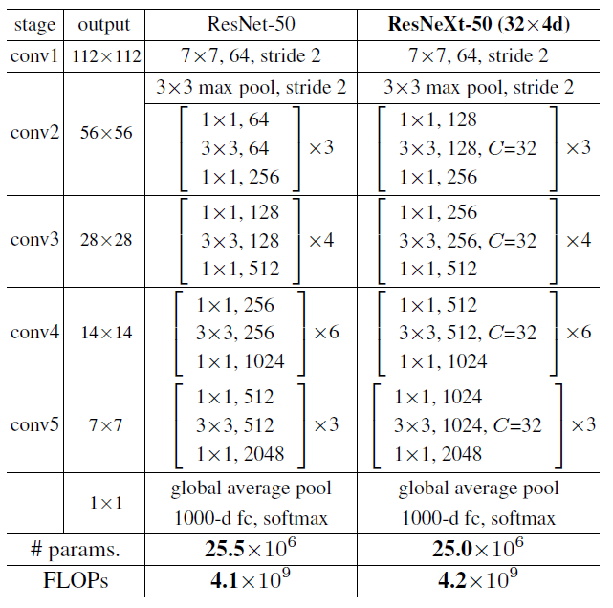
Method Template
Cardinality = 32
Width = 4d
input/output width of the template is fixed as 256-d
all widths are doubled each time when the feature map is subsampled
Table 1. (Left) ResNet-50. (Right) ResNeXt-50 with a 32x4d template. Inside the brackets are the shape of a residual block, and outside the brackets is the number of stacked blocks on a stage. “C=32” suggests grouped convolutions [24] with 32 groups. The numbers of parameters and FLOPs are similar between these two models.

Slide 29
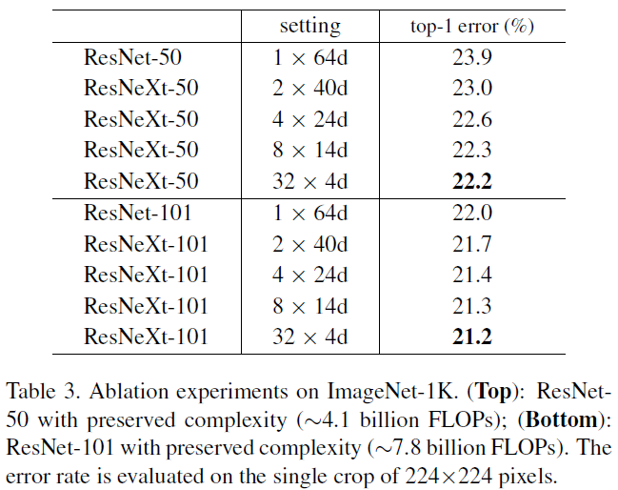
Experiments on ImageNet1K
Cardinality vs. Width.
ResNet-50 baseline has top-1 error at 23.9% and the 32x4-d ResNeXt-50 has error at 22.2% . A 1.7% lower
the 324d ResNeXt-101 outperforms the ResNet-101 counterpart by 0.8%
adopt a bottleneck width no smaller than 4d
Notes:
Comparing with ResNet-50 (Table 3 top and Fig. 5 left), the 32x4-d ResNeXt-50 has a validation error of 22.2%, which is 1.7% lower than the ResNet baseline’s 23.9%.
With cardinality C increasing from 1 to 32 while keeping complexity, the error rate keeps reducing. Furthermore, the 324d ResNeXt also has a much lower training error than the ResNet counterpart, suggesting that the gains are not from regularization but from stronger representations.
with complexity preserved, increasing cardinality at the price of reducing width starts to show saturating accuracy when the bottleneck width is small. We argue that it is not worthwhile to keep reducing width in such a trade-off.

Slide 30
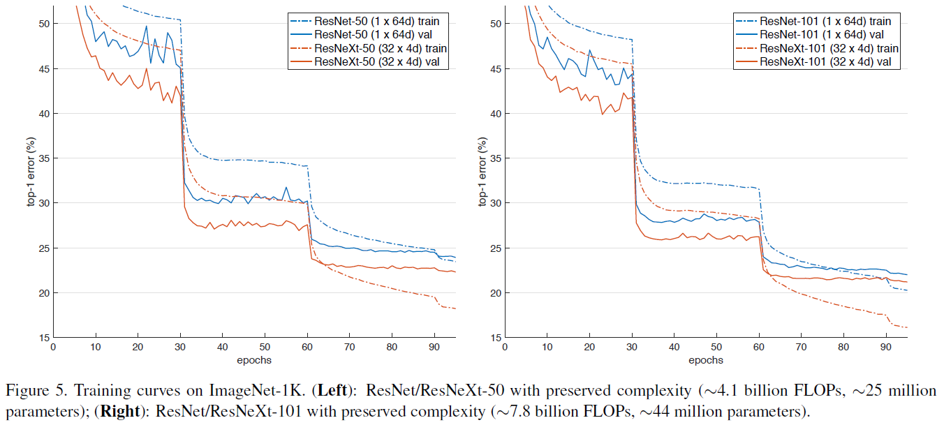
Experiments on ImageNet1K
Notes:
We simply replace all blocks in ResNet-50/101 with our blocks.
Comparing with ResNet-50 (Table 3 top and Fig. 5 left), the 32x4-d ResNeXt-50 has a validation error of 22.2%, which is 1.7% lower than the ResNet baseline’s 23.9%.

Slide 31
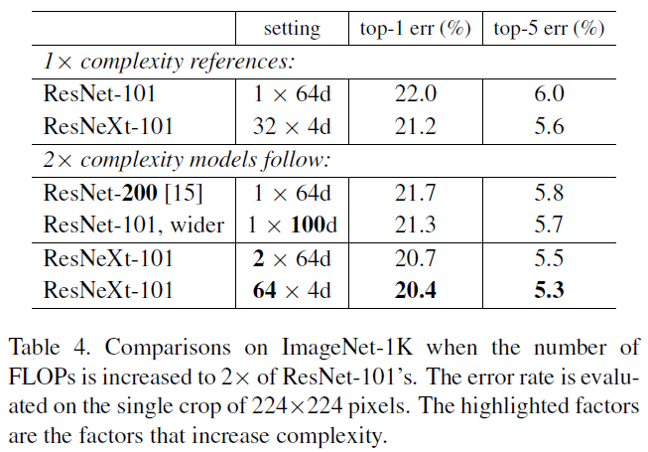
Experiments on ImageNet1K Increasing Cardinality vs. Deeper/Wider
Going deeper to 200 layers. We adopt the ResNet-200 [15].
Going wider by increasing the bottleneck width.
Increasing cardinality by doubling C.
Notes:
Increasing complexity by 2 consistently reduces error vs. the ResNet-101 baseline (22.0%). The improvement is small when going deeper (ResNet-200, by 0.3%) or wider (wider ResNet-101, by 0.7%).
On the contrary, increasing cardinality C shows much better results than going deeper or wider. doubling C on 164d ResNet-101 baseline and keeping the width) reduces the top-1 error by 1.3% to 20.7%
cardinality is a more effective dimension than the dimensions of depth and width. 324d ResNet-101 (21.2%) performs better than the deeper ResNet-200 and the wider ResNet-101, even though it has only 50% complexity

Slide 32
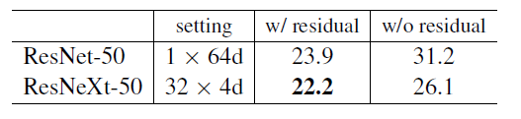
Residual Connections
Removing shortcuts from the ResNeXt-50 increases the error by 3.9 points to 26.1%.
Removing shortcuts from its ResNet-50 counterpart is much worse (31.2%).
residual connections are helpful for optimization
whereas aggregated transformations are stronger representations, they perform consistently better than their counterparts with or without residual connections.

Slide 33
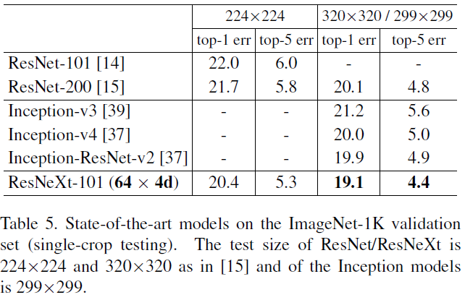
Experiments on ImageNet1K
Comparisons with state-of-the-art results
Performance
On 8 GPUs of NVIDIA M40, training 324d ResNeXt-101 in Table 3 takes 0.95s per mini-batch, vs. 0.70s of ResNet-101 baseline that has similar FLOPs.
Training the 2complexity model (644d ResNeXt-101) takes 1.7s per mini-batch and 10 days total on 8 GPUs.
Notes:
Table 5 shows more results of single-crop testing on the ImageNet validation set.
In addition to testing a 224x224 crop, we also evaluate a 320x320 crop.
Results for a single-crop top-5 error rate of 4.4% and better than ResNet, Inception-v3/v4, and Inception-ResNet-v2

Slide 34
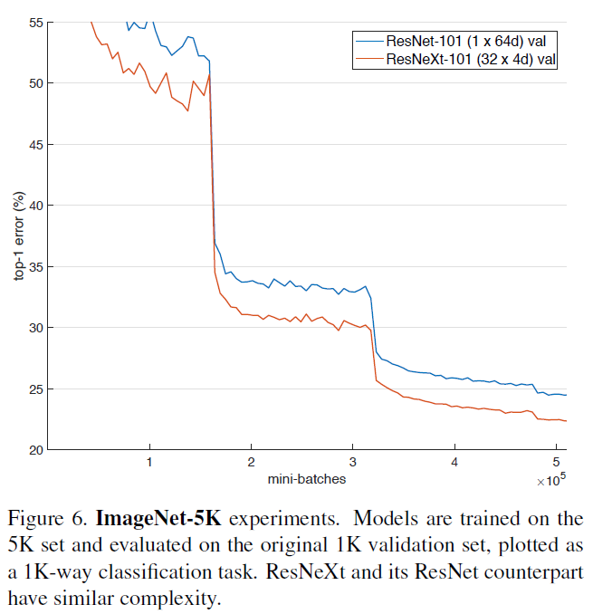
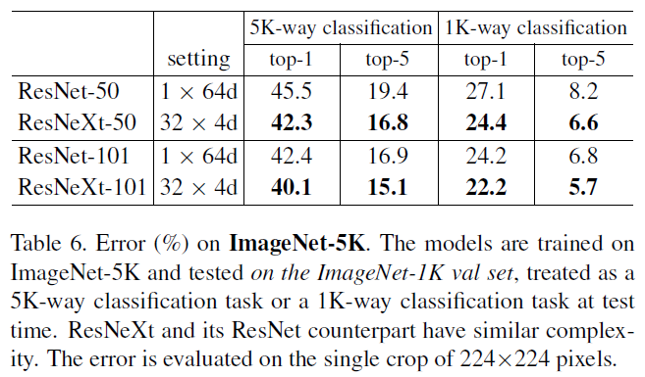
Experiments on ImageNet5K
Notes:
5K dataset is a subset of the full ImageNet-22K set
The 5000 categories consist of the original ImageNet- 1K categories and additional 4000 categories that have the largest number of images in the full ImageNet set.
6.8 million images, about 5 of the 1K set
Implementation details –
5K-training models are all trained from scratch
trained for the same number of mini-batches as the 1Ktraining models (so 1/5 epochs).
Table 6 and Fig. 6 show
the comparisons under preserved complexity.
ResNeXt-50 reduces the 5K-way top-1 error by 3.2% comparing with ResNet-50, and ResNetXt-101 reduces the 5K-way top-1 error by 2.3% comparing with ResNet-101.
Models trained on 5K perform comparably with the 1K set – seen from errors for 5K being (22.7% / 5.7%) and for 1K being (21.2% / 5.6%) – (top-1 / top-5)
This proves that it is a promising way to classify even the more complex 5K set.

Slide 35
Experiments on CIFAR and COCO Object detection
CIFAR-10 and CIFAR-100 datasets experimented
Single 33 conv layer, followed by 3 stages of 3 residual blocks, and end with average pooling and a fully-connected classifier (total 29-layer deep)
The test results points to the consistent statement – increasing cardinality is more effective
Evaluating the generalizability on the COCO object detection set
Models trained on minival set - 80k training set plus a 35k val subset and evaluate on a 5k val subset
AP is improved over both 50 and 101 layers, with conclusion being more training data will lead to even better results without increasing complexity much.

Slide 36
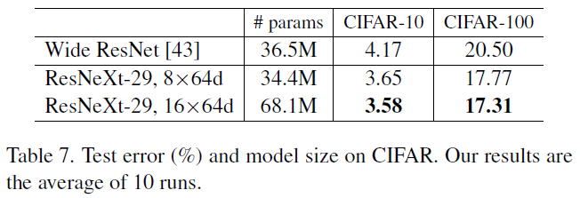
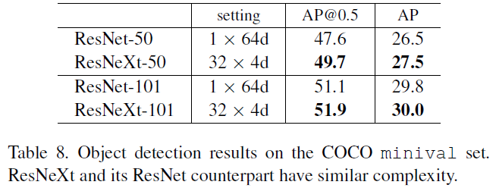
Notes:
Table 7 shows the results and model sizes, comparing with the Wide ResNet which is the best published record. ResNeXt model with a similar size (34.4M) shows results better than Wide ResNet. Also achieves 3.58% test error (average of 10 runs) on CIFAR-10 and 17.31% on CIFAR-100. These are the state-of-the-art results (with similar data augmentation) in the literature including unpublished technical reports.
Evaluating COCO style Average Precision (AP) as well as AP@IoU=0.5 On the 50-layer baseline, ResNeXt improves AP@0.5 by 2.1% and AP by 1.0%, without increasing complexity. ResNeXt shows smaller improvementson the 101-layer baseline. We conjecture that more training data will lead to a larger gap, as observed on the ImageNet-5K set.

Slide 37
References
http://icml.cc/2016/tutorials/icml2016_tutorial_deep_residual_networks_kaiminghe.pdf
https://cs231n.github.io/neural-networks-1/
http://image-net.org/challenges/posters/JKU_EN_RGB_Schwarz_poster.pdf
http://vision.stanford.edu/teaching/cs231n/
https://www.coursera.org/learn/neural-networks-deep-learning/lecture/7dP6E/deep-l-layer-neural-network

Slide 38
THANK YOU

