Slide 1
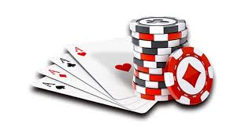
Poker
Jesse Bond, Fawzan Khan, Trevor MacDonald

Slide 2
What is Poker?
Poker is a card game in which a player bets on whether the
value of their hand is greater than the value of other player’s hands.
Poker is a game of luck and skill. The player who hasn't folded and has the highest value hand at the end of round wins the pot. The pot is a cash pile which is made up of the blinds and wagers of all the players.

Slide 3

Project Introduction
1

Slide 4
Project Goals
An interactive poker game
Stay true to the original
Network support
We wanted to make a Poker game that’s easy to play on a computer and just as fun as in-person, without gambling actual cash.

Slide 5
Code Demo, Interactions, and Test Cases
2

Slide 6
Classes
Game
This class is the backbone of the project, it handles the game logic for each round such as the dealer and taking turns.
PlayerInGame
PlayerInGame handles the logic for card comparisons. It checks your hand and the community cards for the best possible card combination to give your hand the most value.
Card & Deck
The Deck class contains functionality for a deck of 52 cards created by the Card class.
Account
The account class holds a players information, such as their name, total cash on hand, and total winnings.

Slide 7
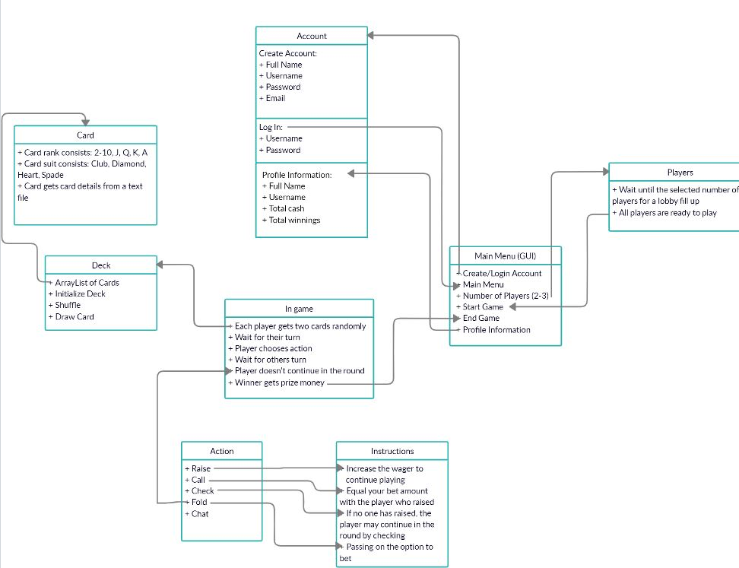
Game Flow

Slide 8
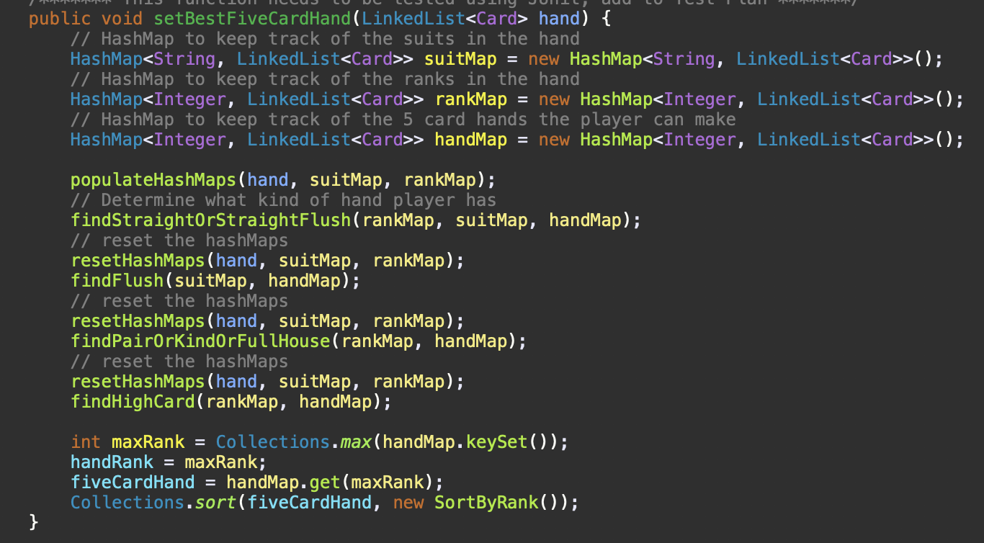

Slide 9
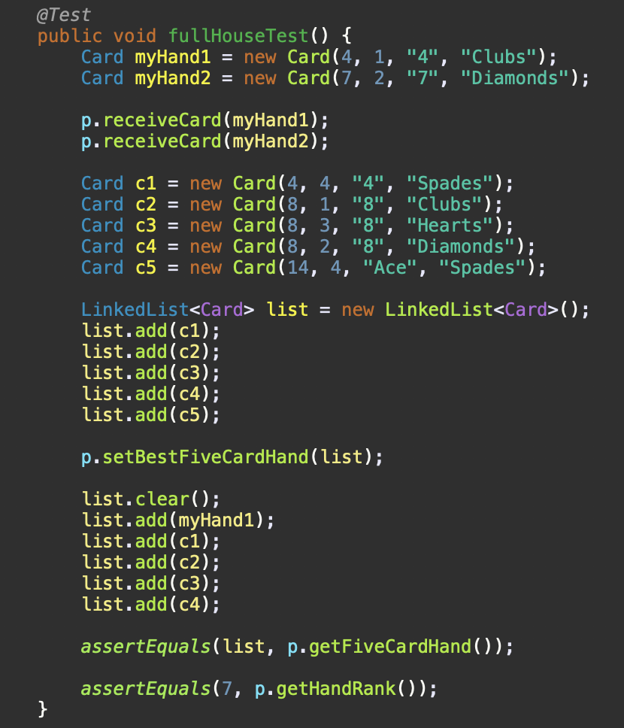
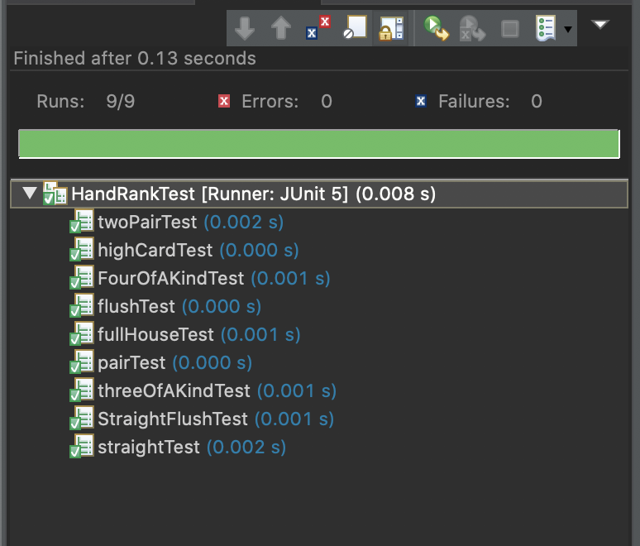
Test Cases

Slide 10
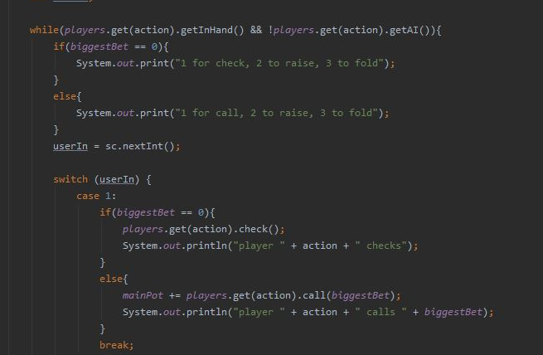
Code Demo & Interactions

Slide 11
Conclusion
3

Slide 12
Summary
We accomplished our main goal, which was to create a poker game that stayed true to the original.
We acknowledge our shortcomings in not creating a poker game that exists over a network and not fully fleshing out the GUI.

Slide 13
Thank You

