Slide 1
Code Fair 2017
Joshua Bauer and Kris Bebbington
Web presence and code fair promotion

Slide 2
Web Development Processes
Competitor Benchmarking
User Analysis
Design documentation / prototyping
Content inventory
Site Map
Navigation
User Testing
Additional features / refine code

Slide 3
Team Processes
Agile / sprints
GitHub
Issues
Milestones
Agile project board

Slide 4
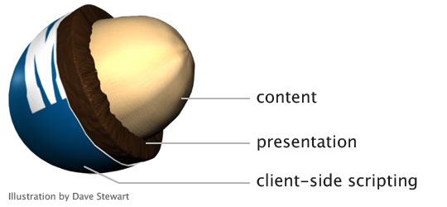
Technical Detail
Progressive Enhancement
JavaScript simple and effective
Picture: https://alistapart.com/article/understandingprogressiveenhancement

Slide 5
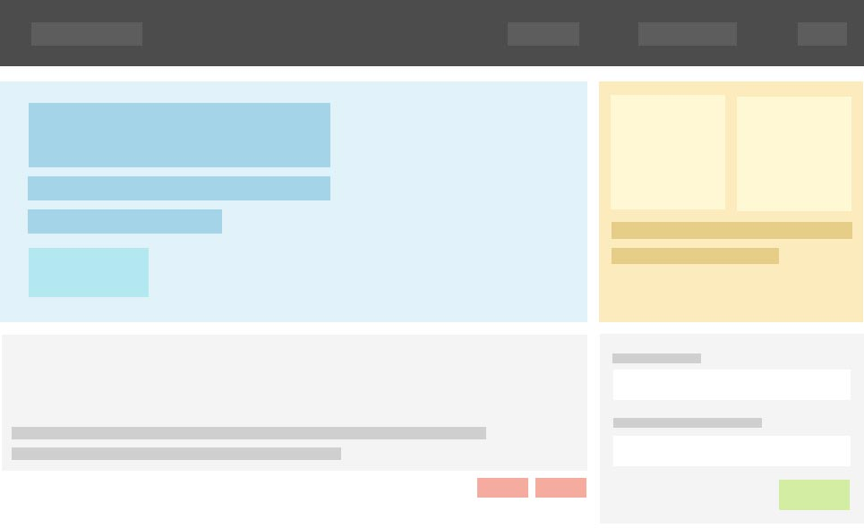
Technical Detail Continued
PureCSS, base Stylesheet
Made a few adjustments
Picture: https://purecss.io

Slide 6
JavaScript
jQuery Form Validator
Pure JavaScript Modal
PhotoSwipe (jQuery)

Slide 7
Site Demo

