Slide 1
Remote Metal Detection System
By Jay Wei
Prof. Jiang
Ens491

Slide 2
What ?
This system will not only detect the existence of the underground metal object but also provide location reference without close by human involvement.

Slide 3

Why?
Underground metal detection today either for mine detection or treasure hunt involved close-by human intervention.
This is rather dangerous and time consuming

Slide 4
How?
The system will mainly consist of a metal detection circuit and a camera-based tracking software
The detection circuit can be mounted on an RC vehicle which continuously send signal to an remote software via RF.
The software will continuously track the position of the RC vehicle through it external camera module. At same time, analyze the signal received to determine the existence of underground metal.
Upon founding of the metal, the software will flag the location of the detector at that specific moment.

Slide 5
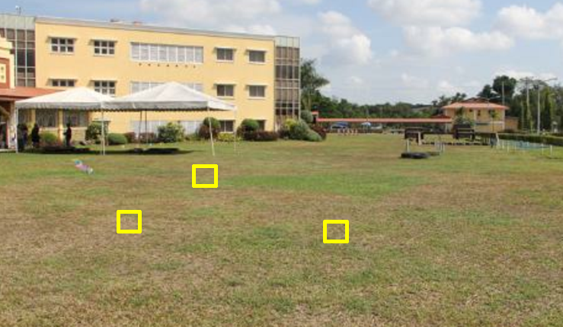
Example of the resulting image
The yellow box indicates the location at where the detector has detected metal.

Slide 6
Specifications
The area which the metal detector can be deployed shall be up to 200 sf
The metal detector will have detection depth up to 10cm below ground
The metal object to be detected shall not be smaller than the size of a quarter

Slide 7
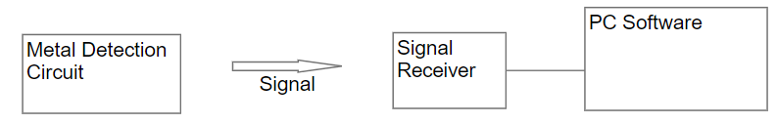
System Level Block Diagram
Detection Circuit utilizes LC tank to continuously transmitting a frequency signal
Frequency signal to be received and measured by an remote receiver
The receiver will constantly send frequency value to the PC via serial communication port

Slide 8
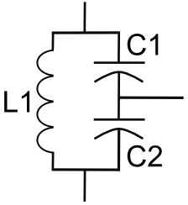
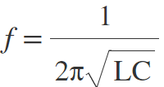
Technical Detail - Metal Detection Circuit
Circuit on the left shows a typical LC tank circuit.
The current discharged from the serial capacitors flows through the inductor, when the capacitor is fully discharged, the inductor begin to discharge to maintain the current flow, thus charging the capacitor. Process repeats resulting in oscillation
Let C1=C2=0.1uF =>C = 0.05uF
L1 = 1mH
f=1/(2*3.14*sqrt(0.05*10^-6*10^-3))
= 22kHz (base frequency)

Slide 9

Technical Detail - Metal Detection Circuit continuous
Metal influence frequency
Inductance equation for coil
Since relative permeability of metal > 1, Inductance increase as coil approach metal. => decrease in frequency
So the goal is to detect the change in frequency as it indicates the existence of nearby metal

Slide 10
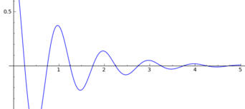
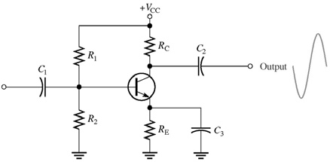
Technical Detail - Metal Detection Circuit continuous
In real life, oscillation dies out almost instantaneously
BJT Amplifier added to continuously add gain to the oscillation
Common emitter amplifier

Slide 11
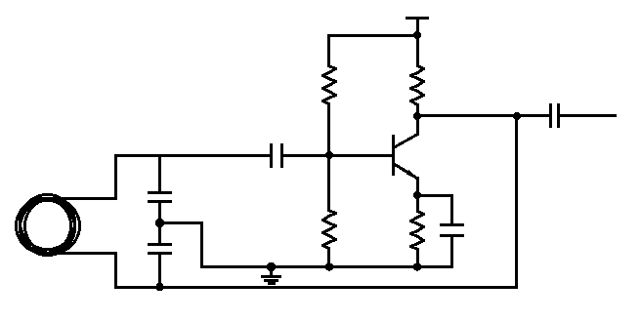
Technical Detail - Metal Detection Circuit continuous
Complete metal detection circuit

