Slide 1
Flight Price Prediction
Presented By :-Jay Bhalala

Slide 2
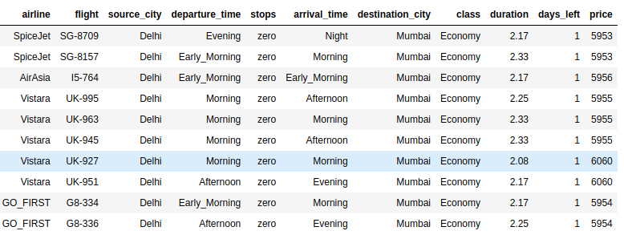
Flight Price Prediction(data)
Notes:
airline: refers to the company or carrier that operates the flight. It has 6 unique values are,
SpiceJet, AirAsia, Vistara, GO_FIRST, Indigo, Air_India
flight: refers to company code + Flight number, A numeric code assigned by the airline to identify the specific flight, ranging from one to four digits. It have total 1561 unique flight are there, and total 1254 unique flight number.
source_city: The starting city name from where the flight originates. There are 6 unique cities,
Delhi, Mumbai, Bangalore, Kolkata, Hyderabad, Chennai
destination_city: city name where the flight is scheduled to arrive. There are 6 unique cities,
Kolkata, Hyderabad, Chennai, Delhi, Mumbai, Bangalore
departure_time: The scheduled time of departure of the flight from the source_city,
Evening, Early_Morning, Morning, Afternoon, Night, Late_Night
stops: The number of stops the flight makes on its way to the destination_city,
zero, one, two_or_more
arrival_time: The scheduled time of arrival of the flight at the destination_city.
Evening, Early_Morning, Morning, Afternoon, Night, Late_Night
class: The class of the flight, such as
Economy, business
duration: The total duration(float numbers) in hours of the flight from the departure_time to the arairline, class, availability, and other factorsrival_time.
days_left:The number of days between the date of the flight search and the departure date of the flight. integer number varies 1 to 49.
price: The cost of the flight ticket, which may vary based on the all the above features.

Slide 3
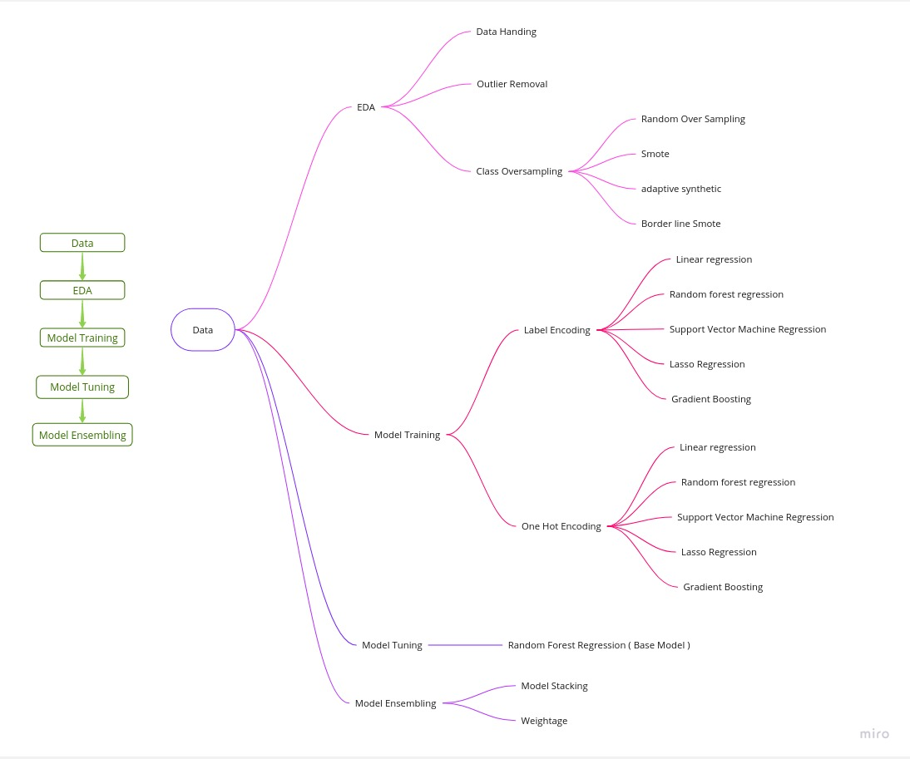
Work Flow

Slide 4
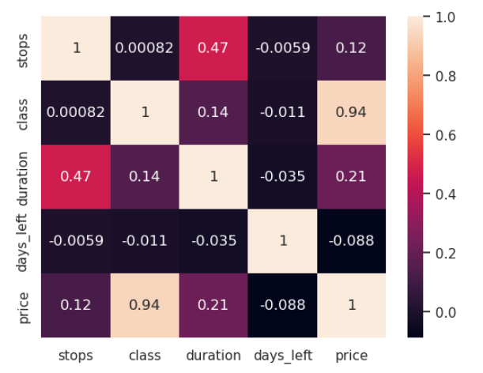
EDA
Missing data
Remove outliers
Bivariate analysis
Correlation matrix

Slide 5
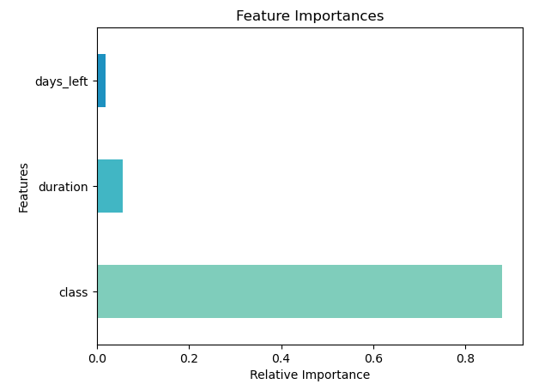
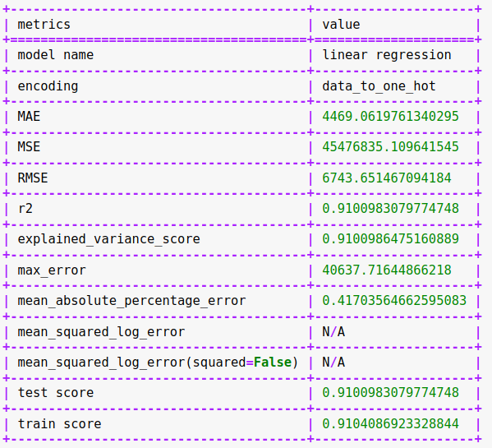
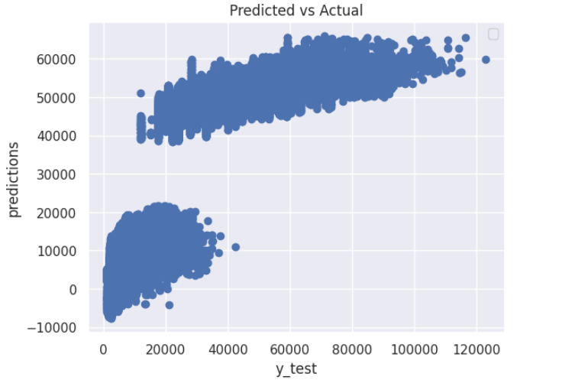
Linear Regression Model

Slide 6
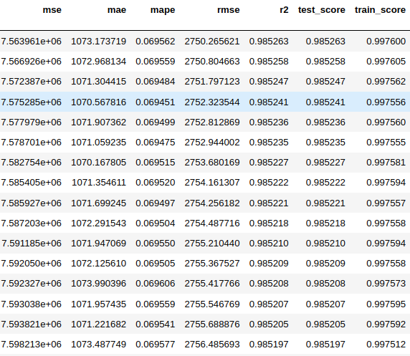
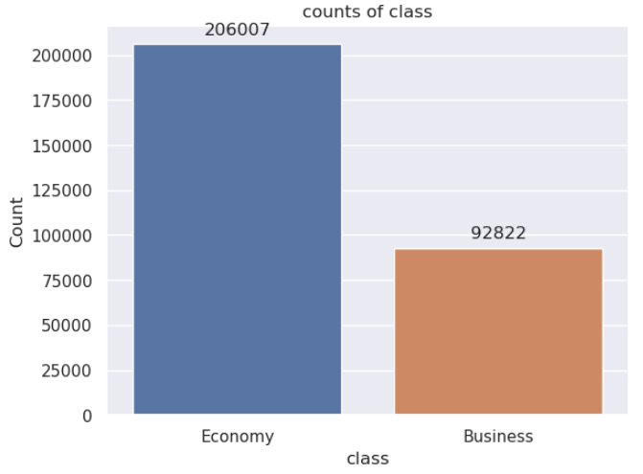
Class Over Sampling
Random over sampling
Smote
Adaptive synthetic
Border line Smote

Slide 7
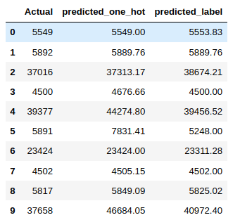
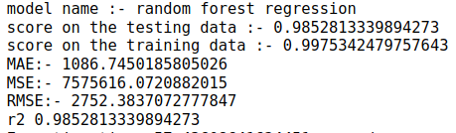
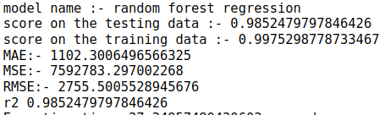
Label Encoding Vs One Hot Encoding
One hot encoding
Label encoding

Slide 8
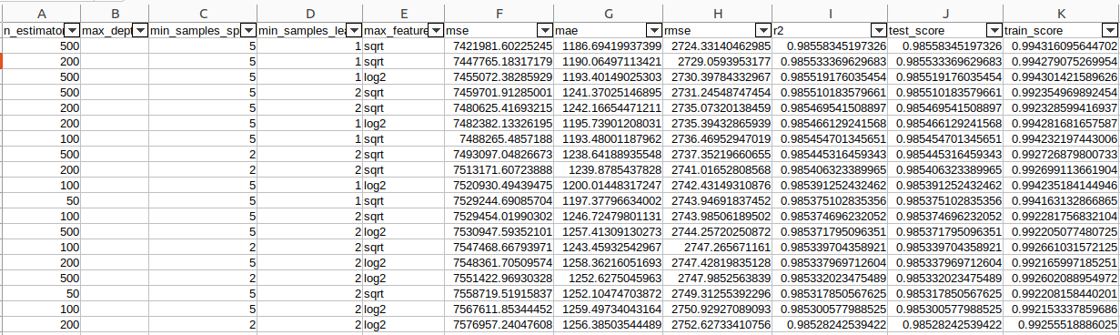
Hyper Parameter Tuning On Random Forest Model

Slide 9
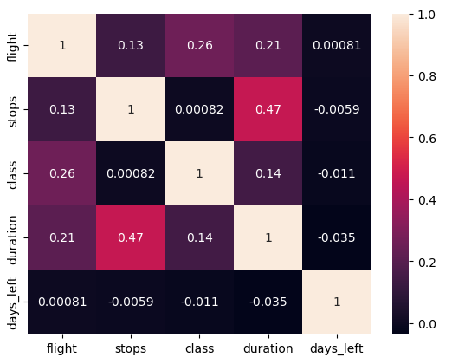
Flight Column Use
To use flight column in the dataset with 1561 unique values
performing one-hot encoding would require significant computational resources.
As an alternative, I opted for label encoding.

Slide 10
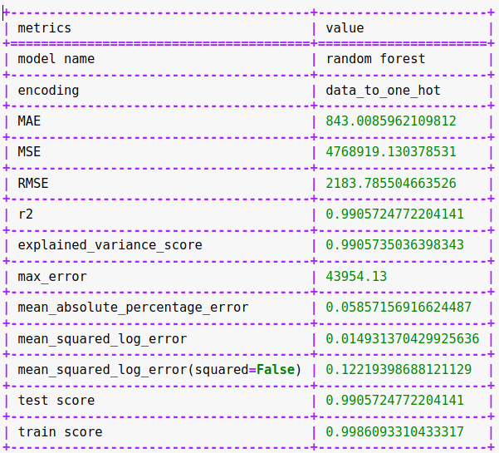
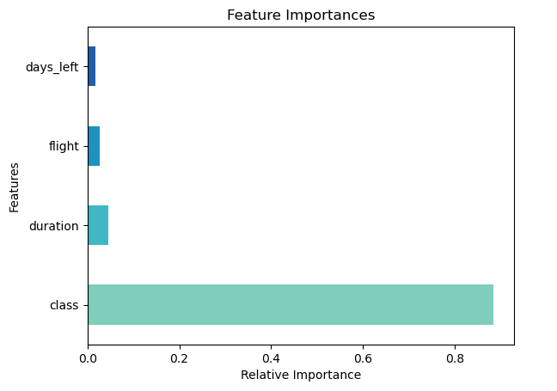
Different Models
Include flight feature with label encoding
Use model with both encoding
Random forest Regression
Linear Regression
Gradient boosting Regression
Lasso Regression
Support vector machine regression

Slide 11
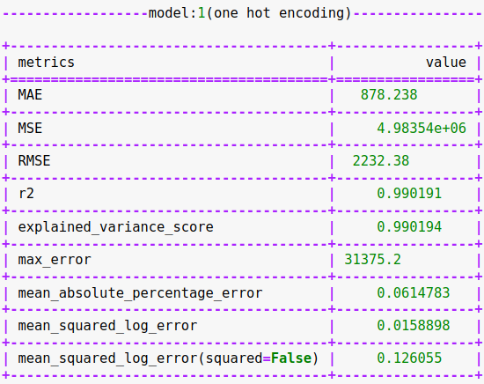
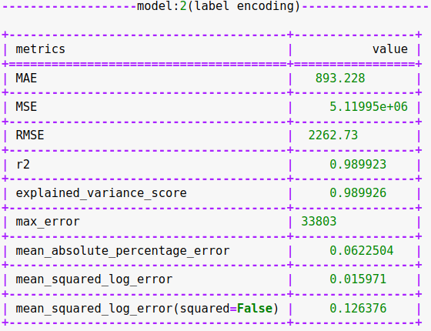
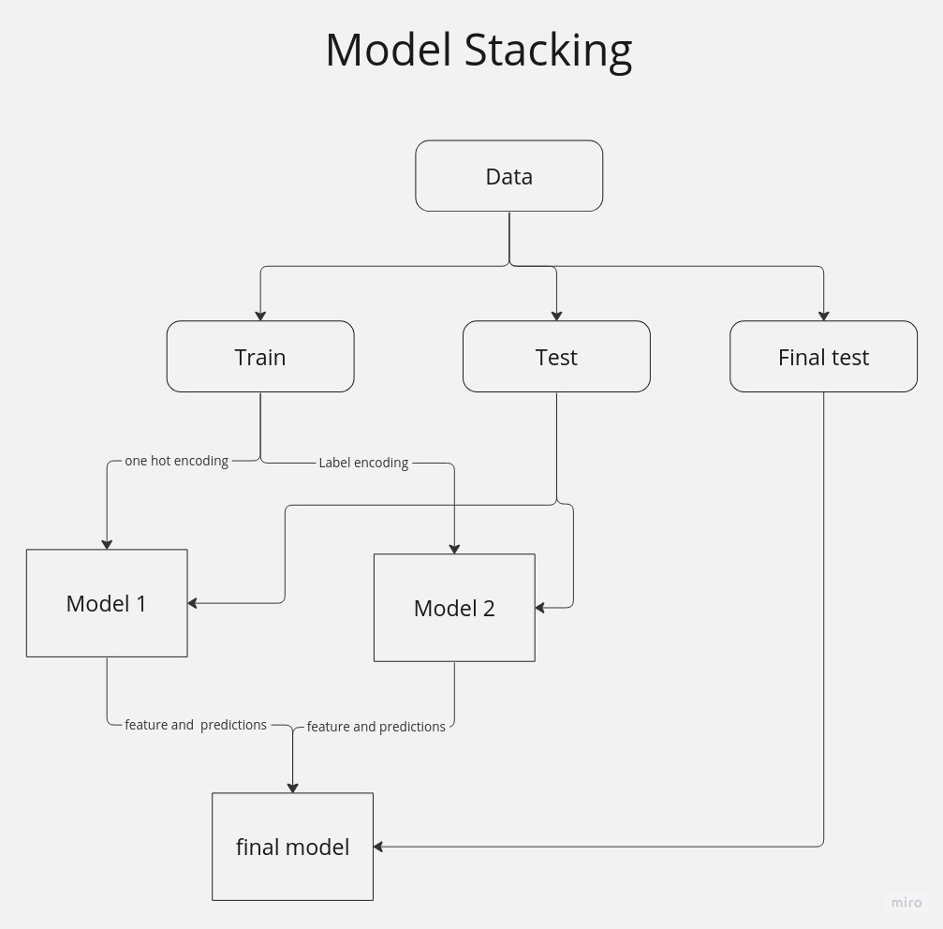
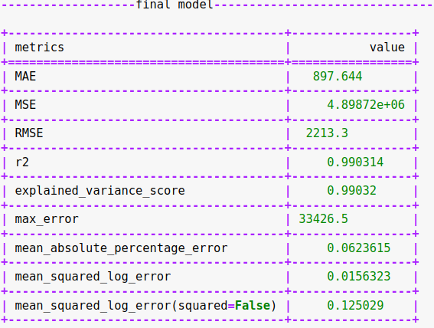
Model Stacking

Slide 12
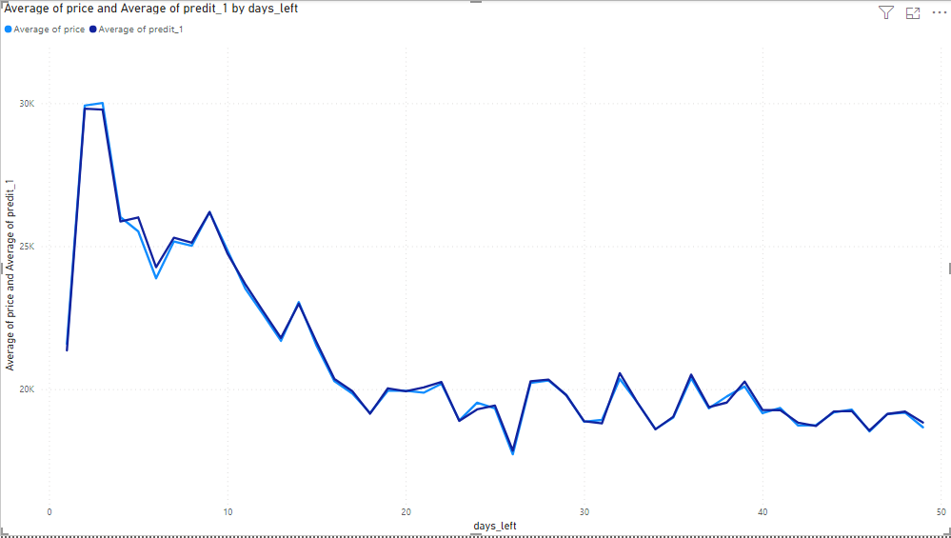
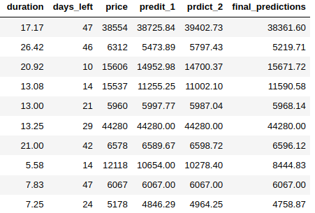
Model Stacking Results

Slide 13
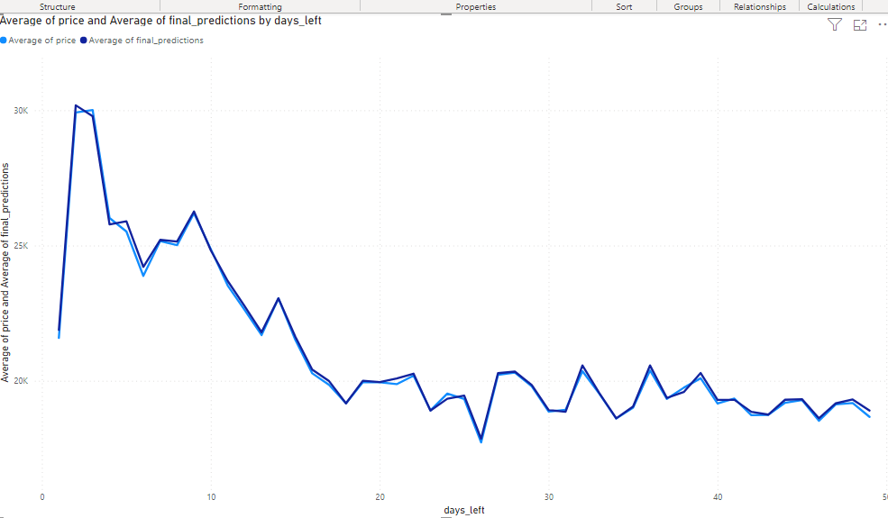
Model Stacking Results

Slide 14
Thank You

