Slide 1
PRODUCT RECOMMENDATION SYSTEM USING CUSTOMER HISTORY BY MACHINE LEARNING Team-47
Guide:Ms.D.Dakshayani Himabindu
Bh.Jaya Krishna Sri-19071A12C6
P.Srujana -19071A12G1
Sk.Afreen-19071A12G8
G.Shivani-20075A1215

Slide 2
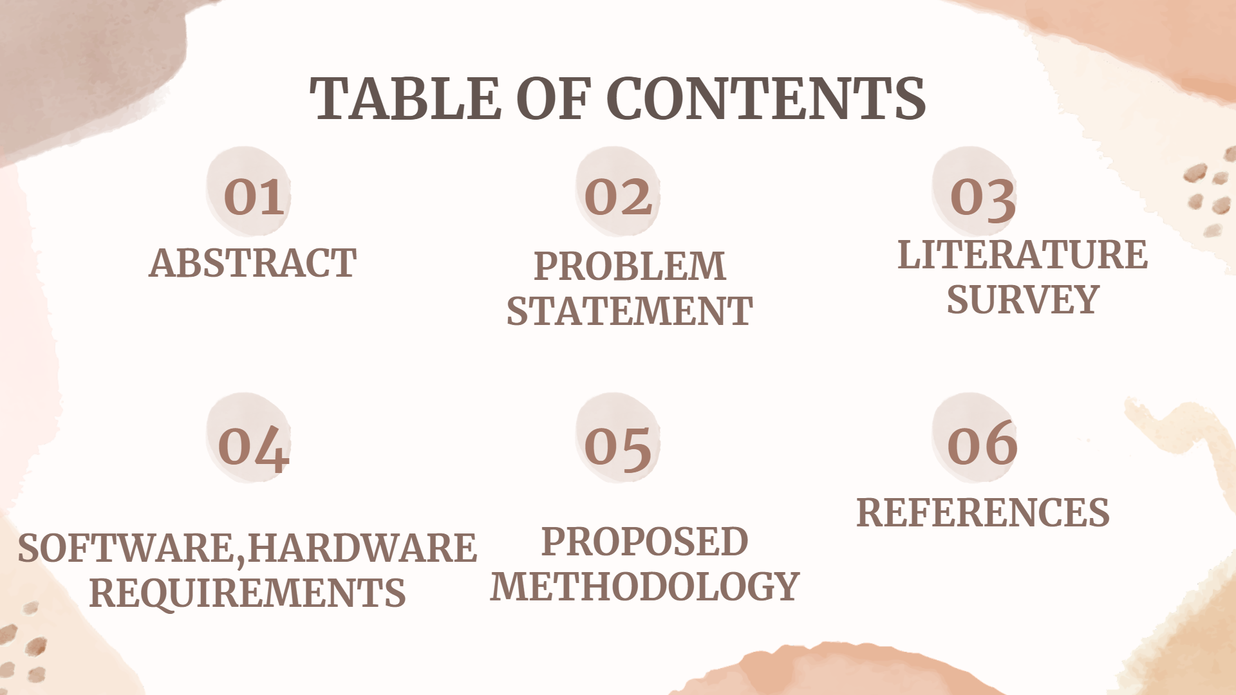
TABLE OF CONTENT
.
You can delete this slide when you’re done editing the presentation.

Slide 3
ABSTRACT
Recommendation systems are a subclass of machine learning which generally deal with prediction of products.
It is possible to fulfill customer’s needs and expectations, helping maintaining loyal customers while attracting new customers.

Slide 4
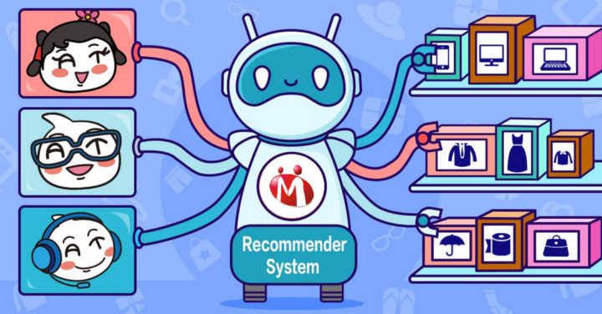
PROBLEM STATEMENT
To build a product recommender system with the goal of predicting and suggesting a list of items that a customer is likely to purchase and predicting the products based on current product.
It also predicts most popular products and top selling products

Slide 5
PROPOSED SOLUTION
It predicts 10 top popular products.
The recommendation engine can provide personalized suggestion of products to the users depending on their previous purchase history.
It also predicts the related products of the current product by purchase history.

Slide 6
LITERATURE SURVEY
1)Internal Journal for research science
(in applied science & engineerinf technology)
Author:Ketki Kinkar
Volume:9
Issue:VII
Month of Publication:July 2021
link:https://www.researchgate.net/publication/353757917_Product_Recommendation_System_A_Systematic_Literature_Review
2)Publisher Name : IJERT
Authors : Varisht Ghedia, Gaurang Pansare, Dhaval Mehta, Prof. Amruta Mhatre
Paper ID : IJERTCONV5IS01203
Volume & Issue : ICIATE – 2017 (Volume 5 – Issue 01)
Published (First Online): 24-04-2018
ISSN (Online) : 2278-0181
link:https://www.ijert.org/study-of-recommendation-engines-for-e-commerce-websites

Slide 7
LITERATURE SURVEY
3)IJARCCE
International Journal of Advanced Research in Computer and Communication Engineering
ISO 3297:2007 Certified
Recommendation Systems for E-Commerce:
Author:Priya S,Mansoor Hussain D
Volume: Vol. 6
Issue: 4
Published: April 2017
link:https://ijarcce.com/upload/2017/april-17/IJARCCE%2096.pdf
4)Computer Science & Electronics Journals
An Effective Product Recommendation System for E-Commerce Website Using HybridRecommendation Systems
Author:S. Shruthi, Dr. J. Viji Gripsy
Volume:8
Issue :2
Published: March 2017 - Sept 2017
link:http://csjournals.com/IJCSC/PDF8-2/14.%20Shruti.pdf

Slide 8
Hybrid
Content-based filtering
Popularity based
Collaborative filtering
RECOMMENDATION SYSTEMS
Item-based
User-based

Slide 9
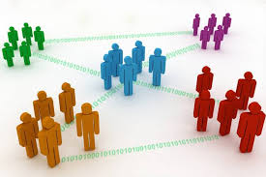
Popularity based Approach
The easiest type of recommendation system is based on item popularity.
Products with high no of orders can be considered as most frequently purchased items
# To find the most popular items, include the no of customers purchased and provide more weightage to products purchased by more customers
Weighted No_of_Orders (W) = O * (C / M)
O = No_of_Orders
C = No_of_Customers purchased the product
M = Maximum no of customers made transactions in the entire period

Slide 10

CUSTOMER BASED
Customer frequently purchased
Products recommended to customer

Slide 11
Customer frequently purchased:
In this approach,the most frequently purchased products by the customer are displayed.This is done by applying popularity based approach for the specific customer.
:
Products recommended to customer:
In this Find the correlation between every two customers and build a correlation matrix using corr() method
Used Spearman method in identifying the correlation.
Products are recommended to customer based on customer purchase history

Slide 12
ITEM BASED
Similar Products Recommendation:
This function performs the below functionality
for the input product
get the list of products with similar purchasing
pattern and correlation coefficient
Display’s the top 10 related products based on
The current entered product.

Slide 13
SOFTWARE HARDWARE REQUIREMENTS
Processor-Intel Core i5-4440
CPU-3.10 GHz
Operating System-Windows
RAM- >4GB RAM
VS Code
Flask(Web-development framework for Python)
IDE- Google Colaboratory
Python-Python 3.10.7

Slide 14
PROPOSED METHODOLOGY
Preprocessing
Loading Dataset
Building Model
Loading Libraries
User-based
Popularity Based Model
Item-based

Slide 15
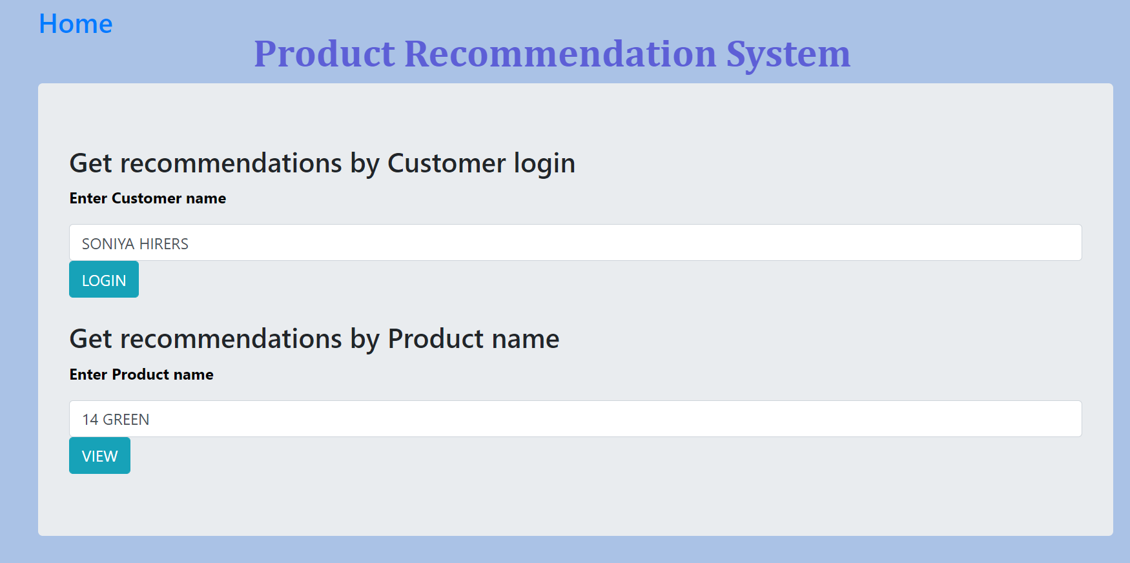
OUTPUTS: Login page for entering customer name and product name

Slide 16
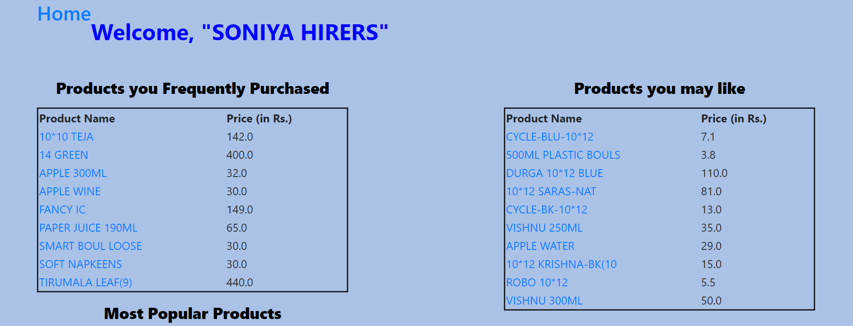
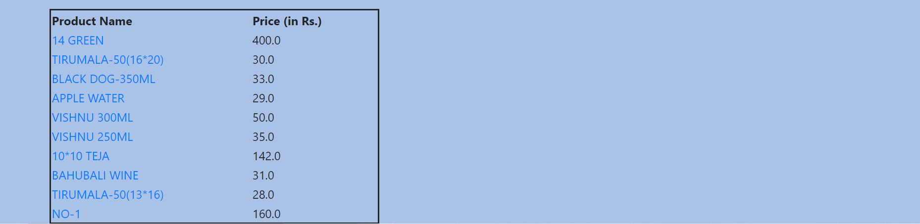
Home page for customer

Slide 17
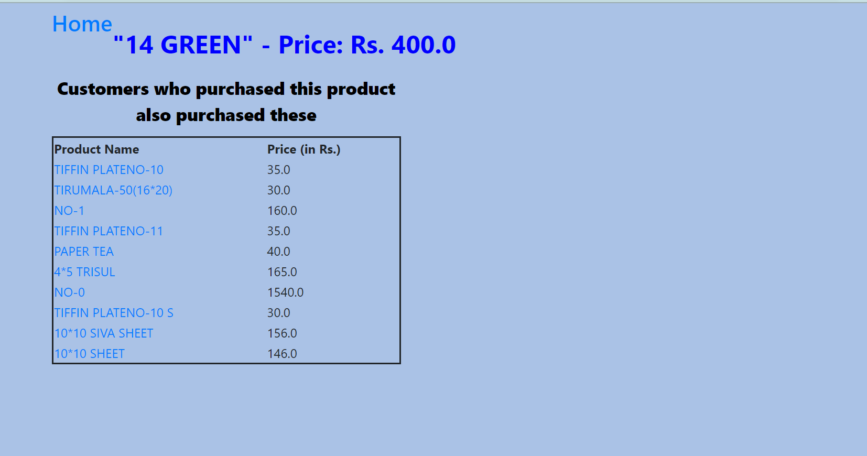
Page displayed after entering Product name

Slide 18
REFERENCES
https://www.researchgate.net/publication/353757917_Product_Recommendation_System_A_Systematic_Literature_Review
https://en.wikipedia.org/wiki/Recommender_system
https://ieeexplore.ieee.org/document/4061458
https://towardsdatascience.com/exploratory-data-analysis-%20%20%20%20%20%20%208fc1cb20fd15
https://link.springer.com/chapter/10.1007/978-981-15-0790-8_13IEEE Computer Society
https://www.cs.umd.edu/~samir/498/AmazonRecommendations.pdf)
https://www.ijert.org/research/recommender-systems-types-of-filtering-techniques-IJERTV3IS110197.pdf

Slide 19
THANK YOU

