Slide 1


VISUAL ALGO
19071A12C6 - BH. JAYA KRISHNA SRI
19071A12C9 - B. MEGHANA
19071A12E2 - K. MAMATHA
19071A12G8 - SK. AFREEN
Under the guidance of-
Mrs.S.Swathi
Assistant Professor
Dept. of IT

Slide 2


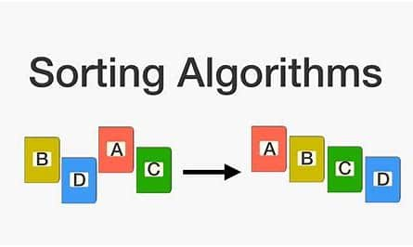
Visual Algorithm-
This project is for educational purpose.
The main objective of this project is to help beginners to be able to visualize the basic algorithms and get a better understanding of the underlying operations.

Slide 3
Sorting-
Sorting is a very classic problem of reordering items of an array (or a list) in a certain order (increasing, non-decreasing, decreasing, non-increasing, lexicographical, etc).
We have learnt sorting algorithms like bubble sort, selection sort, insertion sort, quick sort. But often we fail to understand the core idea of a particular algorithm maybe because we are unable to visualize how they work. So the most important thing to understand about these algorithms is visualization.

Slide 4

Technologies used:
Creating the website's User Interface (UI) using HTML, CSS and enhancing it further using Bootstrap; without actually implementing any of the app's core features.
Implementation of animations, effects and core functionalities (sorting algorithms) using JavaScript

Slide 5
Various Sorting Algorithms:
Bubble sort
Selection sort
Insertion sort
Merge sort
Quick sort

Slide 6
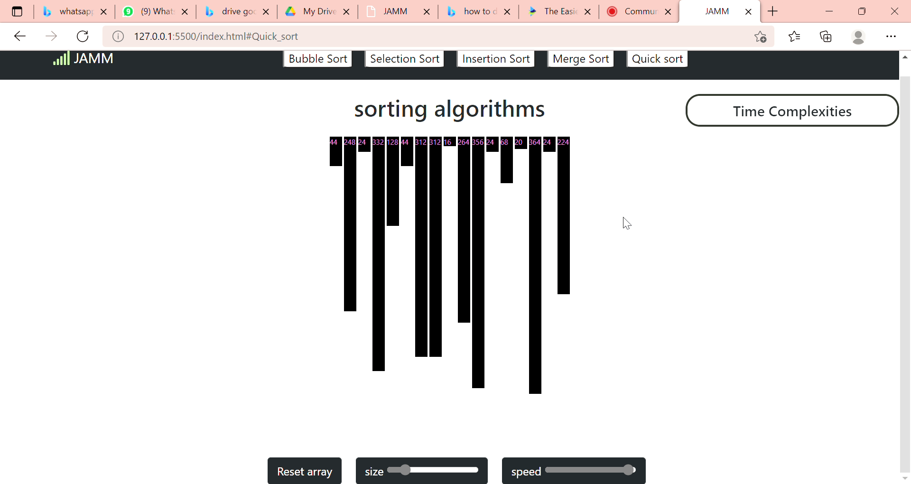
BUBBLE SORT

Slide 7
Implementing Bubble Sort Algorithm:
Following are the steps involved in bubble sort:
STEP-1: Starting with the first element(index = 0), compare the current element with the next element of the array.
STEP-2: If the current element is greater than the next element of the array, swap them.
STEP-3: If the current element is less than the next element, move to the next element. Repeat Step 1.

Slide 8
Complexity Analysis of Bubble Sort:
In Bubble Sort, n-1 comparisons will be done in the 1st pass, n-2 in 2nd pass, n-3 in 3rd pass and so on. So the total number of comparisons will be,
(n-1) + (n-2) + (n-3) + ..... + 3 + 2 + 1 Sum = n(n-1)/2 i.e O(n²)
Worst Case Time Complexity [ Big-O ]: O(n²)
Best Case Time Complexity [Big-omega]: O(n)
Average Time Complexity [Big-theta]: O(n²)
Space Complexity: O(1)

Slide 9
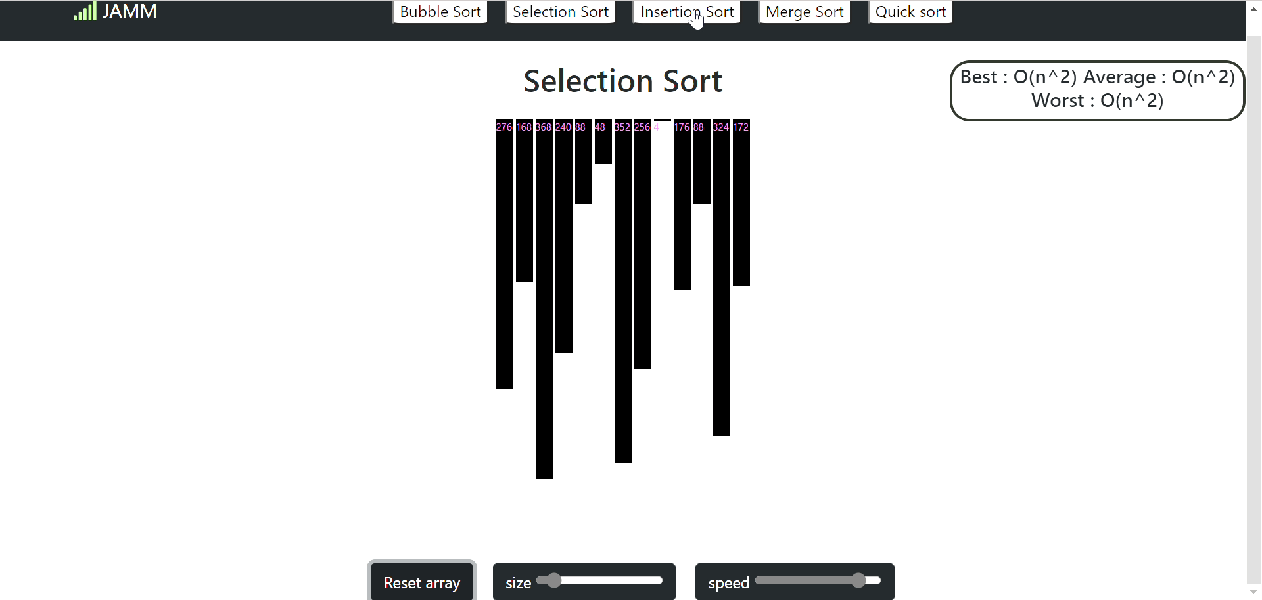
INSERTION SORT

Slide 10
Implementing Insertion Sort Algorithm:
Following are the steps involved in insertion sort:
STEP-1:We start by making the second element of the given array, i.e. element at index 1, the key. The key element here is the new card that we need to add to our existing sorted set of cards(remember the example with cards above).
STEP-2:We compare the key element with the element(s) before it, in this case, element at index 0:
If the key element is less than the first element, we insert the key element before the first element.
If the key element is greater than the first element, then we insert it after the first element.
STEP-3:Then, we make the third element of the array as key and will compare it with elements to it's left and insert it at the right position.
STEP-4:And we go on repeating this, until the array is sorted.

Slide 11
COMPLEXITY ANALYSIS OF INSERTION SORT ALGORITHM:
Worst Case Time Complexity [ Big-O ]: O(n²)
Best Case Time Complexity [Big-omega]: O(n)
Average Time Complexity [Big-theta]: O(n²)
Space Complexity: O(1)

Slide 12
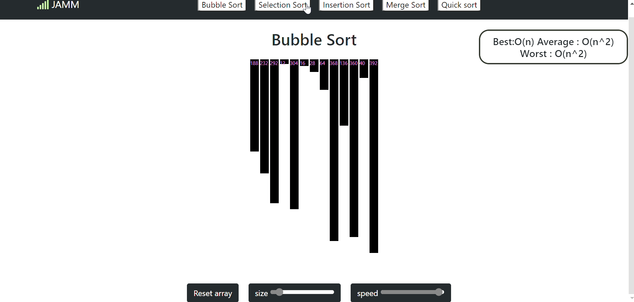
SELECTION SORT

Slide 13
Implementing Selection Sort Algorithm:
Following are the steps involved in selection sort:
STEP-1: Starting from the first element, we search the smallest element in the array, and replace it with the element in the first position.
STEP-2: We then move on to the second position, and look for smallest element present in the subarray, starting from index 1, till the last index.
STEP-3: We replace the element at the second position in the original array, or we can say at the first position in the subarray, with the second smallest element.
STEP-4: This is repeated, until the array is completely sorted.

Slide 14
COMPLEXITY ANALYSIS OF SELECTION SORT ALGORITHM:
Worst Case Time Complexity [ Big-O ]: O(n²)
Best Case Time Complexity [Big-omega]: O(n²)
Average Time Complexity [Big-theta]: O(n²)
Space Complexity: O(1)

Slide 15
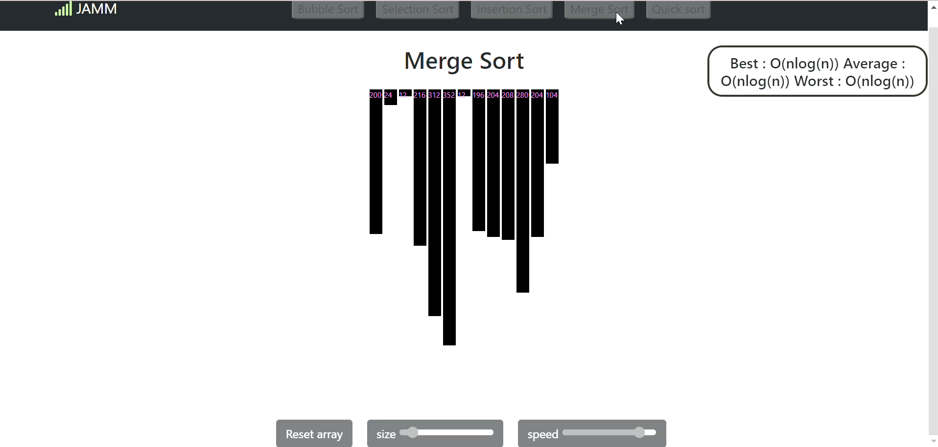
MERGE SORT

Slide 16
Implementing Merge Sort Algorithm:
In merge sort we follow the following steps:
STEP-1: We take a variable p and store the starting index of our array in this. And we take another variable r and store the last index of array in it.
STEP-2: Then we find the middle of the array using the formula (p + r)/2 and mark the middle index as q, and break the array into two subarrays, from p to q and from q + 1 to r index.
STEP-3: Then we divide these 2 subarrays again, just like we divided our main array and this continues.
STEP-4: Once we have divided the main array into subarrays with single elements, then we start merging the subarrays.

Slide 17
COMPLEXITY ANALYSIS OF MERGE SORT ALGORITHM:
Worst Case Time Complexity [ Big-O ]: O(n*log n)
Best Case Time Complexity [Big-omega]: O(n*log n)
Average Time Complexity [Big-theta]: O(n*log n)
Space Complexity: O(n)

Slide 18
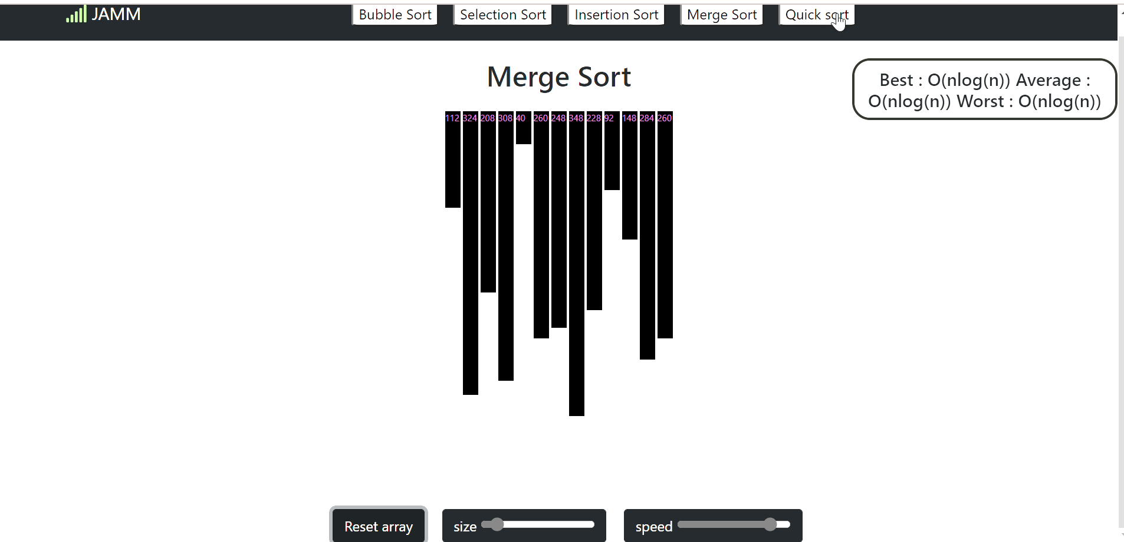
QUICK SORT

Slide 19
Implementing Insertion Sort Algorithm:
In Quick sort we follow the following steps:
Step-1: pick any element as pivot.
Step-2:The key process in quickSort is partition(). Target of partitions is, given an array and an element x of array as pivot, put x at its correct position in sorted array
Step-3:Put all smaller elements (smaller than x) before x
Step-4:Put all greater elements (greater than x) after x. All this should be done in linear time.
Step-5:Call Quick sort function for left array and right array.

Slide 20
COMPLEXITY ANALYSIS OF QUICK SORT ALGORITHM:
Worst Case Time Complexity [ Big-O ]: O(n*log n)
Best Case Time Complexity [Big-omega]: O(n*log n)
Average Time Complexity [Big-theta]: O(n*log n)
Space Complexity: O(n)

