Slide 1


Slide 2
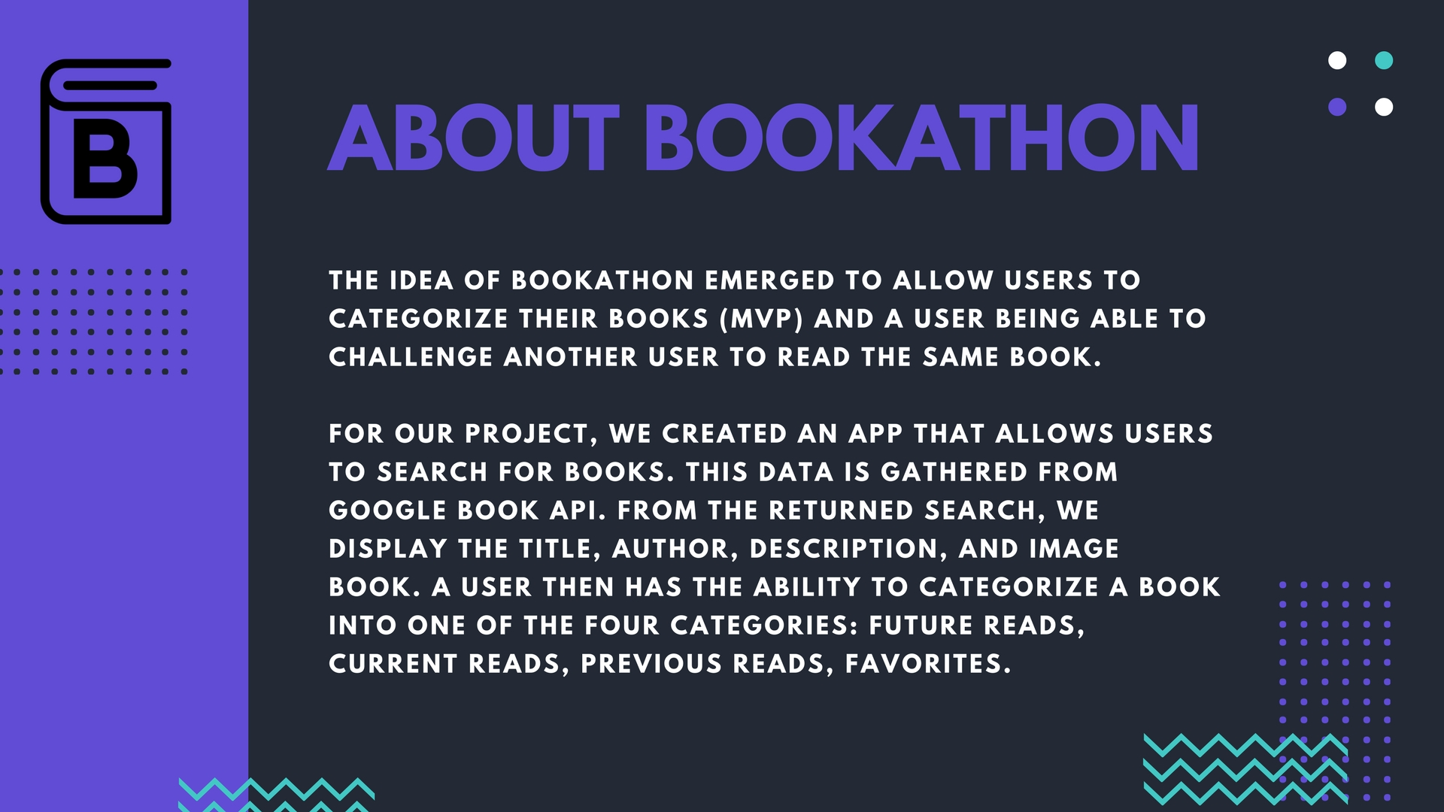

Slide 3


Slide 4


Slide 5
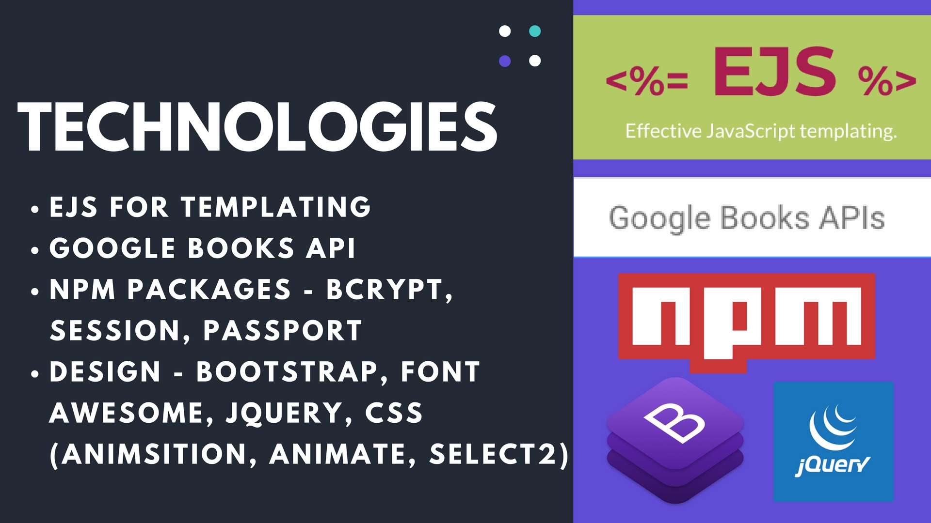

Slide 6


Slide 8
Tables
Users
Id | Email | Password
1
2
Books
Id | Title | Author | Description | Thumbnail
1
2
3

Slide 9
Favorites
Id | Book Id | User Id
1
2
3
Currently Reading
Id | Book Id | User Id
1
2
3

Slide 10
Future Reads
Id | Book Id | User Id
1
2
3
Previously Read
Id | Book Id | User Id
1
2
3

Slide 11
5 Tables:
Users
Books
Favorites
Future reads
Previously read
Currently reading

Slide 12
App Capabilities
Create an account
Search for books using the Google Books API
Display book information in search results
Ability to add books to 4 different lists

Slide 13


Slide 14


Slide 15


