Slide 1
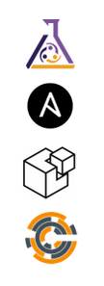
Pitchbook
Activate
Select an Identity
Authenticate
Use AXE
Use Your own tools

Slide 2


AXE Tools
Identities & Credentials
$AXE_ROOT
~/.axe

Slide 3




Download
V1 VM Image(s)
VM Creation
VM 1st Boot cloud-init
Clone, Cleanup, Customize
Ready to use

