Slide 1
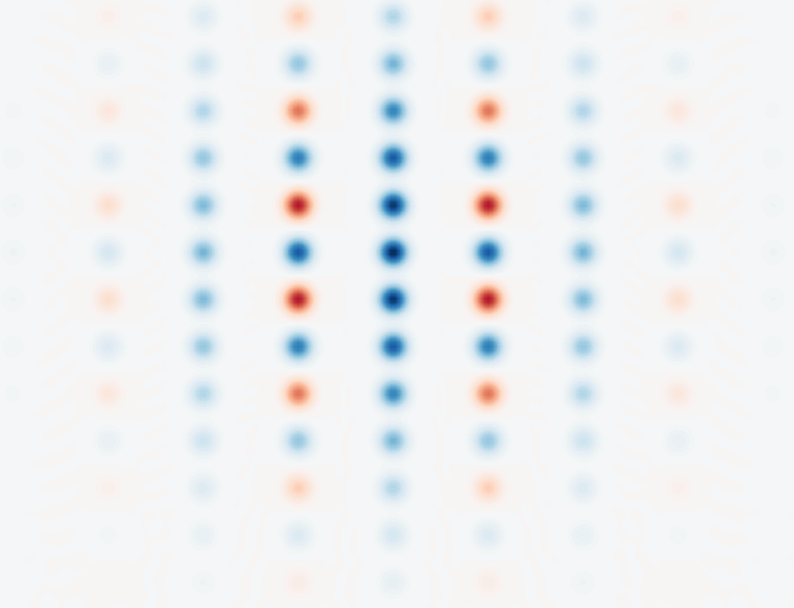
Further study of GKP error correction
Jérémie Boudreault

Slide 2
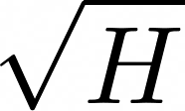
Goal :
Study

Slide 3

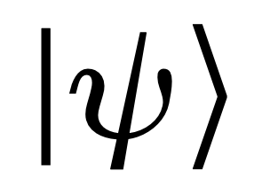
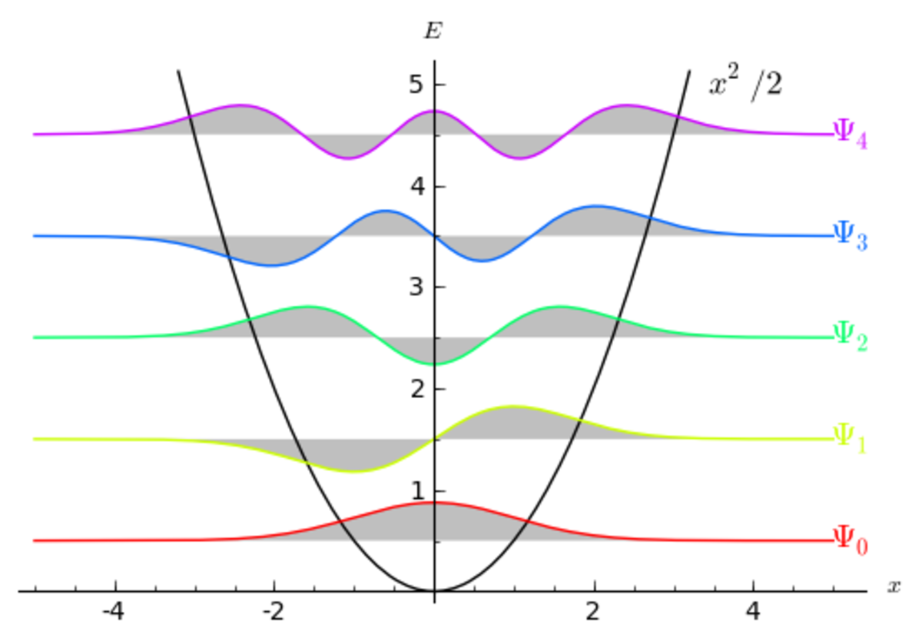
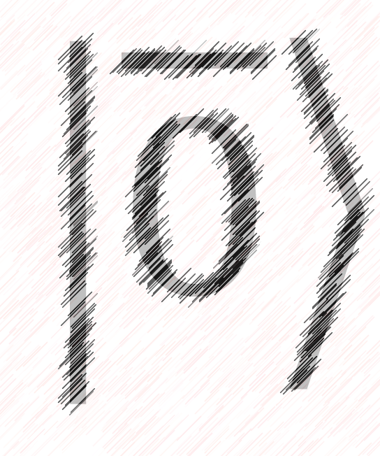
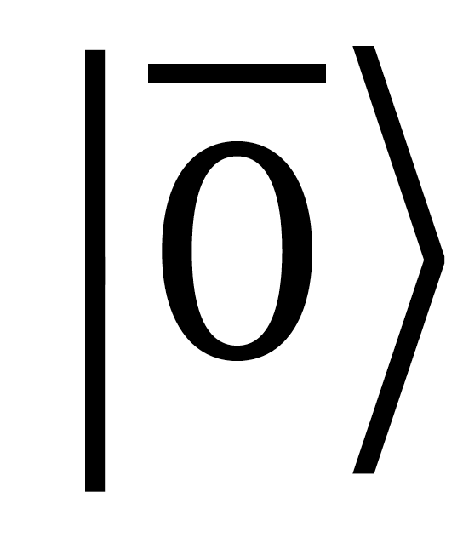
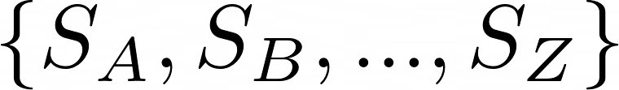
GKP codes
(Gottesman-Kitaev-Preskill)
Bosonic stabilizer error correcting codes
Bosonic stabilizer error correcting codes

Slide 4
Goal :

Slide 5
Goal :

Slide 6
Goal :

Slide 7
Goal :

Slide 8
Goal :

Slide 9
Goal :

Slide 10
Goal :

