Slide 1
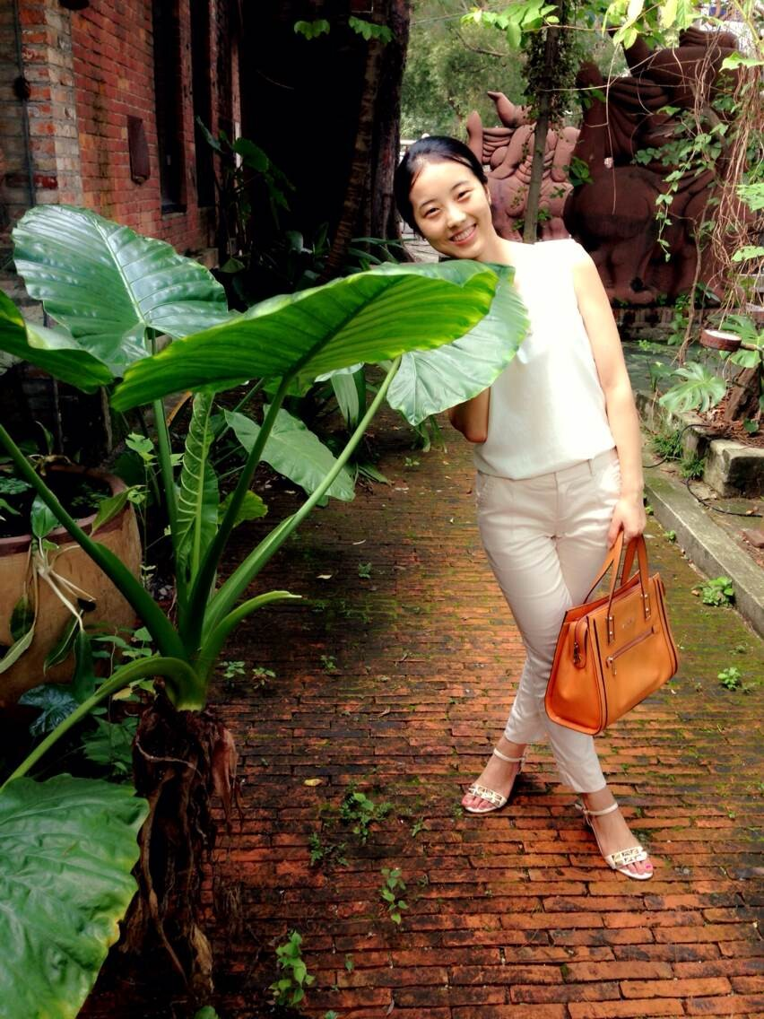
魏来
future
四川 眉山
+86 15626456602
396302759@qq.com

Slide 2
EDUCATION
华南师范大学，硕士学位
Graduated from South China Normal University with master’s degree
专业 | 传播学
Major | communication
2016 MASTER’S DEGREE
2012 Bachelor ’S DEGREE
湖北经济学院，学士学位
Graduated from Hubei University Of Economics with bachelor's degree
专业 | 外国语言文学
Major | Foreign Languages and Literatures

Slide 3

EXPERIENCE
1
2
3
4
？
两个专业
三个城市
四段实习
经历

Slide 4

something
性格
character
兴趣
habits
梦想
dream
开朗
热情
亲和力
读书
旅游
跑步
高高兴兴上班
平平安安回家

Slide 5
SKILLS
Writing
English
Office
PS
80%
70%
65%
30%

Slide 6
show
I wish to wish the wish you wish to wish, but if you wish the wish the witch wishes, I won't wish the wish you wish to wish

Slide 7
final
THANK YOU!

