Slide 1
Machine Learning: How does it work?
Jay Buckingham
March 2019

Slide 2
Outline
Simple example: Linear regression
Simple classification: 2 classes
Using Numpy
Using TensorFlow
Classifying handwritten digits
Using logistic regression
Using Convolutional Neural Network (ConvNet)

Slide 3
Simple Regression Example
Linear Regression, 2D points
Notebook linregression2_naive.ipynb
Then linregression_vectorized.py

Slide 4
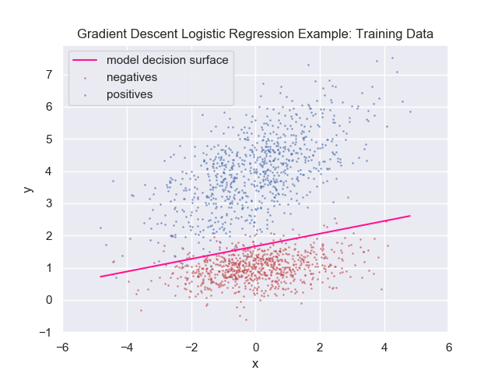
Logistic Regression: Decision Surface

Slide 5
Simple Classification Example
Logistic regression, 2 classes, 2D points
Using Numpy
logisticregression_np.ipynb
Train accuracy: 0.96875
Test accuracy: 0.97500

Slide 6
Logistic Regression using TensorFlow
Quick TensorFlow example
tf_arithmetic_example1_tb.py
Logistic regression using TensorFlow
tf_logisticregression_naive.py
tf_logisticregression.py

Slide 7
Quick TensorFlow Example: Arithmetic
Let: a = 15, b = 5
Want: result = (a * b) / (a + b)
Create computation graph mult = a * b add = a + b result = mult / add

Slide 8
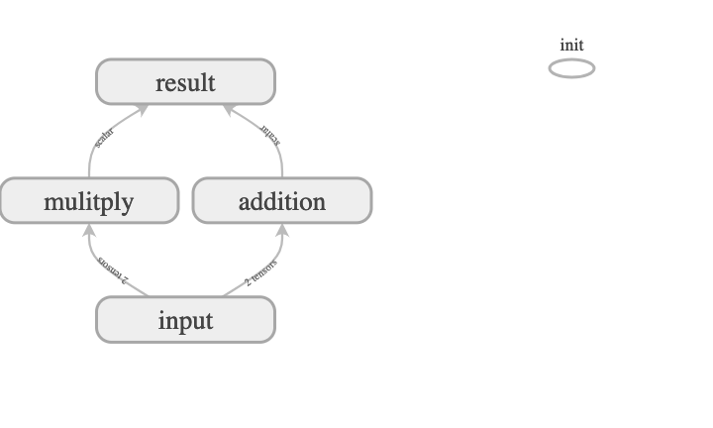
Create TensorFlow Computation Graph

Slide 9
TensorFlow: Simple arithmetic example
Show tf_arithmetic_example1_tb.py

Slide 10
Logistic regression in TensorFlow
We reimplement our numpy logistic regression code in TensorFlow.
Two versions: naïve and more typical TensorFlow:
tf_logisticregression_naive.py
tf_logisticregression.py

Slide 11
Logistic regression in TensorFlow works
Works better than hand-written gradients in Numpy:
Train Accuracy: 0.9844
Test Accuracy: 0.9900

Slide 12
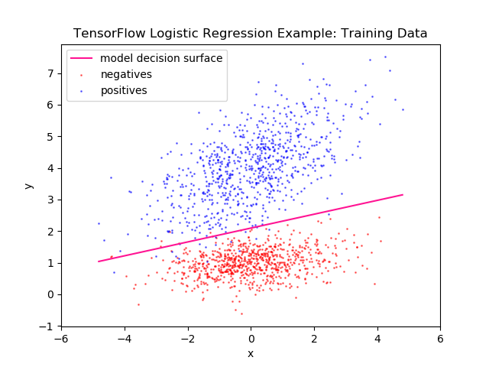
Logistic regression in TensorFlow: Decision Line

Slide 13
Classify Handwritten Digits
Try logistic regression
Then exploit 2D structure with Convolutional Neural Network

Slide 14
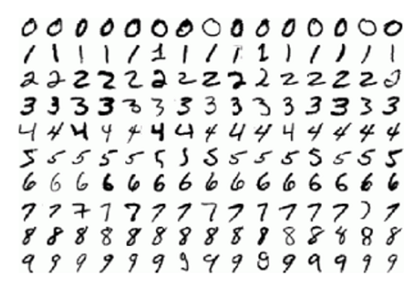
MNIST Handwritten Digits: Examples

Slide 15
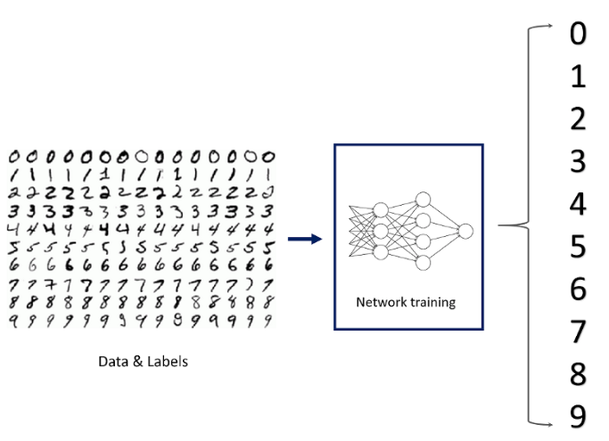
Model maps input image to target label

Slide 16
Classify Handwritten Digits: Logistic Regression
Using logistic regression
Usual 1 layer of weights
mnist1.py
Test Accuracy: 0.9191

Slide 17
Classify Handwritten Digits: Convolutional Neural Network
Using Convolutional Neural Network
Architecture:
Input: 28 x 28 x 1 images
Conv layer
Max pooling layer
Conv layer
Max pooling layer
Fully connected layer
Fully connected layer
Test Accuracy: 0.9802

Slide 18
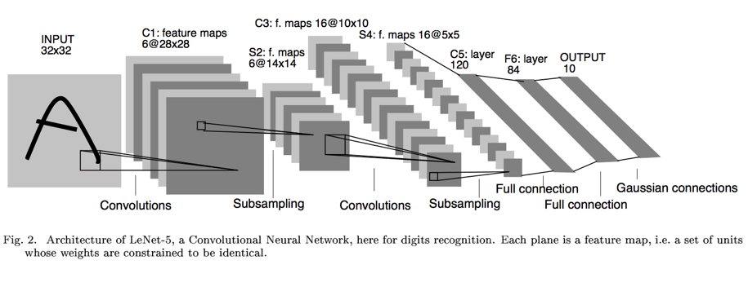
Similar to LeNet5

Slide 19
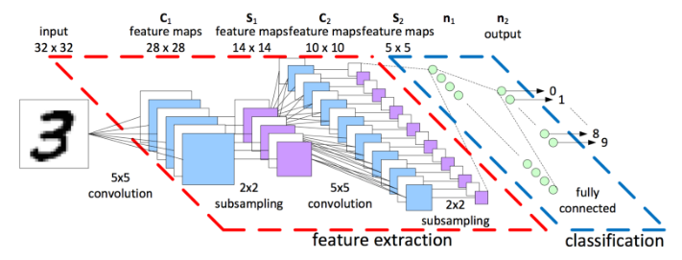
MNIST ConvNet Architecture

Slide 20
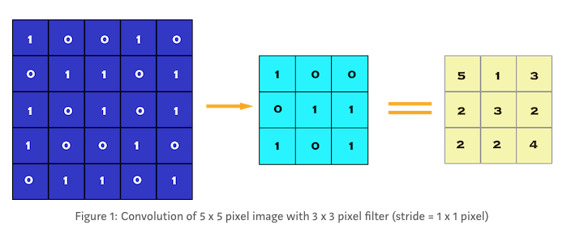
Convolution Example
From: https://towardsdatascience.com/image-classification-in-10-minutes-with-mnist-dataset-54c35b77a38d

Slide 21
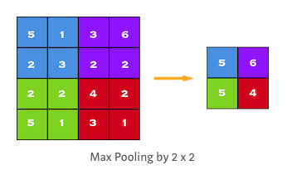
Max Pooling Example
From: https://towardsdatascience.com/image-classification-in-10-minutes-with-mnist-dataset-54c35b77a38d

Slide 22
Convolution Animation
See: https://blog.goodaudience.com/convolutional-neural-net-in-tensorflow-e15e43129d7d

Slide 23
Convolutional Neural Network in TensorFlow
See: mnist_cnn.py

Slide 24

Deep Learning – Much Deeper than in 1990
http://web.cse.ohio-state.edu/~panda.2/5194/slides/2.c.GoogLeNet.pdf

Slide 25
Takeaways
Can train accurate models for classification tasks using neural networks.
Key operations:
Matrix multiplies to compute
Input-to-output mapping
Gradients of cost wrt weights
Scientists now use frameworks such as TensorFlow to train and run neural networks.
They compute the gradients required.
We get large speed-ups using GPU, TPU
Need to convey how Intel enables these speed-ups.

