Slide 1
HACK2HIRE
TEAM GO
DOGIPARTHI VENAKATA SATYA SAI SUJAN
DHAVALESWARPU ANUDEEP
PENTAPARTHI TAPASWI
MAMIDI SAIVEER
JAYACHANDRA KASARLA

Slide 2
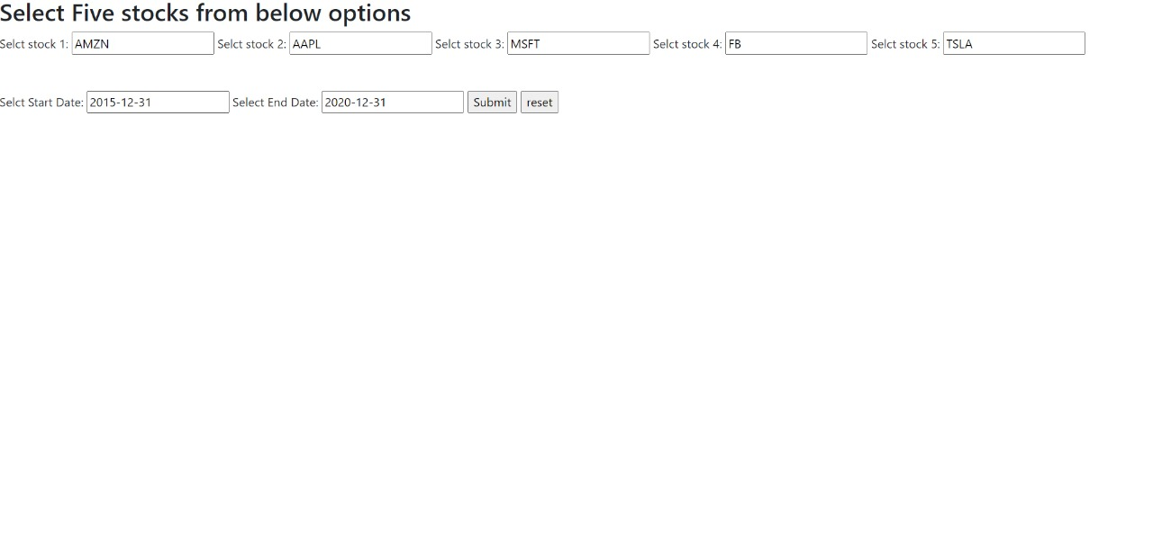
USER INPUT THROUGH FORM:

Slide 3
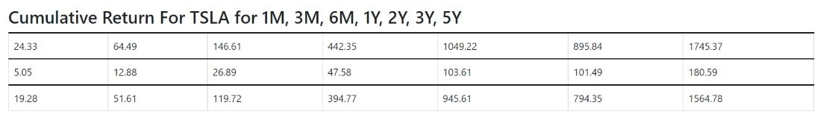
PERFORMANCE MEASUREMENT DASHBOARD FOR TESLA (CUMULATIVE RETURNS):

Slide 4
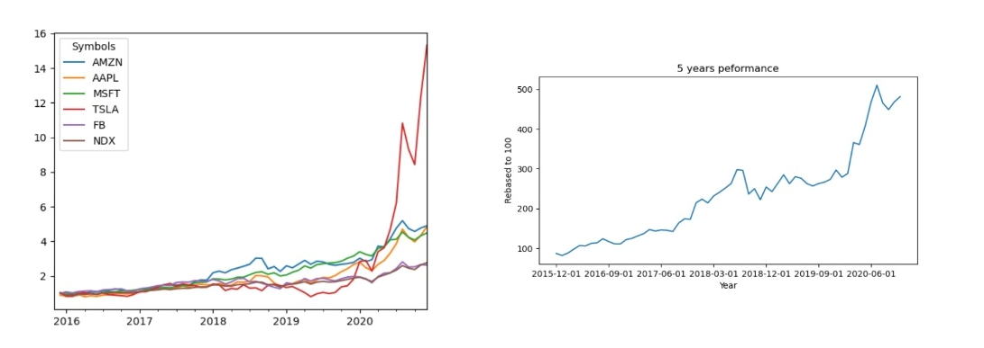
GRAPH FOR ALL STOCKS ALONG WITH BENCHMARK NDX

Slide 5

FINAL INVESTMENT PROFITS:

Slide 6
CHALLENGES FACED
Lack of much interaction in the beginning
Not getting the values correctly
Limited time to plan, develop and test the site

Slide 7
THANK YOU

