Slide 1
Where to open a coffee shop in Hong Kong?

Slide 2
Introduction
There are a totally 18 districts in Hong Kong, and each district has its own special features.
Let’s find out what is the best location to open a coffee shop in Hong Kong
Income data will be used to estimated how affordable is people from different districts
Districts where coffee shop being the most common venue will be considered
The number of coffee shops in the districts will be used as a reference too

Slide 3
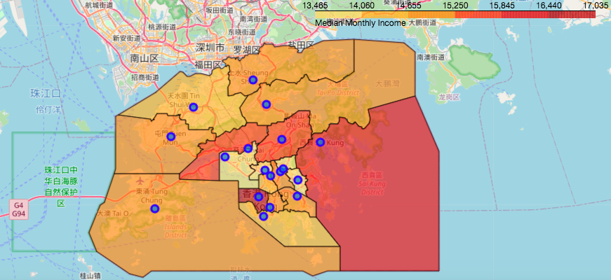
Different income level by districts
Highest income: Central and Western

Slide 4
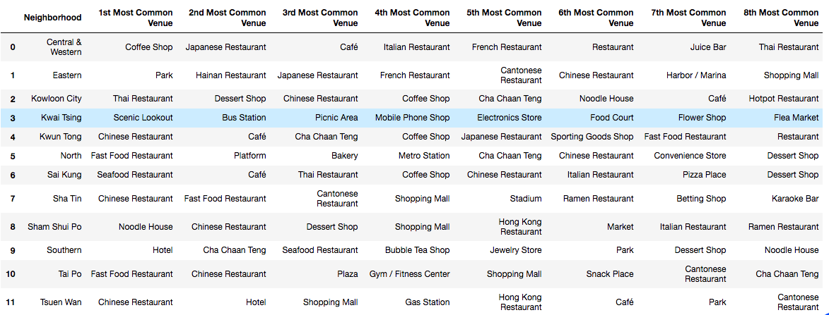
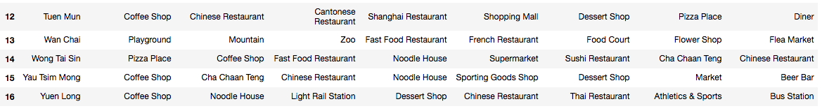
Top 8 common venues by district

Slide 5
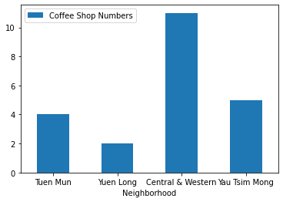
number of coffee shops in the four district of interest

Slide 6
Conclusion
People from Central and Western, Yau Tsim Mong, Yuen Long and Tuen Mun likes coffee shops the best
Central and Western is the district with highest income and it is a commercial district
Yuen Long and Tuen Mun are household districts where commercial buildings are less
Coffee shops in these districts have different target customers
People who would like to open a coffee shop should decide what kind of coffee shop to open first
If he wants a higher-class coffee shop, Central and Western is a good choice
If he wants a down-to-earth one, Yuen Long maybe a better choice since it has fewer number of coffee shops than Tuen Mun

