Slide 1
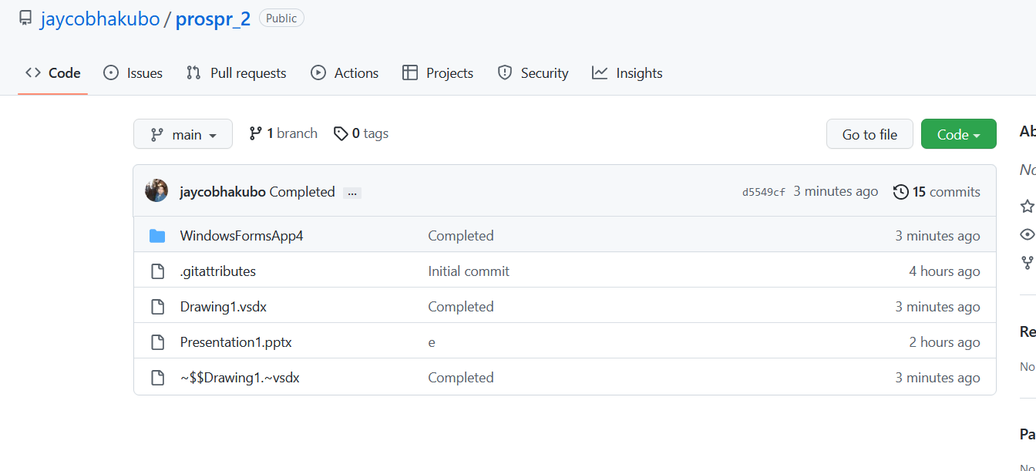
CLICK CODE

Slide 2
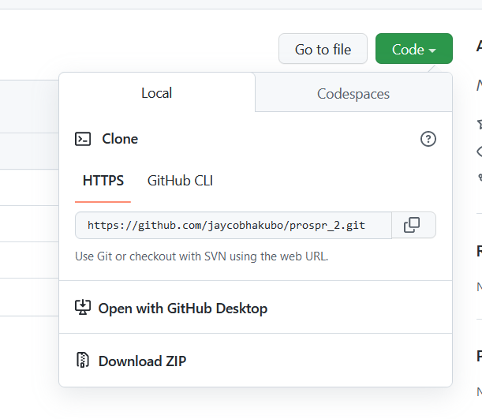
CLICK DOWNLOAD

Slide 3
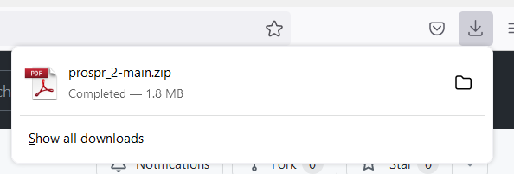

Slide 4
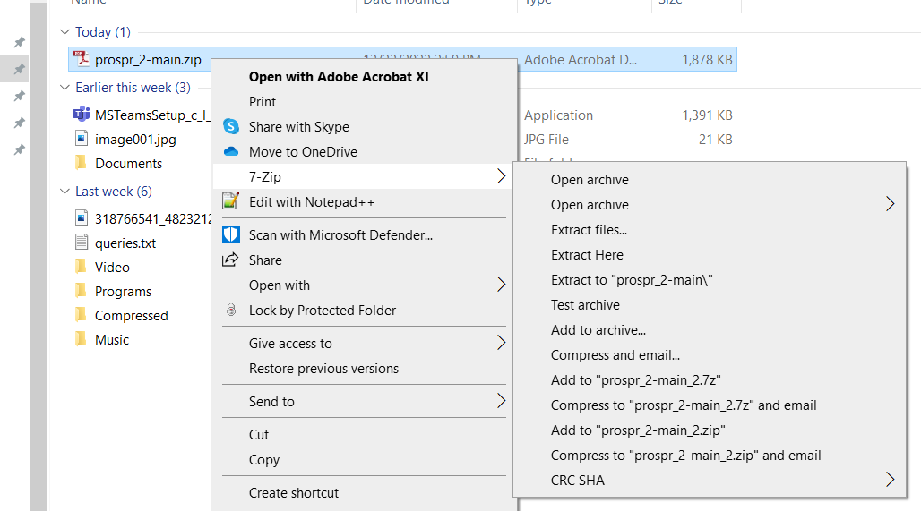

Slide 5
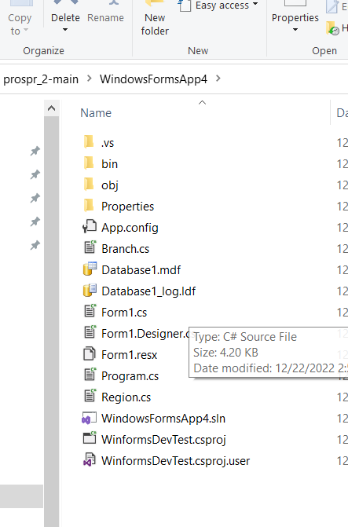
FIND THE DOWNLOADED FiLE THENUNZIP

