Slide 2
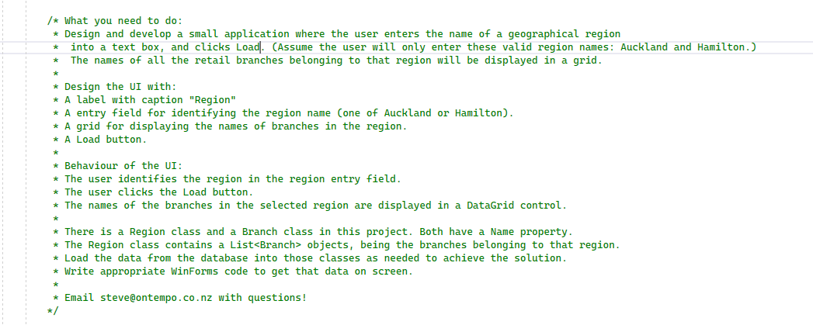

Slide 3
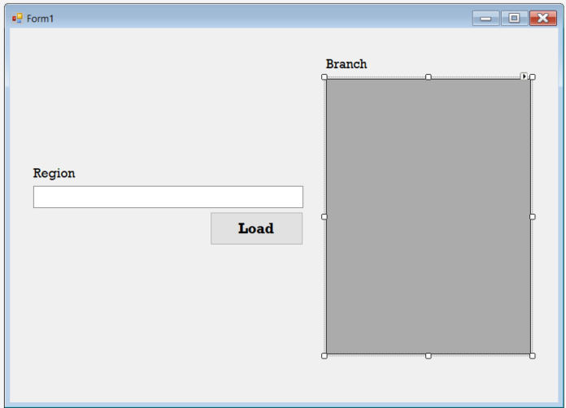
Create User Interface
A label with caption "Region"
A entry field for identifying the region name (one of Auckland or Hamilton).
A grid for displaying the names of branches in the region.
A Load button.

Slide 4


Add our member variable

Slide 5
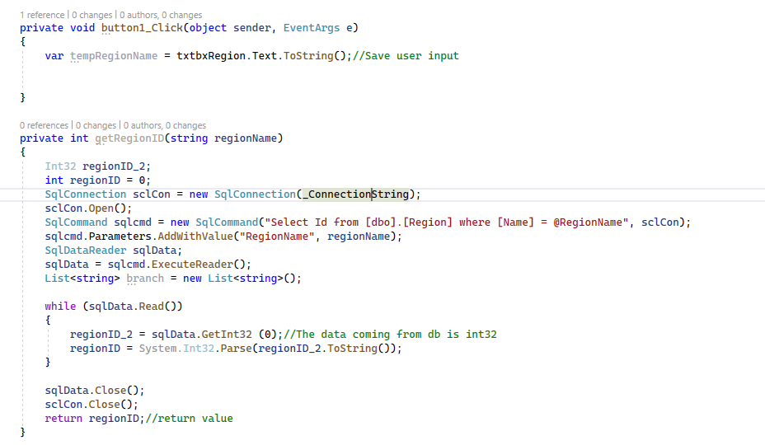
Load click event
Save user input region into a temp variable.
Get the regionID of the region from db.

Slide 8
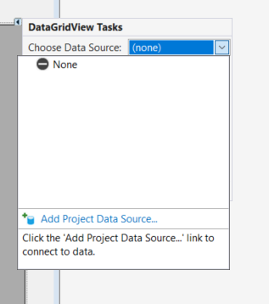

Slide 9
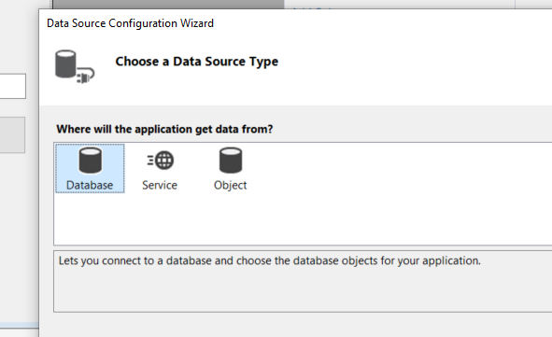

Slide 10
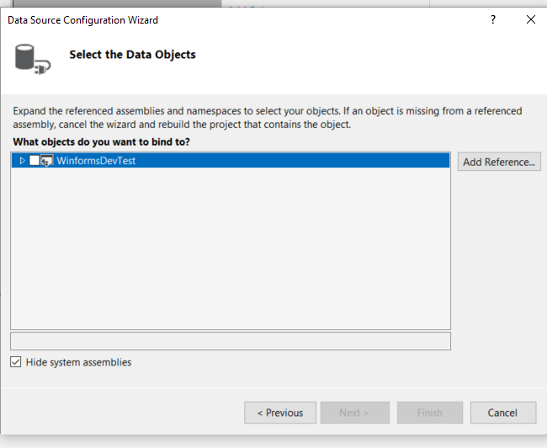

Slide 11
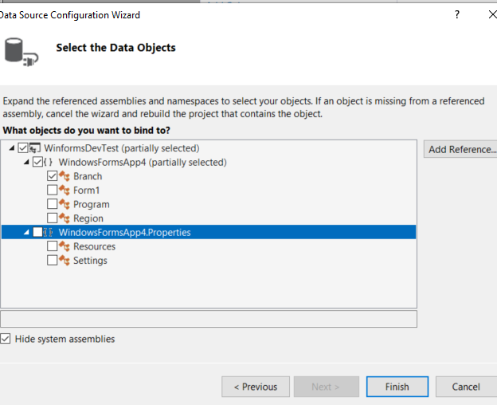

Slide 12
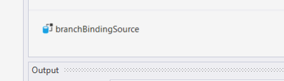

Slide 14
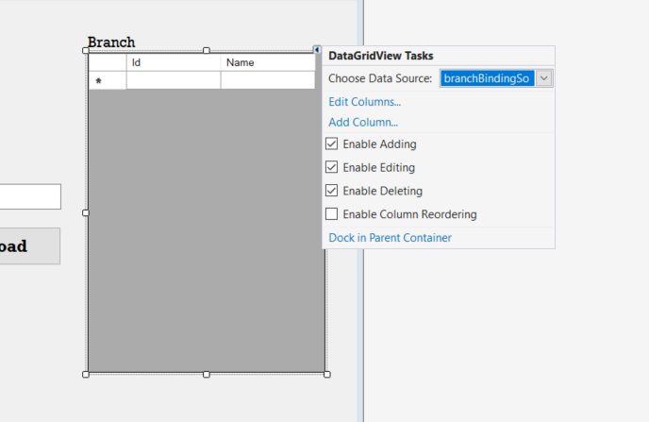

Slide 15
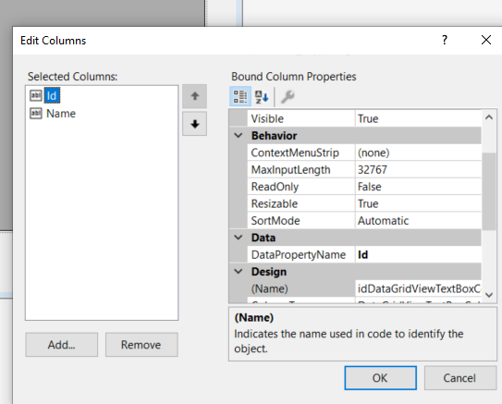

Slide 16
