Slide 1
Intro to Computer Science
Spring 2017
Notes:
Design, testing, and debugging techniques (often skipped in introductory courses)
Reading and modifying familiar and unfamiliar code
Create a College Board account here (requires AI, DI, or CEEB code):
CEEB=481173
https://account.collegeboard.org/login/login?pfIdp=PROFA&appId=120&DURL=https%3A%2F%2Faccount.collegeboard.org%2Fprofessional%2FverifyTST%3Ftype%3DviewProfile%26DURL%3Dhttps%3A%2F%2Faccount.collegeboard.org%2Fprofessional%2Fdashboard
Instructor links for CS:A
Two-page Course Overview
https://secure-media.collegeboard.org/digitalServices/pdf/ap/ap-course-overviews/ap-computer-science-a-course-overview.pdf
FAQ
http://apcentral.collegeboard.com/apc/public/courses/teachers_corner/224718.html
Teacher's Guide
http://apcentral.collegeboard.com/apc/members/repository/ap07_compsci_teachersguide.pdf
Instructor links for CS:P
Course and Exam Description for AP Computer Science Principles: Including the Curriculum Framework (Fall 2016)
https://secure-media.collegeboard.org/digitalServices/pdf/ap/ap-computer-science-principles-course-and-exam-description.pdf
AP CSP Course Home Page
http://apcentral.collegeboard.com/apc/public/courses/teachers_corner/231724.html
AP CSP Exam Page
http://apcentral.collegeboard.com/apc/public/exam/exam_information/231726.html
About the AP Digital Portfolio
http://apcentral.collegeboard.com/apc/members/exam/exam_information/227536.html
AP Central CSP Site for Coordinators
http://apcentral.collegeboard.com/apc/public/ap_coordinators/exams_special_preparation/232559.html
Introducing AP Computer Science Principles
https://apstudent.collegeboard.org/apcourse/ap-computer-science-principles/create-the-future-with-ap-csp
AP Course Audit
http://www.collegeboard.com/html/apcourseaudit/courses/ap_computer_science_principles.html
Providers of CSP Curricula and Pedagogical Support
https://advancesinap.collegeboard.org/stem/computer-science-principles/curricula-pedagogical-support
Recruitment Strategies for AP CSP
https://advancesinap.collegeboard.org/stem/computer-science-principles/recruitment-strategies

Slide 2
A Brief History of Computer Science
Very
^

Slide 3
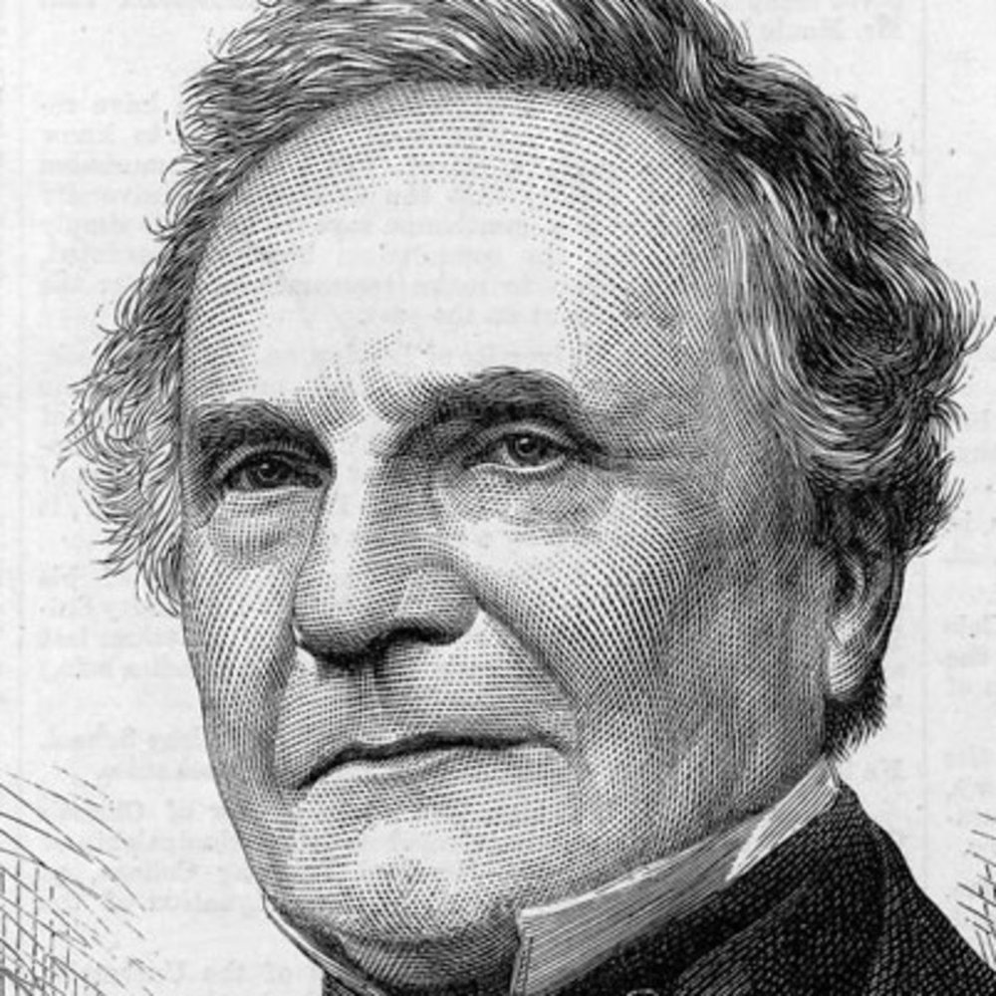
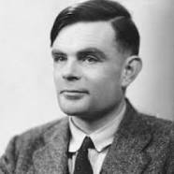
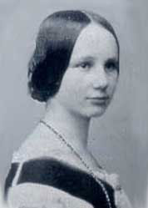
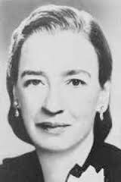
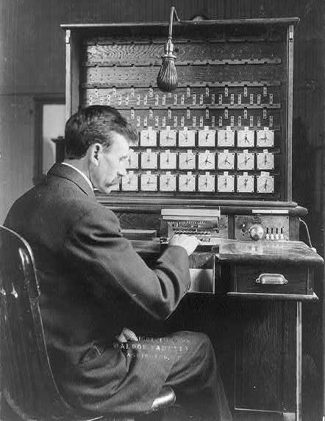
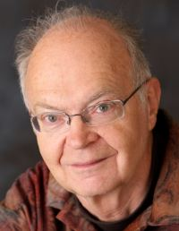
Some dramatis personae of (classical) computer science
Charles Babbage (1791-1871) is considered the "father of computing" for originating the notion of the programmable computer. His designs were costly, and not practical for the era in which he lived.
Alan Turing (1912-1954) is considered the "father of theoretical computer science and artificial intelligence". He laid the groundwork for the modern understanding of computer design, algorithm analysis.
Augusta Ada King-Noel, Countess of Lovelace (née Byron) (1815-1852), often called the "first programmer".
"The Analytical Engine weaves algebraic patterns just as the Jacquard loom weaves flowers and leaves."
- 1843
Grace Hopper (1906-1992) wrote the first compiler (for the programming language COBOL). She was in the U.S. Navy, and reached the rank of Rear Admiral.
Herman Hollerith (1860-1929), in preparation for the 1890 U.S. Census, invented electronic tabulators and punch cards, then founded the Tabulating Machine Company, which later became International Business Machines (IBM).
Donald Knuth (b. 1938) is a prolific computer science author and lecturer, and is in the process of writing the multi-volume tome The Art of Computer Science.

Slide 4
A Brief Family Tree of Some Programming Languages
Python
Nimrod
Perl
Ruby
Scala
Kotlin
Jython
C
C++
Java
Processing
D
C#
Rust
ML
OCaml
F#
Haskell
←← Lisp
Emacs Lisp
Clojure
Smalltalk
Self
JavaScript
Dart
SQL
TypeScript
1970s 1980s 1990s 2000s 2010s
Dart
Notes:
Other recent programming languages:
* 2007: Go (created at Google)
* 2009: node.js
* 2014: Swift (created at Apple)

Slide 5
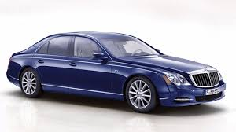
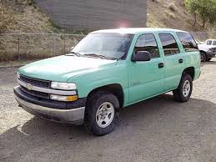
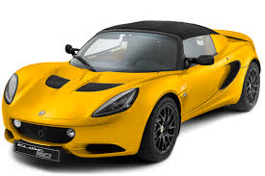
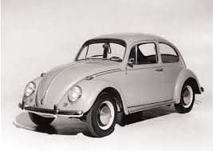
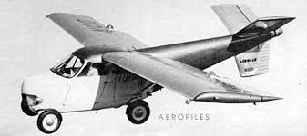
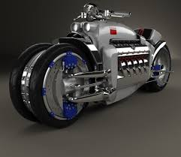
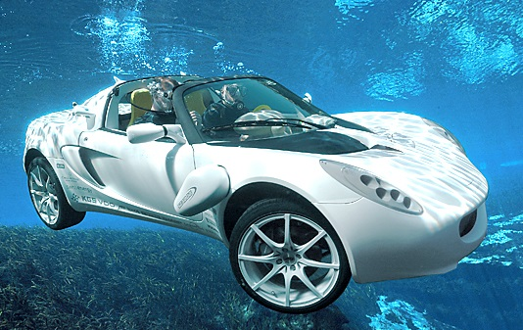


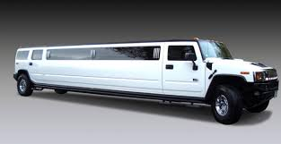
Why so many programming languages?!
Though there are many specialized areas of software development (operating systems, games, graphics, high performance, etc.), they're all pretty much alike—with functions, operators, classes, etc.—right?
Not quite.
Some programming languages out there are very, very different from Python and Java.

Slide 6
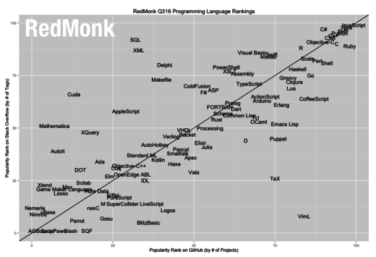
RedMonk Q316 Programming Language Rankings
JavaScript
Java
PHP
Python
C++
CSS
JavaScript, PHP, and CSS appear here because of their use in web pages.
Java, Python, and C++ are so-called "general purpose programming languages".
Many of the others are specific to a given "domain":
SQL for database work
R for data analysis
Lua for game development
VHDL for circuit design
TeX for typesetting
SuperCollider for music
synthesis

Slide 7
The foundations of our software
Where our code lives:
Applications
Web servers
Software libraries
Test & debugging code
etc.
Python/Java code
Compiler and bytecode
Operating system
Low-level code (e.g., C, assembly)
Assembly
CPU instruction set
Computer hardware
CPU and its components
Hardware libraries
Boolean algebra
Transistor logic
Circuit theory
Electrical physics
Electrodynamics
Quantum mechanics
Grace Hopper
territory
Charles Babbage territory.
Includes memory and I/O.
Named after George Boole (1815-1864)
Transistors invented in 1947
Stuff we mostly
ignore, because we can … except
when we can’t

Slide 8
What is computer science?
The term "computer science" as used today often includes three separate areas:
1. Classical computer science # The study of algorithmic processes that describe and transform information.
2. Software engineering # The software life cycle: getting stuff done with software. (Our primary focus.)
3. Hardware engineering # CPU/GPU design, memory, disk drives, network connections, routers, etc.
4. Sociology of trends in computer use (e.g., digital citizenship)
Software engineering can include collecting requirements, writing, testing, debugging, deploying, etc.
(The term "programming" is sometimes applied more narrowly to only the writing of the software.)
Trend: Desktop programs → Mobile apps and cloud computing.
Trend: Program ability limited to the knowledge of subject matter experts → Machine learning.
Trend: Working with small, well-understood components → Modifying large, partially understood components.
Notes:
Classical computer science is also called "informatics" in some countries and languages.
Why MIT stopped teaching SICP: http://lambda-the-ultimate.org/node/5335
This post also includes a useful list of what one reader thought should be considered fundamental.
Bottom-up Computer Science
https://www.bottomupcs.com/

Slide 9


The bumpy terrain of software or: if you're stuck, get help (also: testing is a good thing)
The dream: Software is written by typing at full speed. Bugs are rare anomalies. It’s basically smooth sailing all the way.
The reality: Software can be complicated. The interplay of complex requirements, arcane language features, and implementation quirks can lead to subtle problems that can be hard to find and costly to fix. Or they can even lie hidden for ages.

Slide 10
We have a Mars problem
Software in your phone is not only extensively tested before it's shipped, but tested in use by millions of users after shipment.
Some software is embedded in single-use devices, or devices that cannot be easily reached after deployment. Such as the U.S.'s Mars Climate Orbiter, which crashed into the surface of Mars in 1999. One software component expected metric units, while another produced units in English units (foot-pound-seconds).
Minimum safe altitude: 80 km. Actual altitude on disintegration: 57 km. Boom.
And then, in November of 2016, the ESA's Schiaparelli lander released its parachute when it was still two miles above the surface of Mars. This might have been due to a sensor malfunction, or a software bug. An investigation is underway.
Landing speed: 185mph (300kph). Boom.
Moral of the story: Software is difficult to get right. Some is even more difficult.
Notes:
Schiaparelli lander:
http://gizmodo.com/a-crazy-miscalculation-doomed-the-sciaparelli-lander-1789319670
Could also mention the 500-mile email (https://www.ibiblio.org/harris/500milemail.html). A consultant had upgraded the version of SunOS used by the statistics department and, in doing so "downgraded" Sendmail, so Sendmail could not read the newer, long configuration options. The changed the SMPT timeout to zero or, in practice, about 3 milliseconds. (Network was 100% switched and on fiber (2/3*c), so negligible router delay.)
How the 2016-12 leap second brought down Cloudflare DNS:
https://blog.cloudflare.com/how-and-why-the-leap-second-affected-cloudflare-dns/
Compilers can optimize out erasure of data that is no longer used (e.g., memset in the Tor anonymity network):
https://cryptocoding.net/index.php/Coding_rules#Prevent_compiler_interference_with_security-critical_operations

Slide 11
Extra Slides

Slide 12
Additional Resources
Learn Python the Hard Way
https://learnpythonthehardway.org/book/
Names are important
https://andidog.de/blog/2016-11-14-names-are-important-improving-use-of-terms-in-software-engineering
Types are shapes
https://stevekrouse.com/types-are-shapes-d6af1e83192f#.pxe1a5n29
Splines
https://www.reddit.com/r/computergraphics/comments/5g0sp6/there_are_so_many_kinds_of_spline_curves_out/
Machine Learning Isn't Data Science
http://www.iamwire.com/2016/12/machine-learning-isnt-data-science/146736
12 Algorithms Every Data Scientist Should Know
http://www.datasciencecentral.com/profiles/blogs/12-algorithms-every-data-scientist-should-know

Slide 13
Additional Resources
Algorithms, by Jeff Erickson
http://www.cs.illinois.edu/~jeffe/teaching/algorithms
“You are welcome to use any subset of this material in your own classes without asking my permission, but please give me proper credit and please include a link to this web page (http://www.cs.illinois.edu/~jeffe/teaching/algorithms) for the most recent revision.
Cognitive biases that affect decisions:
http://www.businessinsider.com.au/cognitive-biases-that-affect-decisions-2015-8
A beginner's guide to ACID and database transactions
https://vladmihalcea.com/2014/01/05/a-beginners-guide-to-acid-and-database-transactions/
Blown to Bits: Your Life, Liberty, and Happiness After the Digital Explosion
http://www.bitsbook.com/wp-content/uploads/2008/12/B2B_3.pdf
Up and Down the Ladder of Abstraction
http://worrydream.com/LadderOfAbstraction/
Eric Lippert on types:
https://blogs.msdn.microsoft.com/ericlippert/2011/09/07/what-is-this-thing-you-call-a-type-part-two/

