Slide 1
Metropolitan Convention Center
Event Registration Application
Sam Brinker & Jayda Schmidt

Slide 2
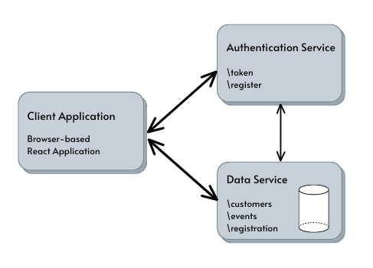
Application Design:
ReactJS Client Application
Authentication Service
Data Service (HyperSQL DB)
Application Internal Functionality:
Client application utilizes JWT tokens provided by authentication service for attendee login & HSQLDB API interactions
Attendee authentication will be verified by authentication service and HSQLDB
Attendee registration/account creation will be completed by authentication service and HSQLDB API

