Slide 1





Axis Max Life Insurance
Smart Term Plan Plus
1
Confidential; Not for external circulation

Slide 2



Branding
Eligibility Criteria
Boundary conditions
Claim Assurance Certificate
Lowest Premium Guaranteed
SA payout to nominee
Claim Intimation
Cover continuous
Riders
Additional benefits
Health management services
Tax Benefit
Terms and conditions
USP’s

Slide 3


Insurer Branding
3rd Largest Private Bank in India
Started in 1994, Axis-Max has 269 Branches in India
Claim Settlement Ratio: 99.7%
Solvency Ratio: 2.01
Death Claim Amount Paid in FY 23-24: 1254 Crores INR
Axis Bank is Promoter and Largest Shareholder in Axis Max Life Insurance
3

Slide 4





Axis Max Branding
99% claims paid ratio for last 5 years
#1 on claims paid ratio for last 5 years
4
Confidential; Not for external circulation

Slide 5
Eligibility Criteria
Parameters | Descriptions (Subject to revision as per insurer guidelines)
Entry Age | For Regular Pay, Single Pay & Limited Pay 5, 7, 10, 12, 15yrs 18 to 60yrs
Policy Term (PT) | Minimum: 10yrs Maximum Maturity Age - Entry Age
Maximum Age at Maturity | 85yrs
Premium Payment Term (PPT) | Regular Limited: Pay for first 5, 7, 10, 12, 15 & Pay till 60yrs of age Single
Premium Payment Frequency (PPF) | Monthly, Quarterly, Half yearly & yearly

Slide 6
Boundary Conditions: Annual Income & Education
Occupation | Education | Income | Sum Assured
Salaried (Age 18 TO 35 yrs) | Graduate | 3L | 50L
Salaried & Self-employed | 12th Pass | 5L | HLV

Slide 7






Riders
1. Accidental Death Benefit
3. Accidental Disability
3. Critical Illness
Terminal Illness

Slide 8






Riders
Additional Riders | Available | Inbuilt, Free | Optional, Paid
Accidental Death Benefit | Yes
Accidental Total Permanent Disability | Yes
Critical Illness | Yes
Accelerated Critical Illness | No
Terminal Illness | Yes
Waiver of Premium | Yes
Hospicare Benefit | No
Parent Income Protect | No

Slide 9

Accidental Death Benefit & Dismemberment: (Optional, Paid)
During the policy term, 100 % of the rider sum assured will be paid in case you meet with an accident, leading to dismemberment or death.
Condition: Policy holder dies on the spot of accident or within 180 days from the date of accident
Additional payout on death or dismemberment due to an accident
Provides comprehensive coverage for accidental injuries, including death and dismemberment
It offers payouts for various levels of dismemberment, whether partial or total offering the required financial support for medical treatments and lifestyle adjustments
Base life cover also gets paid out in case of death
Payout: Rider SA is over & above Base SA Note: Rider SA cannot be more than Base SA

Slide 10

Rider 2
Accidental Total Permanent Disability: (Optional, Paid)
In case of Total and Permanent Disability due to accident & Sickness or disease, 100% of Rider SA will be paid to the Policyholder and the Policy will continue.
Condition:
If the body is permanently disabled. or is unable to use/loss of one eye & one arm or one eye & one leg or one leg & one arm or both eyes or both legs or both arms.
And disability should permanent for 180 Days.
This rider is visible only when maturity age is selected up to 75 yrs.
Payout: Rider SA over and above from Base SA. Note: Rider SA cannot be more than Base SA.

Slide 11

Rider 3
Critical Illness Rider: (Optional, Paid)
Critical illness rider is an additional coverage that can be added to the insurance policy in exchange of additional premium. Under critical illness rider a lump sum amount is provided to the family of the life assured in case the life assured is diagnosed with a listed critical illness during the policy tenure.
Critical illness rider is available in 2 variants:
Gold Variant : Total 22 diseases are covered which includes 1 minor disease.
Platinum Variant : Total 64 diseases are covered which includes 5 minor disease.
If a customer gets diagnosed with any minor disease covered in any variant (Gold/Platinum) 25% of rider SA or Rs 5 Lakh lower of both will be paid.
If a customer gets diagnosed with any major disease covered in any variant (Gold/Platinum) 100% of rider SA minus minor disease claim paid (If any) will be paid.

Slide 12

Rider 3
Critical Illness Rider: (Optional, Paid)
Conditions:
Max CI is available with PT = 20 yrs
In case of Max life critical illness rider, company provides premium guarantee which means there will be no change in premium of critical illness rider for the next 10 yrs.
In case if a customer purchases policy with Max Life CI gold variant rider along with disability rider, the rider name will be changed to Gold Plus variant.
Critical Illness Benefit for Angioplasty is subject to a maximum of 5 Lac. On payment of Angioplasty, if the Critical Illness Benefit is more than 5 Lac, the policy will continue for other Critical Illness with CI Benefit reduced by Angioplasty payout. The future premiums payable for the residual CI Benefit will reduce proportionately.

Slide 13

Rider 3
Critical Illness Rider: (Optional, Paid)
Case 2 - In case if a customer purchases policy with Max Life CI platinum variant rider along with disability rider the rider name will be changed to Platinum Plus variant.
Conditions:
Waiting Period:
Minor Disease - 180 days
Major Disease - 90 days
Survival Period: 14 days
Payout: Rider SA will be given over and above base SA

Slide 14

Rider 4
Terminal Illness: (Inbuilt, Free)
If any 2 Indian Medical Association (IMA) certified doctors declare that the policyholder will die in the coming 180 days (6 months) because of any disease, Terminal Illness Rider will provide the Basic SA of Term Plan to the insured/nominee before the death, and the plan will be terminated.
Payout: 100% Base SA Subject to 1CR
Note: Doctor should not belong to policy holder’s family. AIDS/HIV is not covered.

Slide 15

Rider 5
Waiver of Premium on Accidental Total Permanent Disability & or 11 Critical Illnesses: (Optional, Paid)
Waiver of all future premium, in case of Disability (Loss of 2 limbs or sight of both the eyes or disability permanent for min 180 days) or diagnosis of Critical Illness (listed 11 Critical Illnesses).
Conditions for WOP on CI: Waiting period - 90 days Survival period - 30 days
Payout: None
Available only in limited pay option.

Slide 16

SA Payout to Nominee
Options | Payout
Lumpsum | 100% Sum Assured on Demise

Slide 17




Additional Benefits

Slide 18

Additional Benefit
Additional Benefit | Available | Inbuilt, Free | Optional, Paid
Full refund of premium | Yes
Housewife | Yes
Life stage benefit | No
Voluntary Top up | No
Claim Intimation | Yes
Discount on Premium | Yes
Cover continuous benefit | Yes
1
8

Slide 19

Full Refund of Premium
“Sir , with this benefit , you can protect your family & also Exit the policy or end the policy if your all responsibility has been over and get your Paid Premiums Back ( without the GST & Loading Premiums).
This implies that the plan served the purpose when you needed it for Family Protection . And when you don’t need it anymore, you can exit it by getting your paid premium back, making it a Full Refund Premium Plan”
19

Slide 20

Full Refund of Premium
Conditions:-
Min PT:- 40 years
Customer can not exit in First 29yrs & Last 4yrs
Exit Any policy year starting 30th policy year
policybazaar.com
20

Slide 21

Cover Continuance Benefit
2
1

Slide 22
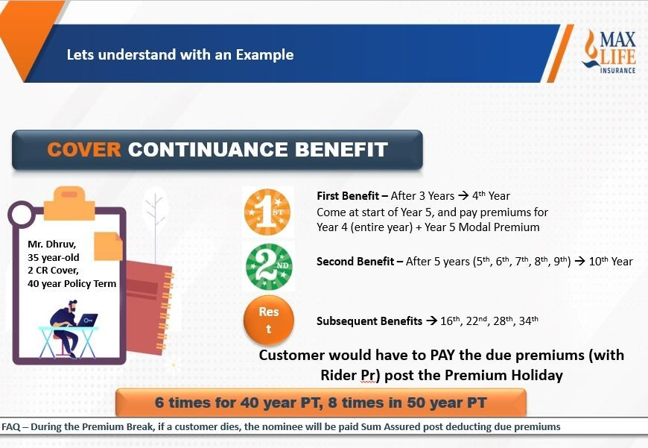
policybazaar.com
22

Slide 23

Insta Claim Payout
2 Lacs Immediate payout on Claim intimation
2 lacs for SA >= 1 cr.
1 lacs for SA >= 50 lacs & <1 cr. 25k for SA < 50 lacs
2 Lacs paid within 1 working day upon intimation of death (out of the base sum assured)
Activated after a waiting period of 1 year
Documents Needed
2
3

Slide 24

Additional Benefit
Housewife cover
2
4

Slide 25
Additional Benefits
Min SA for HW | Max SA for HW | Max SA for HW (Dependent on husband's SA) | Husband needs to have an existing Term Plan, from any insurer | Husband's Education
25L | 1CR | No | No | Graduate
Housewife's Education [Proof not needed at issuance] | Husband's Minimum Annual Income | PAN & Aadhar Card Card of HW | Tax Benefits under Sec 80 C | Rider
Graduate | 5L - Sal/SE (Upto 50L) & 10L - Sal/SE(More Than 50 to 1cr) with income proof | Mandatory | Either Husband or Wife | TI, ADB & WOP
2
5

Slide 26





Smart Cover option
New Parents – Higher Liabilities
Next 10 – 15 Years are more Important
HOME Loan
Offer EXTRA Cover for Important Phase of Life
YOUNG Parents
Launching Smart Cover -- Get 50% extra cover for just 15% - 20% extra cost
2
6

Slide 27




Lifeline Plus
Currently you share Income & Liabilities with your Husband
In unfortunate event (death of Husband) – All comes on you..
Women Cover – Sold as Rider
In unfortunate event -- You Get 1 Cr
For Ma'am, she would have an option to increase the Sum Assured by 50%
For you Ma'am, you would have an option to increase the Sum Assured
(upto 50 Lacs) at current product rates
by 50% (upto 50 Lacs) at current
product rates
Premium increase □ 8% per Yr After 5 Years □ 40%...
But you get extra Sum Assured at TODAY’s Rates
Get -- Upto 50% Sum Assured (upto 50 Lacs) @ No FINANCIALS, only Medicals
Exclusive Benefit for Female
* Rates calculated basis the age at that time
Life Insured
2
7

Slide 28
Additional Benefit 5
Discount on Premium:
Discount Parameters | Salaried | Self Employed
On 1st Year Premium | 15% | NA
2
8

Slide 29

Sum Assured Booster
Flexibility to Enhance Coverage!
The Sum Assured Booster (SAB) lets you increase your coverage without changing your premium
BONUS Sum Assured
2% (Regular Pay)
3% (Limited Pay)
How It Works
Choose between:
OR
A First-Year Discount
Increase your Base Sum Assured with the Sum Assured Booster.

Slide 30


Quick Guide to Sum Assured Booster
2% on Regular Pay
3% on Ltd. Pay
1 Cr
2 Lacs
1 Cr
3 Lacs
Regular Pay
Limited Pay
2 Cr
4 Lacs
2 Cr
6 Lacs
5 Cr
10 Lacs
5 Cr
15 Lacs
Additional Money taken for SA Booster is returned back in Double Premium Back
Bonus on your Sum Assured
15% for 1 Year == 0.4% for 40 year Policy Term
□ Against 0.4% Premium we get 2% / 3% higher Sum Assured
Let go of your First Year Discount of 15% and Get 2% / 3% additional Sum Assured for LIFETIME
i

Slide 31



