Slide 1


ANALYSIS IMDB DATASET
By Using of SQL

Slide 2
Data Summary
Movies Table
Primary Key: movie_id
Attributes: title, industry, release_year, imdb_rating, studio, language
Financials Table
Primary Key: movie_id
Attributes: budget, revenue, unit, currency
Actors Table
Primary Key: actor_id
Attributes: name, birth_year
Movie_actor Table
Primary Keys: movie_id, actor_id
Languages Table
Primary Key: language_id
Attributes: name

Slide 3
Key Field
Movies | Financials | Actors | Movie_actor | Languages
movie_id | movie_id | actor_id | movie_id | language_id
title | budget | name | actor_id | name
industry | revenue | birth_year
release_year | unit
imdb_ratting | currency
studio
language

Slide 4
Entity Relationship Diagram
Movies (movie_id) ───< Financials (movie_id)
│
├───────< Movie_actor (movie_id, actor_id) >─────── Actors (actor_id)
│
└───────< Languages (language_id)
Key Relationships
Movies to Financials: one-to-one
Movies to Actors: many-to-many (via Movie_actor)
Movies to Languages: one-to-one

Slide 5
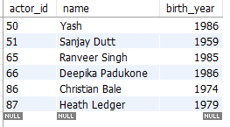
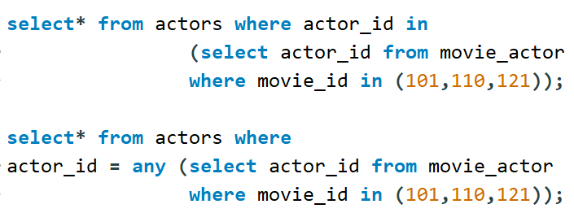
Key Insights
select actors who acted in any of this movie_id (101,110,121)

Slide 6
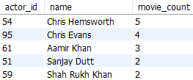
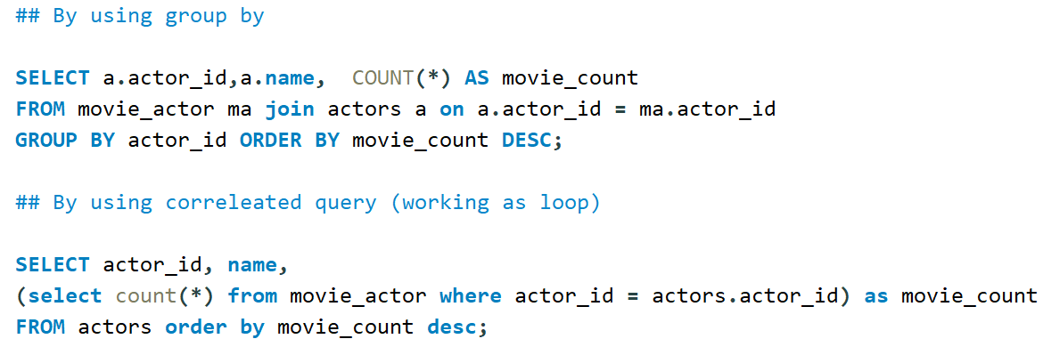
Key Insights
# select actor_id, actor_name and total number of movies they acted in their carrer

Slide 7
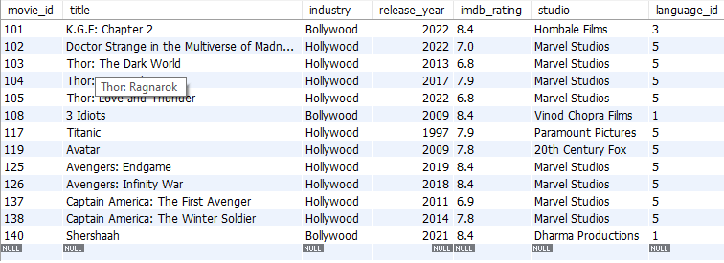
Key Insights
## select all movies with ratting is >than any marvel movies

Slide 8

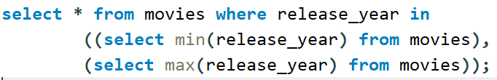
Key Insights
# Select all the movies with minimum and maximum release_year.

Slide 9
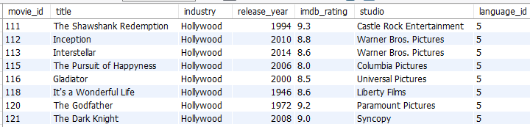
Key Insights
# # Select all the rows from the movies table whose imdb_rating is higher than the average rating

Slide 10
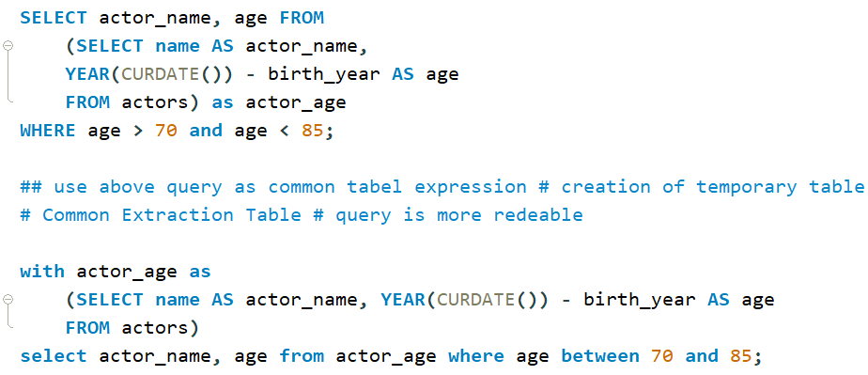
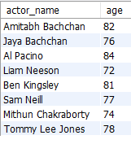
Key Insights
# # Getting all actors whose age is between 70 and 85

Slide 11

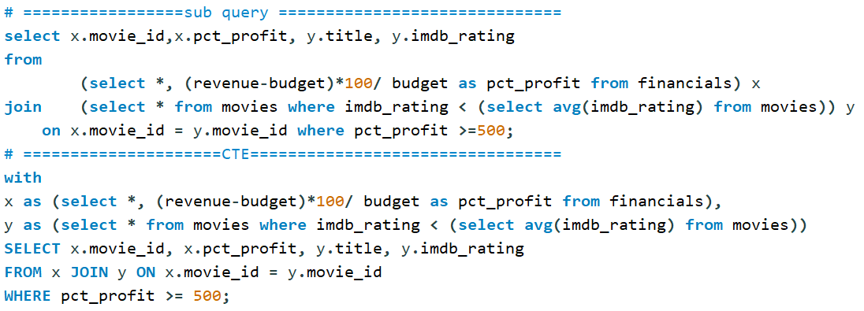
Key Insights
# # Movies that produce 500 % profit and their ratting was less than avg ratting from all movies

