Slide 1
Deep Q Learning for Trading
Jaydeep

Slide 2
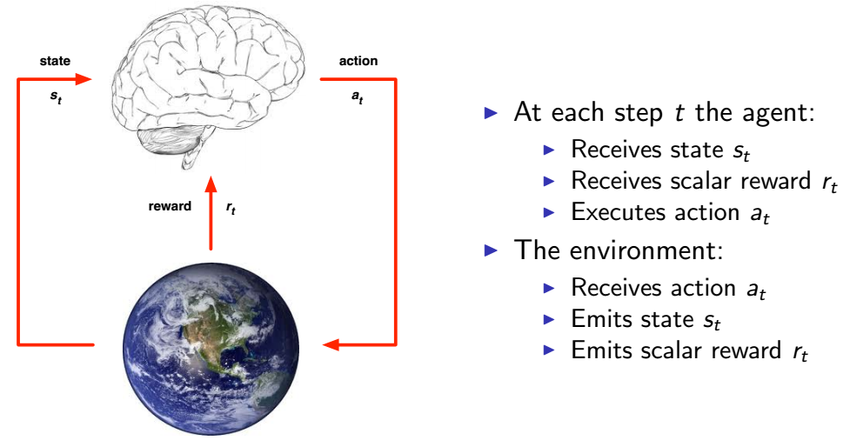
Reinforcement Learning : Agent and Environment

Slide 3
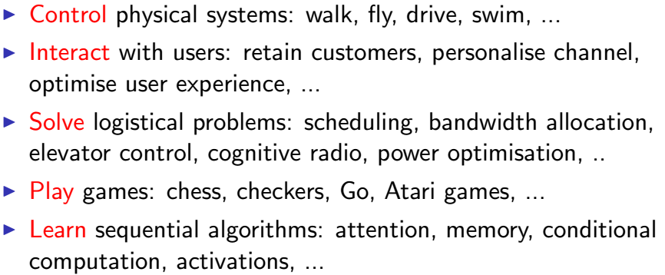
Examples of RL

Slide 4
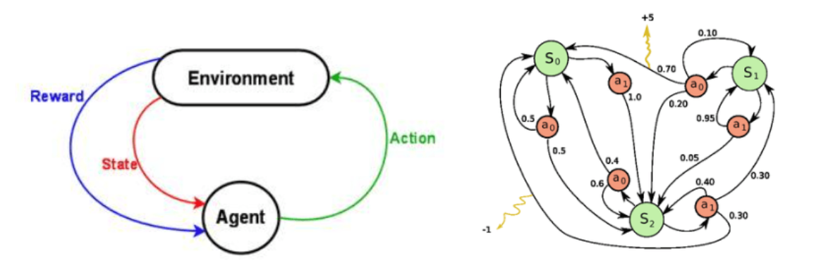
Markov Decision Process (MDP)

Slide 5

Discounted Future Reward

Slide 6


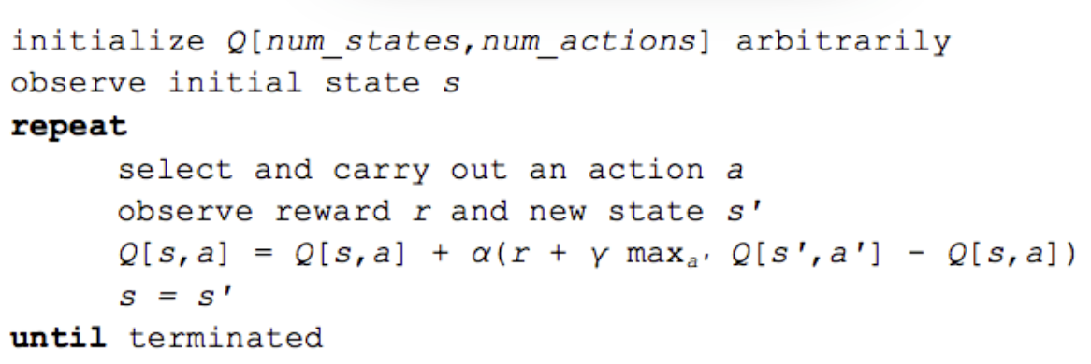
Q Learning
Bellman’s Equation :
Value Iteration :

Slide 7
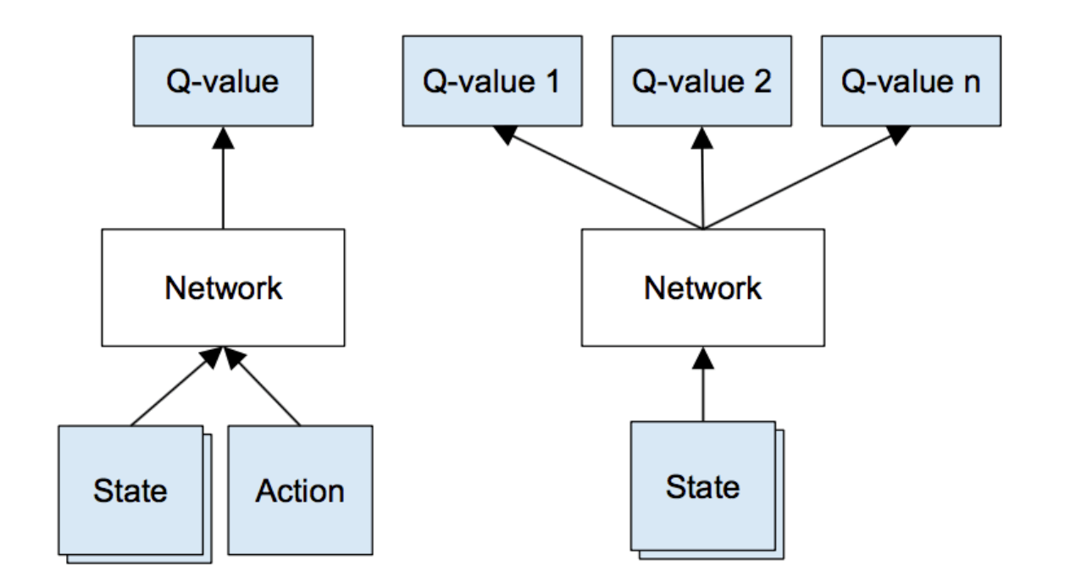
Deep Q Learning

Slide 8
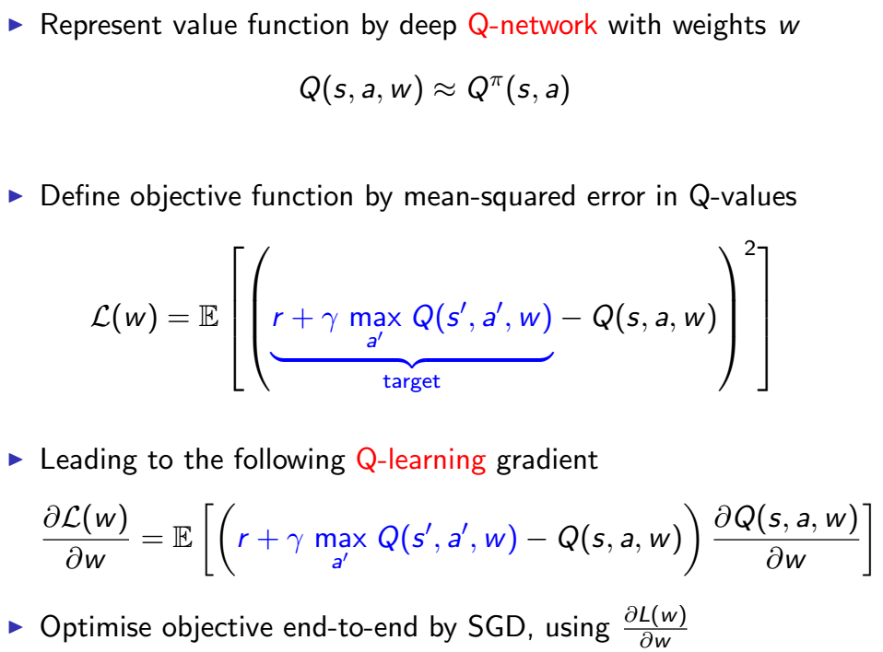
Deep Q Learning

Slide 9
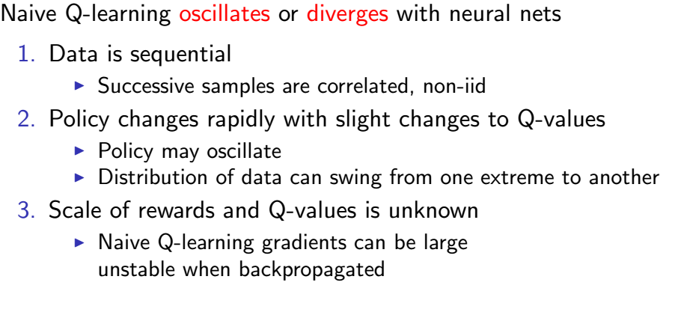
Stability Issues with Deep RL

Slide 10
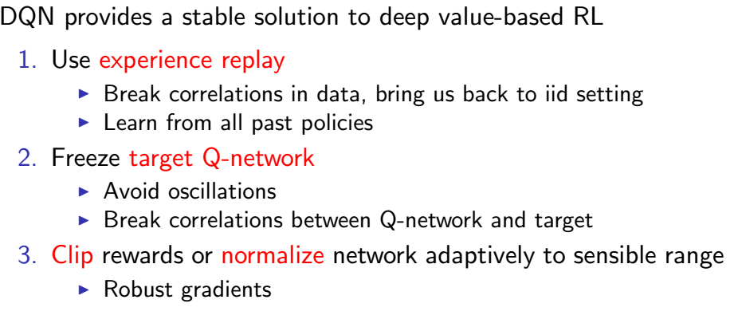
Solutions

Slide 11
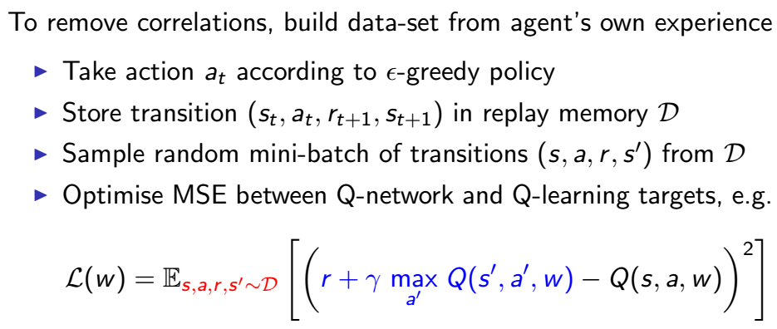
Stable Deep RL (1) : Experience Replay

Slide 12
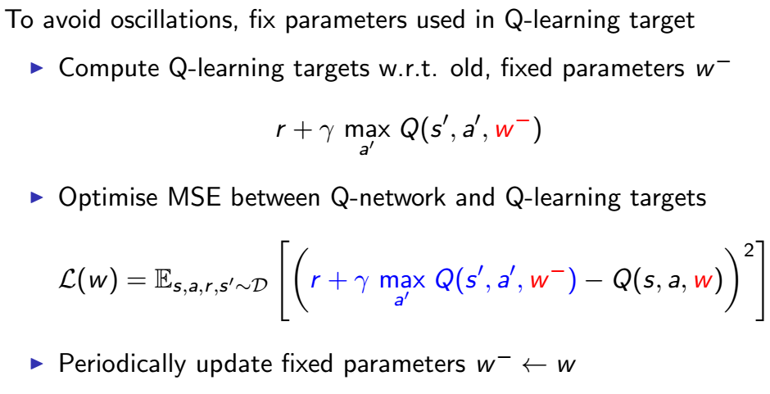
Stable Deep RL (2) : Fixed Target Q Network

Slide 13
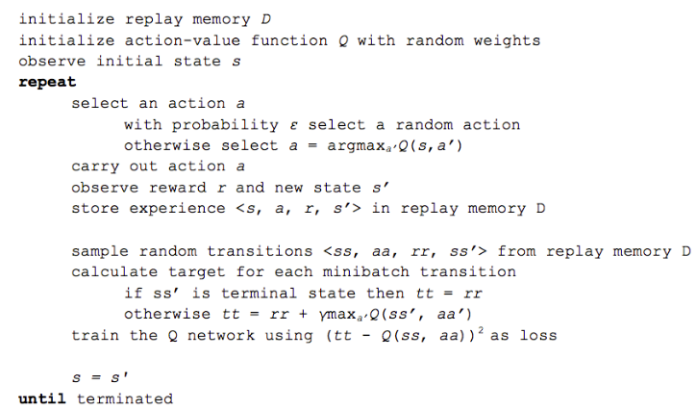
DQN Algorithm

Slide 14
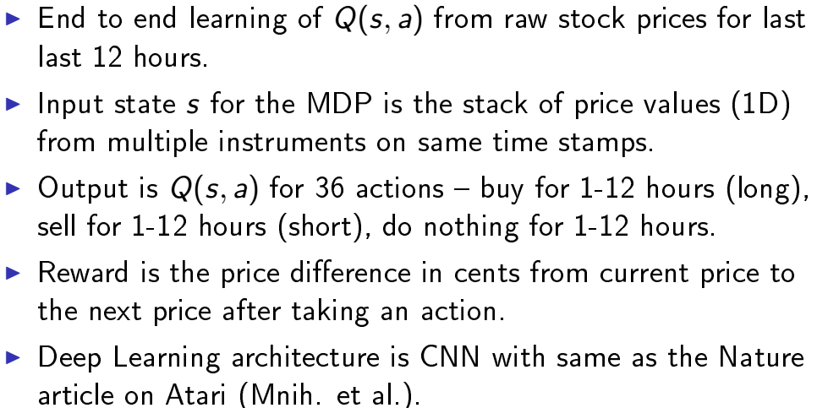
DQN for Trading

Slide 15
Code
https://github.com/jaydeepde/dqn_trading.git

Slide 16
Thank you.

