Slide 1



K. J. Somaiya Institute of Engineering & Information Technology, Mumbai
Department of Information Technology
Academic Year 2021-22
Smart News Summarization
Guided by Prof. Harsh Bhor
Hardi Patel(LY-IT-43)
Jaydeep Patel (LY-IT-44)
Mitali Patil (LY-IT-47)

Slide 2
Outline of Project
Introduction
Problem statement
Literature Survey
Summary
Proposed system
Software and Hardware requirement
System design
System implementation
Conclusion
References

Slide 3
Introduction
■ We tend to read multiple news articles on a daily basis but a certain news topic may not contain all the relevant information.
■ We can have an insightful information out of the comprehensive articles that will help us save a lot of time and energy.
■ Text summarization is a way of minimizing a textual document to a meaningful summary by preserving its information content and the overall meaning.
■ This system uses extractive based summary along with sentiment analysis and text classification
■ This will help us enhance the readability of a particular news article without missing any important points
■ The situation is worst for visually impaired people, the inability to read a text has a great impact on their life
■ So, we present a method for visually impaired people based on the sense of sound which is obviously better and more accurate than the sense of touch.

Slide 4
Problem Statement
Aim of the project is to build a system that will help us enhance the readability of a particular news article without missing any important point.
The System will have two major phases News Classification and News Summarization.
Our aim is to display every news article in form of Headline, Author ,Date of publication, Summary, Sentimental Analysis, News Classification and Finally in Audio Format.

Slide 5
Literature Review
The research paper [2] demonstrates and proves that the parts of the text that are present in the content and that repeat frequently have a high probability of being present on the summarized content or are the better terms to be present on the summarized content. This paper has coined the term weight on each content (which is the frequency count of that specific text in the content) that produces good results when kept in the summarized content.
The extractive-based summarization extracts the most important information from the original document. Extensive research on extraction-based summarization has been conducted in [3] developed a single document extractive text summarizer for Malayalam. They used a rank-based approach, assigning a score to each word in each sentence based on its importance, then selecting the top N-ranked sentences and generating a summary. The results are presented using the standard metric ROUGE. Using corpuses of news stories, Feng et al. created a single
document extractive text summarizer [4].

Slide 6
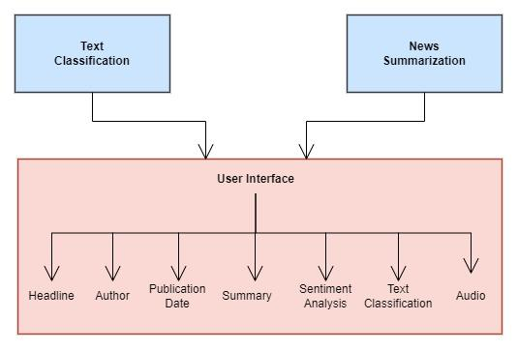
Summary

Slide 7
Proposed System
Aim of the project is to build a system that will help us enhance the readability of a particular news article without missing any important points.
For physically imparied people our system is very useful as it consists of audio files of summarized news article.
Part-1: News Summarization
Part-2: Sentimental Analysis
Part-3: Text Classification
Part-4: Converting generated summary to audio format

Slide 8
Software Requirement
Jupyter Notebook
Python and its libraries
numpy, pandas
matplotlib, seaborn
textblob
nltk
Scikit-learn
pygame and pyttsx3

Slide 9
System Design
Extractive Summarization
News Classification
1. Exploratory Data Analysis
2. Data cleaning and pre-processing
3. Model Building
4. Model Evaluation
News Summarization
1. Exploratory Data Analysis
2. Data cleaning and Data Pre-processing
3. Summarization

Slide 10
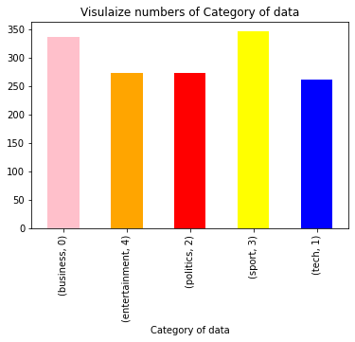
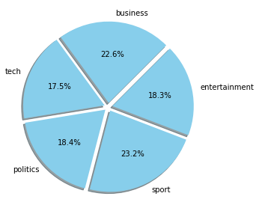
System Implementation
EDA For Text Classification

Slide 11

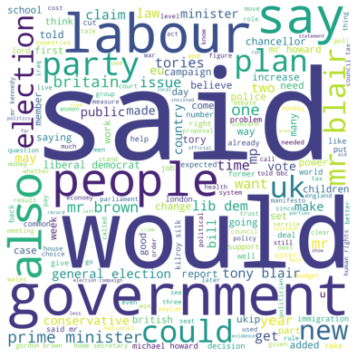

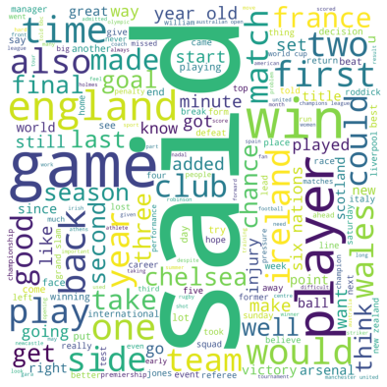
Word Cloud for technology
Word Cloud for sports
Word Cloud for business
Word Cloud for politics

Slide 12
Model Building
Logistic Regression
Random Forest
Multinomial Naive Bayes
Support Vector Classifier
Decision Tree Classifier
K Nearest Neighbour
Gaussian Naive Bayes

Slide 13
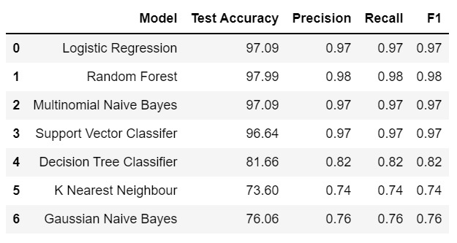
Model Evaluation

Slide 14
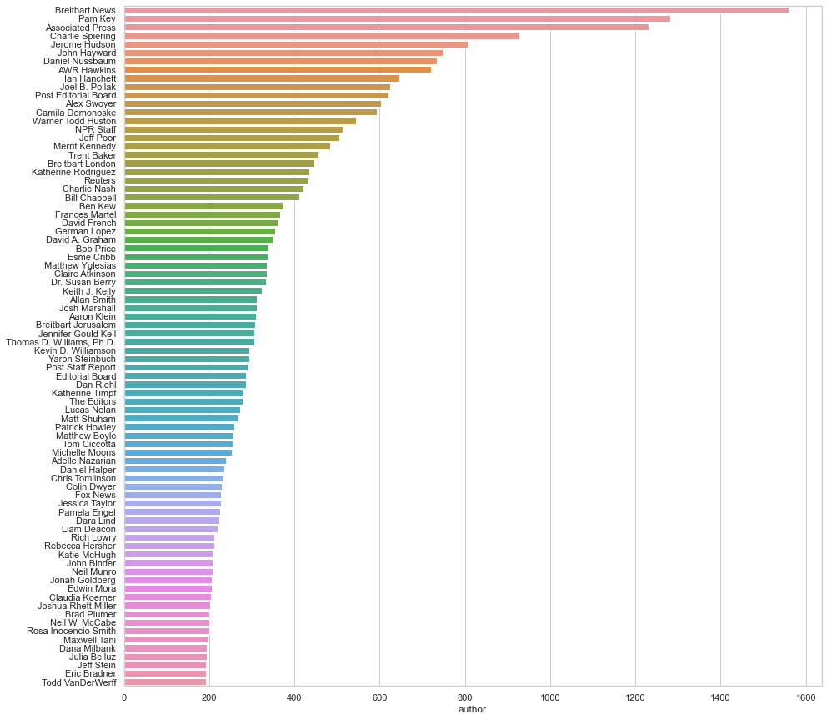
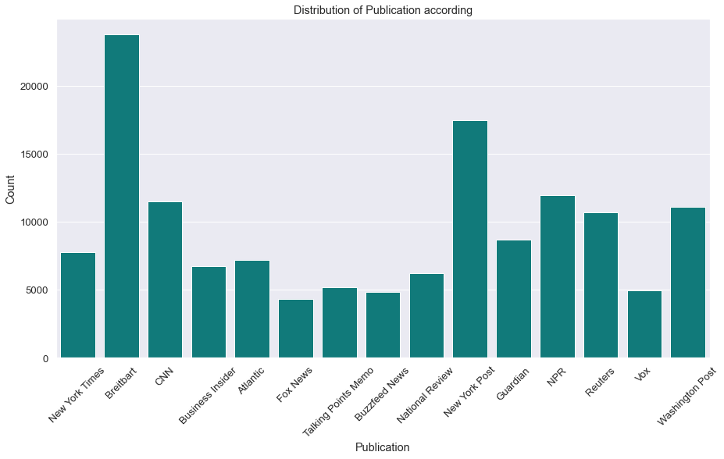
EDA for Summarization

Slide 15
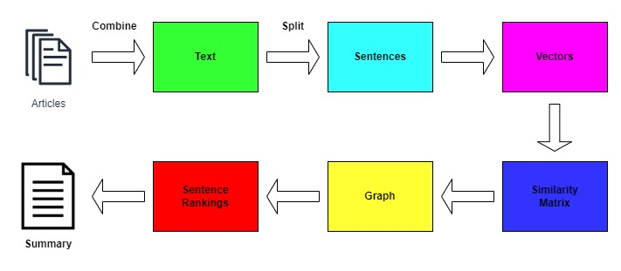
Text Rank Algorithim for Summarization

Slide 16
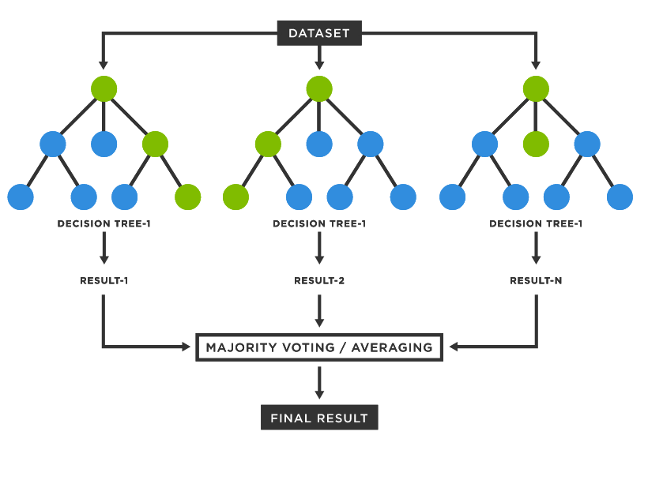
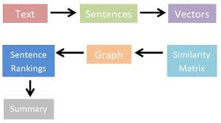
Algorithm Used
For Extractive News Summarization:
Text Rank
For Text Classification:
Random Forest

Slide 17



Slide 18
Conclusion
Successfully implemented Extraction-based Summarization with News Classification and Sentiment Analysis.
Generated summary provides only the important content from online news articles.
Sentiment Analysis provides the view of various news channels.
The model summarized content is finally converted to speech.
Algorithm used were Random forest for text classification and text rank for extractive summarization.

Slide 19
Reference
Babar, Samrat & Tech-Cse, M & Rit,. (2013). Text Summarization:An Overview.
Villatoro-Tello, E., Villaseñor-Pineda, L., Montes-y-Gómez, M.: UsingWord Sequences for Text Summarization. In: Sojka, P., Kopeček, I., Pala, K.(eds.) TSD 2006. LNCS (LNAI), vol. 4188, pp. 293–300. Springer,Heidelberg (2006)Mahajan, M.; Nimbhorkar, P.; Varadarajan, K. (2009). "The Planar kMeansProblem is NP-Hard". Lecture Notes in Computer Science 5431: 274–285
P. Krishnaprasad, A. Sooryanarayanan, and A. Ramanujan, "Malayalam text summarization: An extractive approach," 2016 International Conference on Next Generation Intelligent Systems (ICNGIS), Kottayam, 2016, pp. 1-4.
Feng Li, Yan Chen and Zhoujun Li, "Learning from the past: Improving news summarization with past news articles," 2015 International Conference on Asian Language Processing (IALP), Suzhou, 2015, pp. 140-143.

Slide 20
Thank You

