Slide 1


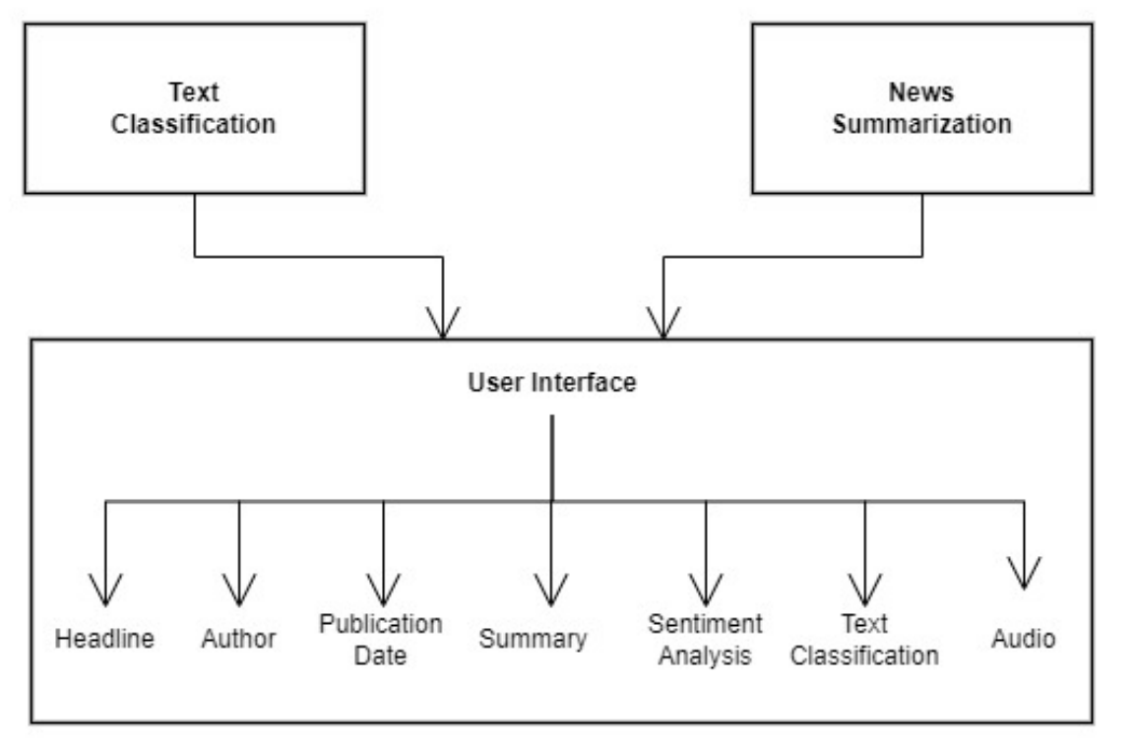

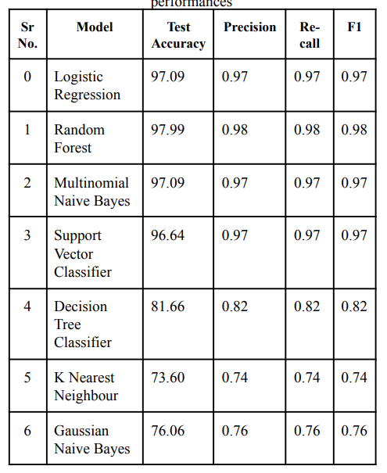

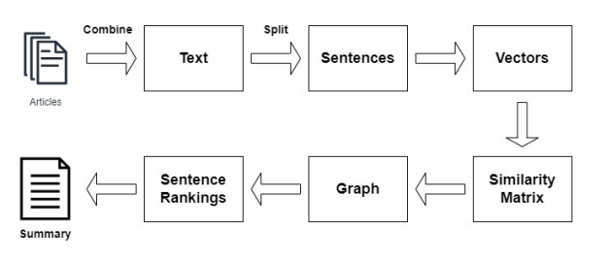
Title: Smart news Summarizer.
Hardi Patel (LY-IT), Jaydeep Patel (LY-IT), Mitali Patil (LY-IT).
Abstract
Implementation
system design (contd…)
On a daily basis, we read multiple news articles, but a single news topic may not contain all of the relevant information. We can obtain useful information from the comprehensive articles, which will save us a lot of time and energy. Text summarization is a way of reducing a text to a meaningful summary while retaining the information content and overall meaning. This system will help us enhance the readability of a particular news article without missing any important points. Sentiment Analysis is performed on the summary to understand the sentiment of the news articles. Text classification is used to organize, structure, and categorize different types of news articles.
Exploratory Data Analysis: Exploratory Data Analysis (EDA) is a method of analyzing datasets to summarize their main characteristics, often using visual methods, in data mining. EDA is used before modeling to see what the data can tell us. It is difficult to determine important data characteristics by looking at a column of numbers or an entire spreadsheet. It can be time-consuming, boring, and/or overwhelming to derive insights from raw numbers. In this situation, exploratory data analysis techniques have been developed to help.
Lemmatization: The process of grouping together the various inflected forms of a word so that they can be analyzed as a single item is known as lemmatization. Lemmatization is similar to stemming in that it adds context to words. As a result, it connects words with similar meanings to a single word. Because lemmatization performs morphological analysis on the words, it is preferred over stemming.
Model Building
Declared Dependent and Independent Value
Train Test and Split the Dataset
Model evaluation
Model evaluation is the process of using different evaluation metrics to understand a machine learning model's performance, as well as its strengths and weaknesses. Model evaluation is important to assess the efficacy of a model during initial research phases, and it also plays a role in model monitoring.
Introduction
Giving machines the ability to think has always been a far-fetched dream for humans, but with the development of Machine Learning in the last few decades, giving machines "brain" is no longer a far-fetched dream. Yes, machines can now be programmed to learn and apply what they've learned to perform a wide range of previously human-only tasks. Among the Machine Learning applications are the generation of a summary of a given piece of text and the conversion of text to speech. As a result, it is clear that this paper employs a method based on Machine Learning concepts to provide a clear and concise summary of a piece of text. Furthermore, it contributes to a variety of fields and has the potential to do so. It also contributes to a variety of fields and can be linked to or implemented in a variety of other systems. Another motivation is to allow visually impaired people to obtain news in a much more efficient manner without the help of others. Automatic Text Summarization, also known as Text Reduction, is a fascinating and developing area of natural language processing.
Results
Algorithm
The first step would be to concatenate all of the text in the articles, followed by splitting the text into individual sentences. Following that, the similarities between sentence vectors are computed and saved in a matrix. The similarity matrix is then graphed for sentence rank calculation, with sentences serving as vertices. The similarity matrix is then converted into a graph for sentence rank calculation, with sentences as vertices and similarity scores as edges. Finally, the final summary is composed of a set number of top-ranked sentences.
methodology
For the inputted news article, the system generates an extractive-based summary. The article is first pre-processed, and then a summary is generated. The generated summary is then passed to the sentiment analyzer to determine its polarity. Concurrently, the news article is run through a text classification algorithm to determine which category it belongs to. Finally, the summary is available in audio format for the benefit of the visually impaired. The major stages of the system are described below.
system design
Conclusions
Data cleaning and preprocessing: Data preprocessing is the process of converting raw data into an understandable format. Because we cannot work with raw data, this is a critical step in data mining. The data quality should be checked before using machine learning or data mining algorithms.
Data cleaning and Data Pre-processing
➢ Converting to lowercase
➢ Removing the HTML
➢ Removing the email ids
➢ Removing The URLS
➢ Removing the contractions
➢ Removing the Trailing and leading whitespace and double spaces
➢ Removing punctuations from the article
➢ Removing the Stopwords.
➢ Keyword Extraction
We have generated summary provides only the important content from online news articles.
News Classification helps us categorize those news articles into their respective category.
Sentiment Analysis provides the view of various news channels. The model summarized content is finally converted to speech. .
Extractive and abstractive summarization
Extractive Summarization: The first step would be to concatenate all of the text in the articles, followed by splitting the text into individual sentences. The following step will be to find vector representations (word embeddings) for each and every sentence. Sentence rank computation is done by converting similarity matrix to graph with sentence fragments as
vertices and similarity scores as sides. Finally, the final summary is composed of a set number of top-ranked sentences.
Abstractive Summarization: An abstract is a brief summary of a research article, thesis, review, conference proceeding, or any in-depth analysis of a particular subject and is often used to help the reader quickly ascertain the paper's purpose.
references
[1] Fabrizio Sebastiani, "Machine Learning in Automated Text
Categorization," ACM Computing Surveys, vol. 34, no. I,
March 2002, pp. I-47.
[2] C. S. Ishikiriyama, D. Miro, and C. F. S. Gomes, “Text
mining business intelligence: A small sample of what words
can say,” in Procedia Computer Science, 2015, vol. 55, pp.
261–267, doi: 10.1016/j.procs.2015.07.044.
[3] J. Hoon Baeg, “The Analysis of Journals Topics and Trend:
Text Mining and Word Cloud,” J. Assoc. Inf. Sci. Technol.,
doi: 10.9776/16578.
Notes:
‹#›

