Slide 1

Seasonal Agriculture
Performance Analysis
Jaydeep Popat
V.V.P. Engineering College
AICTE STU ID : STU6a6645024b1081785087234

Slide 2

PROBLEM STATEMENT
Indian agriculture follows three major seasonal cycles—Kharif (Monsoon), Rabi (Winter), and Zaid (Summer). This project investigates how seasonality affects yield, profitability and water efficiency using farm-level data.
Primary challenges: seasonal differences in water efficiency, crop viability and profit margins; climate volatility; irrigation resource misallocation; and concentration of severe losses in high-stress seasons.

Slide 3
Project Description
1. Data Preparation
Season-aware median imputation; duplicate check; outlier review.
2. Feature Engineering
Profit margin, cost per tonne, profitability flag and water efficiency.
3. Exploratory Analysis
Season, climate, crop, irrigation and financial relationships.
4. Statistical Validation
ANOVA, Chi-Square contingency and Pearson correlation.
Outliers were retained as potential agricultural risk signals rather than automatically discarded.

Slide 4

WHO ARE THE END USERS?
Progressive Farmers & FPOs
Crop-season matching, irrigation scheduling and margin protection.
Agri-Lenders & Crop Insurers
Credit-risk assessment and calibration of seasonal insurance support.
Policy Makers & Extension Centers
Evidence-based irrigation subsidies and regional input allocation.

Slide 5

Technology Used
Python 3.11
Core analytical runtime
Jupyter / Colab
Reproducible notebook workflow
Pandas & NumPy
Cleaning and feature engineering
Matplotlib & Seaborn
Statistical visualization
SciPy (stats)
ANOVA, Chi-Square, Pearson correlation
Version control: GitHub repository for dataset, notebook and presentation.

Slide 6
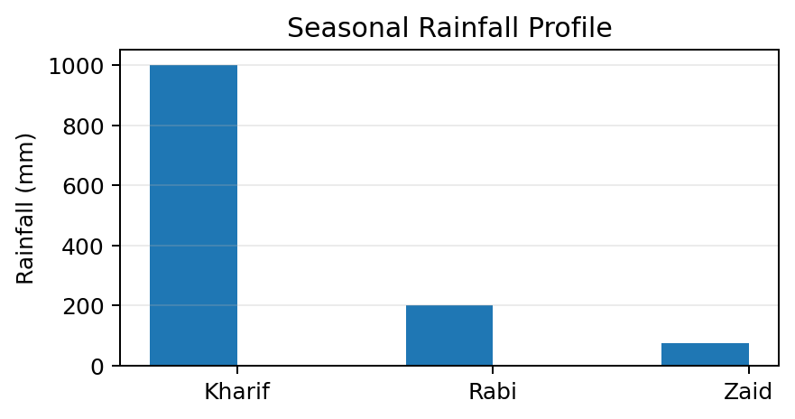
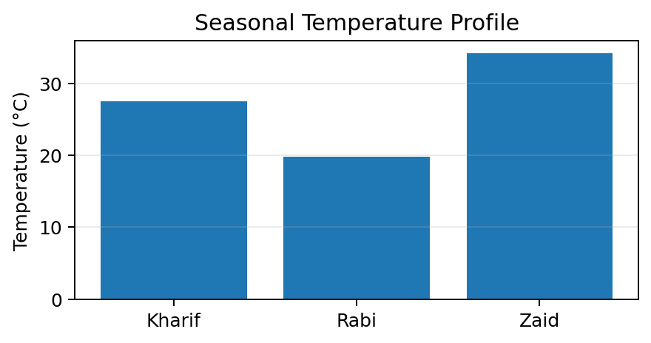
RESULTS
Seasonal Agro-Climatic Profiling
Kharif: 850–1150 mm rainfall, 27.5°C, 82.4% humidity, 38.2% soil moisture.
Rabi: 120–280 mm rainfall, 19.8°C. Zaid: 40–110 mm rainfall, 34.2°C and the lowest soil moisture (18.1%).

Slide 7
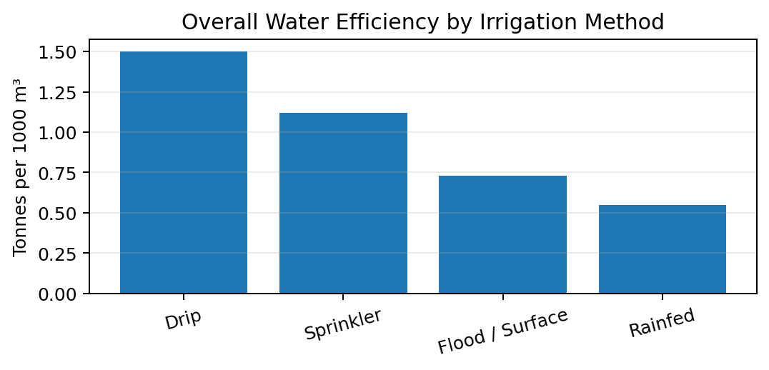
RESULTS
Irrigation Efficiency Benchmarking
Drip
1.50 t / 1k m³
Sprinkler
1.12 t / 1k m³
Flood: 0.73
Rainfed: 0.55
Drip is 2.05× more efficient than flood irrigation overall.

Slide 8
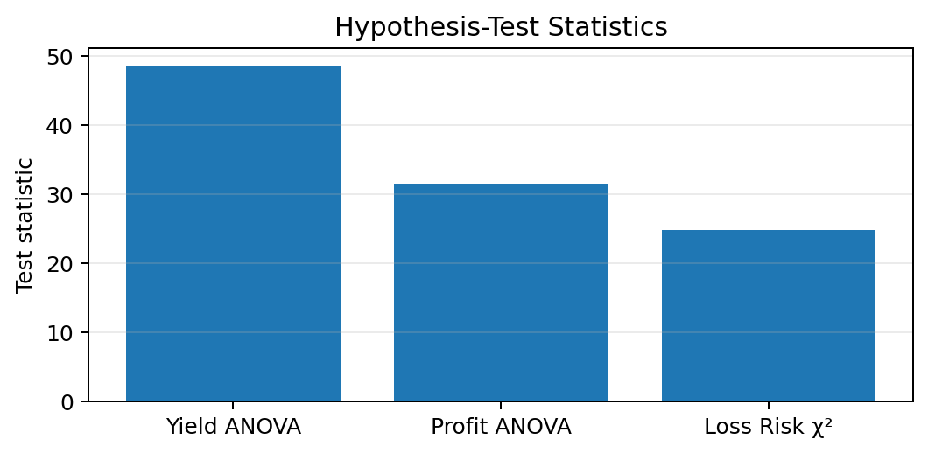
RESULTS
Statistical Hypothesis Testing
Yield ANOVA
F = 48.621
p < 0.00001
Profit ANOVA
F = 31.409
p < 0.00001
Loss Risk χ²
24.814, dof = 2
p = 0.00004
All three tests reject H₀ at α = 0.05; season is significantly associated with yield, profit and loss risk.

Slide 9
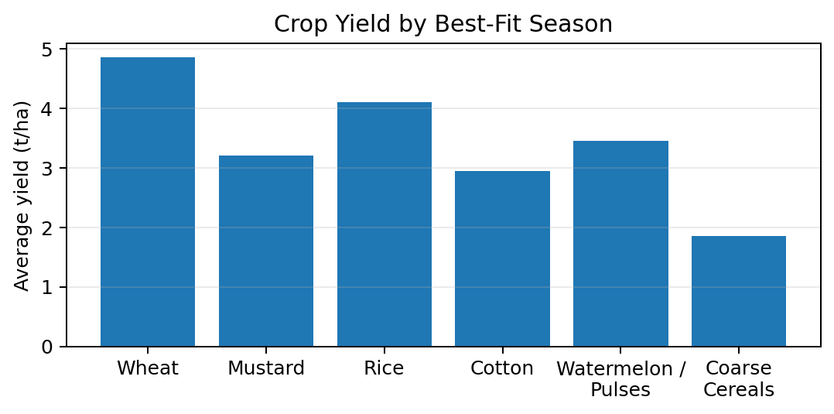
RESULTS
Crop Performance & Profitability
Wheat (Rabi)
4.85 t/ha | +34.2%
Mustard (Rabi)
3.20 t/ha | +38.6%
Rice (Kharif)
4.10 t/ha | +24.8%
Coarse cereals (Zaid): −4.2% margin

Slide 10
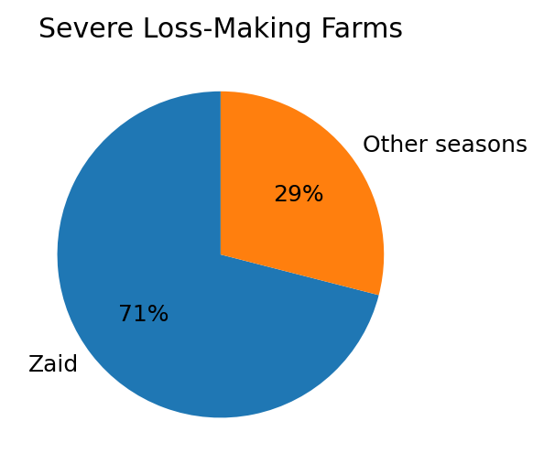
RESULTS
Key Risk & Decision Insights
71% of severe loss-making farms (Profit < 0) occurred during Zaid.
Punjab & Haryana show resilient Rabi profitability linked to irrigation infrastructure.
Maharashtra & Karnataka show higher Kharif cash-crop profit volatility.
Decision implication: prioritize seasonal crop fit, efficient irrigation and targeted risk support.

Slide 11
Future Scope
Predictive ML
XGBoost and Random Forest models for seasonal yield and profit forecasting.
Satellite & Drone Data
Sentinel-2 NDVI and evapotranspiration indicators for crop-stress monitoring.
IoT Edge Sensors
LoRaWAN soil-moisture probes to support precision irrigation decisions.

Slide 12
GitHub Link
Project Repository
https://github.com/jaydeeppopat19/Seasonal-Agriculture-Performance_Analysis
Repository contains:
CSV dataset • Jupyter Notebook • Final presentation • README

Slide 13

VOIS Course Completion Certificate

Slide 14
Thank you
Seasonal Agriculture Performance Analysis
Jaydeep Popat | Data Visualization

