Slide 1
GPP
Fibonacci Sequence
2017270217 임수빈
2015270107 채병철
2015270463 장규삼

Slide 2
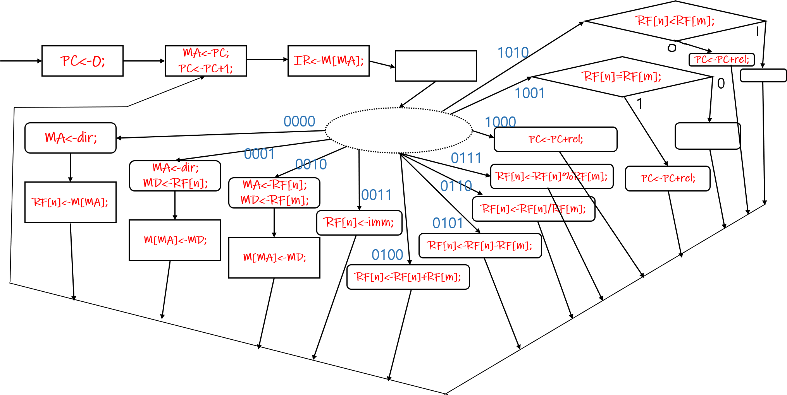
ASM with Datapath
RF[o]<-0;
RF[o]<-1;
RF[o]<-1;
RF[o]<-RF[n]%RF[m];
RF[o]<-0;
RF[o]<-RF[n]/RF[m];
RF[o]<-RF[n]-RF[m];
RF[o]<-RF[n]+RF[m];

Slide 3
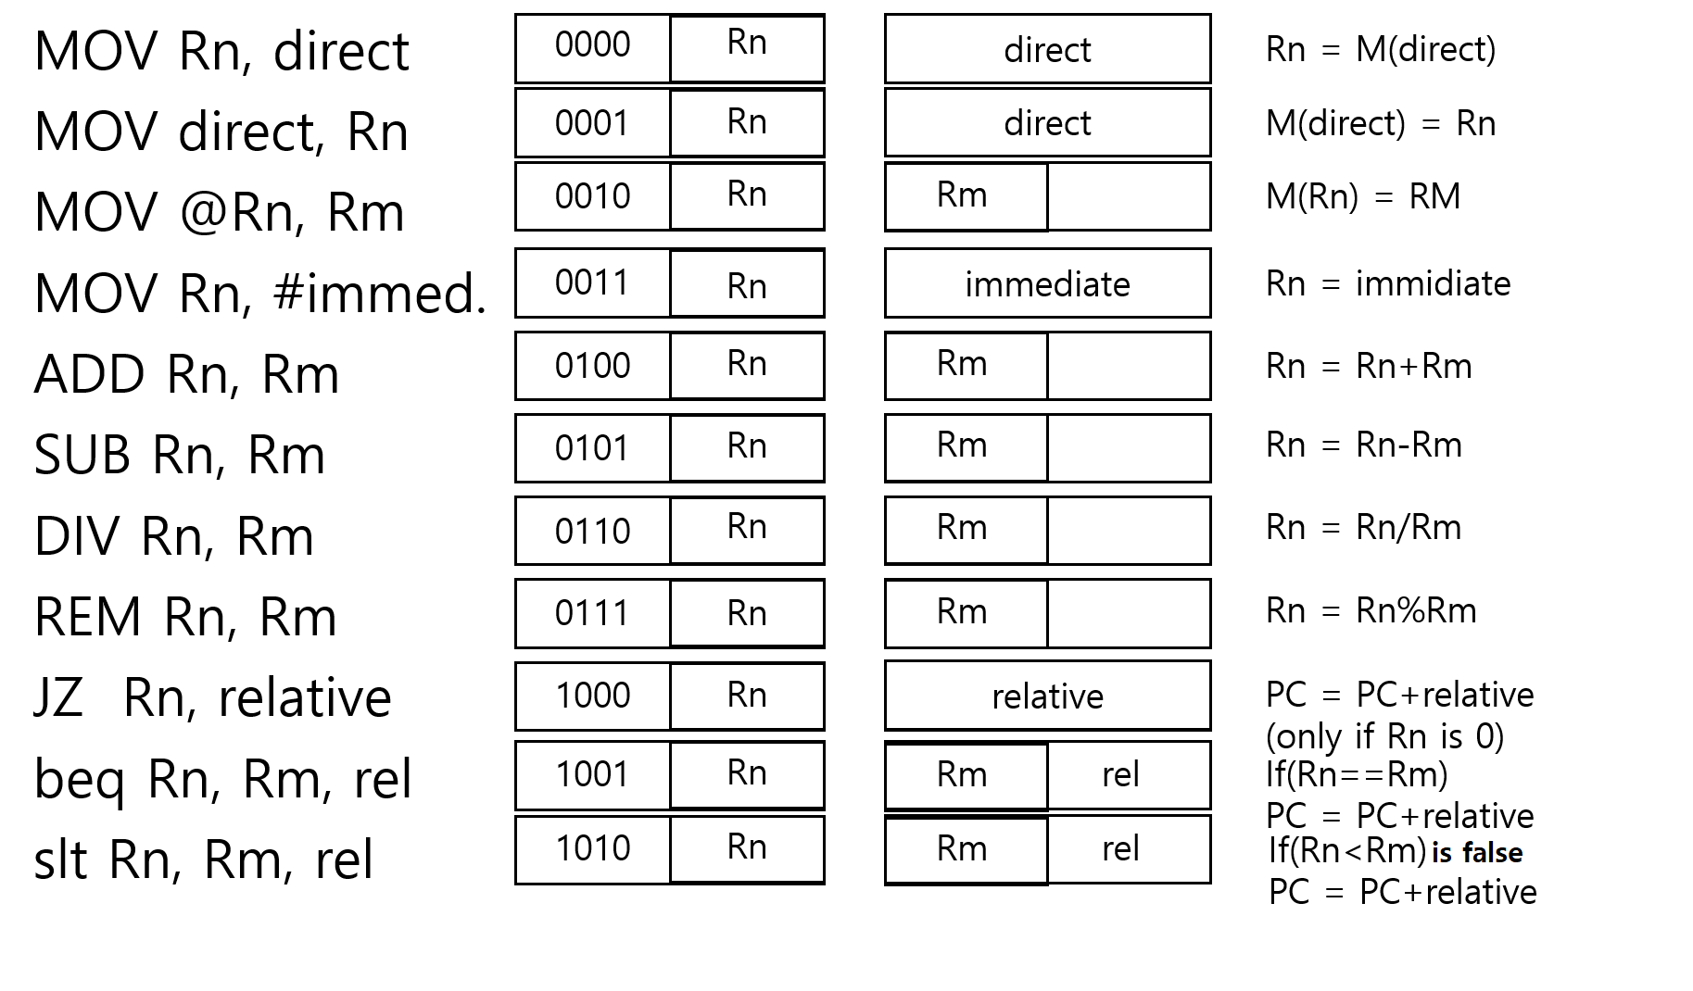
Instruction set
,Ro
Ro
,Ro
Ro
,Ro
Ro
,Ro
Ro
Ro
Ro
If(Rn==Rm) Ro<-0;
Ro
Ro
If(Rn<Rm) Ro<-1;

Slide 4
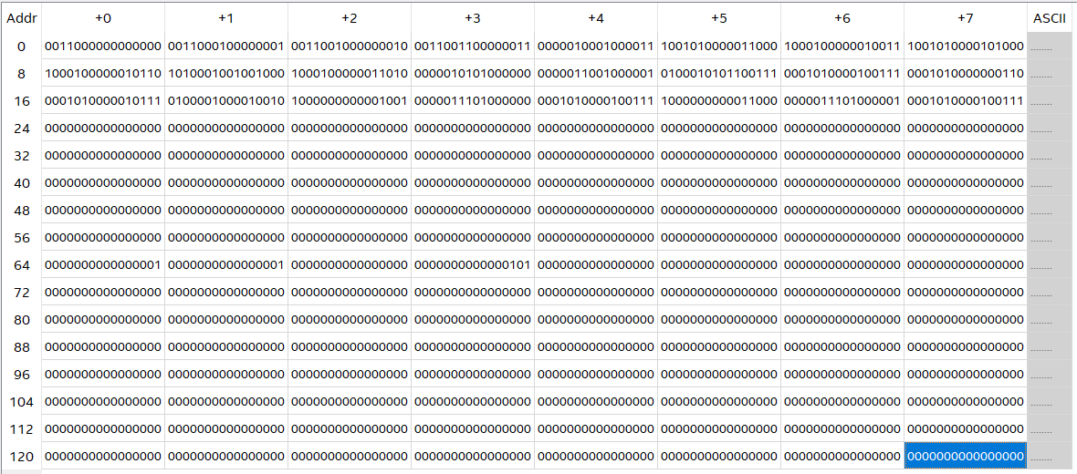
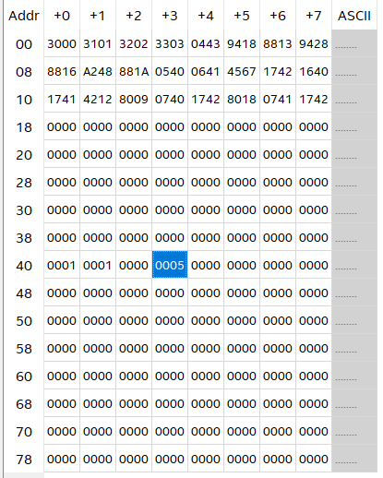
mif

Slide 5
program
MOV R0 #0
MOV R1 #1
MOV R2 #2
MOV R3 #3
MOV R4 0x43
beq R4 R1 R8
JZ R8 0x13
beq R4 R2 R8
JZ R8 0x16
slt R2 R4 R8
JZ R8 0x18
MOV R5 0x40
MOV R6 0x41
ADD R5 R6 R7
MOV 0x42 R7
MOV 0x40 R6
MOV 0X41 R7
ADD R2 R1 R2
JZ R0 0X09
MOV R7 0X40
MOV 0X42 R7
JZ R0 0X18
MOV R7 0X41
MOX 0X42 R7

