Slide 1
Posture Analysis (sublux)
Jayden Weaver

Slide 2
Overview
An Android Application
Written in Java
Analyzes photos pixel by pixel to determine posture.

Slide 3
Analysis
To separate the focus of the image from the background, a pixel from what is very likely the background is chosen.
The pixel chosen is (x:0 y:0).
This pixel’s color is considered the background color.
All other pixels with a color close to this color are considered part of the background.
The pixels outside of the threshold are considered the focus of the image.

Slide 4
Analysis
Pixels considered part of the background are colored blue.
Pixels considered the focus of the image are colored black.
The image is then combed through to remove excess black pixels. These pixels are colored blue. This process leaves the outline of the subject of the image.

Slide 5
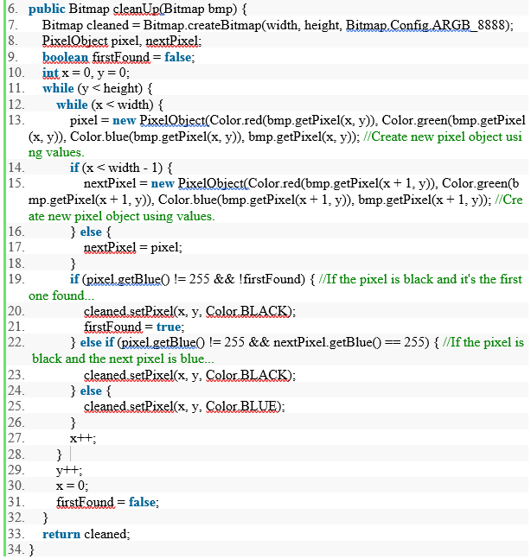
Analysis
Due to how this analysis works, a solid background is recommended.
The code for thinning out black pixels is shown.

Slide 6
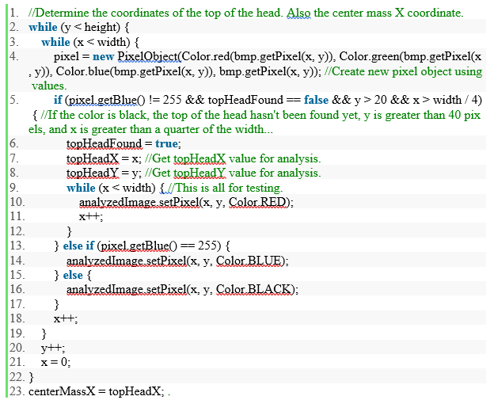
Location of head
Starting from the top, pixel (x:0,y:0), each pixel color is checked. If the color is blue, move on. If the color is black, this is the top of the head.
This pixel’s location is the center mass x value, and the y value is the top of the subject. These values are necessary for the analysis of the rest of the image.

Slide 7
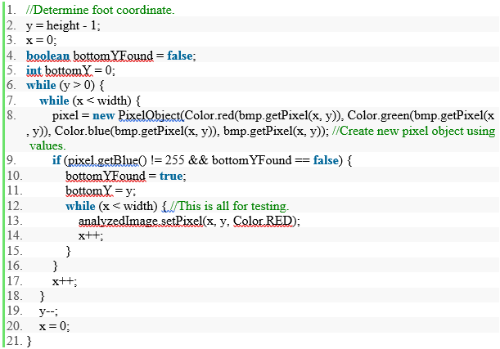
Location of Feet
Same process as locating the head, but in reverse.
Necessary to find the center mass y-coordinate.
Once found, center mass y-coordinate is (top of head – bottom of feet) / 2.
The center mass location will be the starting point later in hip analysis.

Slide 8
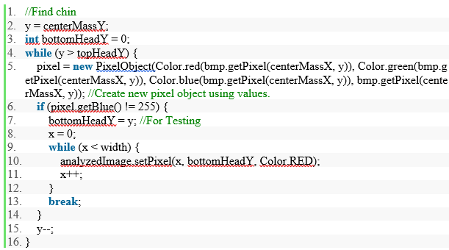
Location of chin
Locating the chin will give relative location of shoulders.
To locate, begin at Y = center mass Y. Check each pixel color. If blue, decrement Y and check again. If black, chin is located. If y is equal to the top of the head Y location, break and use default value zero. Chin could not be located. Continue analysis without locating chin.

Slide 9
Shoulder Locations
The relative location of the shoulders is at the y-coordinate of the chin.
A variable shoulderLine is created, centerMassY – bottomHeadY, to determine a location to restart search. This decreases chance of error.
The search for the shoulders begins at this y-coordinate.
The x-coordinate for the search is either a ¼ of the center mass x or ¾ of the center mass x depending on left or right shoulder.
Each pixel has its color checked for black by incrementing Y.
If no pixel is found before reaching the shoulder line variable, start over and decrement or increment x depending on left or right shoulder.

Slide 10
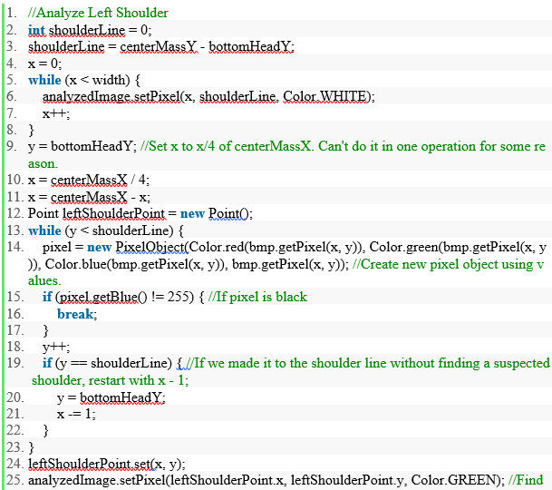
Shoulder Locations
The code for left shoulder analysis is shown.

Slide 11
Hip Locations
Similar to previous steps, hips are located by starting at the center mass of the subject.
The x-coordinate is decremented or incremented until a black pixel is found.
If no black pixel is found, increment y-coordinate until a black pixel is found.
If a black pixel cannot be found, the results of the posture analysis will be inaccurate.

Slide 12
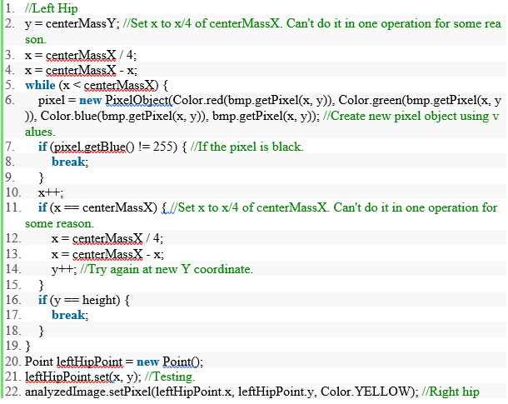
Hip Locations
The code for locating left hip is shown.

Slide 13
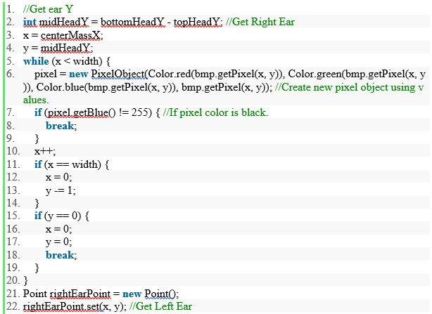
Ear Locations
Useful for determining if the head is tilted.
Found the same way as previous body parts.
Code for right ear is shown here.

Slide 14
Coordinate Comparison
Once all of the body parts have been located, the position of these body parts are compared.
If body part distances are outside of a certain threshold, the posture is considered poor and the user is notified of how their posture varies from good posture.
“Good” posture is all body parts being symmetrical.

Slide 15
Coordinate Comparison
The threshold is different for different body parts.
Additionally, the threshold varies based on image size. (Example: 5 pixels is a bigger deal on a 100x100 image than on a 1000x1000 image. Therefore, the threshold must be dynamic, and not hardcoded.
Multiple comparisons allow for a user to be notified If only some aspects of their posture are considered undesirable.

Slide 16
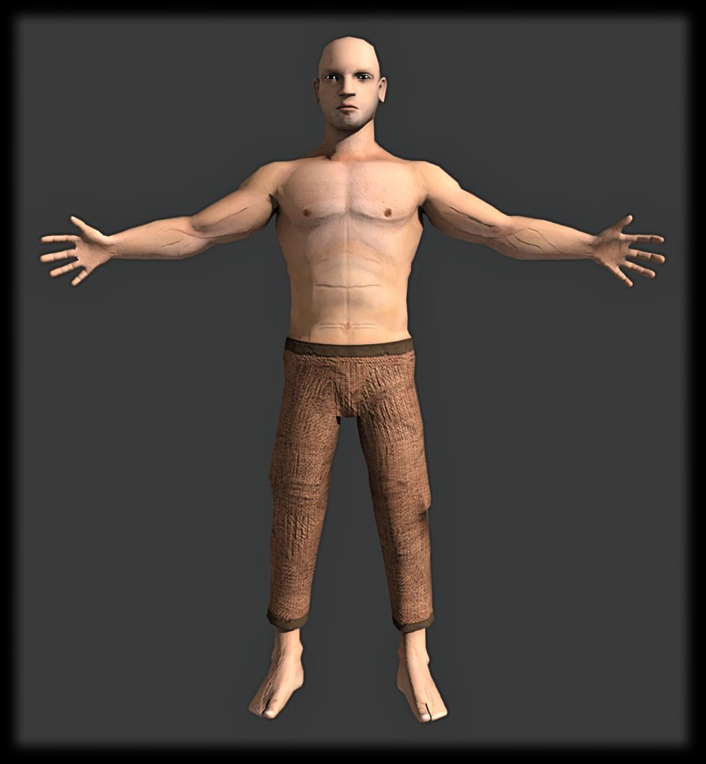
Before

Slide 17
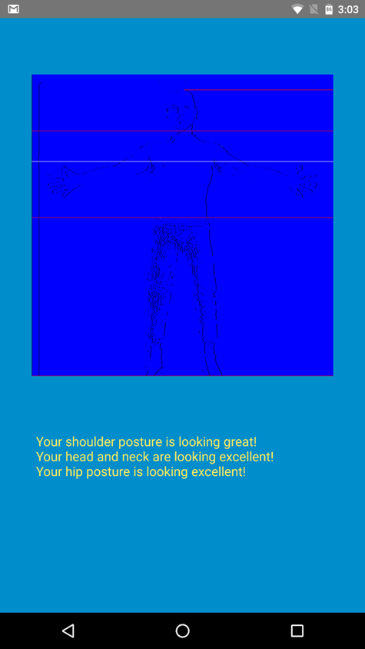
After

