Slide 1
Posture Analysis (sublux)
Jayden Weaver

Slide 2
Overview
Android Application
Written in Java
Analyzes Posture Through Photos
Compares Locations of Body Parts

Slide 3
Analysis
To separate focus from background, pixel is chosen.
The pixel chosen is (x:0 y:0).
This pixel’s color is considered the background color.
All pixel colors are checked against background color.
Pixels outside of the threshold are focus of the image.

Slide 4
Analysis
Pixels considered background are colored blue.
Pixels considered focus are colored black.
Solid background recommended.
Combed through again, leaving outline.

Slide 5
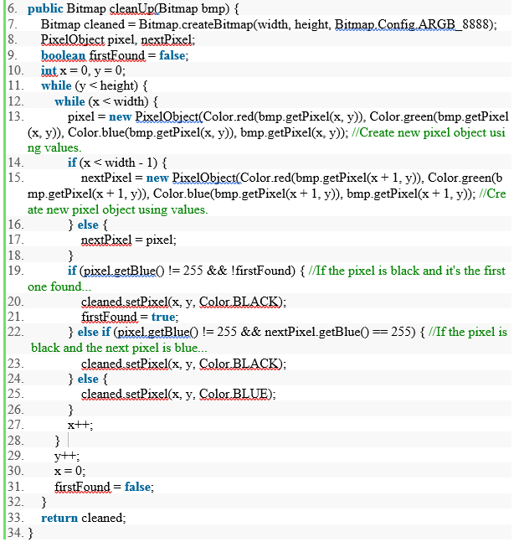
Analysis
The code for thinning out black pixels is shown.

Slide 6
Location of head
Starting from pixel (x:0,y:0), pixel colors are checked.
If blue, move on. If black, top of head.
This is center mass x value
Y value is top of the subject.
Necessary for the analysis of the rest of the image.

Slide 7
Location of Feet
Same process as locating the head, but in reverse.
Necessary to find the center mass y-coordinate. (bottom of feet – top of head) / 2
Center mass location will be starting point in hip analysis.

Slide 8
Location of chin
Locating the chin will give relative location of shoulders.
To locate, begin at Y = center mass Y.
Check each pixel color.
If black, chin is located.
If blue, decrement Y and check again.
If unable to locate, attempt without.

Slide 9
Shoulder Locations
Relative location of shoulders is y-coordinate of chin.
The search for the shoulders begins at this y-coordinate.
X-coordinate for search is ¼ or ¾ of center mass x depending on shoulder.
Check color.
Variable shoulderLine is created, centerMassY – bottomHeadY, to determine location to restart search.
If not found, decrement x and restart.

Slide 10
Hip Locations
Hips are located by starting at the center mass of the subject.
X-coordinate decremented or incremented until a black pixel is found.
If no black pixel is found, increment y-coordinate until a black pixel is found.
If a black pixel cannot be found, continue analysis.

Slide 11
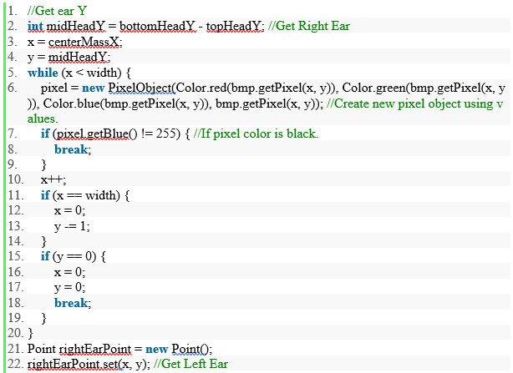
Ear Locations
Useful for determining if the head is tilted.
Code for right ear is shown.

Slide 12
Coordinate Comparison
Position of body parts are compared.
If outside of threshold, posture is poor.
“Good” posture is all body parts being symmetrical.

Slide 13
Coordinate Comparison
Threshold is different for different body parts.
Additionally, the threshold varies based on image size.
Multiple comparisons allow for a user to be notified If only some aspects of their posture are considered undesirable.
Multiple comparisons allow for accurate results even when some parts could not be located.

Slide 14
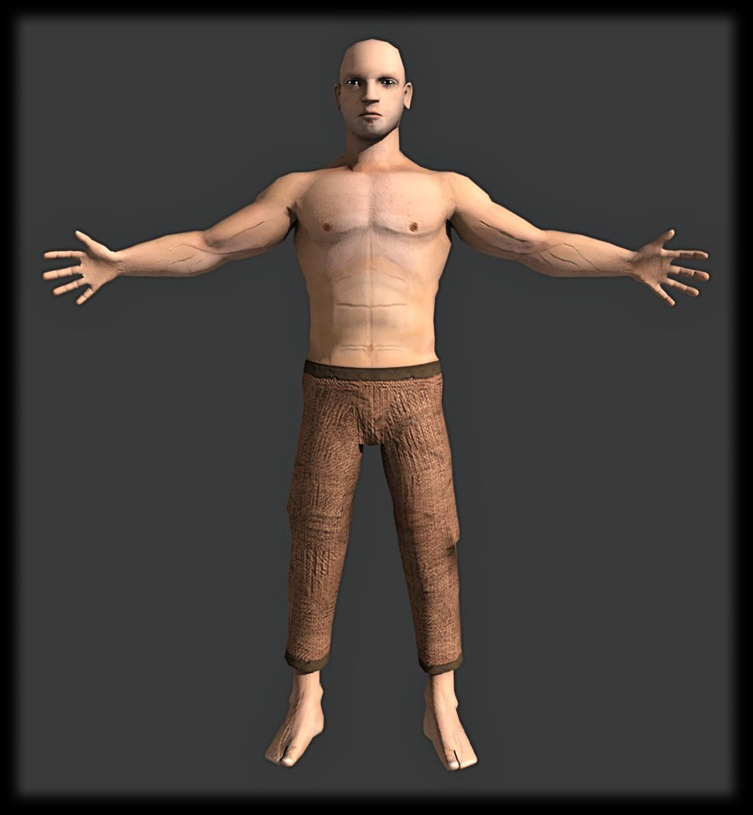
Before

Slide 15
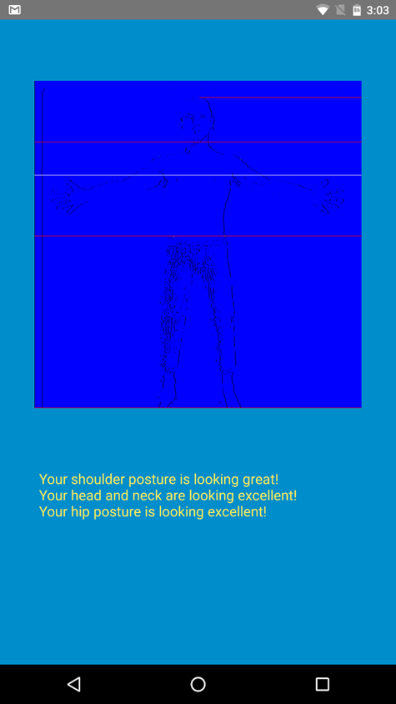
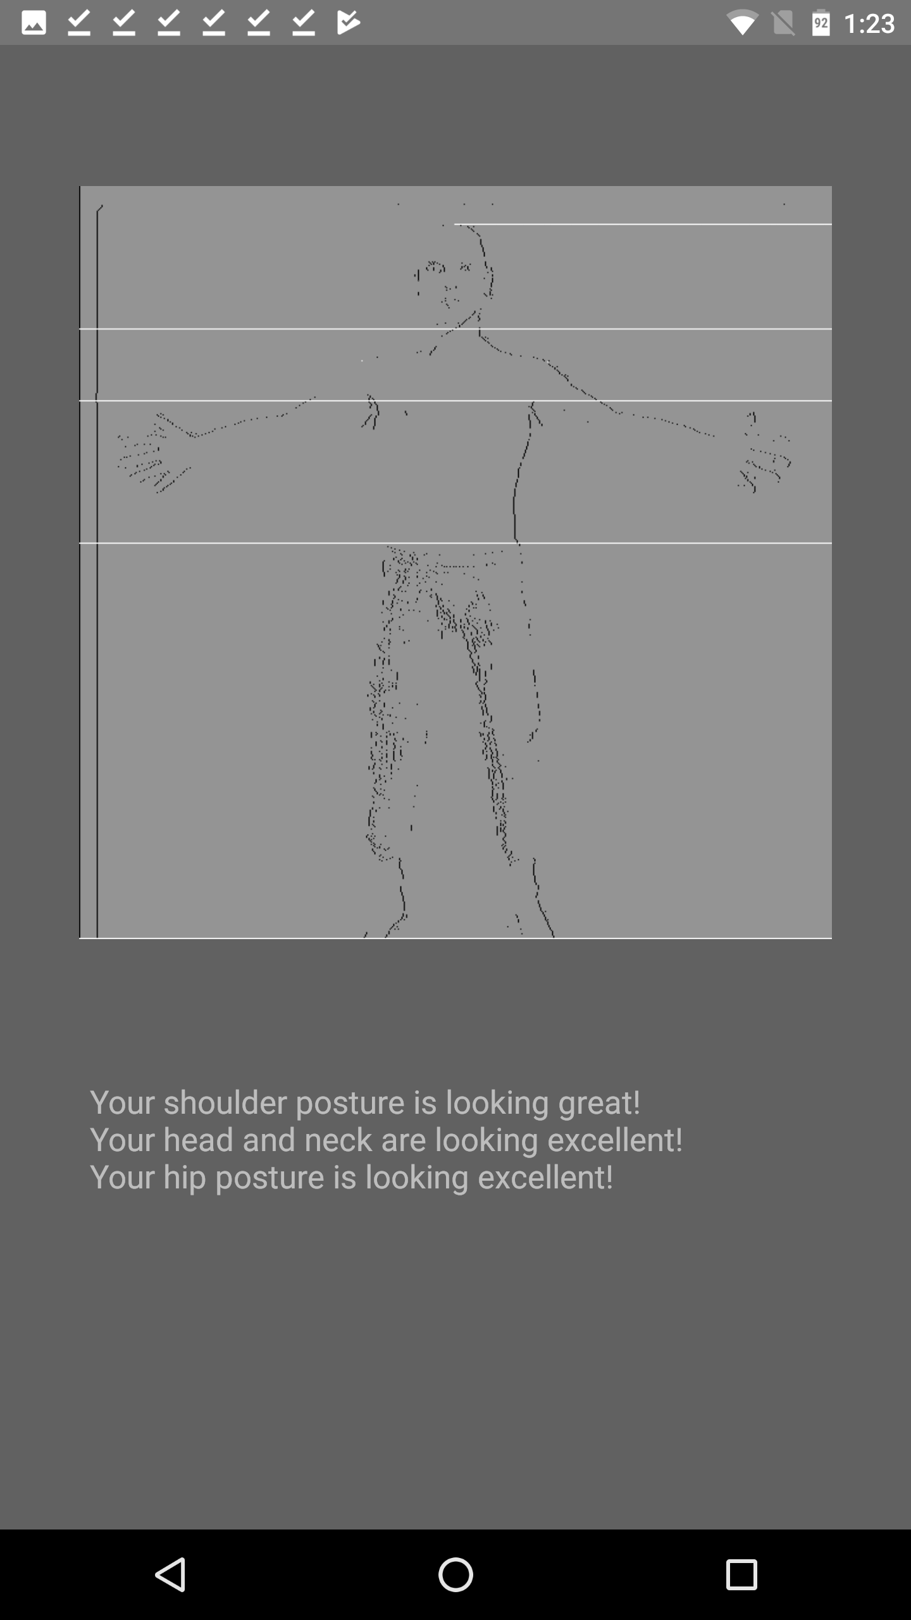
After

Slide 16
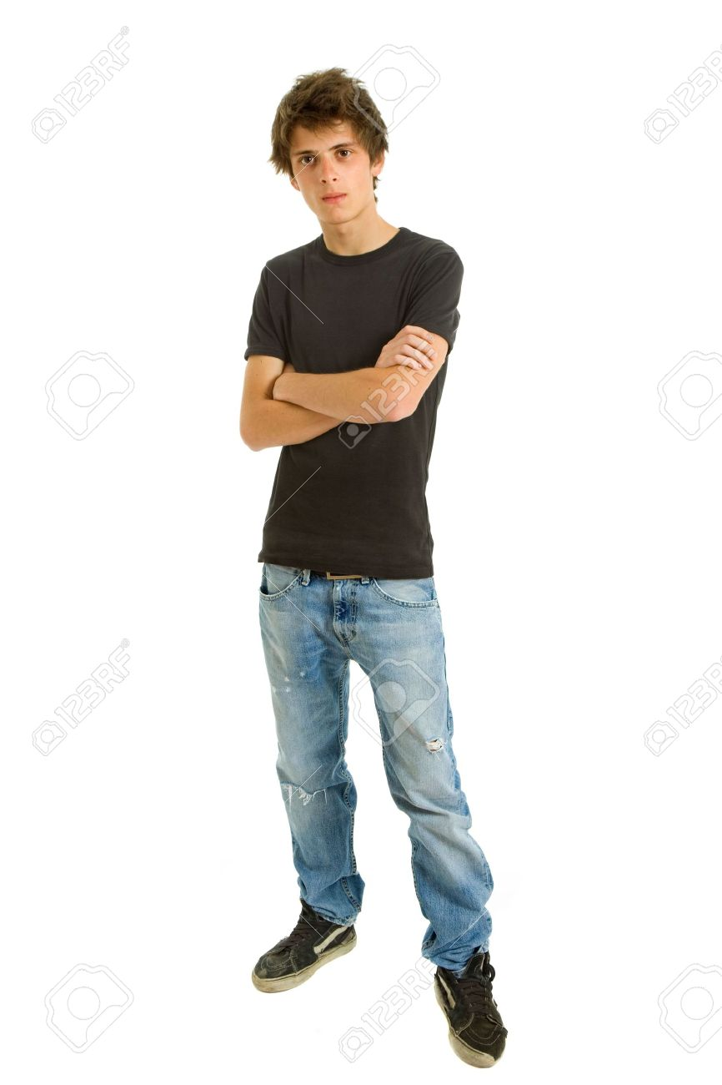
Before

Slide 17
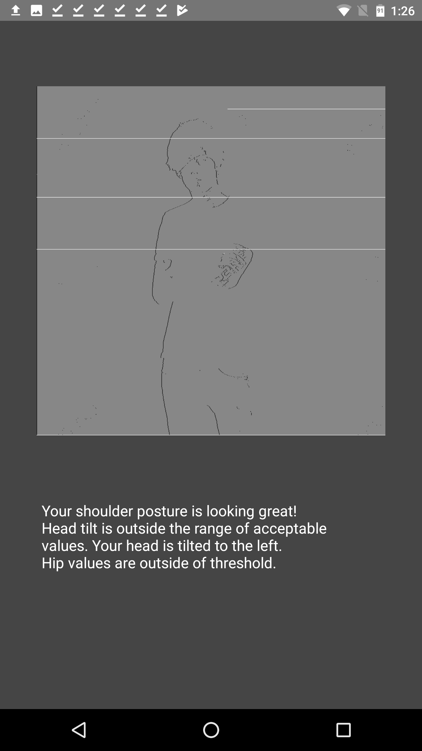
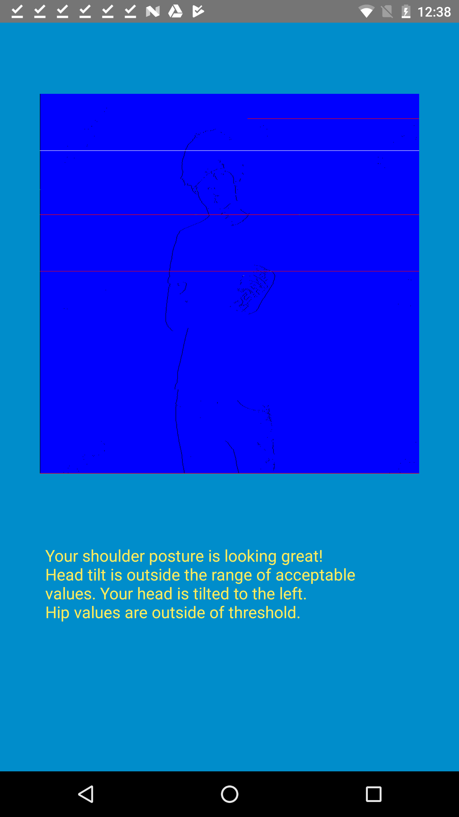
After

Slide 18
Problems
Threshold Size
Image Size
Practicality

Slide 19
Solutions
Dynamic Threshold
Reduce Image Resolution
Marketing Business

Slide 20
Conclusion
Android Application
Compares positions of body parts to determine posture.
Balance between speed and accuracy.
Different paths to take.

Slide 21
acknowledgements
Keith McKim
Nicholai Cascio
Jordan Weaver
John Davlin

Slide 22
References
InnocentKiller, April 19, 2018, answer on amburnside, “Get filepath and filename of selected gallery image in Android”, Stack Overflow, December 2, 2013, https://stackoverflow.com/a/20324422

Slide 23
Questions?

