Slide 1
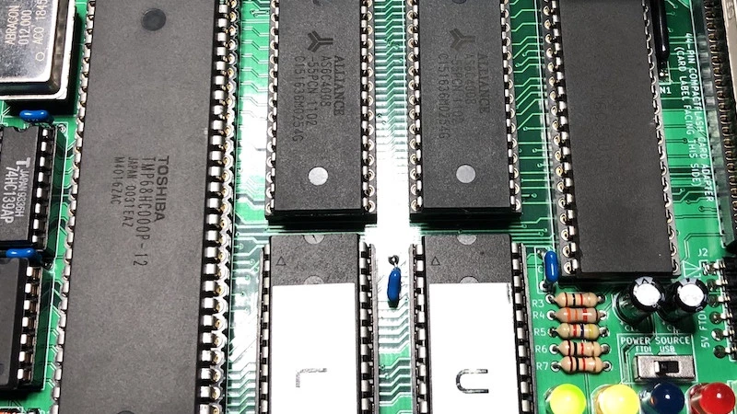
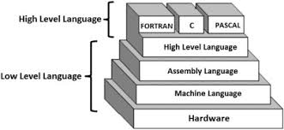
Motorola 68000 Disassembler with EASy68K
Team Terminal
Gabriel Acuna, Jayden Fullerton, Luo Leng, Sean Miles
https://drive.google.com/file/d/1reSHCguLaaU5Tgzv2IjKgoFaXPSiRVIS/view?usp=sharing
Notes:
Intro

Slide 2
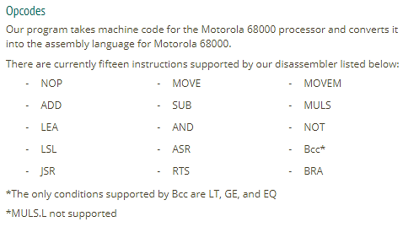
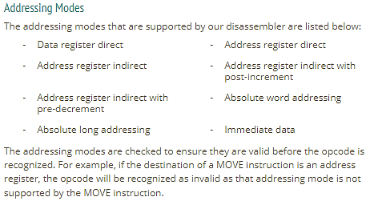
Opcodes and Addressing Modes
Functionality: All required features implemented

Slide 3
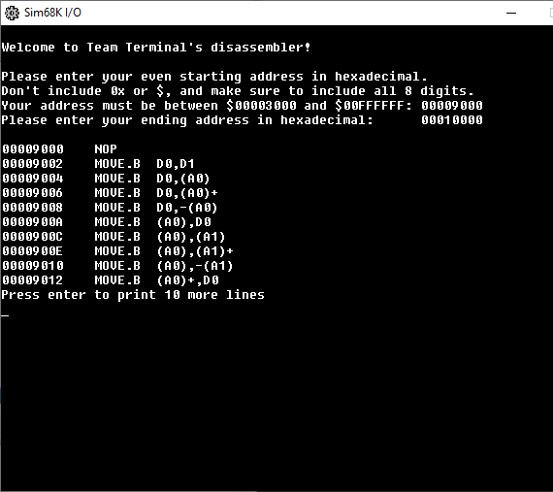
Input/Output Features
Functionality: All required features implemented
Prints ten lines at a time, prompts you to press Enter
Provides appropriate information outlining how to format your input
Properly questions user if they would like to try again after ending address has been reached

Slide 4
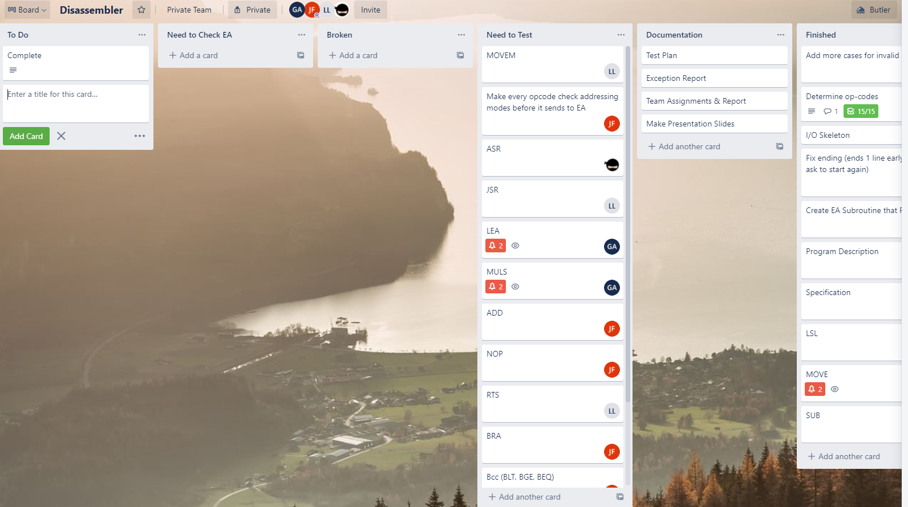
Teamwork

Slide 5
List of Incomplete Tasks
None!
We were able to resolve everything outlined in the specification.

Slide 6
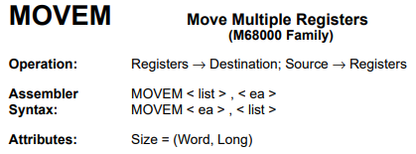
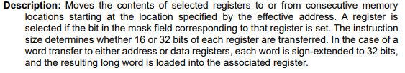
Problems Encountered
*It’s finished, but it wasn’t easy*

Slide 7

Observed Bugs of The Simulator
None!
Not bugs but some limitations
You cannot scroll or look through previous output from the simulator.
You cannot copy the output, which would be nice to use with output comparison tools for testing.

Slide 8

Thank You Now for the Demo!

