Slide 1



WIREFLY
INFO 6150 FINAL PROJECT

Slide 2

Meet our team
Shraddha Mhetre
Jay Devnani
Dushyanth SriNilay
Dheeraj Reddy

Slide 3

PURPOSE
WireFly is the easiest way to save on your cellular bill. Based on your wireless needs and budget, you'll be able to determine which family package is right for you. Our app lets you to connect with the owner of the plan. Our application helps owners of the family plan to fill the vacant spot by posting the request in our application.

Slide 4










Tech Stack
Programming Languages
Other
Data Storage
JavaScript Framework
API

Slide 5
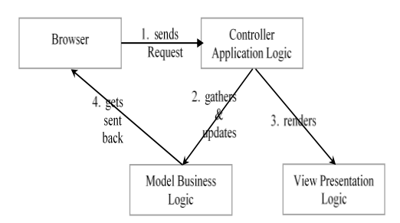
MVC Architecture

Slide 6
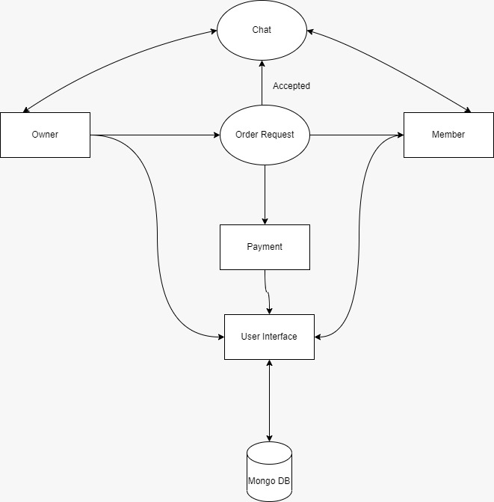
Domain Model

Slide 7
Features
Chat using socket.io
01
Payment using stripe API
02
Nodemailer for sending OTP
03
JWT token for Authentication
04
Lottie files for animation
05

Slide 8
Let’s have a look at demo

Slide 9
Screenshots

Slide 10
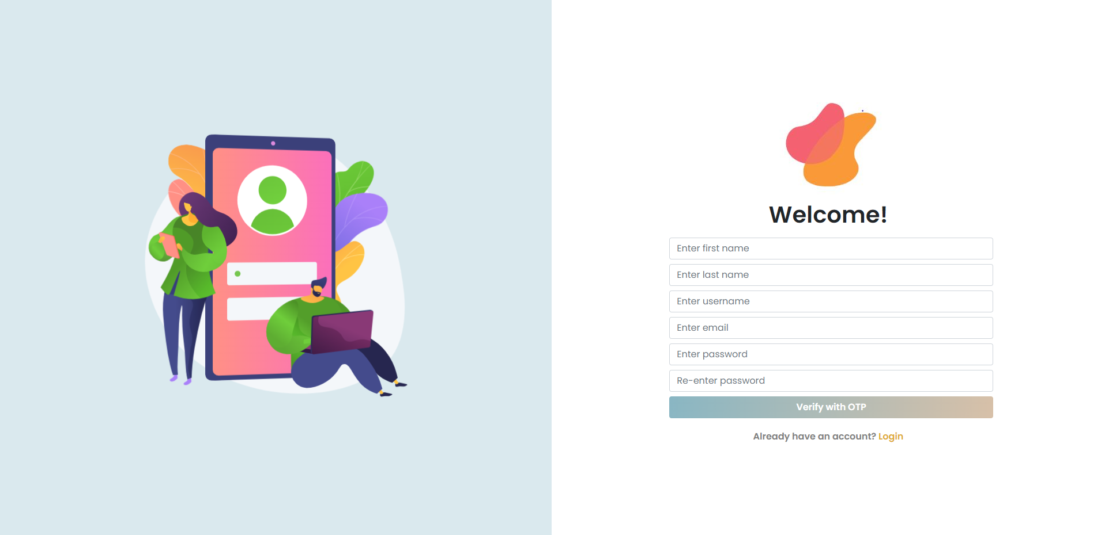

Slide 11
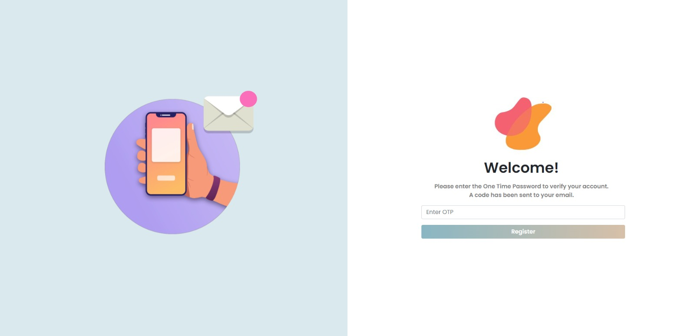

Slide 12
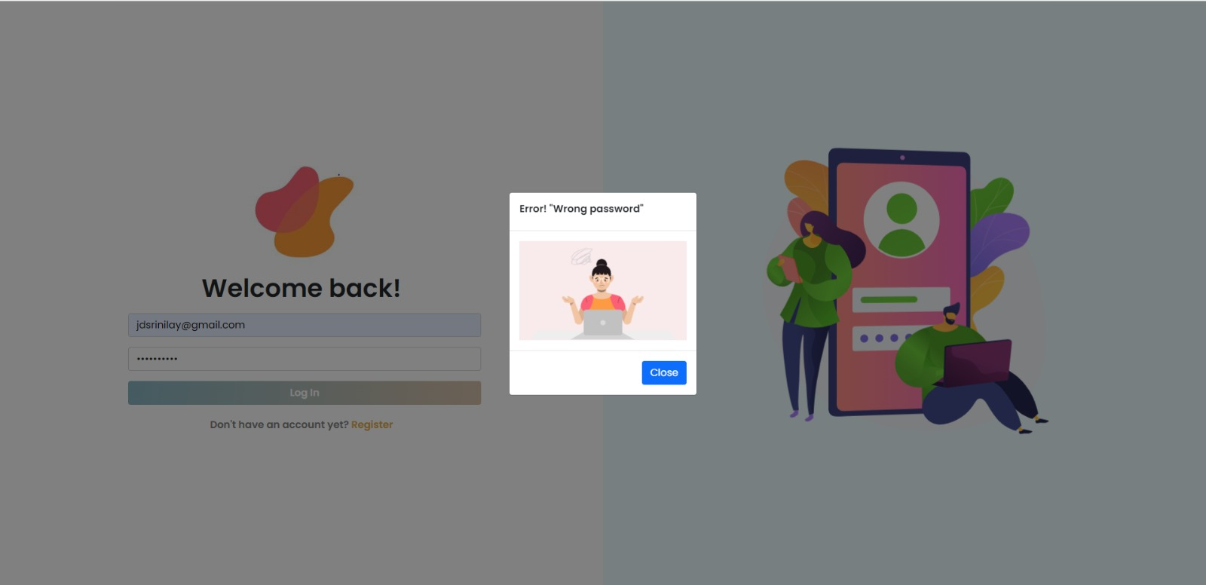

Slide 13
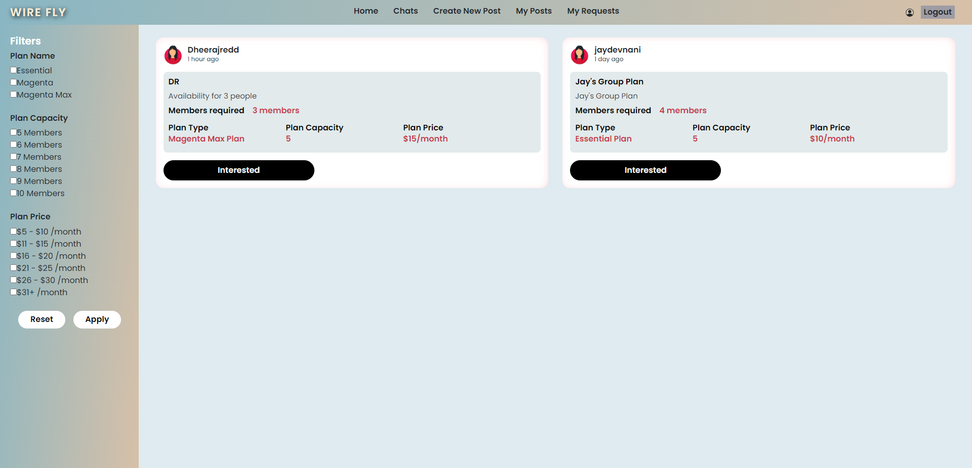

Slide 14
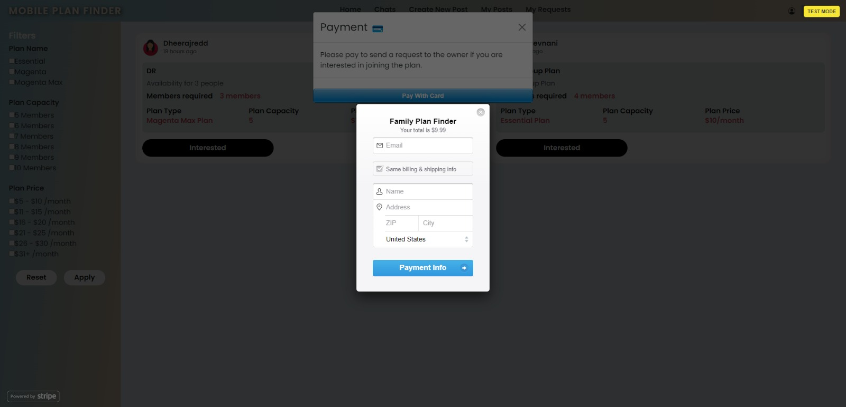

Slide 15
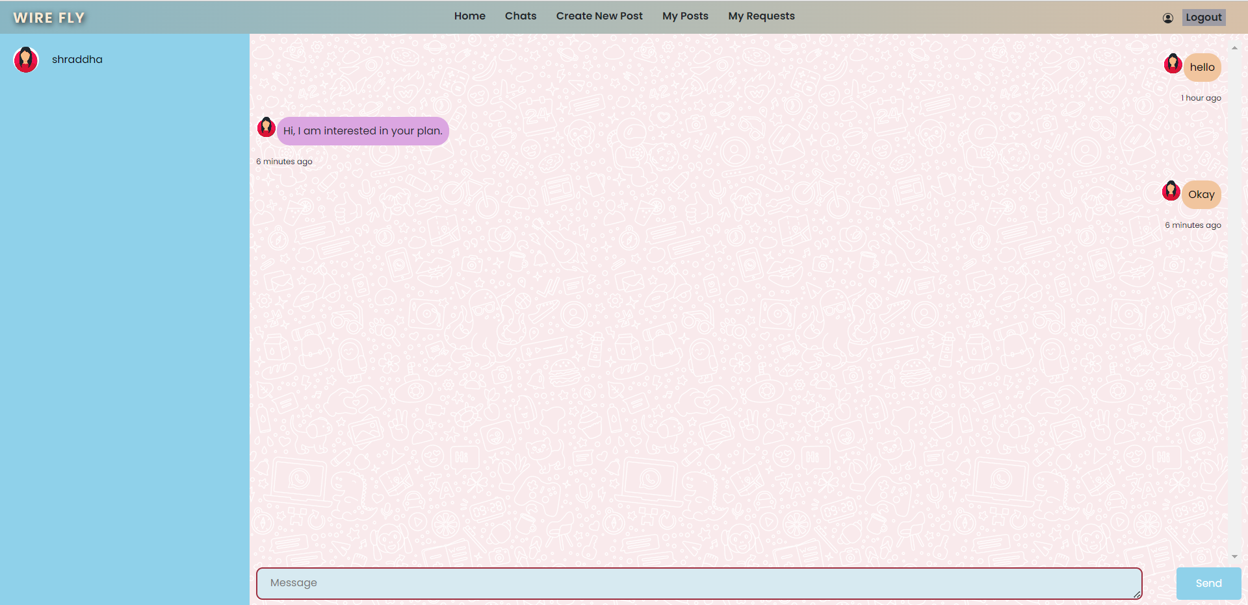

Slide 16
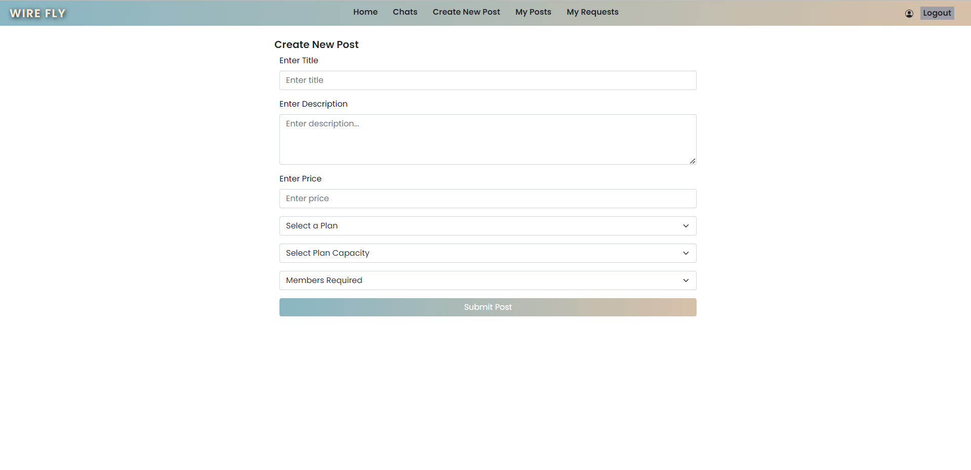

Slide 17
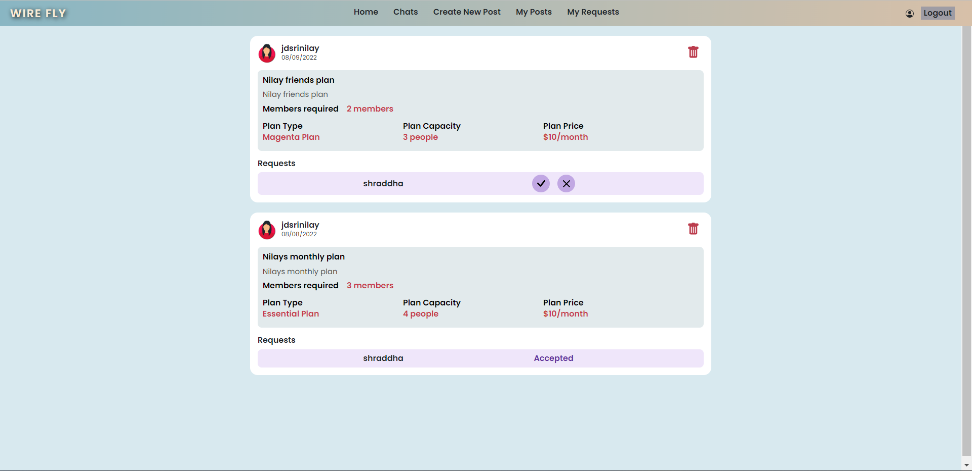

Slide 18
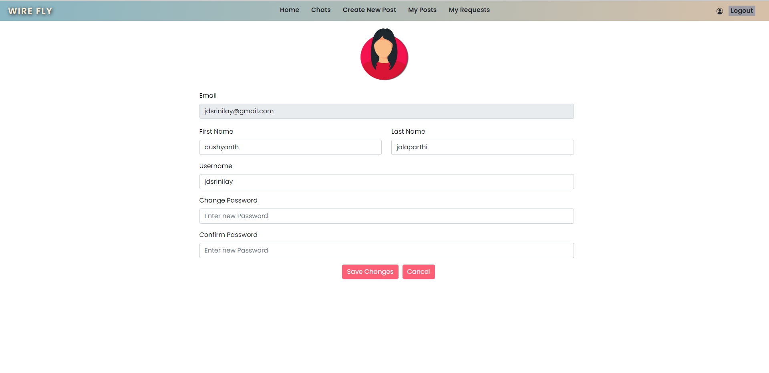

Slide 19
Thank YOU

