Slide 1


VIDYARTHI PROJECT BY ISHA VARDHAN 26BHI10025
VIT BHOPAL UNIVERSITY

Slide 2


HOTEL
MANAGEMENT SYSTEM USING PYTHON
HOTEL MANAGEMENT SYSTEM
Python Programming Project
Presented by: ISHA VARDHAN 26BHI10025. SCHOOL SCAI. BRANCH ;BTECH CSE IN HEALTH INFORMATICS
Project: Hotel Management System
Language: Python
PYTHON COURSE CODE:- CSE1021

Slide 3
FEATURES
1. View All Rooms
2. Check Available Rooms Only
3. Book a Room
4. Checkout & Billing
5. Exit

Slide 4
LET SEE THE LOGIC BEHIND THE CODE

Slide 5
1. Data Structure (rooms Dictionary)
Concept: The hotel database uses a Python Dictionary where key-value pairs link room numbers to their details.
Format: Room Number -> [Room Type, Per Day Price, Max Capacity, Status / Booking Info]
Dynamic Slot: Index [3] holds "Available" by default. Upon booking, it is replaced with a nested dictionary containing guest details:
2. Room Inventory Display (view_all_rooms)
Iteration: Uses a for loop with .items() to traverse every room number and list in the dictionary.
Variable Unpacking: Unpacks values into readable variables (room_type, price, capacity, availability) for clean code structure.
Conditional Logic: Uses an if/else block:
  If availability == "Available", it displays the room as free.
  Otherwise, it accesses availability["name"] from the nested dictionary to show who currently occupies the room

Slide 6
3. Availability Filter (check_availability)
Counter Pattern: Initializes a tracking variable (count = 0).
Filtering Loop: Loops through the dictionary and checks index [3] of each room.
Logic: If info[3] == "Available", it prints the room details and increments count += 1.
Zero-Check: After completing the loop, an if count == 0: condition alerts the user if all rooms are fully booked
4.Booking & Validation (book_room)
Existence Check: Verifies if room_no in rooms to ensure the room exists.
Availability Guard: Ensures rooms[room_no][3] == "Available" to prevent overwriting existing bookings.
Capacity Validation: Compares user input guest_count against rooms[room_no][2]. If guest_count > max_capacity, the booking is blocked.
Duration Check: Confirms that stay days are greater than 0.
Error Handling: Uses try/except ValueError blocks to catch invalid non-numeric inputs without crashing the application.

Slide 7

5. Checkout & Bill Calculation (checkout_and_billing)
Active Booking Verification: Ensures the requested room is currently occupied before attempting checkout.
Math Logic: Retrieves the price per day and stay duration from memory and calculates the final cost:
$$\text{Total Bill}=\text{Price Per Day}×\text{Days Stayed}$$
Status Reset: Overwrites index [3] back to "Available", making the room immediately available for future bookings.
.
GIVEN BELOW THE FLOW CONTROL OF MY PROJECT
(I HAVE USED HANDMADE LOOP CONTROL FROM MS WORD TO SHOW THE AUTHRNTICITY OF
THE PROJECT)

Slide 8
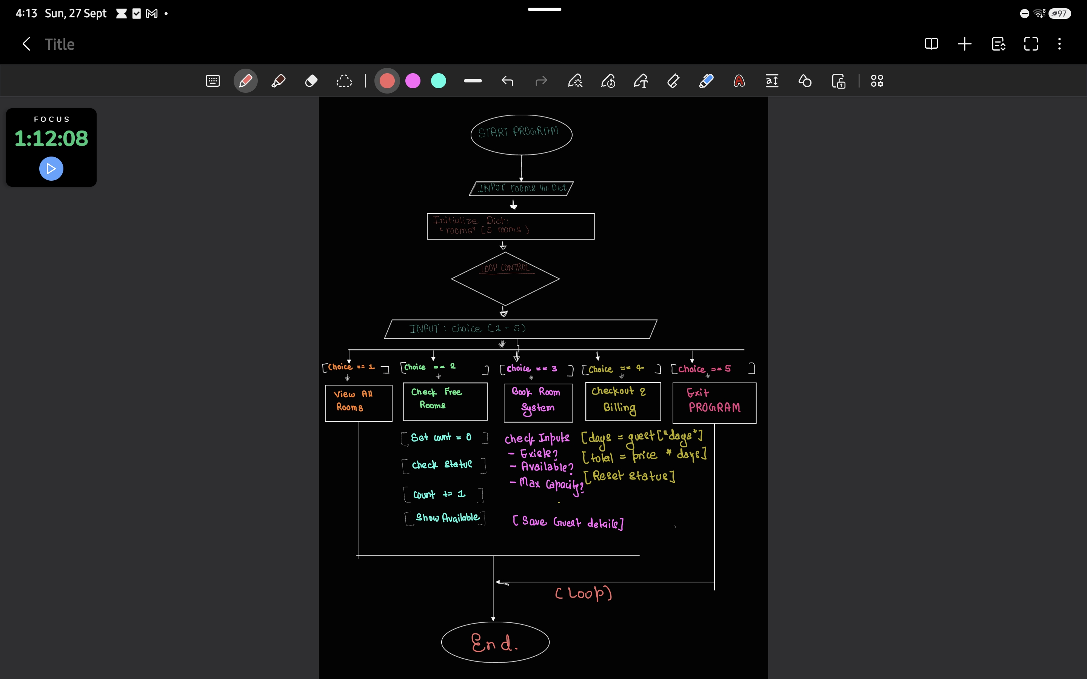

Slide 9
THE UPCOMING PPT ARE OUTPUT THAT I GOT AFYER RUNNING MY CODE
TERMINAL ADDRESS DISCRIPTION TESTED ON VS CODE
C:\Users\ASUS\Documents\VIDYARTHI PROJECT ISHA26BHI10025> & C:\Users\ASUS\AppData\Local\Python\pythoncore-3.14-64\python.exe "c:/Users/ASUS/Documents/VIDYARTHI PROJECT ISHA26BHI10025/HOTEL MANAGEMENT.PY"

Slide 10
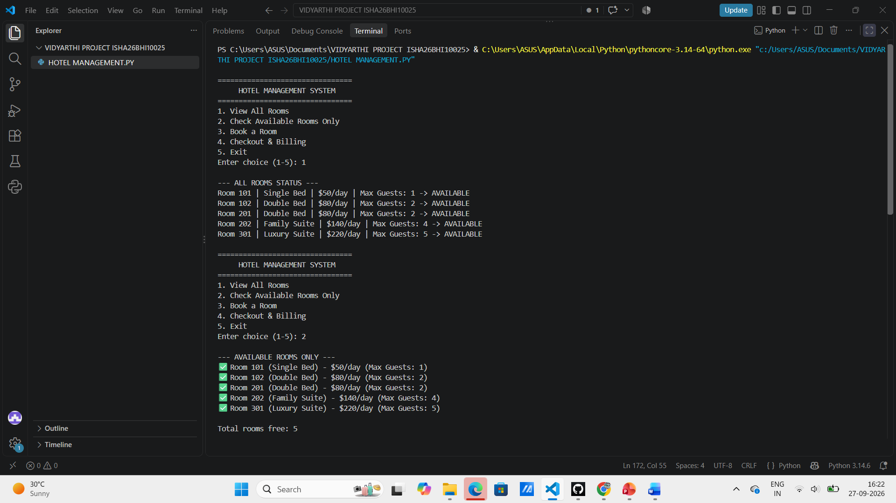
THE OUTPUT I GOT AFTER RUNNING MY CODE

Slide 11
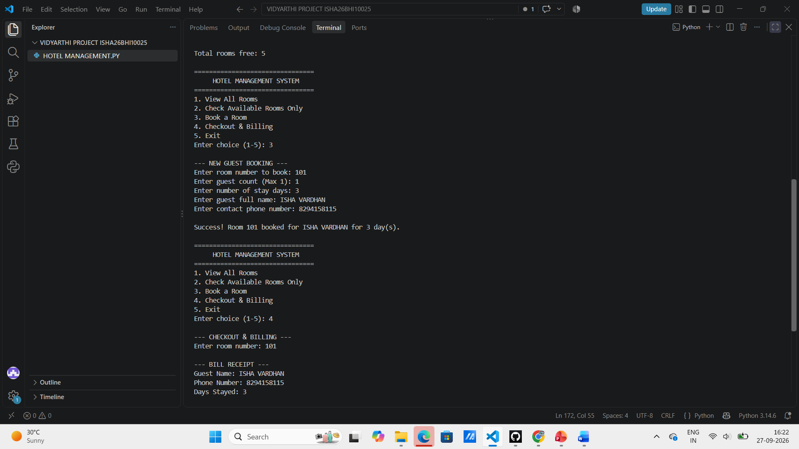

Slide 12
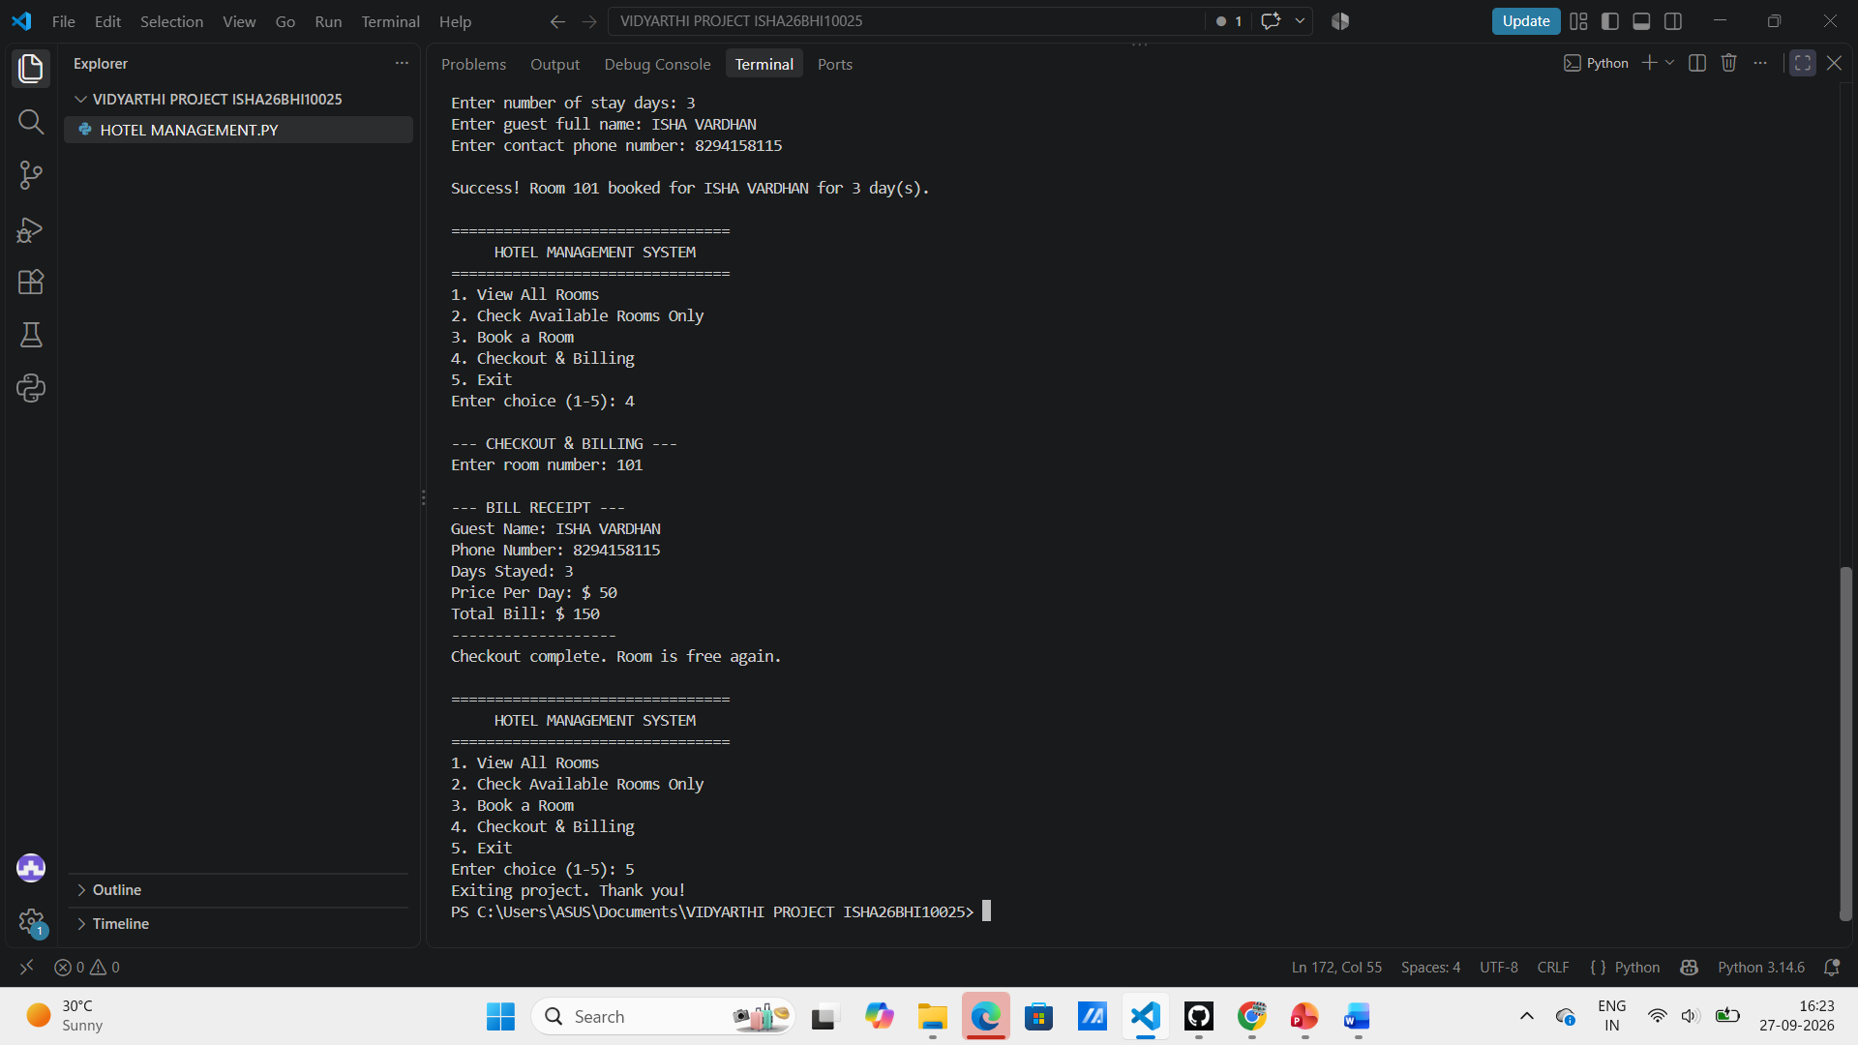

Slide 13
REPORT
THANK
YOU

