Slide 1
ONLINE FOOD ORDERING SYSTEM
MANAGED TO:
SHREE ADARSH BCA COLLEGE RADHANPUR
EXAM NO: YEAR:2023-24
GROUP NO:
SUBMITTED BY: GUIDED BY:
GAUSWAMI JAYDIP M.T.CHAUDHARI
CHAUHAN MOTISINH

Slide 2
INDEX
SR NO | TOPIC NAME | PAGE NO
1 | Project profile | 3
2 | Introduction | 4
3 | Need of online food order system | 5
4 | Hardware & Software Requirement Minimum Server-Side Requirement Minimum Client-Side Requirement | 6
5 | Specification requirement | 8
5 | Schema diagram | 12
6 | Data dictionary | 17
 | Structure of project | 21
8 | Scope and feasibility | 24
9 | System analysis | 25
10 | System design | 26
11 | Implementation | 27
12 | Screen shot User side layout Manager side layout | 28 to 43

Slide 3
Project profile
PROJECT NAME | ONLINE FOOD ORDERING SYSTEM
FRONT END TOOL | PHP , JAVASCRIPT , HTML , CSS , BOOTSTRAP
BACK END TOOL | MYSQL
OPERATING SYSTEM | WINDOW
SERVER | XAMPP

Slide 4
Introduction
Online food ordering is the process of ordering food from a website .The product can be either ready-to-eat food (e.g., direct from a certified home-kitchen, restaurant) or food that has not been specially prepared for direction consumption (e.g., vegetables direct from a farm/garden. etc).The aim of developing Online Food Ordering system project is to replace the traditional way of taking orders with computerized system. Another important reason for developing this project is to prepare order summary reports quickly and in correct format at any point of time when required

Slide 5
Need of OFOS
Helps customer to order their food at any time. The customers will be able to order their favorite dishes at any point of time, and as we have pointed out earlier, that time is a minimal option, and restaurants must have a specified system through which they can serve a huge number of customers while making their work smoother. Ordering.co is one of the best platforms which provides all of these platforms along with numerous innovative features which has turned countless small and large businesses into an inspiring leader in the online marketplace

Slide 6
Minimum Client Side Requirement
 | Hardware Requirement
➢ Ram
:2GB
: Pentium (R) Dual Core Processor
➢ Processor
: 128 GB
➢ Hard Disk
• | Software Requirement
➢ Operating System
: Windows, Mac, Linux
: any browser
➢ Application Software

Slide 7
Minimum Server Side Requirement
Hardware Requirement
➢ Ram : 4GB
➢ Processor : Pentium (R) Dual Core Processor
➢ Hard Disk : 512 GB
Software Requirement
Application Software
➢ Front-End Tool
: HTML, CSS, JavaScript, PHP, Bootstrap
➢ Back-End Tool
: MySQL
➢ Other Tool
: Adobe Photoshop cs

Slide 8
Specification Requirement
1.External Interfaces –
This interface will be actual interface through which the user will communication with the application and perform the desired tasks.
Admin login
I.D:
Role: Admin wishes to login to the system
Precondition: Username and Password
Success end Condition: Main option of screen display
Failed end Condition: User has entered incorrect
Username and Password or both

Slide 9
Edit
ID:
Precondition: User has successfully navigated to the search result
Success end Condition: User has successfully made the changes
1.To edit user records in the data base, first search the record you want to edit then click on ‘edit’ button.
2.Edit the particulars user that you want to change and click on’ Save’ button

Slide 10
2. Software Product Feature:
Online Food Order
Login Information System
Description
-The system will maintain the login information of its user to enter in to the software
Validating Checks
-Administrator need to login the unique id and password. -Contact number should have maximum 10 digits. -All the details must be fill up. -Email address should be in the proper format.

Slide 11
Sequencing information
-Login information should be filled before the user allowed.
Error Handling
-If user doesn’t filled up validate information then the system display error message for user and request to enter the validate information. Performance required
Security
-System should be Protected from unauthorized access Where the validate Username and Password are required so no other can access.
Maintainability
-System should be design in a maintain order. So it can be easily modified.

Slide 12
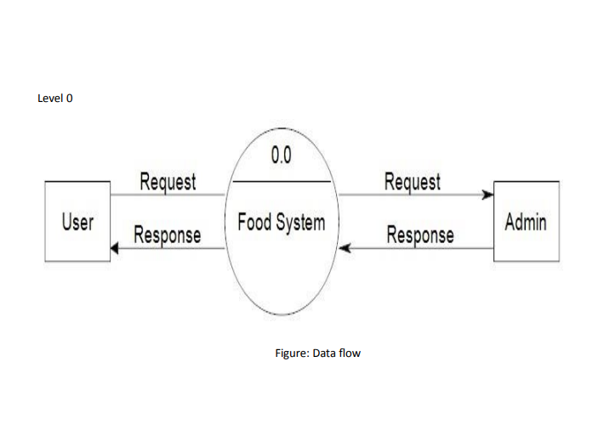
Schema diagram

Slide 13
pwd
email
Phone no
name
address
oid
oid
pid
quntity
name
oid
odate
eid
salary
Phone no
Customer
places
order
deliveryboy
employee
contains
user
regno
products
vehcle
price
vid
description
pid
name
Er diagram

Slide 14
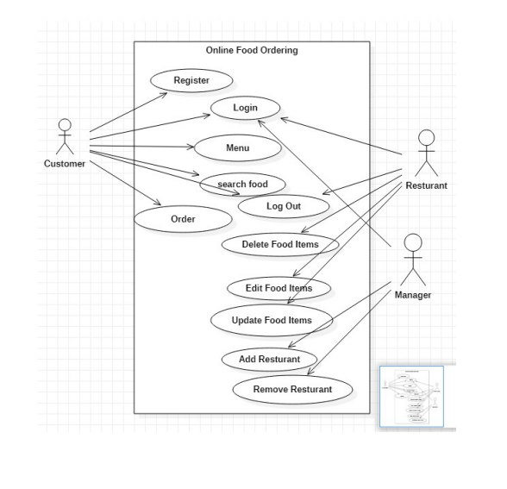
Figure: Use case Diagram of Ecommerce

Slide 15
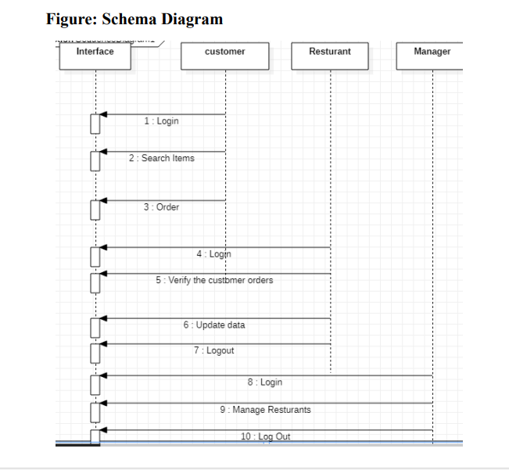

Slide 16
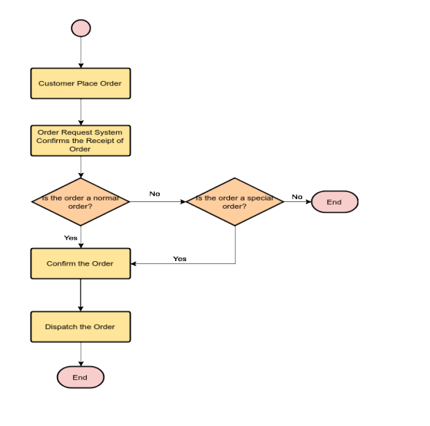
Figure: Flowchart of Ecommerce

Slide 17
Data dictionary
Logical database
Customer table:
Column | Type | Null | description
Username (primary key) | Varchar(30) | Not Null | Unique identification
Full name | Varchar(30) | Not Null | Customer name
Email | Varchar(30) | Not Null | Email id specified
Contact | Varchar(30) | Not Null | Customer Contact no
Address | Varchar(30) | Not Null | Customer address
Password | Varchar(30) | Not Null | Password for authentication

Slide 18
Indexes:
Key name | Type | Uniquie | Packed | Column | Cordinality | Collation | Null
Primary | Btree | Yes | No | Username | 5 | A | No

Slide 19
Food table
Column | Type | Null | Default | Linkes to
Fid (primary) | integer(30) | Not Null
Name | varchar(30) | Not Null
Price | int(30) | Not Null
Description | varchar(200) | Not Null
R_id (primary) | int(30) | Not Null |  | Restaurants->R_id
Images_path | varchar(200) | Not Null
Option | varchar(10) | Not Null | Enable

Slide 20
Data Design:
Data Model: A database model is a type of data model that determines the logical structure of a database and fundamentally determines in which manner data can be stored, organized and manipulated.

Slide 21
Structure of the project
Before Login
Login
Register
Administrator Login
About Us
Contact Us

Slide 22
After Administrator Login
Edit Website Details
Add Food Items
Remove food Items
Add Restaurants
Delete Restaurant
Logout

Slide 23
After User Login
My Profile
Menu
Search Food Items
My Cart
Order
Logout

Slide 24
Scope and Feasibility
This activity is also known as the feasibility study. It begins with a request from the user for a new system. It involves the following:
Identify the responsible user for a new system
Clarify the user request
Identify deficiencies in the current system
Establish goals and objectives for the new system
Determine the feasibility for the new system
Prepare a project charter that will be used to guide the remainder of the Project

Slide 25
System Analysis
It is a process of collecting and interpreting facts, identifying the problems, and decomposition of a system into its components.
Context diagram
Leveled data flow diagrams
Process specification for elementary bubbles
Data dictionary for the flow and stores on the DFDs.

Slide 26
System Design
System design involves transformation of the user implementation model into software design. The design specification of the proposed system consists of the following:
Database scheme
Structure charts
Pseudo codes for the modules in structure charts

Slide 27
Implementation
This activity includes programming, testing and integration of modules into a progressively more complete system. Implementation is the process of collect all the required parts and assembles them into a major product

Slide 28
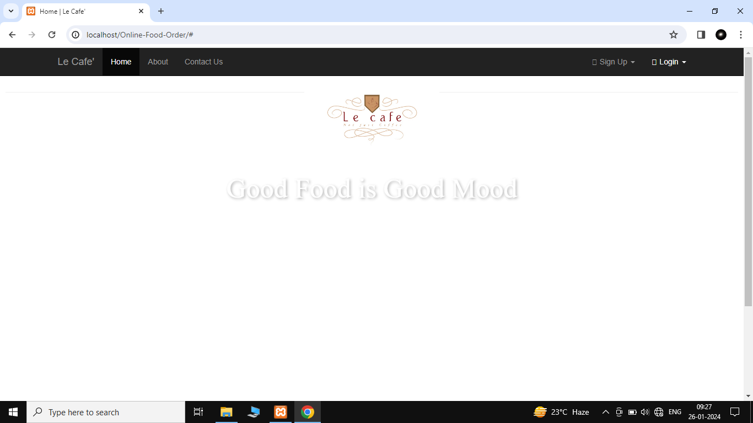
Screen Shot
Home Page

Slide 29
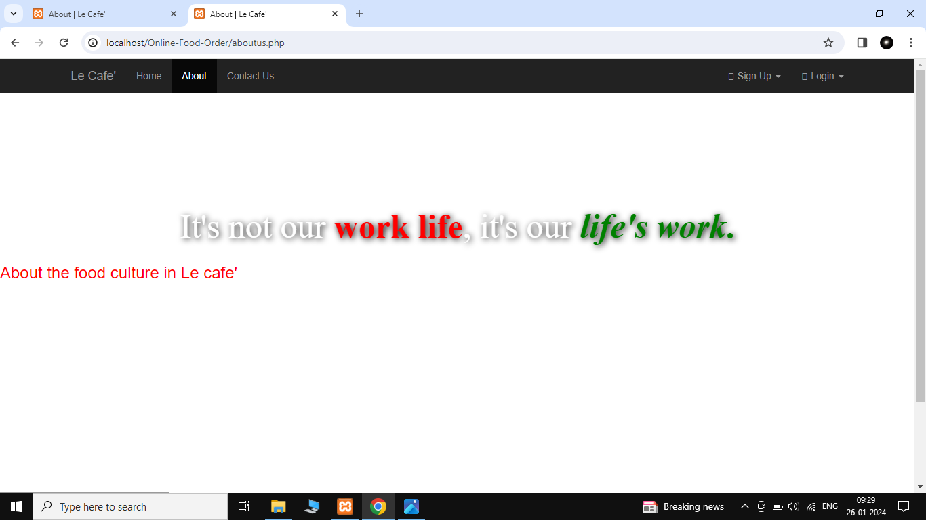
About page

Slide 30
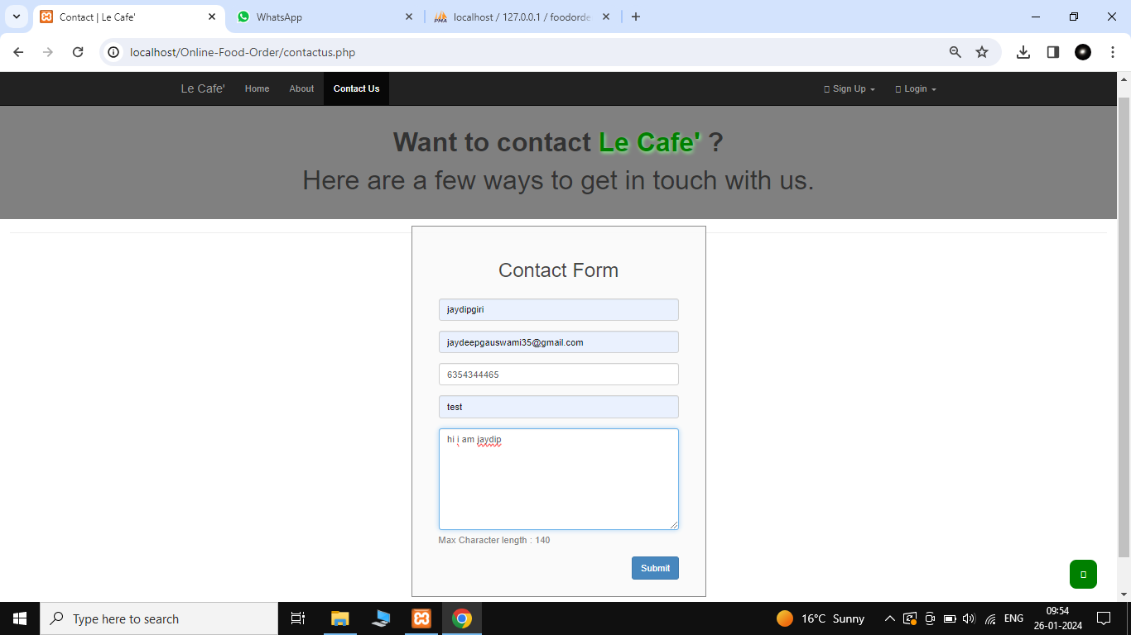
Contact page

Slide 31
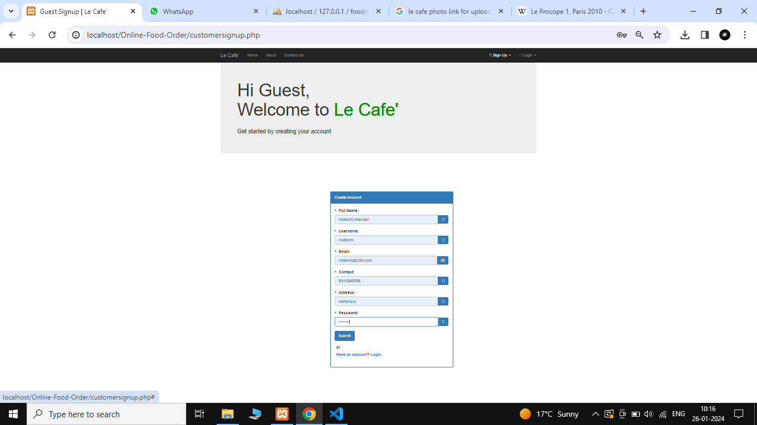
User Signup page

Slide 32
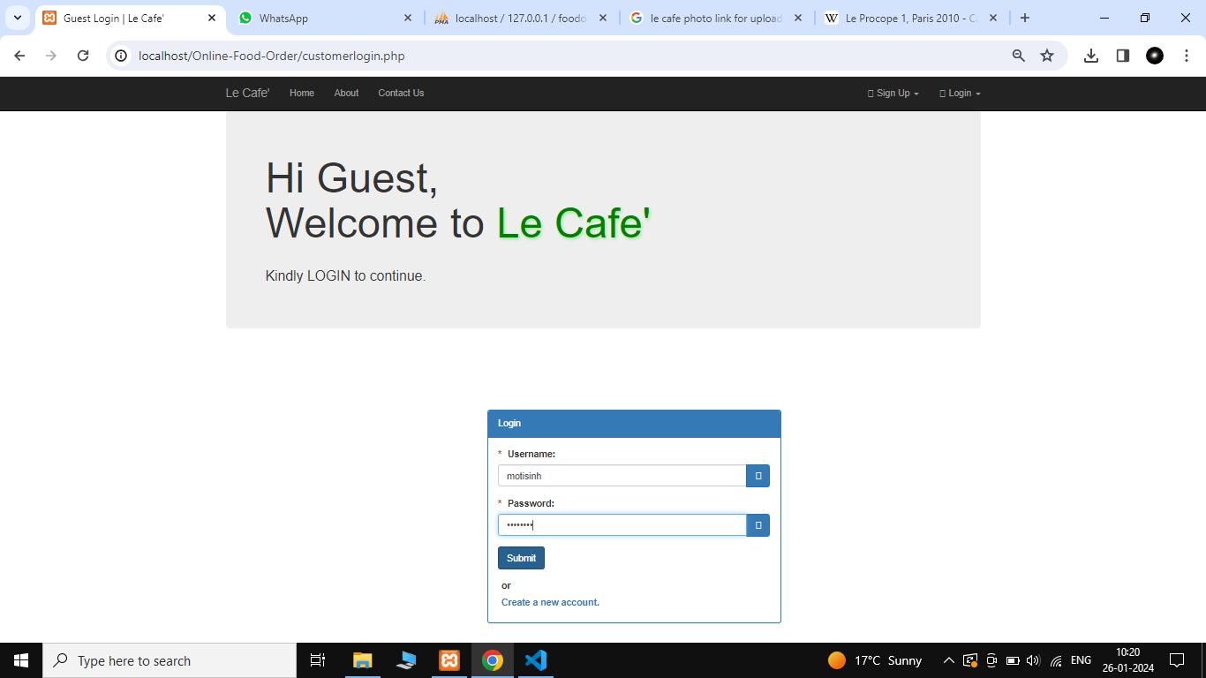
User Login page

Slide 33
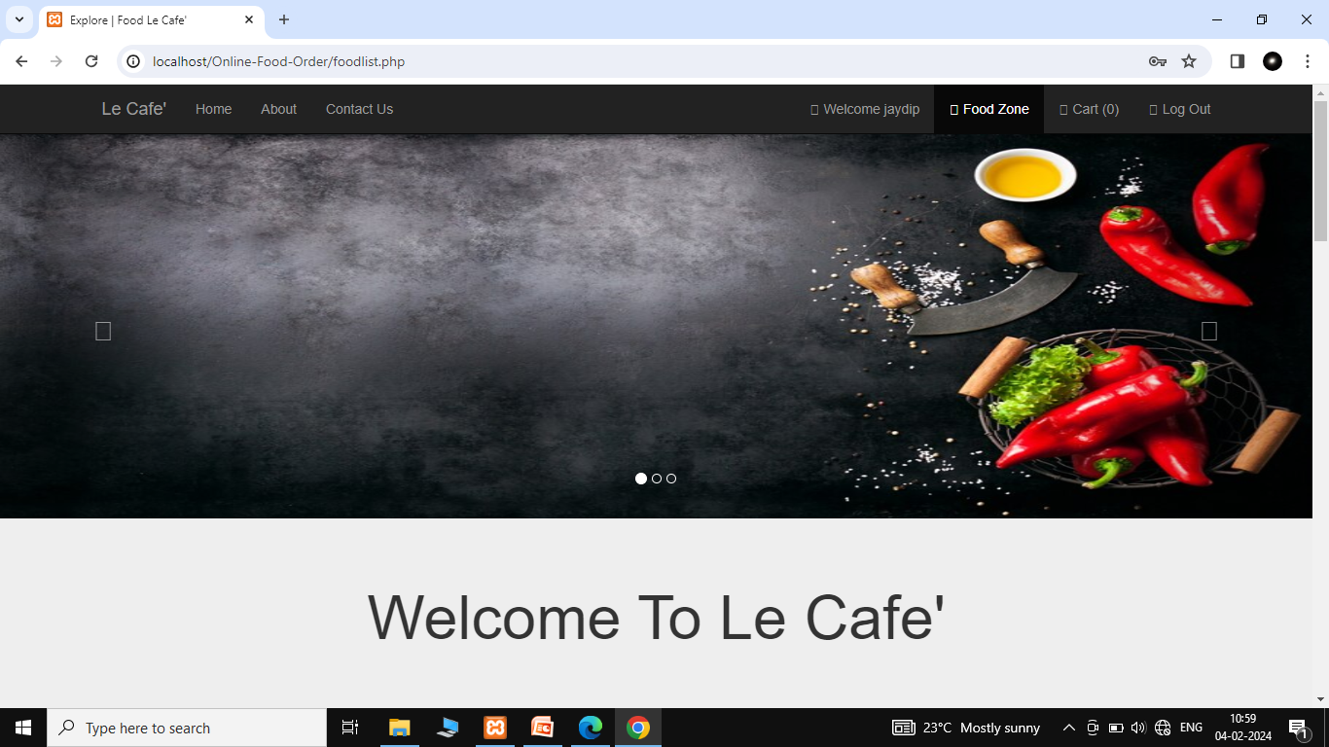
After user login food zone or food list

Slide 34
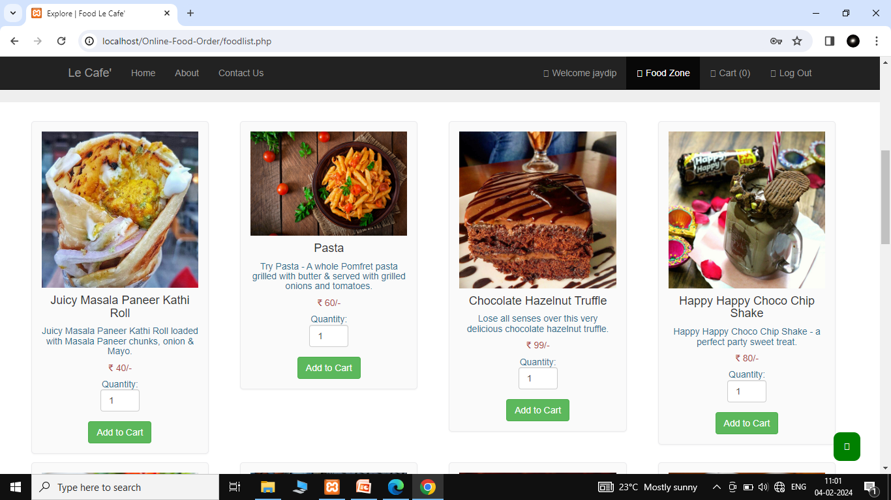
Food list

Slide 35
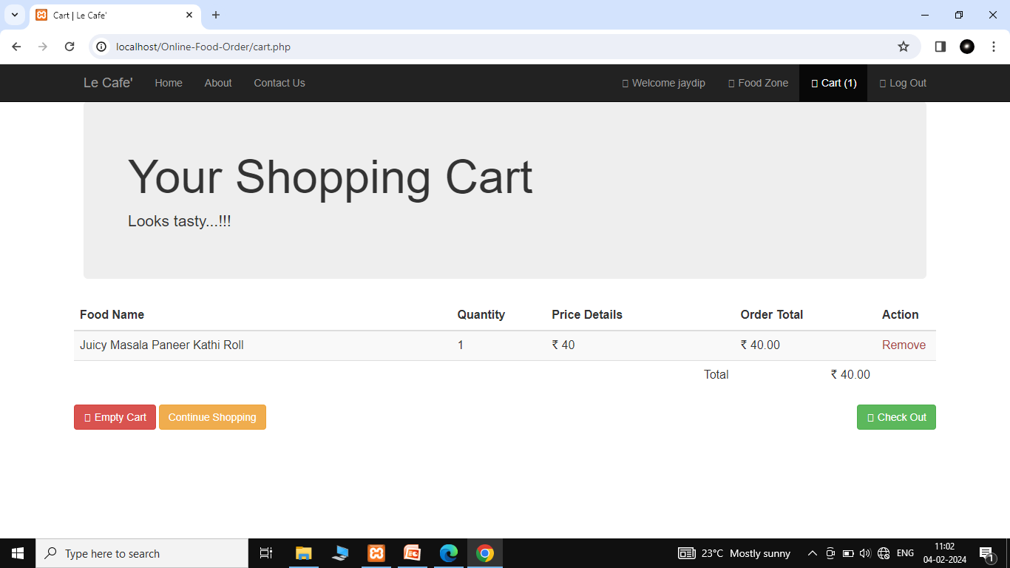
Cart

Slide 36
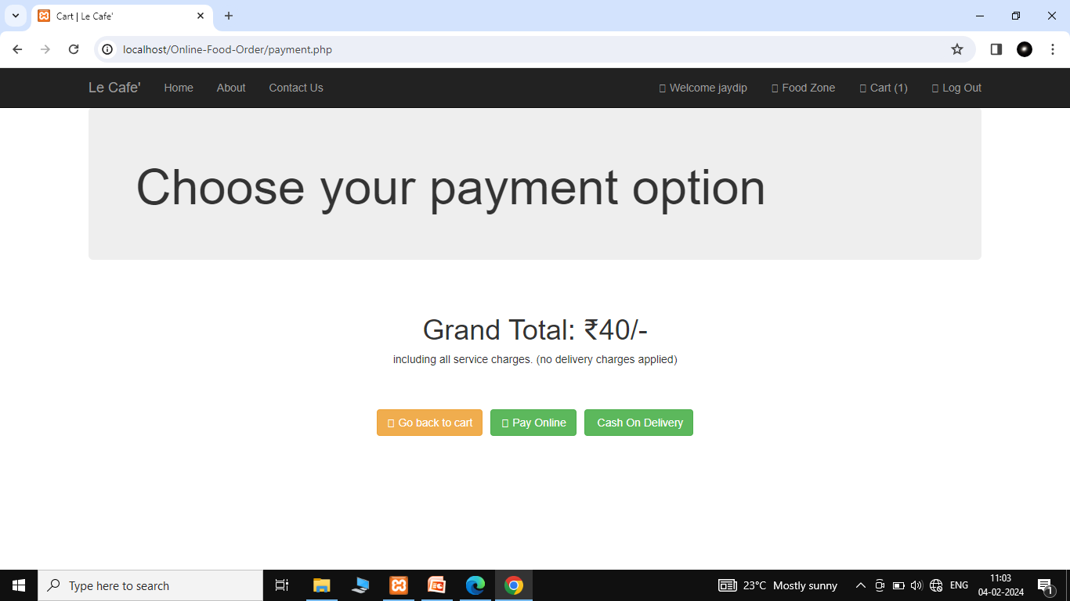
Payment option or page

Slide 37
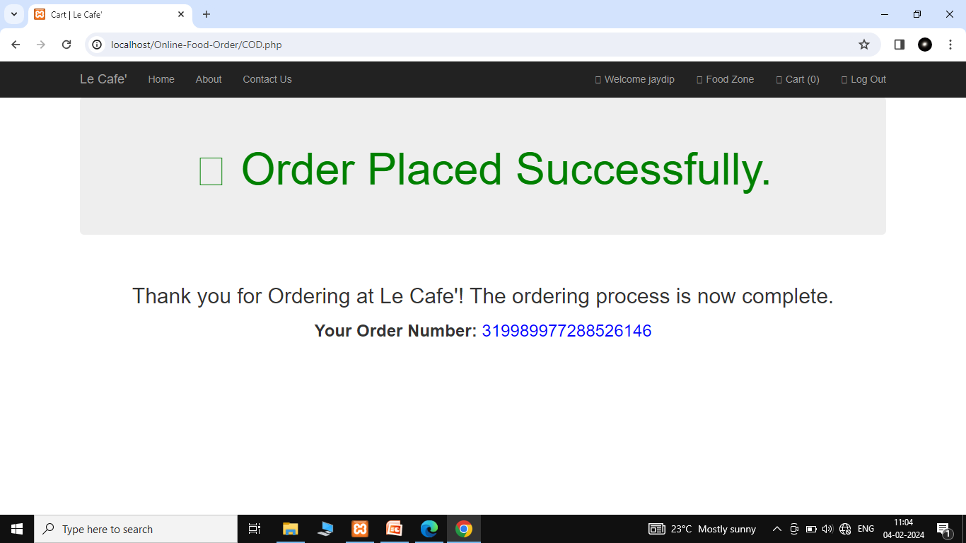
Order placed successfully

Slide 38
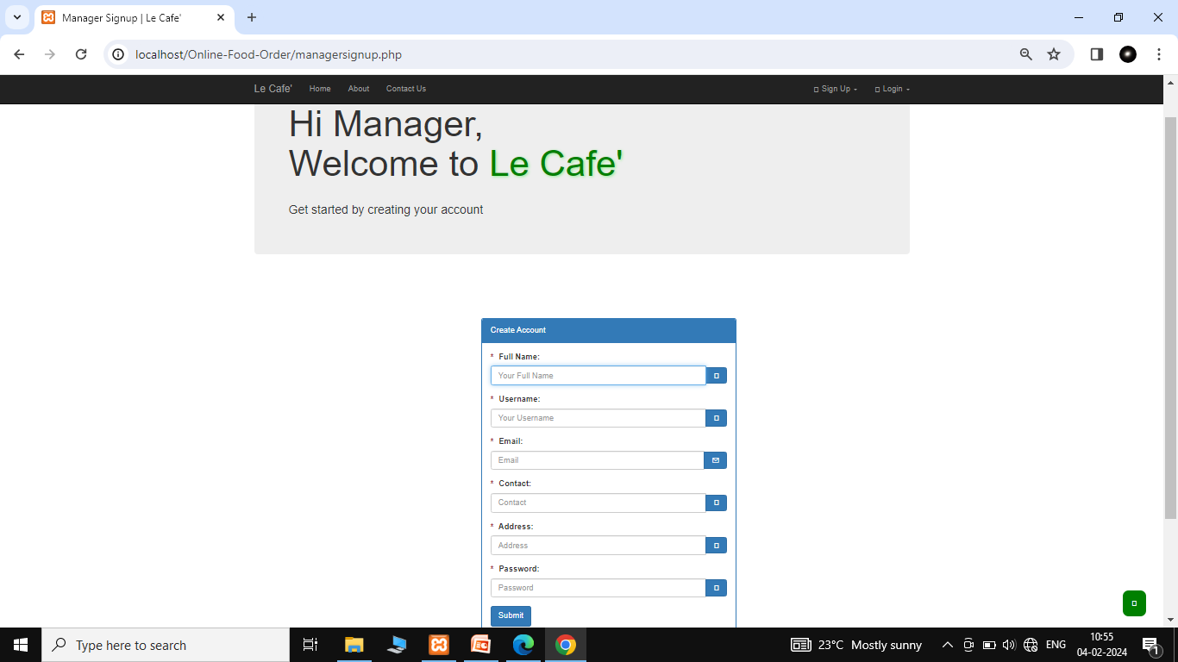
Manager signup page

Slide 39
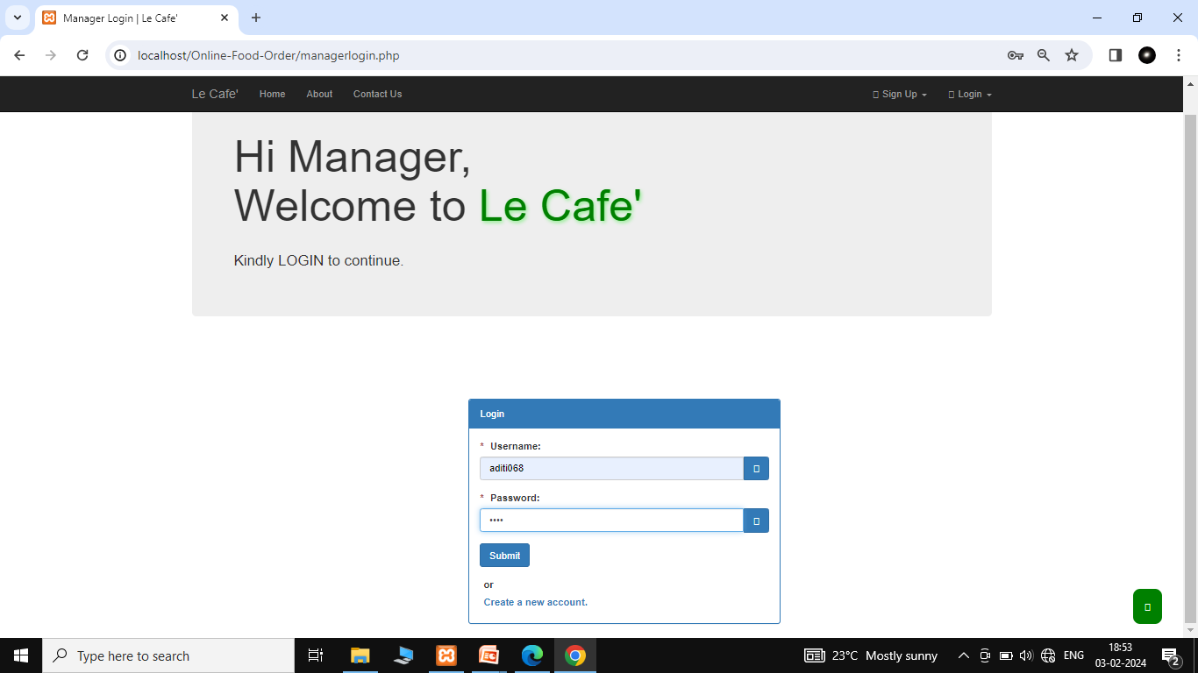
Manager login page

Slide 40
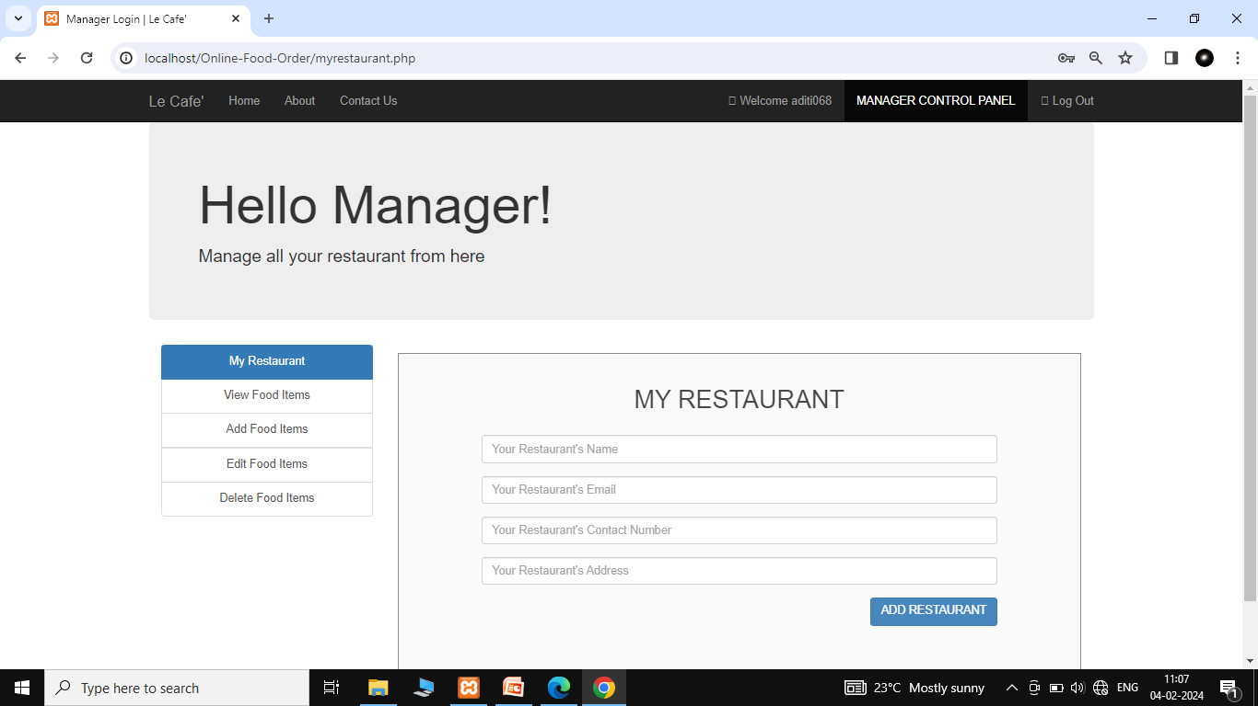
Manager control panel

Slide 41
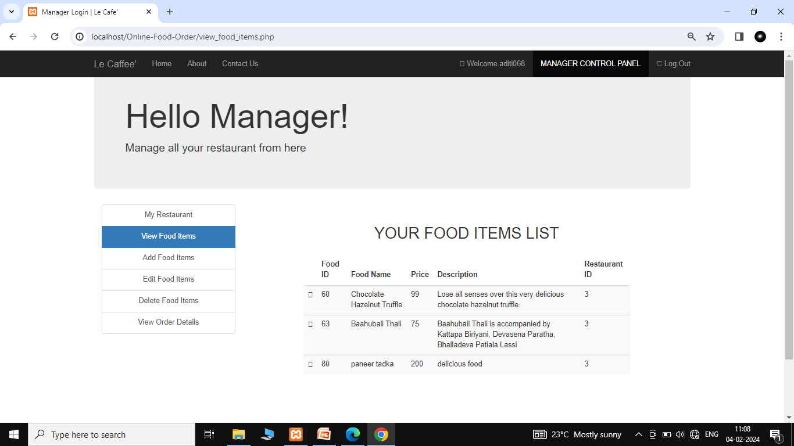
View Food item

Slide 42
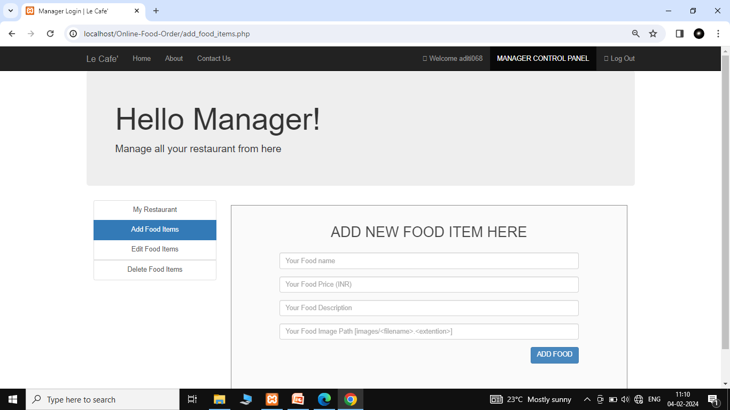
Add food items

Slide 43
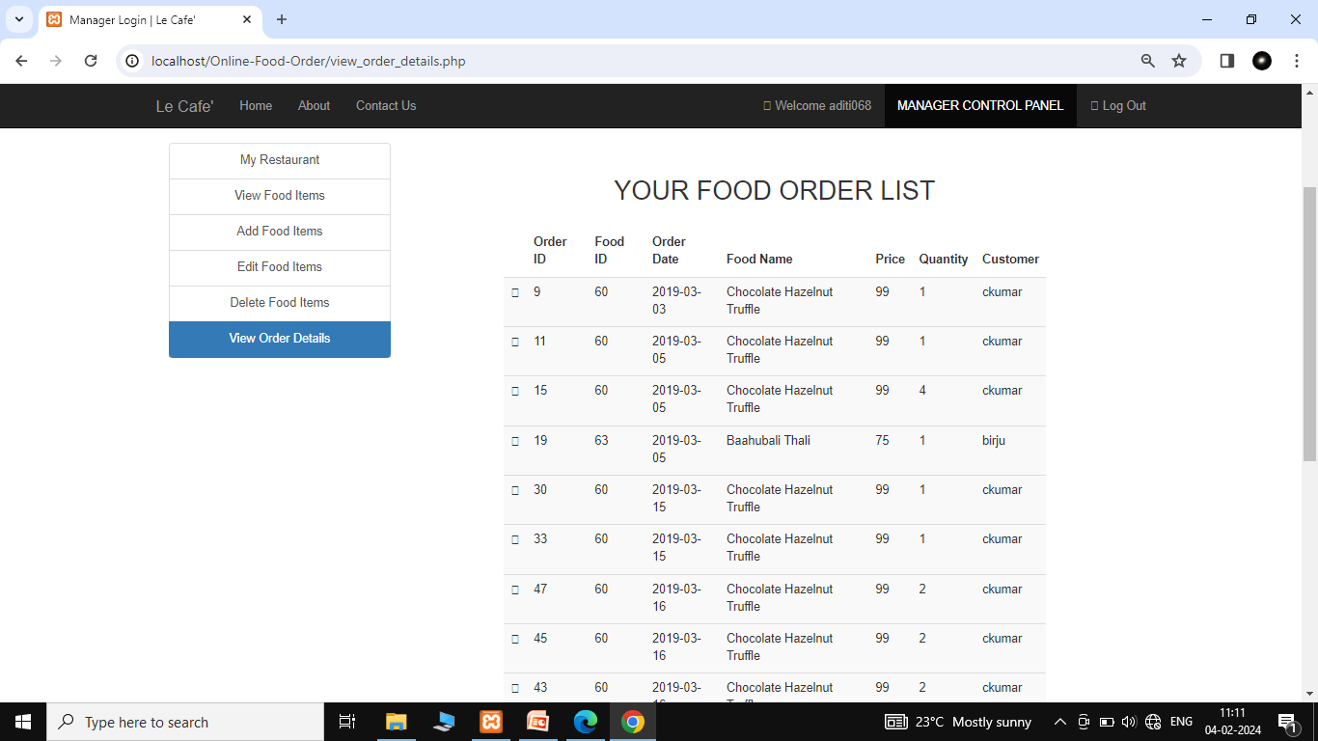
Food order list how and when order food

Slide 44
Thank you

