Slide 1
KubeCon India 2026 Highlights
Jaydipsinh Jadeja
Platform Engineer @ Acoustic

Slide 2
Agenda
• What is KubeCon?
• AI + Cloud Native
• LLM Inference
• Platform Engineering
• Policy as Code
• Chaos Engineering
• Key Trends
• Takeaways
• Q&A

Slide 3
What is KubeCon?
• CNCF's flagship conference
• Open source community
• Kubernetes ecosystem
• Latest cloud-native innovations

Slide 4
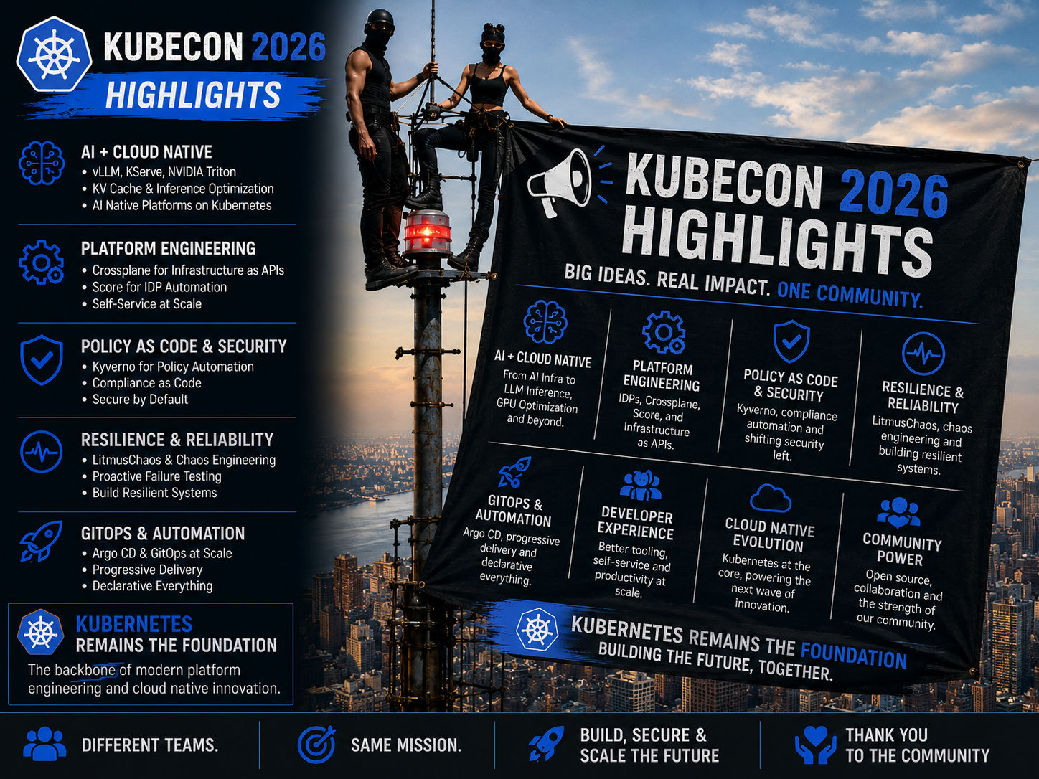

Slide 5
Biggest Themes
• AI Infrastructure
• Platform Engineering
• Security & Governance
• Reliability
• Developer Experience

Slide 6
AI + Cloud Native
• Kubernetes is becoming the AI platform
• DGX GPU clusters
• Production AI workloads
• AI infrastructure at scale

Slide 7
Production LLM Stack
User → API Gateway → KServe → vLLM/Triton → LLM → GPU
Key topics:
• Efficient inference
• GPU utilization
• Scalability

Slide 8
Platform Engineering
• Reduce infrastructure complexity
• Improve developer experience
• Enable self-service platforms

Slide 9
Crossplane
Developer → Crossplane → Cloud Resources
• Kubernetes-native infrastructure
• Infrastructure as APIs
• Multi-cloud provisioning

Slide 10
Score
Developer → score.yaml → Platform generates Kubernetes manifests
• Focus on application intent
• Simplified deployments

Slide 11
Policy as Code
Kyverno:
• Validate
• Mutate
• Generate
• Enforce security and compliance

Slide 12
AI Security
• AI agent governance
• Secure prompts
• Policy enforcement
• Safe AI workflows

Slide 13
Chaos Engineering
LitmusChaos:
• Inject failures
• Observe behavior
• Improve resilience
• Increase confidence

Slide 14
Industry Trends
2022: Containers
2023: Platform Engineering
2024: GitOps
2025: AI
2026: AI Infrastructure

Slide 15
Top 10 Takeaways
1. Kubernetes powers AI
2. LLM inference is production-ready
3. GPUs are strategic resources
4. Platform Engineering is mainstream
5. IDPs simplify development
6. Policy as Code is essential
7. Security shifts left
8. Chaos Engineering builds confidence
9. Open source accelerates AI
10. Community drives innovation

Slide 16
Resources
• CNCF
• KubeCon talks
• vLLM
• KServe
• Crossplane
• Kyverno
• LitmusChaos

Slide 17
Thank You
Questions & Discussion

