Slide 1

Ramrao Adik Institute of Technology
Department of Computer Engineering
TE Mini Project Presentation
On
“Customer Churn Prediction in Banking System”
By
Roll No. Name of Students
18CE1086
18CE1100
18CE1045
Jay Nilesh Doshi
Sanskruti Sanjay Tikone
Pramey Rajesh Dongre
Guided by
Ms. Rajashree Shedge

Slide 2
Outline
Introduction
Literature Survey of existing system
Limitations of existing system
Problem Formulation
Objectives
Proposed Methodology
Implementation Details
References
TE Mini Project Mock 1 Presentation

Slide 3

INTRODUCTION
Customer churn is a concept that is quickly gaining importance and significance, especially in the world's leading and competing organizations. Customer churn can be defined as the group customers or subscribers that discontinue a service over a specific period. It is one of the of the central factors that determines the steady-state of the customer pool that a business can support.The reasons can for example be:
• Availability of latest technology.
• Customer-friendly bank staff.
• Low interest rates.
• Location.
Good customer care facility
• Services offered.
• Churn rate usually lies in the range from 10% up to 30%
BE Project Mock Presenation

Slide 4
INTRODUCTION
• Prediction models are used to identify customers who are likely to churn
• The model uses historical data on former churners and tries to find some similarity with existing customers
• If some similarity is found those customers are classified as potential churners.
BE Project Mock Presenation

Slide 5
LITERATURE STUDY
M.A.H. Farquad [1] proposed a hybrid approach to overcome the drawbacks of general SVM model which generates a black box model (i.e., it does not reveal the knowledge gained during training in human understandable form). The hybrid approach contains three phases:
1) SVM-RFE (SVM-recursive feature elimination) is employed to reduce the feature set.
2) dataset with reduced features is then used to obtain SVM model and support vectors are extracted.
3) rules are then generated using Naive Bayes Tree . The dataset used here is bank credit card customer dataset (Business Intelligence Cup 2004) which is highly unbalanced with 93.24% loyal and 6.76% churned customers. The experimental showed that the model does not scalable to large datasets.
TE Mini Project Mock 1 Presentation

Slide 6
LITERATURE STUDY
Wouter Verbeke [2] proposed the application of Ant-Miner+ and ALBA algorithms on a publicly available churn prediction dataset in order to build accurate as well as comprehensible classification rule-sets churn prediction models.
Ant-Miner+ is a high performing data mining method based on the principles of Ant Colony Optimization which allows to include domain knowledge by imposing monotonicity constraints on the final rule-set.
The advantages of Ant-Miner+ are high accuracy, comprehensibility of the generated models and the possibility to demand intuitive predictive models. Ant-Miner+ results in less sensitive rule-sets, but allows to include domain knowledge, and results in comprehensible rule-sets
TE Mini Project Mock 1 Presentation

Slide 7
LITERATURE STUDY
Ning Lu [3] proposed the use of boosting algorithms to enhance a customer churn prediction. Logistic regression is used as a basis learner, and a churn prediction model is built on each cluster, respectively. The experimental results suggest that boosting algorithm provides a good separation of churn data when compared with a single logistic regression model.
In general, the performance of rotation-based ensemble classifier depends upon:
the performance criteria used to measure classification performance and
the implemented feature extraction algorithm.
Our literature study concludes that following algorithms are ideal for customer churn problem :
a) Decision Tree. b) Logistic Regression. c)Neural Networks.
TE Mini Project Mock 1 Presentation

Slide 8
LIMITATIONS OF EXISTING MODELS
SVM-RFE | AntMiner+ALBA | Logistic Regression
The results of using SVM-RFE model are very good, and this method is quickly taken as a benchmark feature selection algorithm. | AntMiner + and ALBA provide a relatively low number of rules. | Logistic Regression model works best when combined with other boosting algorithms.
However, it does not take into account the correlation probably hidden between features during the feature selection process. | This algorithm runs slower for huge datasets. | Customer data in banking sector is highly skewed so LR model has to be combined with lot many models.
BE Project Mock Presenation

Slide 9
OBJECTIVES
Study the importance of data preprocessing, data normalization and feature selection.
Carefully analyze and assess six-month aggregate credit card usage volumes for active and churned users given by an anonymous financial provider.
Carry out statistical and decision tree analyses for dataset from financial provider and and accompanying theses.
Correlate and compare the results to know which features could be used to predict churn.
Finally, affirm the necessary information required for prominent churn prediction
BE Project Mock Presenation

Slide 10
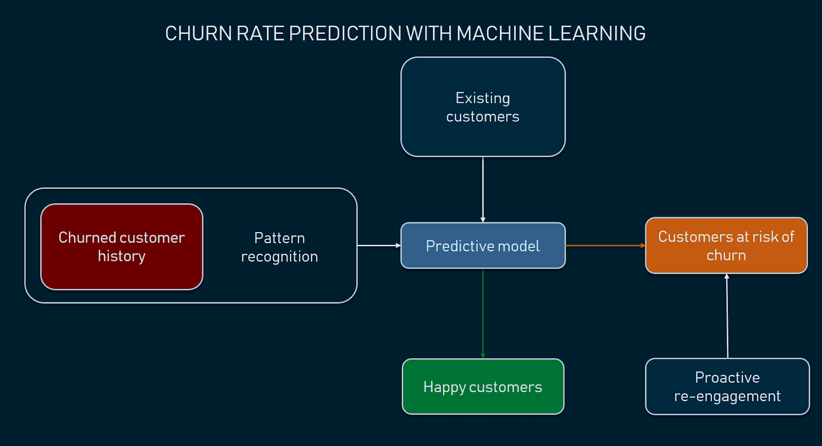
PROPOSED METHODOLOGY
BE Project Mock Presenation

Slide 11
PROPOSED METHODOLOGY
Problem Formulation:
In the competitive business industry, public policies, banking sector and standardization of mobile communication allow customers to easily switch over from one carrier to another, resulting in a strained fluidic market. Churn prediction, or the task of identifying customers who are likely to discontinue use of a service, is an important and lucrative concern of the Banking Industry. The aim of this project is to study and analyze customer churn prediction based on monetary usage volumes with respect to QoE and users’ perspective with the help of Big Data analytics.
Customer churn is always a grievous issue for the business industry as customers do not hesitate to leave if they don’t find what they are looking for. Customer churning is directly related to customer satisfaction. There is no standard model which addresses the issues of global company service providers accurately. Each time the scenario varies depending on the company’s various new policies or perhaps a behavioral change in the mindset of the customer.
BE Project Mock Presenation

Slide 12
PROPOSED METHODOLOGY
Sample Problem Statement
Context :-“ Predict behavior to retain customers. You can analyze all relevant customer data and develop focused customer retention programs.” [Kaggle Data set]
Content :-
Each row represents a customer, each column contains customer’s attributes described on the column Metadata.
The data set includes information about: Customers who left within the last year — the column is called Exited which shows that each customer has left the services.
Customer account information — how long they’ve been a customer, number of products they use, average salary, account balance, country of origin, gender, age, and credit scores, whether they have credit card/not and whether they are an active member or not.
BE Project Mock Presenation

Slide 13
PROPOSED METHODOLOGY
Collecting Data:
The first step requires us to think about who will be interacting with our model, and the various data it will be handling as a result.
Data collected should be free from or contain minimum null/inaccurate values.
Data should not be imbalanced.
Kaggle is an online community of data scientists and machine learners.
It allows users to:
Find and publish data sets
Explore and build models in a web-based data-science environment
Work with other data scientists and machine learning engineers
BE Project Mock Presenation

Slide 14
PROPOSED METHODOLOGY
Data Preprocessing:
Cleaning the data and extracting the important features from the data using various techniques.
This step is responsible for extracting the important attributes from the meta-data accompanying every customer.
BE Project Mock Presenation

Slide 15
PROPOSED METHODOLOGY
Modelling:
Applying and training the different models with appropriate hyperparameters and optimization techniques.
Develop the best model able to formulate a target value fast and well enough. We can achieve this goal through model tuning. That’s the optimization of model parameters to achieve an algorithm’s best performance.
We can judge the different models based on the decided performance metrics such as accuracy,F1 score etc.
BE Project Mock Presenation

Slide 16
PROPOSED METHODOLOGY
Proposed Models:
These are the models that we will try to use now:
Stochastic Gradient Descent (SGD) classifier
Logistic Regression
Random Forest Classifier
BE Project Mock Presenation

Slide 17
PROPOSED METHODOLOGY
Stochastic Gradient Descent (SGD) classifier: -
The word ‘stochastic ‘means a system or a process that is linked with a random probability. Hence, in Stochastic Gradient Descent, a few samples are selected randomly instead of the whole data set for each iteration.
SGD randomly picks one data point from the whole data set at each iteration to reduce the computations enormously.
It is also common to sample a small number of data points instead of just one point at each step and that is called “mini-batch” gradient descent. Mini-batch tries to strike a balance between the goodness of gradient descent and speed of SGD.
BE Project Mock Presenation

Slide 18
PROPOSED METHODOLOGY
Advantages of Stochastic Gradient Descent:
It is easier to fit in the memory due to a single training example being processed by the network.
It is computationally fast as only one sample is processed at a time.
For larger datasets, it can converge faster as it causes updates to the parameters more frequently.
Disadvantages of Stochastic Gradient Descent
Due to frequent updates, the steps taken towards the minima are very noisy. This can often lean the gradient descent into other directions.
Also, due to noisy steps, it may take longer to achieve convergence to the minima of the loss function.
Frequent updates are computationally expensive because of using all resources for processing one training sample at a time
BE Project Mock Presenation

Slide 19
PROPOSED METHODOLOGY
2. Logistic Regression: -
Logistic regression is one of the most popular Machine Learning algorithms, which comes under the Supervised Learning technique. It is used for predicting the categorical dependent variable using a given set of independent variables.
Logistic regression predicts the output of a categorical dependent variable. Therefore, the outcome must be a categorical or discrete value. It can be either Yes or No, 0 or 1, true or False, etc. but instead of giving the exact value as 0 and 1, it gives the probabilistic values which lie between 0 and 1.
Logistic Regression is much similar to the Linear Regression except that how they are used. Linear Regression is used for solving Regression problems, whereas Logistic regression is used for solving the classification problems.
In Logistic regression, instead of fitting a regression line, we fit an "S" shaped logistic function, which predicts two maximum values (0 or 1).
BE Project Mock Presenation

Slide 20
PROPOSED METHODOLOGY
Advantages of Logistic Regression: -
Logistic Regression is one of the simplest machine learning algorithms and is easy to implement yet provides great training efficiency in some cases.
The predicted parameters (trained weights) give inference about the importance of each feature. The direction of association i.e. positive or negative is also given.
Rather than straight away starting with a complex model, logistic regression is sometimes used as a benchmark model to measure performance, as it is relatively quick and easy to implement.
Disadvantages of Logistic Regression: -
Non-linear problems can't be solved with logistic regression since it has a linear decision surface. Linearly separable data is rarely found in real world scenarios. So, the transformation of non-linear features is required.
It is difficult to capture complex relationships using logistic regression. More powerful and complex algorithms such as Neural Networks can easily outperform this algorithm.
Only important and relevant features should be used to build a model otherwise the probabilistic predictions made by the model may be incorrect and the model's predictive value may degrade.
BE Project Mock Presenation

Slide 21
PROPOSED METHODOLOGY
3. Random Forest Classifier: -
Random forest, like its name implies, consists of a large number of individual decision trees that operate as an ensemble. Each individual tree in the random forest spits out a class prediction and the class with the most votes become our model’s prediction.
The fundamental concept behind random forest is a simple but powerful one — the wisdom of crowds. In data science speak, the reason that the random forest model works so well is: A large number of relatively uncorrelated models (trees) operating as a committee will outperform any of the individual constituent models.
The low correlation between models is the key. The reason for this wonderful effect is that the trees protect each other from their individual. While some trees may be wrong, many other trees will be right, so as a group the trees are able to move in the correct direction.
BE Project Mock Presenation

Slide 22
PROPOSED METHODOLOGY
Advantages of Random Forest Classifier: -
Random forest can solve both type of problems that is classification and regression and does a decent estimation at both fronts.
One of benefits of Random Forest is that it can handle thousands of input variables and identify most significant variables so it is considered as one of the dimensionality reduction method.
It has an effective method for estimating missing data and maintains accuracy when large proportion of the data are missing.
It has methods for balancing errors in data sets where classes are imbalanced.
BE Project Mock Presenation

Slide 23
PROPOSED METHODOLOGY
Disadvantages of Random Forest Classifier: -
Model interpretability: Random forest models are not all that interpretable; they are like black boxes.
For very large data sets, the size of the trees can take up a lot of memory.
It can tend to overfit, so you should tune the hyperparameters.
BE Project Mock Presenation

Slide 24
IMPLEMENTATION SOFTWARE
GOOGLE COLABORATORY
Colaboratory, or “Colab” for short, is a product from Google Research.
Colab allows anybody to write and execute arbitrary python code through the browser, and is especially well suited to machine learning, data analysis and education.
More technically, Colab is a hosted Jupyter notebook service that requires no setup to use, while providing free access to computing resources including GPUs.
Colab is free to use.
BE Project Mock Presenation

Slide 25
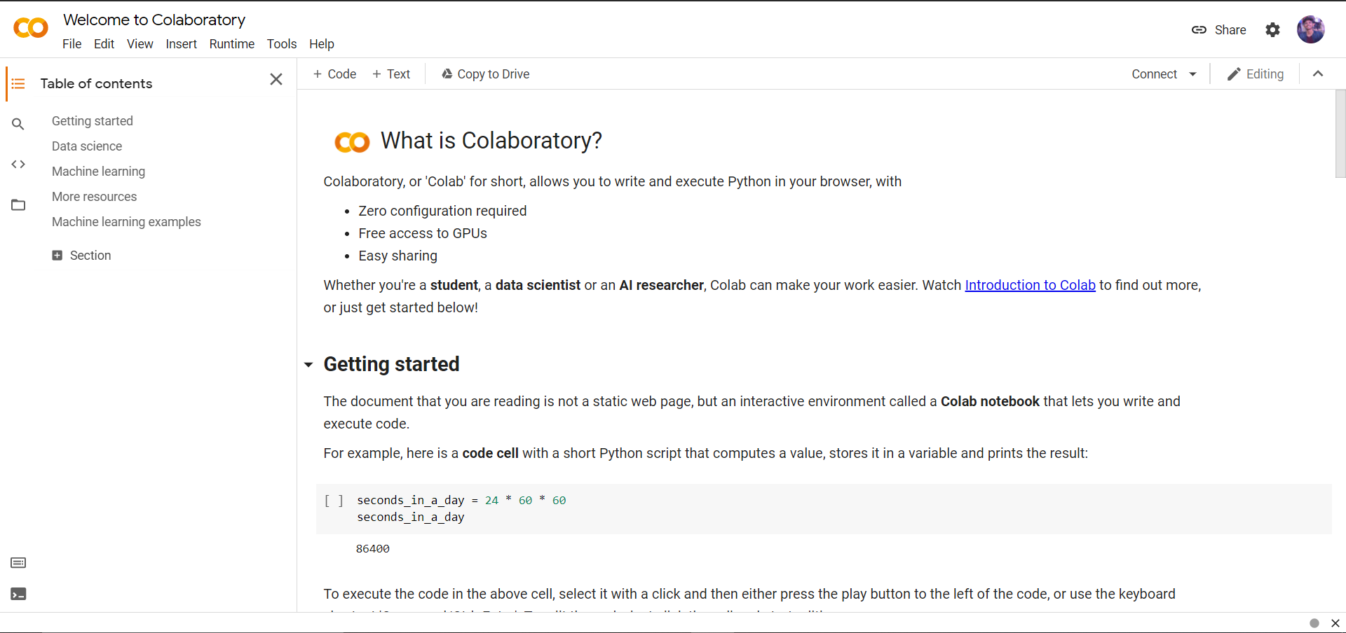
IMPLEMENTATION SOFTWARE
GOOGLE COLABORATORY
BE Project Mock Presenation

Slide 26
IMPLEMENTATION ENVIRONMENT
IMPLEMENTATION STEPS:
STEP 1 : Data selection.
STEP 2 : Data preparation / pre-processing.
STEP 3 : Exploratory Data Analysis
STEP 4 : Modelling and Testing
BE Project Mock Presenation

Slide 27
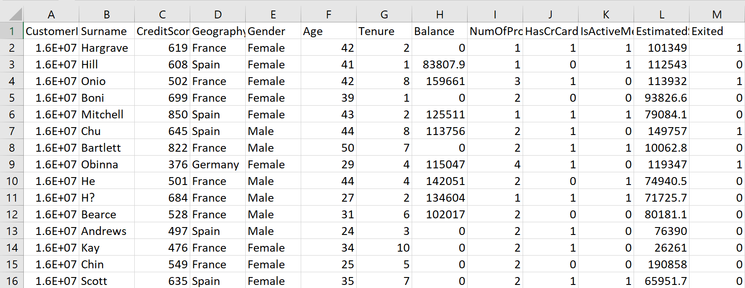
DATA SELECTION
Dataset contains of 13 columns and 10,000 rows.
Dataset Source : www.kaggle.com
BE Project Mock Presenation

Slide 28
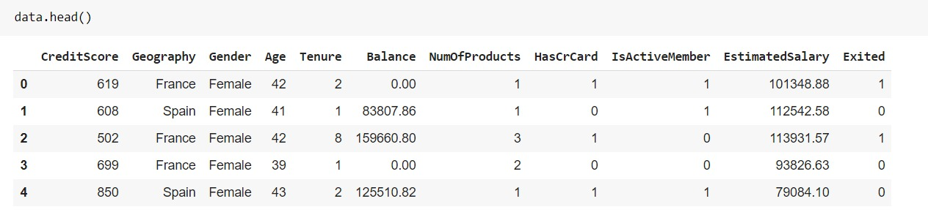
DATA PREPARATION/PREPROCESSING
STEP 2 : Data Preparation/Preprocessing
2.1 - Dropping useless features.
For example: CustomerID , Surname.
BE Project Mock Presenation

Slide 29
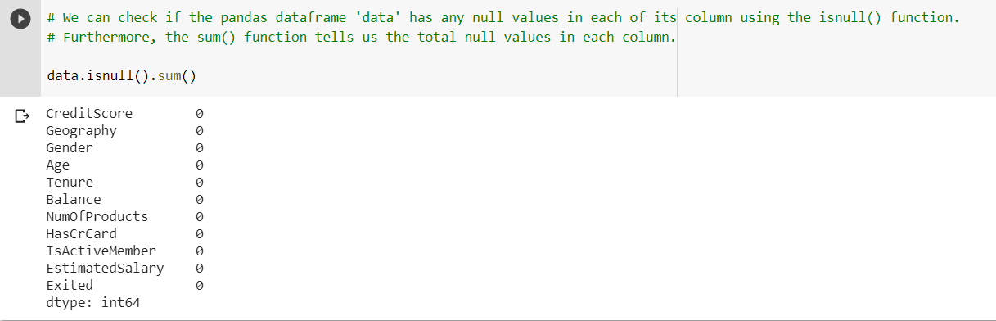
DATA PREPARATION/PREPROCESSING
2.2 – Checking for and removing null values (if any) .
Surprisingly, our dataset contains no null values.
Therefore there is no need for pre-processing step.
BE Project Mock Presenation

Slide 30
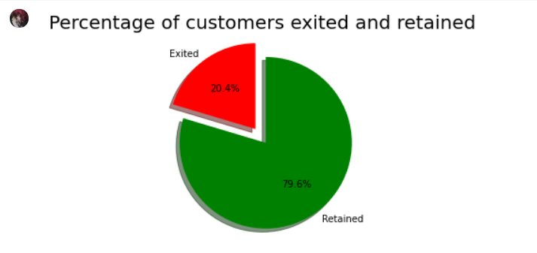
EXPLORATORY DATA ANALYSIS
Step 3 : Exploratory Data Analysis
3.1 – Finding percentage of customers churned and retained.
BE Project Mock Presenation

Slide 31
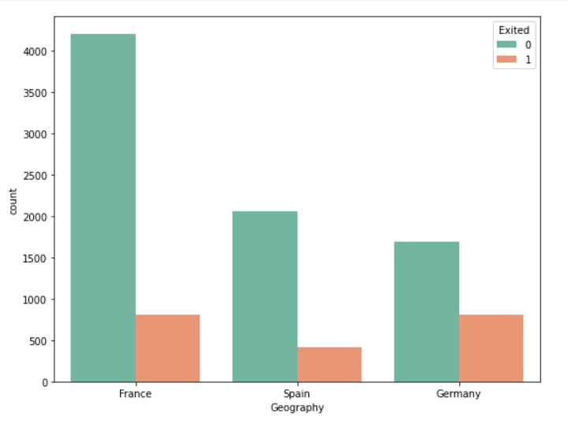
EXPLORATORY DATA ANALYSIS
3.2 - Count column plots to map the dependence of 'Exited' column on categorical features
Dependance on geography:
BE Project Mock Presenation

Slide 32
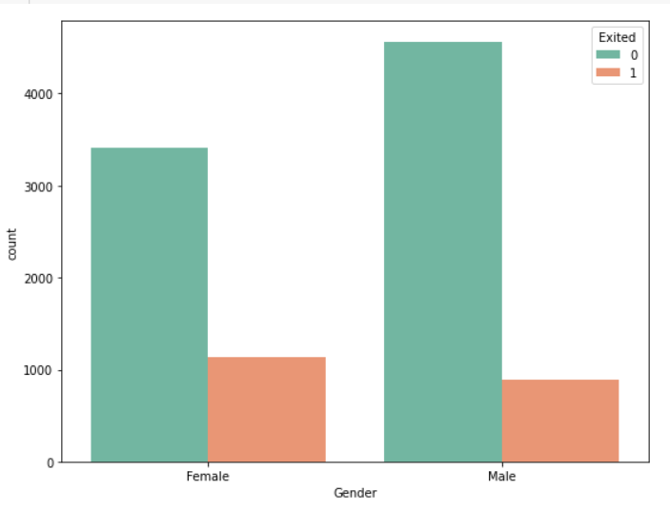
EXPLORATORY DATA ANALYSIS
B) Dependance on Gender:
BE Project Mock Presenation

Slide 33
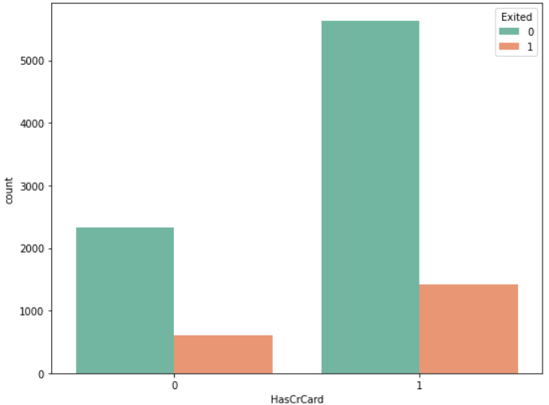
EXPLORATORY DATA ANALYSIS
C) Dependance on owning of Credit card :
BE Project Mock Presenation

Slide 34
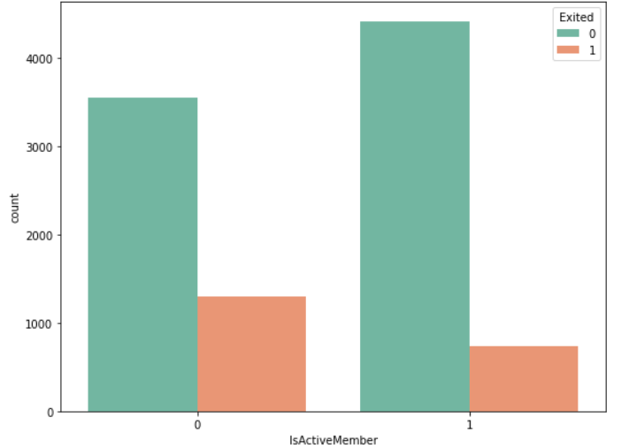
EXPLORATORY DATA ANALYSIS
D) Dependance on whether an Active member or not:
BE Project Mock Presenation

Slide 35
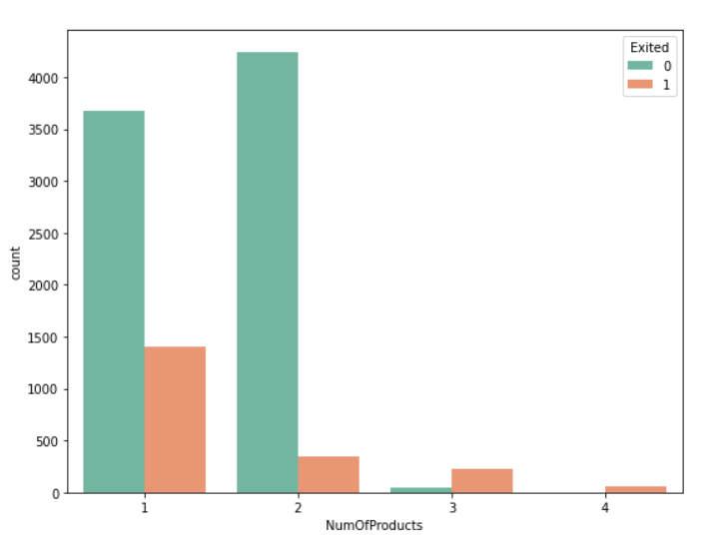
EXPLORATORY DATA ANALYSIS
E) Dependance on Number of products owned:
BE Project Mock Presenation

Slide 36
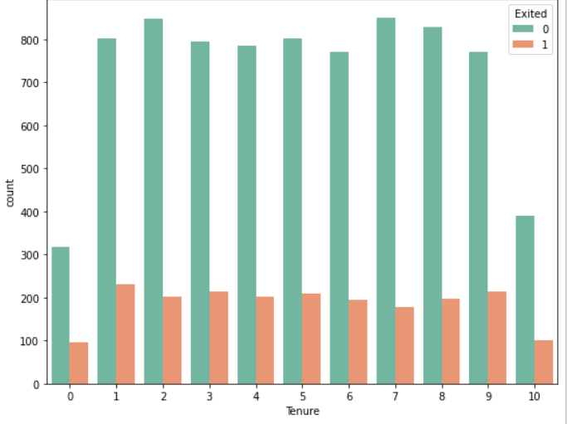
EXPLORATORY DATA ANALYSIS
F) Dependance on Tenure:
BE Project Mock Presenation

Slide 37
EXPLORATORY DATA ANALYSIS
Observations
Geography: Ideally for an evenly-distributed data, if the amount of people from a place is the majority, then the majority of churning should also be within that group. However, it is not so in this case as we see that number of exited people who belong to Germany is almost equal to the number of exits from France.
Gender: We can clearly see the Female customers had more exits than the male customers.
Credit cards: It is generally expected that people who have more interactions and products of the bank, would likely be retained for a longer time. However, we can see that people who have credit cards have more exits than those who do not own credit cards.
Active Member: This is an expected observation. We can see that inactive members have been churned more than members who are active.
Number of Products: This is also an expected observation, where we see that customers who own more products from the bank are likely to be retained for a longer time than those who own less products.
Tenure: We see that the tenure of a customer does not really tell us much if that customer is likely to be churned or not. Initially, it looks like new joinees and older people (10 years) have been churned less. However, on a closer analysis we can see that the overall number of retained customer are significantly less in both these cases. As a result, we can probably conclude that new joinees and older customers may be more likely to be churned as their churn rate (percentage) is likely to be higher than other tenure rates.
BE Project Mock Presenation

Slide 38
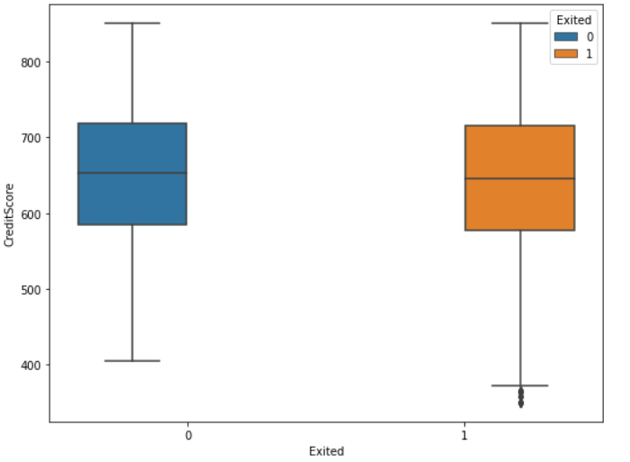
EXPLORATORY DATA ANALYSIS
3.3 - Count column plots to map the dependence of 'Exited' column on continuous
and numerical features
A) Dependance on Credit Score:
BE Project Mock Presenation

Slide 39
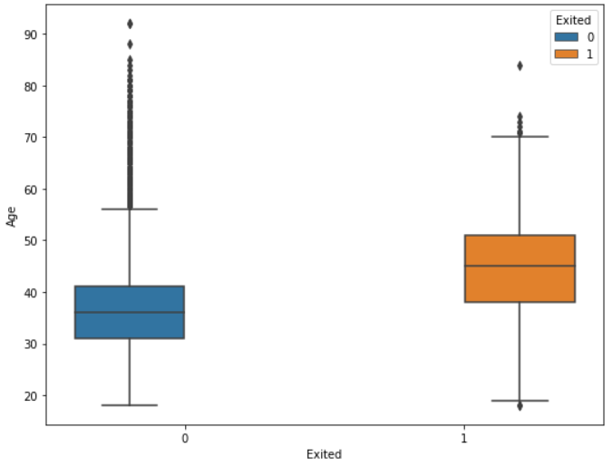
EXPLORATORY DATA ANALYSIS
B) Dependance on Age:
BE Project Mock Presenation

Slide 40
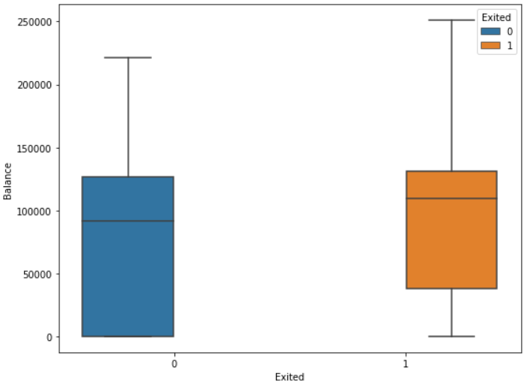
EXPLORATORY DATA ANALYSIS
C) Dependance on Balance:
BE Project Mock Presenation

Slide 41
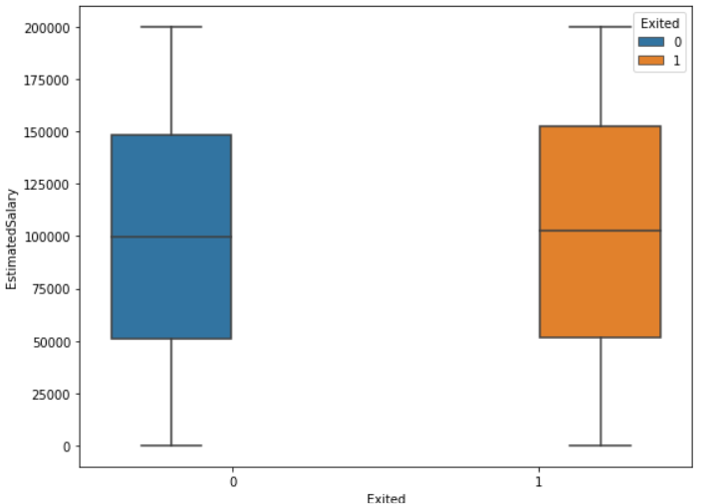
EXPLORATORY DATA ANALYSIS
D) Dependance on Estimate Salary:
BE Project Mock Presenation

Slide 42
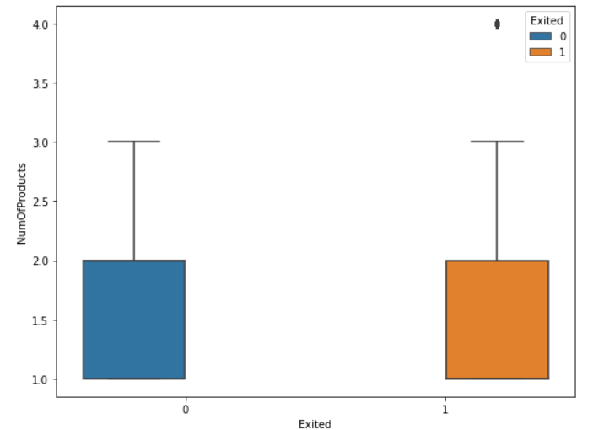
EXPLORATORY DATA ANALYSIS
E) Dependance on Number of products:
BE Project Mock Presenation

Slide 43
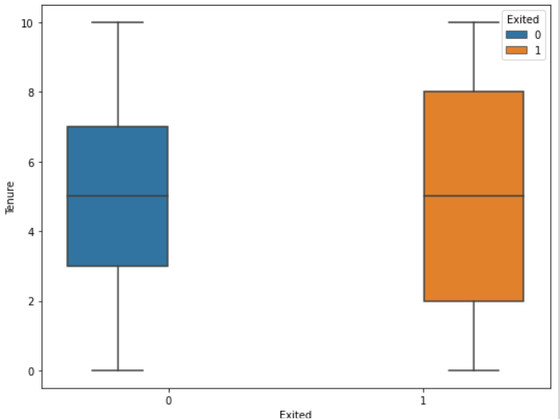
EXPLORATORY DATA ANALYSIS
F) Dependance on Tenure:
BE Project Mock Presenation

Slide 44
EXPLORATORY DATA ANALYSIS
Observations
Credit Score: We can see that Credit Score does not have much effect on the customer churn.
Age: Here we can see that the older customers are more likely to be churned from the bank. This is most probably to keep a younger manpower in the organization.
Balance: When it comes to Balance, we see that the bank is losing a significant number of customers with high balance in their accounts. This is likely to affect the bank's capital as well.
Estimated Salary: Estimated Salary does not seem to affect the customer churn much.
Number of Products: We see that the number of products also does not seem to affect the customer churn.
Tenure: For tenure, as we can see here too, customer belonging more to the two extreme tenure groups (new joinees and older ones) are more likely to be churned.
BE Project Mock Presenation

Slide 45
EXPLORATORY DATA ANALYSIS
3.4 - Split the data into training and testing set:
The data set is split into data_train and data_test.
data_train consists of 80% data (8000 rows) chosen randomly.
data_test consists of remaining 20% data (2000 rows) .
BE Project Mock Presenation

Slide 46
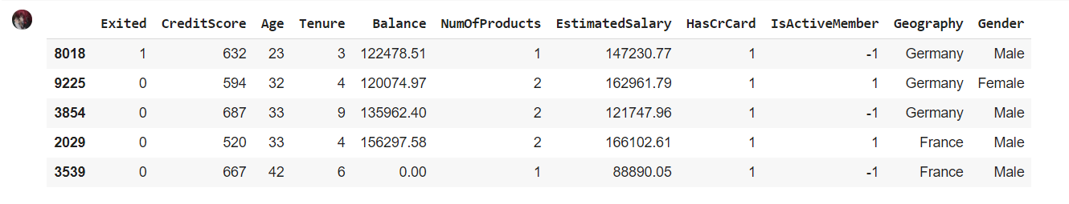
EXPLORATORY DATA ANALYSIS
3.5 - Introducing negative relation between numerical categorical values:
BE Project Mock Presenation

Slide 47
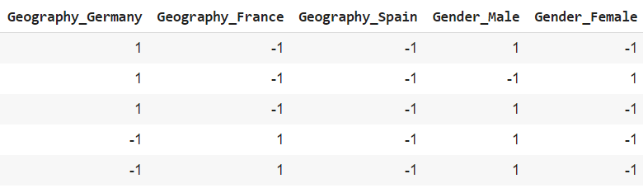
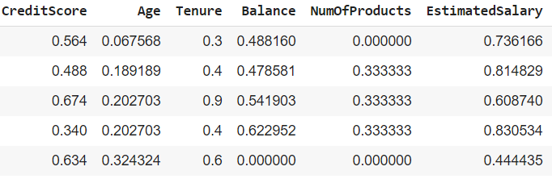
EXPLORATORY DATA ANALYSIS
3.6 – Converting categorical object data into one-hot vectors:
3.7 – Normalizing the discreet values using Min-max scaling:
Formula: Xsc= (X−Xmin) / (Xmax−Xmin)
BE Project Mock Presenation

Slide 48
MODELLING AND TESTING
STEP 4 : Modelling and Testing
4.1 – Importing the necessary libraries:
Important libraries
sklearn.model_selection : GridSearchCV
Models
sklearn.ensemble : RandomForestClassifier
Metrics
sklearn.metrics : accuracy_score
sklearn.metrics : confusion_matrix
sklearn.metrics : classification_report
sklearn.metrics : roc_auc_score
sklearn.metrics : roc_curve
BE Project Mock Presenation

Slide 49
MODELLING AND TESTING
4.2 – Finding the best parameters to apply to Random Forest Classifier using GridSearchCV:
GridSearchCV : -
It belongs to the sklearn.model_classifier package.
It performs exhaustive search over specified parameter values for an estimator.
Important members are fit, predict.
GridSearchCV implements a “fit” and a “score” method. It also implements “score_samples”, “predict”, “predict_proba”, “decision_function”, “transform” and “inverse_transform” if they are implemented in the estimator used.
The parameters of the estimator used to apply these methods are optimized by cross-validated grid-search over a parameter grid.
BE Project Mock Presenation

Slide 50
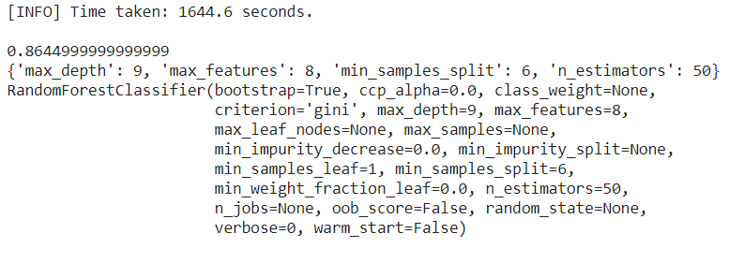
MODELLING AND TESTING
Output of grid search model selection:
BE Project Mock Presenation

Slide 51

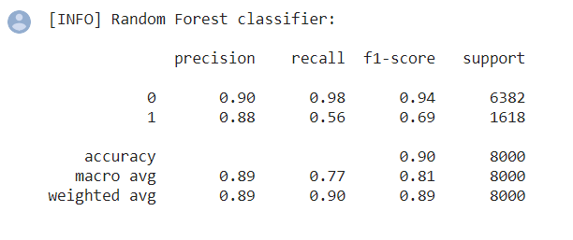
MODELLING AND TESTING
4.3 - Training the Random Forest model using optimal parameters:
Accuracy = (TP+TN)/total
Precision = TP/predicted yes
Confusion Matrix :
Output :-
BE Project Mock Presenation

Slide 52
MODELLING AND TESTING
4.4 – Implementing the RF model on test data:
Output of this stage is the ROC (Receiver Operating Characteristic) curve.
When we need to check or visualize the performance of the multi-class classification problem, we use the AUC (Area Under The Curve) ROC (Receiver Operating Characteristics) curve.
It is one of the most important evaluation metrics for checking any classification model’s performance.
It tells how much the model is capable of distinguishing between classes.
The Higher the AUC, the better the model is at distinguishing between Churned Customers from those Customers who are Retained.
BE Project Mock Presenation

Slide 53
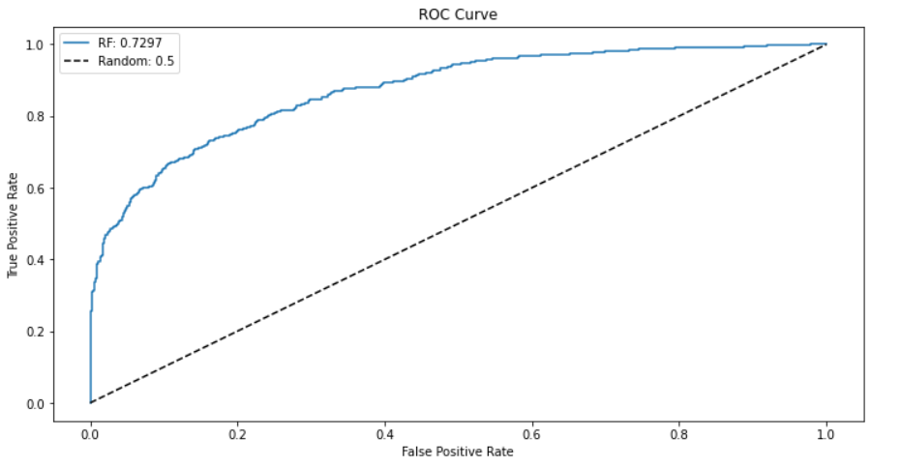
MODELLING AND TESTING
Result:
BE Project Mock Presenation

Slide 54
REFERENCES
References:-
https://journalofbigdata.springeropen.com/articles/10.1186/s40537-019-0191-6
http://www.diva-portal.org/smash/get/diva2:1049992/FULLTEXT02.pdf
https://rstudio-pubs-static.s3.amazonaws.com/565148_6e82a5c320f14869bf63e23bcf59ce9b.html
https://www.neuraldesigner.com/learning/examples/bank-churn
https://medium.com/@rohitlal/customer-churn-prediction-model-using-logistic-regression-490525a78074
Dataset: https://www.kaggle.com/tags/banking
[1] M.A.H. Farquad, Vadlamani Ravi, S. Bapi Raju “Churn prediction using comprehensible support vector machine: An analytical CRM application”, Applied Soft Computing 19 (2014) 31–40.
[2] Wouter Verbeke, David Martens, Christophe Mues, Bart Baesens “Building comprehensible customer churn prediction models with advanced rule induction techniques”, Expert Systems with Applications 38 (2011) 2354–2364.
[3] Ning Lu, Hua Lin, Jie Lu, Guangquan Zhang “A Customer Churn Prediction Model in Telecom IndustryUsing Boosting”, IEEE Transactions on Industrial Informatics, vol. 10, no. 2, may 2014
BE Project Mock Presenation

Slide 55
Thank You

