Slide 1
Functional Data Import Services

Slide 2
Real example
Import Customers
From SAP
To WeConnect
SQL sproc
Cursors, if statements
Imperative code in declarative language
Can’t set breakpoints
Not enough logging
Support ticket (Customer not imported)
Developer has to debug sproc

Slide 3
Why Functional?
Fast Development time
More reliable software
Default immutability (don’t overwrite existing values)
Less time spent testing and fixing
Not enjoyable
Hard to find edge cases
Hard to estimate
C#/Java
Side effects
less predictable code
Verbose syntax – {} () [] ;
Lots of files

Slide 4
Side Effect Example:
class Employee:
int Id
string FirstName
string LastName
bool IsManager = false
List<Employee> DirectReports = null
HR app (like SuccessFactors)
Can view employee profile
Shows Name, EmployeeId, etc.
Managers have direct reports
Shows list of direct reports
Shows count of direct reports
OO language:
Load employee from DB
Allocate Employee object
then set property values from DataReader
Expected Data:
DirectReports is only null if IsManager is false
Actual Data:
Employee has title of Manager
But hasn’t been assigned any direct reports yet
NullReferenceException when trying to show count of direct reports

Slide 5
Functional Language
Can’t allocate an object until you have values for all fields
Nullable fields must be declared at compile time
Actually not nullable
Option types
Some
None
Compiler warning if you don’t check for None
Realize at compile time:
It’s possible to be a manager with no direct reports

Slide 6
Pros/Cons
Performance Solutions
More nodes
Choose when to GC
use Mutable types
Worst case
Only 1 feature in whole app
Rest of app is way more reliable
Use Go
CPU-intensive
Can’t be done in parallel
Benefits of FP:
Less testing and fixing
So, faster dev time
Less chance of releasing a bug
Drawbacks:
Steep learning curve
Terse syntax: {} () []
Output of each function is input to next
Different style
Performance:
More garbage collections
Copying more objects (optimized)

Slide 7
I/O
Side Effects needed for I/O
Mainly done inside OS and drivers
Display to screen:
Overwrite existing RGB values
Video card reads from same memory address on each screen refresh
Everything else:
Pure function
Return value only depends on params
Doesn’t reference stuff like DateTime.Now
I/O from System Clock
Way more predictable
App layers
I/O layer
Pure functions

Slide 8
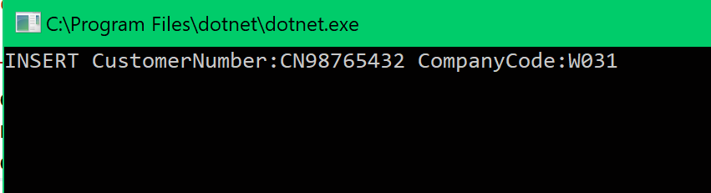
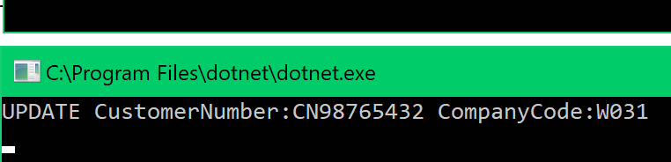
Results
C#
NotImplementedException x 10
So far, 2 bugs in F# code
Wrong value in hardcoded string
Missing Case exception
Worse in C#

Slide 9
Incomplete app
Features
Missing filtering on CompanyCode
Log to DB instead of console
Multiple threads instead of instances
Don’t need to implement these to learn F#
Dev Process
Modify DB so SAP team sees no changes
Use IDENTITY INSERT in sql deployment scripts
Better load test

Slide 10
What I have learned
How to structure business app
Services
Repositories
Factories
Injection
UTs
Error Handling
Recover from Exceptions and resume normal control flow
Dev time:
Equal to C#
Longer to compile, more likely to work
Longer to decide how to structure code
1 month: faster than C#

Slide 11
Still to Research
How to create anonymous records?
Used Tuple instead
Returning existing object creates new object
Almost ready to start a prod app in F#

Slide 12
Conclusion
FP is worth the learning curve
1 dev already knows it
Way better tutorials than 10 years ago
FP really does lead to less bugs
Less testing/fixing
Faster dev time
Once you overcome learning curve
Less bugs in prod

Slide 13
Next Steps?
Start building data imports in F#
Support dashboard
Fable
Compiles F# into Node.JS
Same language on front/back end
Full stack developer
Design/UX

Slide 15
Side Effects
Modify MethodB :
Set MyString to null if MyBool is false
Does this affect MethodA, MethodC?
OO
Find all references
Are MethodA or MethodC called after MethodB?
Functional:
If MethodC depended on MyString, there would already be a string parameter
If MethodB generates a new string value, you have to modify its return type
Developer is way more conscious of what is changing
Properties:
MyInt
MyString
MyBool
Methods:
MethodA
MethodB
MethodC
Could depend on properties
if (myInt == 0)
Could assign to properties
MyBool = false

Slide 16
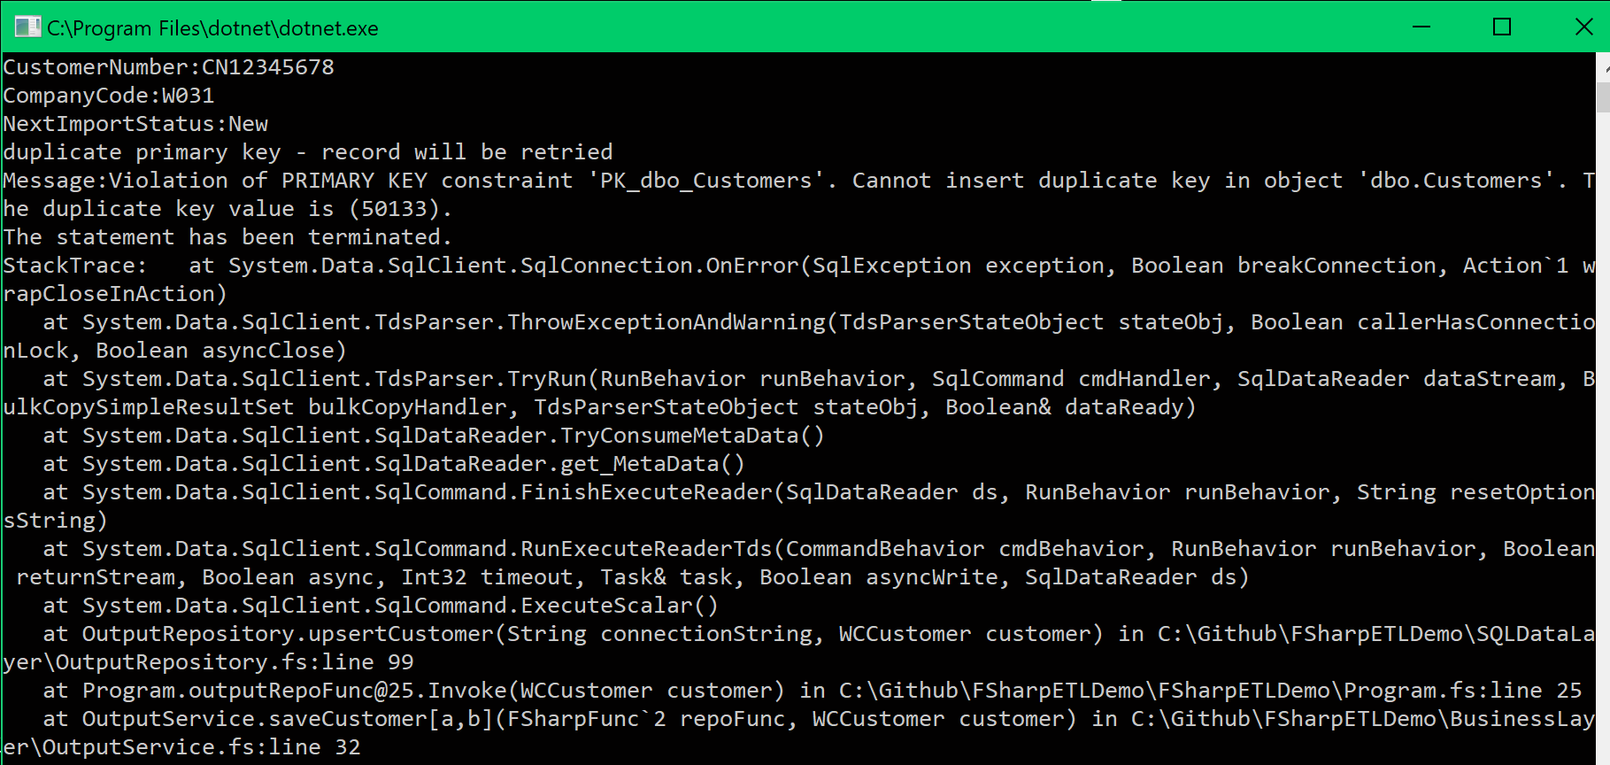
Completed work
Selecting from input
Multiple instances with atomic select-update
Load test ensures input records are not handled twice
Writing to output
Updates – working
Insert – edge case
Existing DB does not have PK auto increment
PK collision
Detecting and logging
Planning to retry these
Limiting scope

