Slide 1
Functional Data Import Services

Slide 2
Real example
Import Customers
From SAP
To WeConnect
SQL sproc
Cursors, if statements
Imperative code in declarative language
Can’t set breakpoints
Not enough logging
Support ticket (Customer not imported)
Developer has to debug sproc

Slide 3
Why Functional?
Fast Development time
More reliable software
Default immutability (don’t overwrite existing values)
Less time spent testing and fixing
Not enjoyable
Hard to find edge cases
Hard to estimate
C#/Java
Side effects
less predictable code
Verbose syntax – {} () [] ;
Lots of files

Slide 4
Side Effect Example:
class Employee:
int Id
string FirstName
string LastName
bool IsManager = false
List<Employee> DirectReports = null
HR app (like SuccessFactors)
Can view employee profile
Shows Name, EmployeeId, etc.
Managers have direct reports
Shows list of direct reports
Shows count of direct reports
OO language:
Load employee from DB
Allocate Employee object
then set property values from DataReader
Expected Data:
DirectReports is only null if IsManager is false
Actual Data:
Employee has title of Manager
But hasn’t been assigned any direct reports yet
NullReferenceException when trying to show count of direct reports

Slide 5
Functional Language
Can’t allocate an object until you have values for all fields
Nullable fields must be declared at compile time
Actually not nullable
Option types
Some
None
Compiler warning if you don’t check for None
Realize at compile time:
It’s possible to be a manager with no direct reports
OR: add UI validation so it’s impossible to set IsManager = true without adding Direct Reports
Probably doesn’t match real life requirements

Slide 6
Type Systems
Both Paradigms:
Hierarchical types
base class: Employee
derived class: Manager
Only Manager has DirectReports property
Property can still be null
Flat types
Match DB model better
Relational
Document

Slide 7
I/O
Side Effects needed for I/O
Update Customer w/ Id = 1000
Overwrite the same disk sector where the Customer already is
Output to screen:
Video card always reads from same memory address
Need to overwrite existing RGB values for each pixel
Everything else:
Pure function
Return value only depends on params
Doesn’t reference stuff like DateTime.Now
Way more predictable
App layers
I/O layer
Pure functions

Slide 8
Pros/Cons
Performance Scenario:
You have an array of 1,000 objects
Want to change 1 object
OO: do a side effect
FP: copy a new list
Workarounds:
Return delta and update list in side effect layer
Break into sub-objects
Customer
NameInfo
AddressInfo
Use a mutable object
Decreases predictability
Okay if only referenced when writing to DB
Benefits of FP:
Less testing and fixing
So, faster dev time
Less chance of releasing a bug
Drawbacks:
Steep learning curve
Terse syntax: {} () []
Output of each function is input to next
Different style
Performance:
More garbage collections
Copying more objects (optimized)
More recursive functions (optimized)

Slide 9
Would you rather?
Fix a bug in prod?
Fix a performance issue in prod?
Load test before prod
Throughput <> performance
Parallel processing
How many records per second <> how many seconds for an individual record

Slide 10
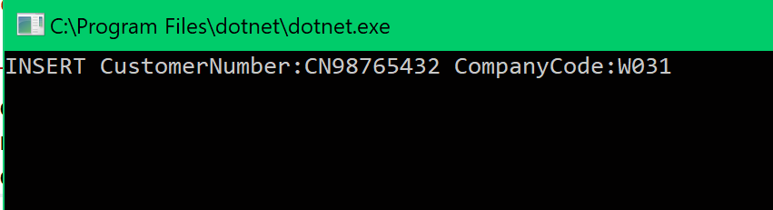
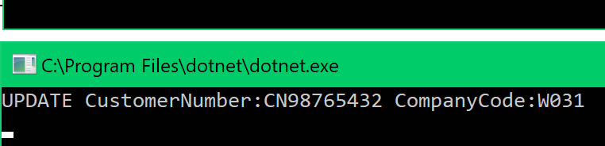
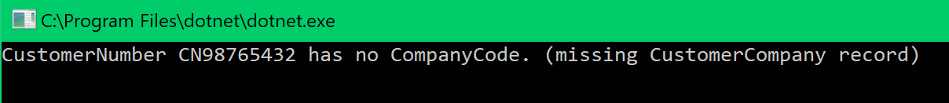
Results
C#
NotImplementedException x 10
So far, 1 bug in F# code
Wrong value in hardcoded string
Bad data
SQL code
Syntax errors
Timeout in load test
HAPPY PATH
Improved log messages

Slide 11
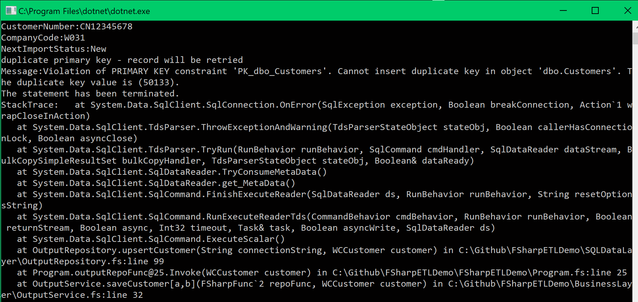
Completed work
Selecting from input
Multiple instances with atomic select-update
Load test ensures input records are not handled twice
Writing to output
Updates – working
Insert – edge case
Existing DB does not have PK auto increment
PK collision
Detecting and logging
Planning to retry these
Limiting scope

Slide 12
Features coming soon
Unit Tests
Update status of input records
Delete successful records
Mark as failed if failed
Retry PK collisions
Log to DB instead of console
Multiple threads
Better load test
10 instances: don’t always get PK collision
20 instances: timeout when loading input
Code cleanup

Slide 13
Conclusion
FP is worth the learning curve
Way better tutorials than 10 years ago
FP really does lead to less bugs
Less testing/fixing
Faster dev time
Less bugs in prod

Slide 14
Next Steps?
Start building data imports in F#
Support dashboard
Fable
Compiles F# into Node.JS
Same language on front/back end
Full stack developer
Design/UX

Slide 16
Side Effects
Modify MethodB :
Set MyString to null if MyBool is false
Does this affect MethodA, MethodC?
OO
Find all references
Are MethodA or MethodC called after MethodB?
Functional:
If MethodC depended on MyString, there would already be a string parameter
If MethodB generates a new string value, you have to modify its return type
Developer is way more conscious of what is changing
Properties:
MyInt
MyString
MyBool
Methods:
MethodA
MethodB
MethodC
Could depend on properties
if (myInt == 0)
Could assign to properties
MyBool = false

