Slide 1
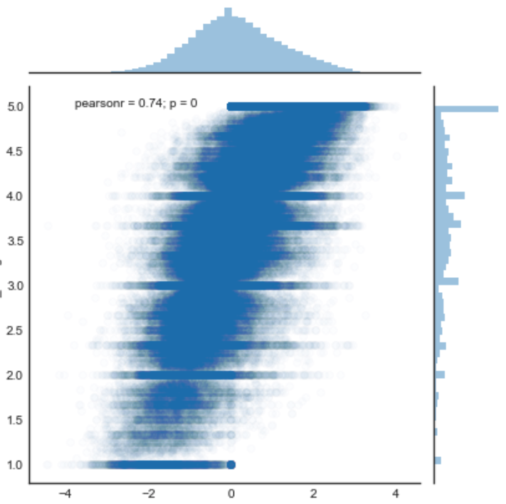
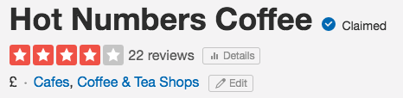
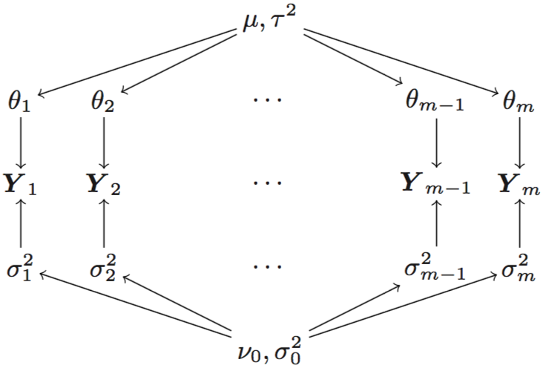
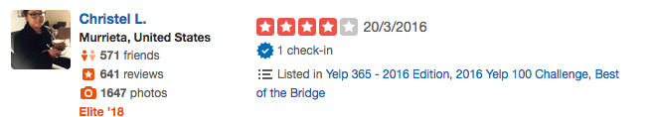
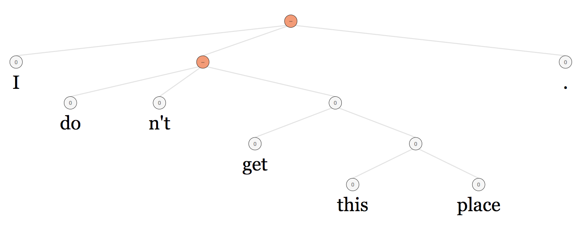

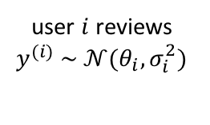

Towards Better Ratings
Methods
1. Star Ratings
2. TrueSkill Ranking
3. Standardization
global mean score
user $i$ mean
Stars
user $i$ reviews
$$y^{(i)} \sim 𝒩(θ_{i},σ_{i}^{2})$$
user $i$ variance
Evaluation
global mean variance
TrueSkill
1. Predict held-out
“matches”
2. Sentiment Analysis
-
Business 1 | Business 2 | Outcome
Hot Numbers | Caffè Nero | ?
Engineering Dept | Computer Lab | ?
-

