Slide 1


Verifyid: Online Barangay System with Identity Authentication through Integration of Image Recognition
Canlas Clyde, Enrique Jhon Mark, Formanes Patrick, Elvin John Recto
IV - BCSAD, College of Computing and Information Sciences (CCIS)

Slide 2

Introduction
Traditional barangay services are manual, slow, and error-prone.
Residents face long queues and multiple visits for documents.
The study proposes a web-based system for Barangay 781 Zone 85.
Uses facial recognition with YOLOv8 and CNN for secure identity verification.
Aims for Faster service, less manual work, better transparency, and reduce errors.

Slide 3
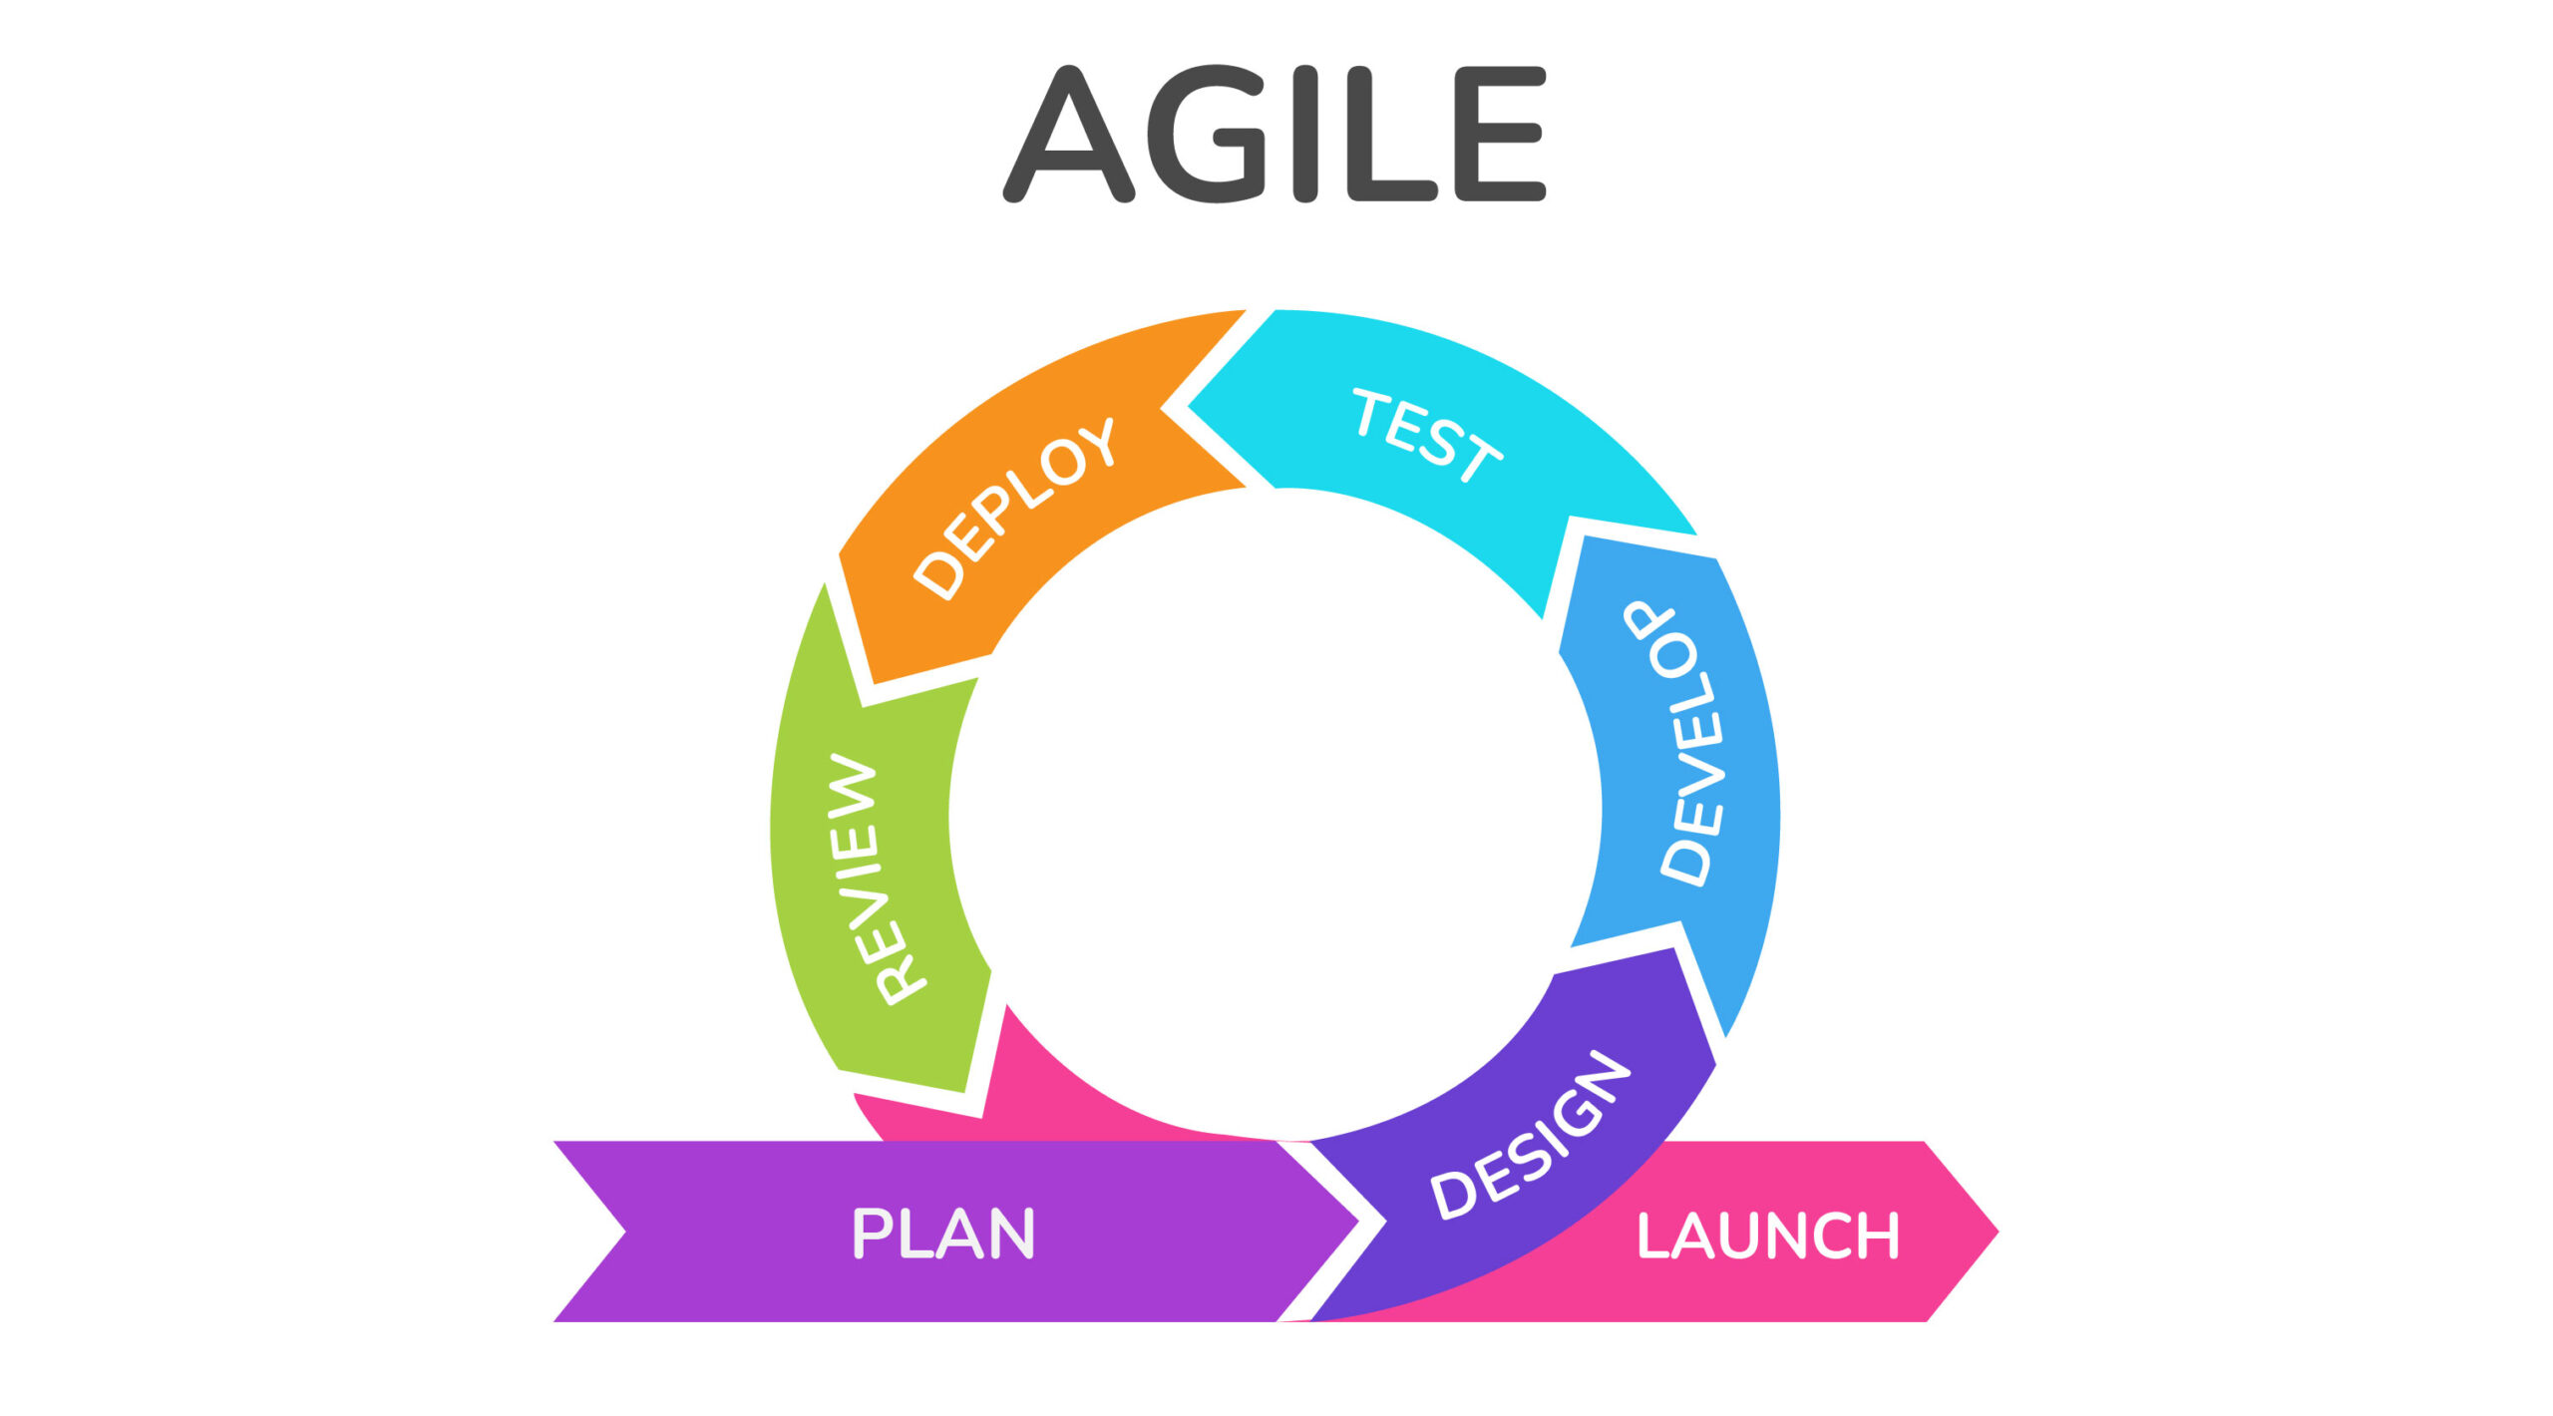
Methodology

Slide 4



Research Design
DESCRIPTIVE RESEARCH
EXPERIMENTAL RESEARCH
DEVELOPMENTAL RESEARCH

Slide 5
Data Collection and Analytical Technique
Survey via Google Forms
351 Respondents including 10 IT Experts
Convenience Sampling
Descriptive Statistics

Slide 6
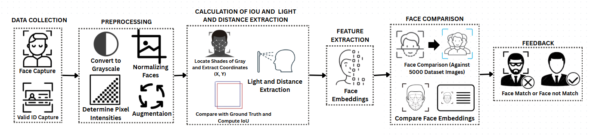
Face Recognition and Comparison Process

Slide 7
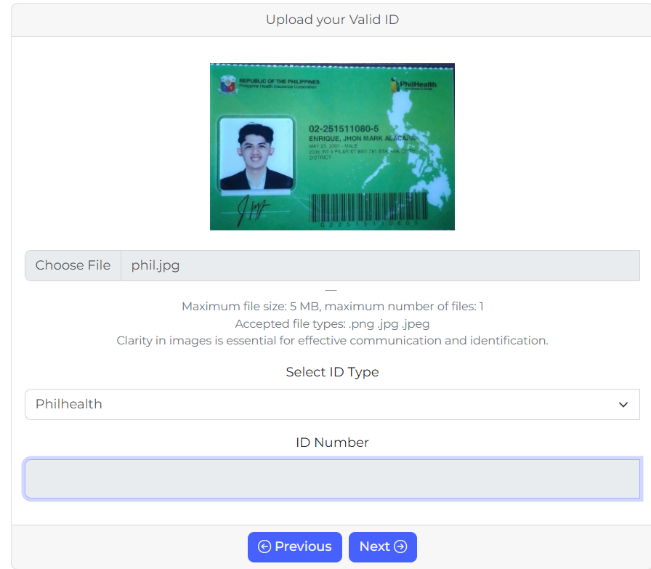
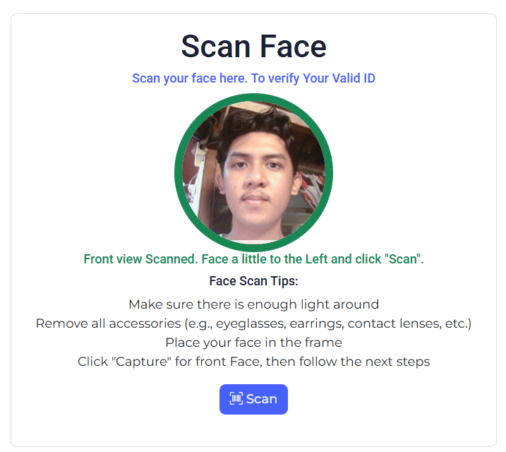
Prototype

Slide 8
Metrics in Different variables
Metrics | YOLOv8 (Controlled Variable) | YOLOv8 and CNN (Uncontrolled variables)
Precision | 0.883 | 0.950
Recall | 0.933 | 0.932
F1 Score | 0.908 | 0.962
Accuracy | 0.903 | 0.936

Slide 9
Performance Comparison
Metrics | Convolutional Neural Network (CNN) | You Only Look Once version 8 (YOLOv8) | Fast Region based Convolutional Neural Network (Fast R-CNN)
Precision | 0.687 | 0.883 | 0.533
Recall | 0.616 | 0.933 | 0.422
F1 Score | 0.601 | 0.908 | 0.342
Accuracy | 0.627 | 0.903 | 0.439

Slide 10
User Evaluation
Metrics | Mean Ratings | Verbal Interpretation
Functional Suitability | 4.70 | Strongly Agree
Performance Efficiency | 4.64 | Strongly Agree
Compatibility | 4.60 | Strongly Agree
Security | 4.49 | Strongly Agree
Average | 4.61 | Strongly Agree

Slide 11
Conclusion
VerifyID improved identity verification and streamlined barangay processes using facial recognition.
YOLOv8 and CNN were integrated, with YOLOv8 showing the best performance in detection accuracy.
Users validated the system’s effectiveness, reliability, and cross-platform compatibility.
Future work will enhance security, mobile support, and real-time feedback.

Slide 12
RECOMMENDATION
Live Scan Feedback
Enhance Usability on Mobile
Alternative Authentication
Enhance Time-Limited Face Scan

