Slide 1




UMEMPC Transact:
A Loan Management Web and Mobile Application for the University of Makati Employees Multi-Purpose Cooperative Using Logistic Regression Algorithm
Innovative Programmers version 3 (IPv3)
Julina Kay Gacura, Edgar Palen Jr., and Aaron Patrick Planta
IV - ACSAD, College of Computing and Information Sciences (CCIS)

Slide 2




1
Member fills application form
Check Salary
2
Management Evaluation
Bookkeeper
Check Loan Balances
Loan Application Process
Check Share Capital
Computation
3
Credit Committee
Audit
Recheck
Recommendees
Prepare Voucher
4
Management
Bookkeeper
Prepare Check
Check Releasing

Slide 3

Issues currently faced by UMEMPC in loan management
1 | Members’ visits
2 | Inefficient tool or application
3 | No update, no progress
4 | Manual calculation
5 | Members’ lack of real-time access to transactions
Office Name / Header

Slide 4
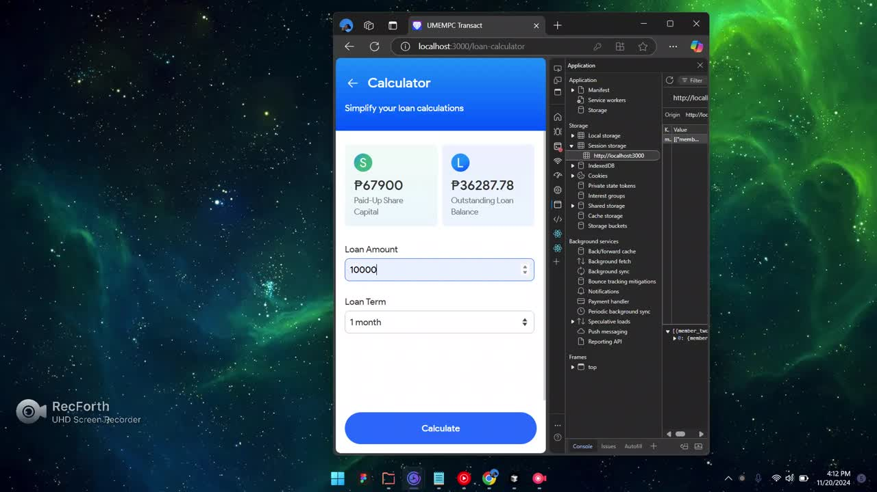
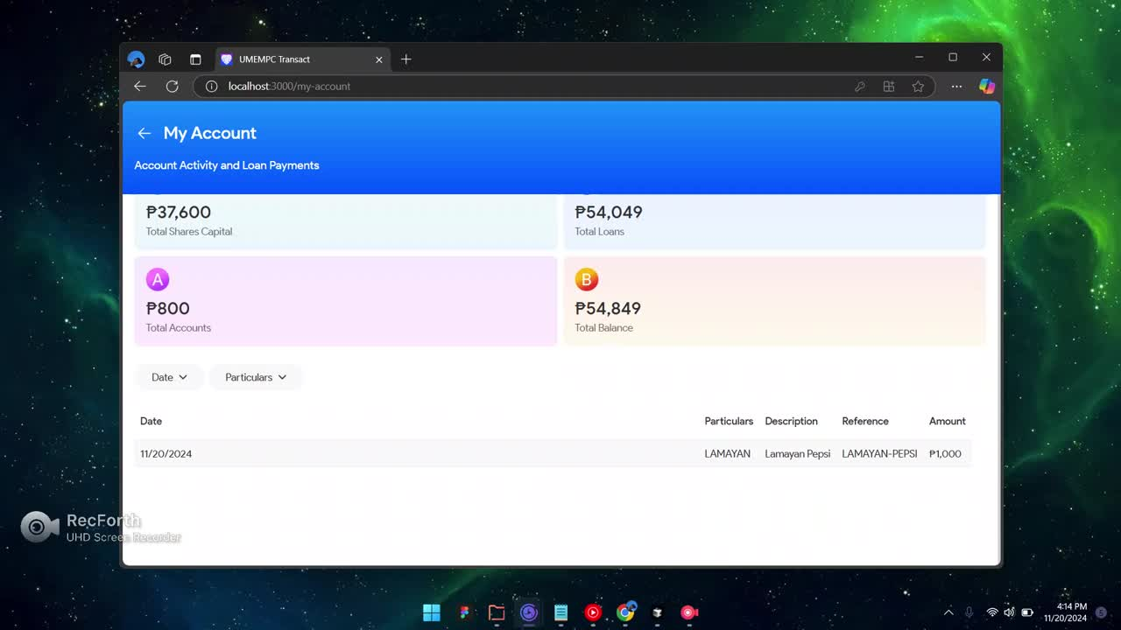

Slide 5
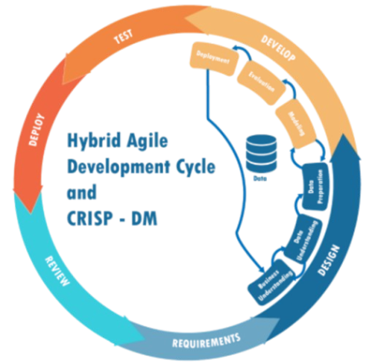
Research Design
Research Methodology
Experimental
Descriptive
Developmental

Slide 6

Machine Learning Model

Slide 7
Model Development Result
Fold # | Proposed Random Forest Model | Logistic Regression Model
k1 | 0.945 | 0.92
k2 | 0.95 | 0.925
k3 | 0.955 | 0.93
k4 | 0.925 | 0.91
k5 | 0.96 | 0.925
Average | 0.9470 | 0.922
p-value | 0.0014 | 0.0014
Metrics | Result
Accuracy | 93%
Precision | 96%
Recall | 94%
F1 Score | 95%
Mean Average Precision | 84%
Classification Accuracy
Model Development

Slide 8
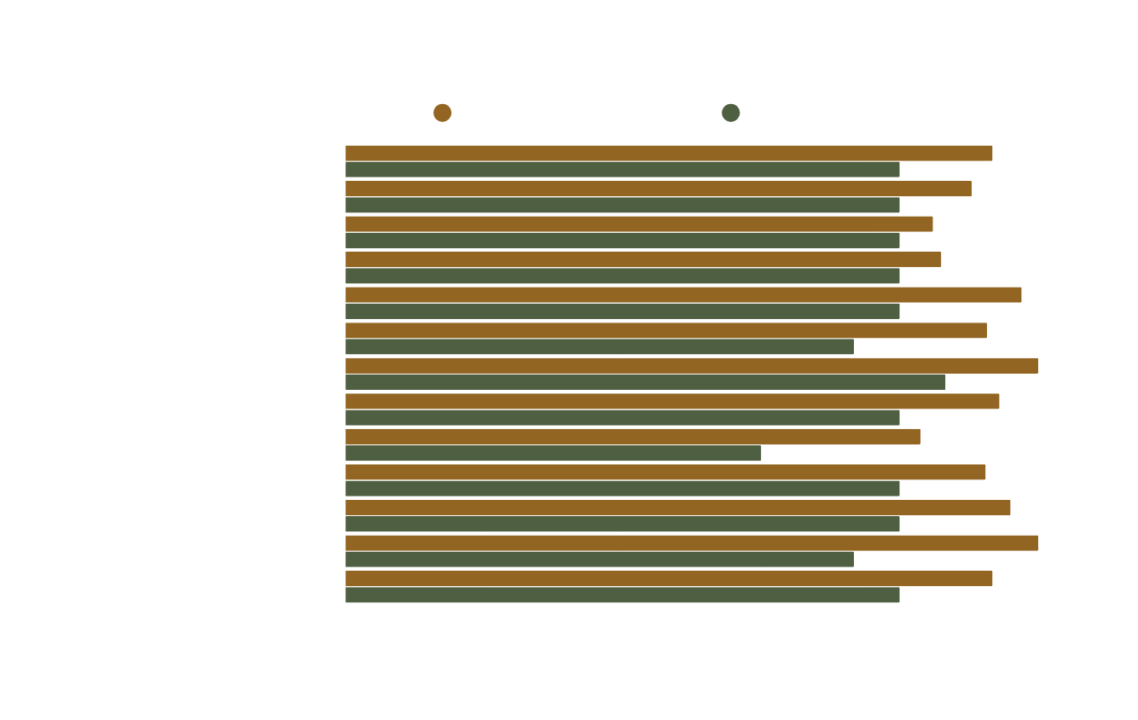
Project Evaluation Results
End Users | End Users
Ave. Mean Ratings | Ave. Remarks
4.36 | Acceptable
End Users | End Users
End Users | End Users
Ave. Mean Ratings | Ave. Remarks
3.90 | Slightly Acceptable
Client | Client

Slide 9

Application Evaluation Result (IT Experts)
End Users | End Users
Ave. Mean Ratings | Ave. Remarks
4.55 | Acceptable
IT Expert | IT Expert

Slide 10

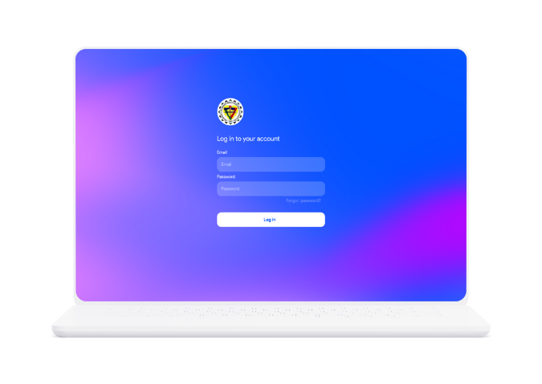
Summary of Findings | Summary of Findings
1 | UMEMPC utilizes a spreadsheet application.
2 | Multiple existing Loan Approval Prediction systems.
3 | Size and treatment of dataset affects the accuracy of the model.
4 | UMEMPC Transact efficiently supports multiple users simultaneously.
5 | Evaluation results: Acceptable & Slightly Acceptable

Slide 11


Conclusion | Conclusion
1 | UMEMPC Transact streamlines the loan application and management of the UMEMPC.
2 | 4.63 average rating for the system’s evaluation result.
3 | 93% accuracy in model development.
4 | The Random Forest Model is statistically better than the Logistic Regression Model.

Slide 12


Further Studies
Determine the optimal parameters for the model to enhance accuracy and overall performance.
Recommendations | Recommendations
1 | UI and UX
2 | Security
3 | Loan application process (Form)
4 | Loan management

Slide 13
Thank you for listening!

