Slide 1
AXYNTRO · PROCESS DIGITAL TWIN
Invoice to Pay, rehearsed end to end before it is real
Meridian Group's supplier-invoice process run as a digital twin: 9 AI agents, the people who stay in the loop, eight simulated systems and 75 realistic invoices, measured against how the process runs today.

Slide 2
THE QUESTION
A process owner doesn't ask 'does the agent work?'
They ask three things the twin answers with evidence:
Does it work together?
Is it actually better?
Where does it break?
Nine agents that each pass their own tests can still fail as a process: a hand-off loses a field, or a gateway routes on nothing.
'86% automatable' is a forecast. Cycle time, people's time and cost per case, against today, are evidence.
Which kind of invoice goes wrong, which step still needs people, and what to fix before go-live.

Slide 3
THE PROCESS TODAY
Invoice to Pay at Meridian Group Finance
9,000 supplier invoices a month. Every step is done by a person today, roughly 75 FTE of hands-on work, before counting the days invoices wait in queues.
Invoice received
Capture invoice data
Accounts Payable Team
Verify supplier
Accounts Payable Team
Check duplicates and fraud signals
Accounts Payable Team
Match to PO and goods receipt
Accounts Payable Team
Resolve match exception
Accounts Payable Team
Code to GL and check VAT
Accounts Payable Team
Approve spend
Budget Holder
Post to ledger
Accounts Payable Team
Schedule payment
Treasury
Send remittance advice
Accounts Payable Team
Invoice paid
Plus three exits: rejected (unknown, blocked or sanctioned supplier), blocked (duplicate or fraud signal), and exceptions resolved with buyer and supplier.

Slide 4
THE TO-BE PROCESS
Agents for the work, people for judgement and authority
Axyntro's blueprint, grounded in policy AP-02, proposed an agent for 9 of the 12 steps. Fraud investigation and spend approval stay with people; this blueprint also left post to ledger with a person.
Invoice received
Capture invoice data
agent
Verify supplier
agent
Check duplicates and fraud signals
agent
Investigate suspected fraud
Finance Controller
Match to PO and goods receipt
agent
Resolve match exception
agent
Code to GL and check VAT
agent
Approve spend
Budget Holder
Post to ledger
Accounts Payable Team
Schedule payment
agent
Send remittance advice
agent
Invoice paid

Slide 5
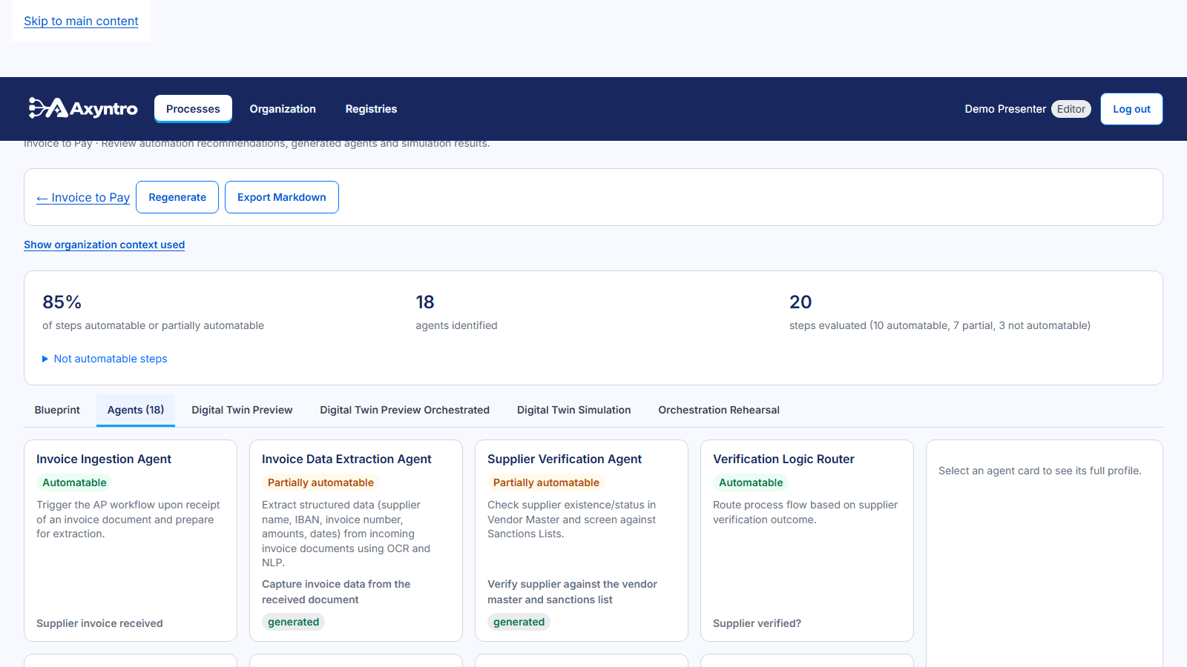
THE AGENTS
One generated agent per step
• 9 agents, each with purpose, inputs and outputs, tools, permissions, guardrails and escalation
• Human checkpoints where the policy asks for review
• Every agent simulation-ready: typed outputs, tool contracts, a test scenario
WHY IT MATTERS
The agents are specifications Axyntro can test, not prompts in a notebook.

Slide 6
THE TWIN'S INGREDIENTS
Four things make a process twin
Agents
A world
9 generated agents, one per automatable step.
8 simulated systems answering from 239 sample records: vendor master, purchase orders, ledger, sanctions list, tax rules, inbox, payments, email.
Cases
Today's baseline
75 invoices across 10 kinds, each with the outcome policy AP-02 requires.
An operating model from a time and motion study: handling and waiting times per step, the cost of four roles, 9,000 invoices a month.

Slide 7
THE SIMULATED WORLD
Systems answer from sample data, not invention
Each agent's tools are wired to records, so a lookup returns the same answer every time and the right outcome is knowable.
System | Records | What it holds | Agent systems it serves
AP ledger | 40 | Accounts payable sub-ledger: posted and paid invoices; post a new invo | ERP Accounts Payable Module, ERP System, ERP/AP Database
Chart of accounts and tax rules | 21 | GL accounts and VAT rates by supplier country | ERP Accounts Payable Module, GL Mapping Configuration, Tax Calculation Engine
ERP purchasing | 75 | Purchase orders and goods receipts | ERP Accounts Payable Module, ERP System, ERP/AP Database, Goods Receipt Module, Purchase O
Invoice inbox | 75 | Received supplier invoices with captured (OCR) fields, by document ref | Document Store, NLP Entity Recognition Model, OCR Service
Payment system | 0 | Treasury payment runs; schedule a payment, look up scheduled payments | Treasury Management System
Sanctions screening | 3 | Sanctions and watchlist screening; returns listed entities matching a | Sanctions Screening API
Supplier email | 0 | Outbound supplier correspondence (rejections, queries, remittance advi | Communication Platform, Document Generation Service, Email Client, Email Service, Email Sy
Vendor master | 25 | Supplier master data: legal name, VAT number, bank account, status, pa | Fraud Detection Heuristics Engine, Vendor Master Database, Vendor Master System
Not backed by data (an LLM plays them): Logging System.

Slide 8
GROUND TRUTH
Invoices with planted problems and known right answers
Generated from facts, not labelled by a model: a duplicate is in the ledger, a fraud signal is a fresh bank account that doesn't match.
Kind of invoice | Cases | Right outcome under AP-02
clean small | 30 | approve -- paid
clean large | 10 | approve -- paid
price variance | 7 | approve -- paid via exception
messy capture | 6 | approve -- paid
duplicate | 6 | escalate -- blocked for investigation
bank change fraud | 4 | escalate -- blocked for investigation
missing goods receipt | 4 | approve -- paid via exception
blocked supplier | 3 | reject -- rejected at supplier check
unknown supplier | 3 | reject -- rejected at supplier check
sanctioned supplier | 2 | reject -- rejected at supplier check

Slide 9
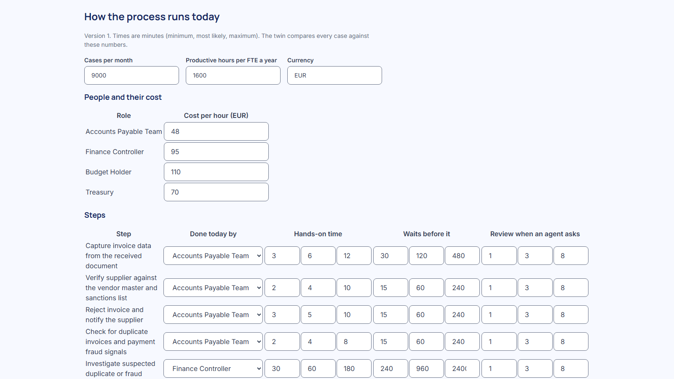
TODAY'S BASELINE
How the process runs today, step by step
• Hands-on time and queue time per step, as minimum / most likely / maximum
• Hourly cost per role: AP team, controller, budget holder, treasury
• Volume: 9,000 invoices a month; 1,600 productive hours per FTE
WHY IT MATTERS
Savings are measured against these numbers, not against zero.

Slide 10
ONE CASE, END TO END
The rehearsal: INV-2026-0003 through every agent
A case file carries every fact forward. Agents decide judgement gateways; the confirmed AP-02 rule decides the EUR 10,000 approval.
s1
t1
Capture invoice data
t2
Verify supplier
Gate g1
t4
Check duplicates and fraud signals
Gate g2
t6
Match to PO and goods receipt
Gate g3
t7
Resolve match exception
t8
Code to GL and check VAT
Gate g4
t10
Post to ledger
t11
Schedule payment
t12
Send remittance advice
e3
Status COMPLETED; AI cost $0.0076 for the whole case. A clean invoice, yet the matching agent sent it to exception handling (t7): the kind of behaviour the twin then measures over many cases.

Slide 11
RUN 1
The twin, as generated
30 invoices, every agent, every decision point.

Slide 12
RUN 1 · AS GENERATED
What the first run showed
Over 30 cases, the to-be process finished 23 end to end; 0% went straight through with no person involved. It reached the right outcome in 67% of labelled cases (49%-81%). People's time per case falls by 26% and cycle time by 70%; at 9,000 cases a month that frees about 20.1 FTE (8.8-33.1).
FINISHED END TO END
STRAIGHT THROUGH
RIGHT OUTCOME
AI COST PER INVOICE
23/30
0%
67%
$0.004
7 cases fell back to a person
no person involved (0%-11%)
against AP-02 (49%-81%, 95% confidence)
every agent turn included

Slide 13
RUN 1 · WHERE IT BREAKS
Results by kind of invoice
Weakest first. A strong average can hide a weak segment.
Kind of invoice | Cases | Right outcome | Straight through
messy capture [Critical] | 2 | 0% (0/2) | 0%
bank change fraud [Critical] | 4 | 50% (2/4) | 0%
price variance [Critical] | 2 | 50% (1/2) | 0%
clean small [Critical] | 9 | 56% (5/9) | 0%
clean large [High] | 3 | 67% (2/3) | 0%
blocked supplier [Strength] | 1 | 100% (1/1) | 0%
duplicate [Strength] | 6 | 100% (6/6) | 0%
missing goods receipt [Strength] | 1 | 100% (1/1) | 0%
sanctioned supplier [Strength] | 2 | 100% (2/2) | 0%

Slide 14
WHAT THE TWIN FOUND
Defects found before production, not after
Each of these would have reached production unseen in a step-by-step agent test. From run 1's case table:
Invoice | Kind | Expected | Twin | What happened
INV-2026-0007 [High] | bank change fraud | escalate | failed | Code to GL and check VAT: final answer not valid JSON
INV-2026-0011 [Critical] | bank change fraud | escalate | approve | routed to approve after: Send remittance advice
INV-2026-0027 [High] | clean small | approve | escalated | Send remittance advice: Exceeded max_tool_calls (10)
INV-2026-0033 [High] | price variance | approve | failed | Code to GL and check VAT: final answer not valid JSON
INV-2026-0034 [High] | clean small | approve | escalated | Send remittance advice: Exceeded max_steps (8) without producing a final answer
INV-2026-0036 [High] | messy capture | approve | escalate | routed to escalate after: Investigate suspected fraud
INV-2026-0037 [High] | clean small | approve | failed | Resolve match exception: final answer not valid JSON
INV-2026-0048 [High] | clean large | approve | reject | routed to reject after: Reject and notify supplier
INV-2026-0054 [High] | clean small | approve | failed | Send remittance advice: Agent called an unknown tool 'remittancesend' that wasn't offered to it
INV-2026-0069 [High] | messy capture | approve | failed | Check duplicates and fraud signals: final answer not valid JSON
Critical: a fraud signal that ends in payment. Warnings: wrong outcome, or a case that fell back to a person.

Slide 15
RUN 2 · THE SAME INVOICES AGAIN
Same invoices, same seed, different answers
Repeating run 1 exactly changed the outcome of 16 of 30 invoices; for 13 it changed whether the answer was right. Agents built on language models aren't deterministic, and only repeated runs show it.
Invoice | Kind | Expected | Run 1 | Repeat
INV-2026-0007 [Right <-> wrong] | bank change fraud | escalate | failed | escalate
INV-2026-0011 [Right <-> wrong] | bank change fraud | escalate | approve | escalate
INV-2026-0016 [Right <-> wrong] | clean small | approve | approve | failed
INV-2026-0025 [Right <-> wrong] | sanctioned supplier | reject | reject | failed
INV-2026-0027 [Right <-> wrong] | clean small | approve | escalated | approve
INV-2026-0028 [Right <-> wrong] | clean small | approve | approve | escalate
INV-2026-0030 [Right <-> wrong] | clean small | approve | approve | escalated
INV-2026-0033 [Right <-> wrong] | price variance | approve | failed | approve
INV-2026-0034 [Other change] | clean small | approve | escalated | failed
INV-2026-0036 [Other change] | messy capture | approve | escalate | timed_out
Right outcome: run 1 67%, repeat 63%. A release gate should require repeated runs per case (Epic 34 trials) before trusting a single number.

Slide 16
RUN 3
Fix what the twin found, then run again
Sandbox and runtime fixes, the same 30 invoices, the same seed.

Slide 17
THE FIXES
What changed between run 1 and run 3
• Sandbox: 'Document Generation Service' is now backed by Supplier email (was Invoice inbox).
• Sandbox: 'NLP Entity Recognition Model' is now backed by Invoice inbox (was an LLM).
• Runtime: an agent whose final answer isn't valid JSON gets one recorded repair turn, as a production runtime would do.

Slide 18
RUN 1 VS RUN 3
Same invoices, same seed: the effect of the fixes
Measure | Run 1 (as generated) | Run 3 (after fixes)
Finished end to end | 23/30 | 24/30
Right outcome | 67% (49%-81%) | 77% (59%-88%)
Straight through | 0% | 0%
People time per invoice | 51 min | 55 min
AI cost per invoice | $0.004 | $0.004
messy capture | 0% | 50%
bank change fraud | 50% | 100%
price variance | 50% | 100%
clean small | 56% | 56%
clean large | 67% | 67%
Both runs use the same 30 invoices and seed. Run-to-run variation (previous slide) is of the same order as some of these differences: read them with their intervals.

Slide 19
EFFICIENCY
Today vs with agents, per invoice (run 3)
The same invoices costed both ways, on the same random draws, so the difference is the process.
Today
With agents
Cycle time (working time, waits + handling)
Today
31.5 h
With agents
7.8 h
People's hands-on time
Today
67 min
With agents
55 min
Cost per invoice (labour + AI)
Today
EUR 82.14
With agents
EUR 73.33
Cycle time 75% shorter (60%-86%); people's time 17% lower (6%-30%). 95% paired bootstrap ranges.

Slide 20
THE BUSINESS CASE
At 9,000 invoices a month
Extrapolated from the twin's sample; every assumption is stated in the report.
PEOPLE HOURS RELEASED
FTE CAPACITY
COST SAVED
CYCLE TIME
20,671
12.9
EUR 951,728
75%
a year (7,160-34,106)
of about 75 today (4.5-21.3)
a year (EUR 350,741-EUR 1.6m)
shorter, waits included
A case the twin could not finish is counted as handled fully by hand (6 cases). Annual figures extrapolate the sample mean to 9,000 cases a month and 1,600 productive hours per FTE; intervals are 95% bootstrap ranges.

Slide 21
STEP BY STEP
Where people stay, and what each agent costs
Step | Done by | Cases | Failed | Agent time | Asks for review | People time today | With agents
Capture invoice data from the received docum [High] | Agent | 30 | 1 | 36 s | 27% | 6 min | 0.8 min
Verify supplier against the vendor master an [High] | Agent | 29 | 1 | 29 s | 93% | 4 min | 2.8 min
Reject invoice and notify the supplier | Agent | 4 | 0 | 48 s | 0% | 5 min | 0.0 min
Check for duplicate invoices and payment fra | Agent | 24 | 0 | 37 s | 71% | 4 min | 2.1 min
Investigate suspected duplicate or fraud | Person | 10 | 0 | -- | -- | 60 min | 60.0 min
Match invoice to purchase order and goods re | Agent | 14 | 0 | 51 s | 0% | 8 min | 0.0 min
Resolve the match exception with buyer and s | Agent | 2 | 0 | 102 s | 100% | 35 min | 3.0 min
Code invoice to GL accounts and validate VAT | Agent | 14 | 0 | 55 s | 0% | 5 min | 0.0 min
Approve invoice spend | Person | 3 | 0 | -- | -- | 8 min | 8.0 min
Post invoice to the ERP ledger | Person | 14 | 0 | -- | -- | 3 min | 3.0 min
Schedule payment in the next payment run | Agent | 14 | 0 | 50 s | 86% | 2 min | 2.6 min
Send remittance advice to the supplier [High] | Agent | 14 | 4 | 54 s | 0% | 4 min | 0.0 min

Slide 22
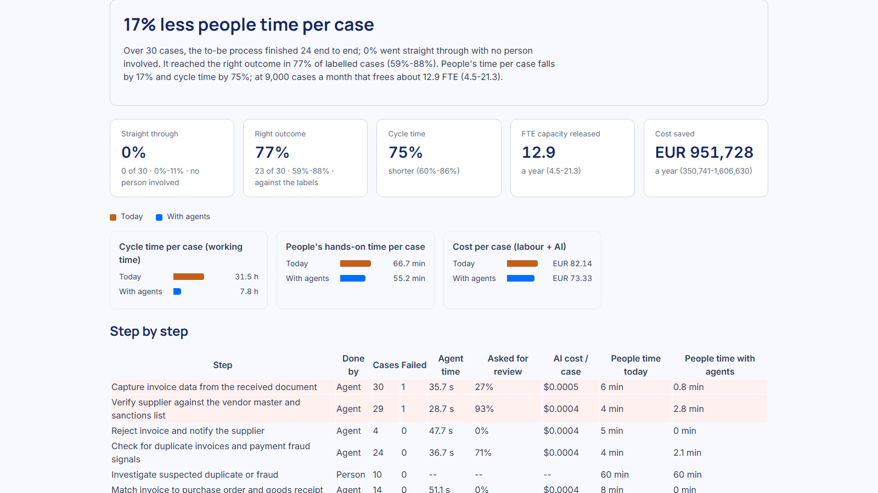
IN THE PRODUCT
The process twin report
• Headline in plain language, with confidence ranges
• Today vs with agents, on one scale per measure
• Per step, per kind of case, outcome matrix, routes taken, every case drillable
WHY IT MATTERS
The same view a process owner uses to decide go or no-go.

Slide 23
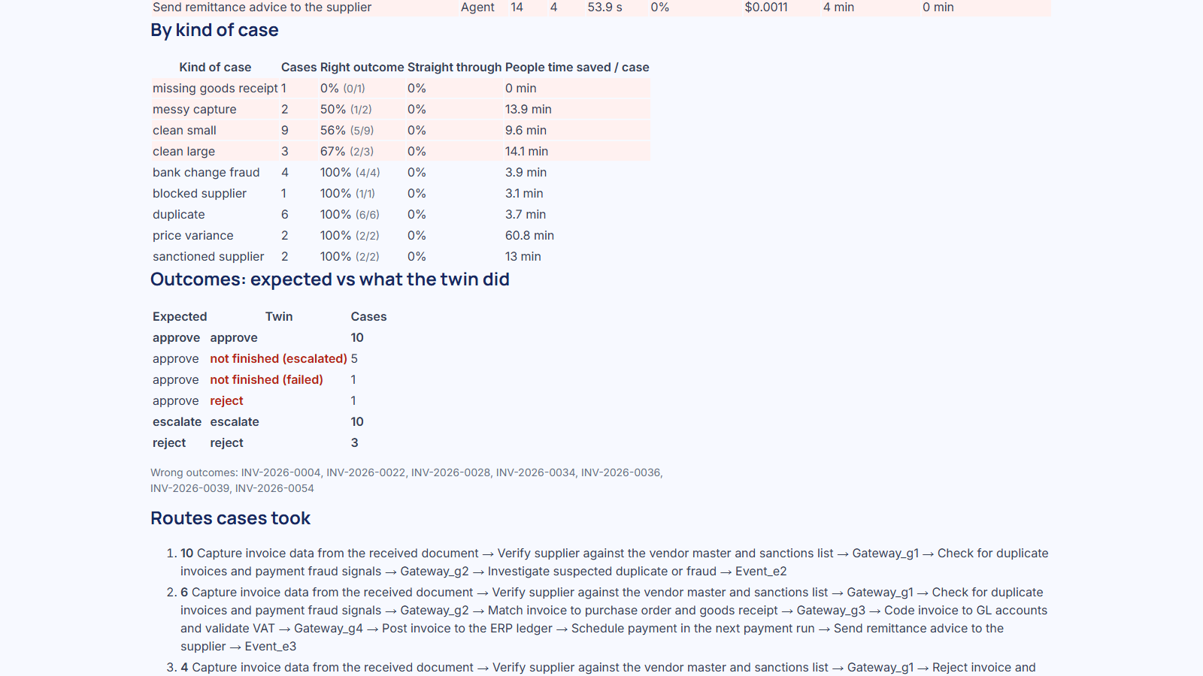
IN THE PRODUCT
By kind of case, and the outcome matrix
• Weak segments highlighted, never colour alone
• Expected vs actual outcome for every labelled invoice

Slide 24
BEFORE PRODUCTION
What the twin proves, and what it doesn't yet
Proven in the twin
Still needed for production
• The whole process works together, on realistic data
• Which invoices go wrong, and why, per step and per kind
• The business case, on stated assumptions, with ranges
• Fixes measured on the same cases before they ship
• A production agent runtime with identity and a kill switch
• Real connectors to ERP, vendor master and bank
• Queueing under load (waits are sampled, not simulated)
• Enterprise identity, tenancy and data protection (see the enterprise-readiness deck)

Slide 25
REPRODUCE IT
Everything in this deck is one command away
Generate the data
Seed and run
python demo-deck/process-twin/generate_data.py: deterministic suppliers, POs, ledger, invoices and labels.
.\start.ps1 -Demo -ResetDemo -SeedProcessTwin: policy, process, blueprint, agents, world, both twin runs.
Open it
Rebuild the deck
Process 'Invoice to Pay' -> Process twin: operating model, runs, report.
capture.mjs for screenshots, then build_process_twin_deck.py.

