Slide 1
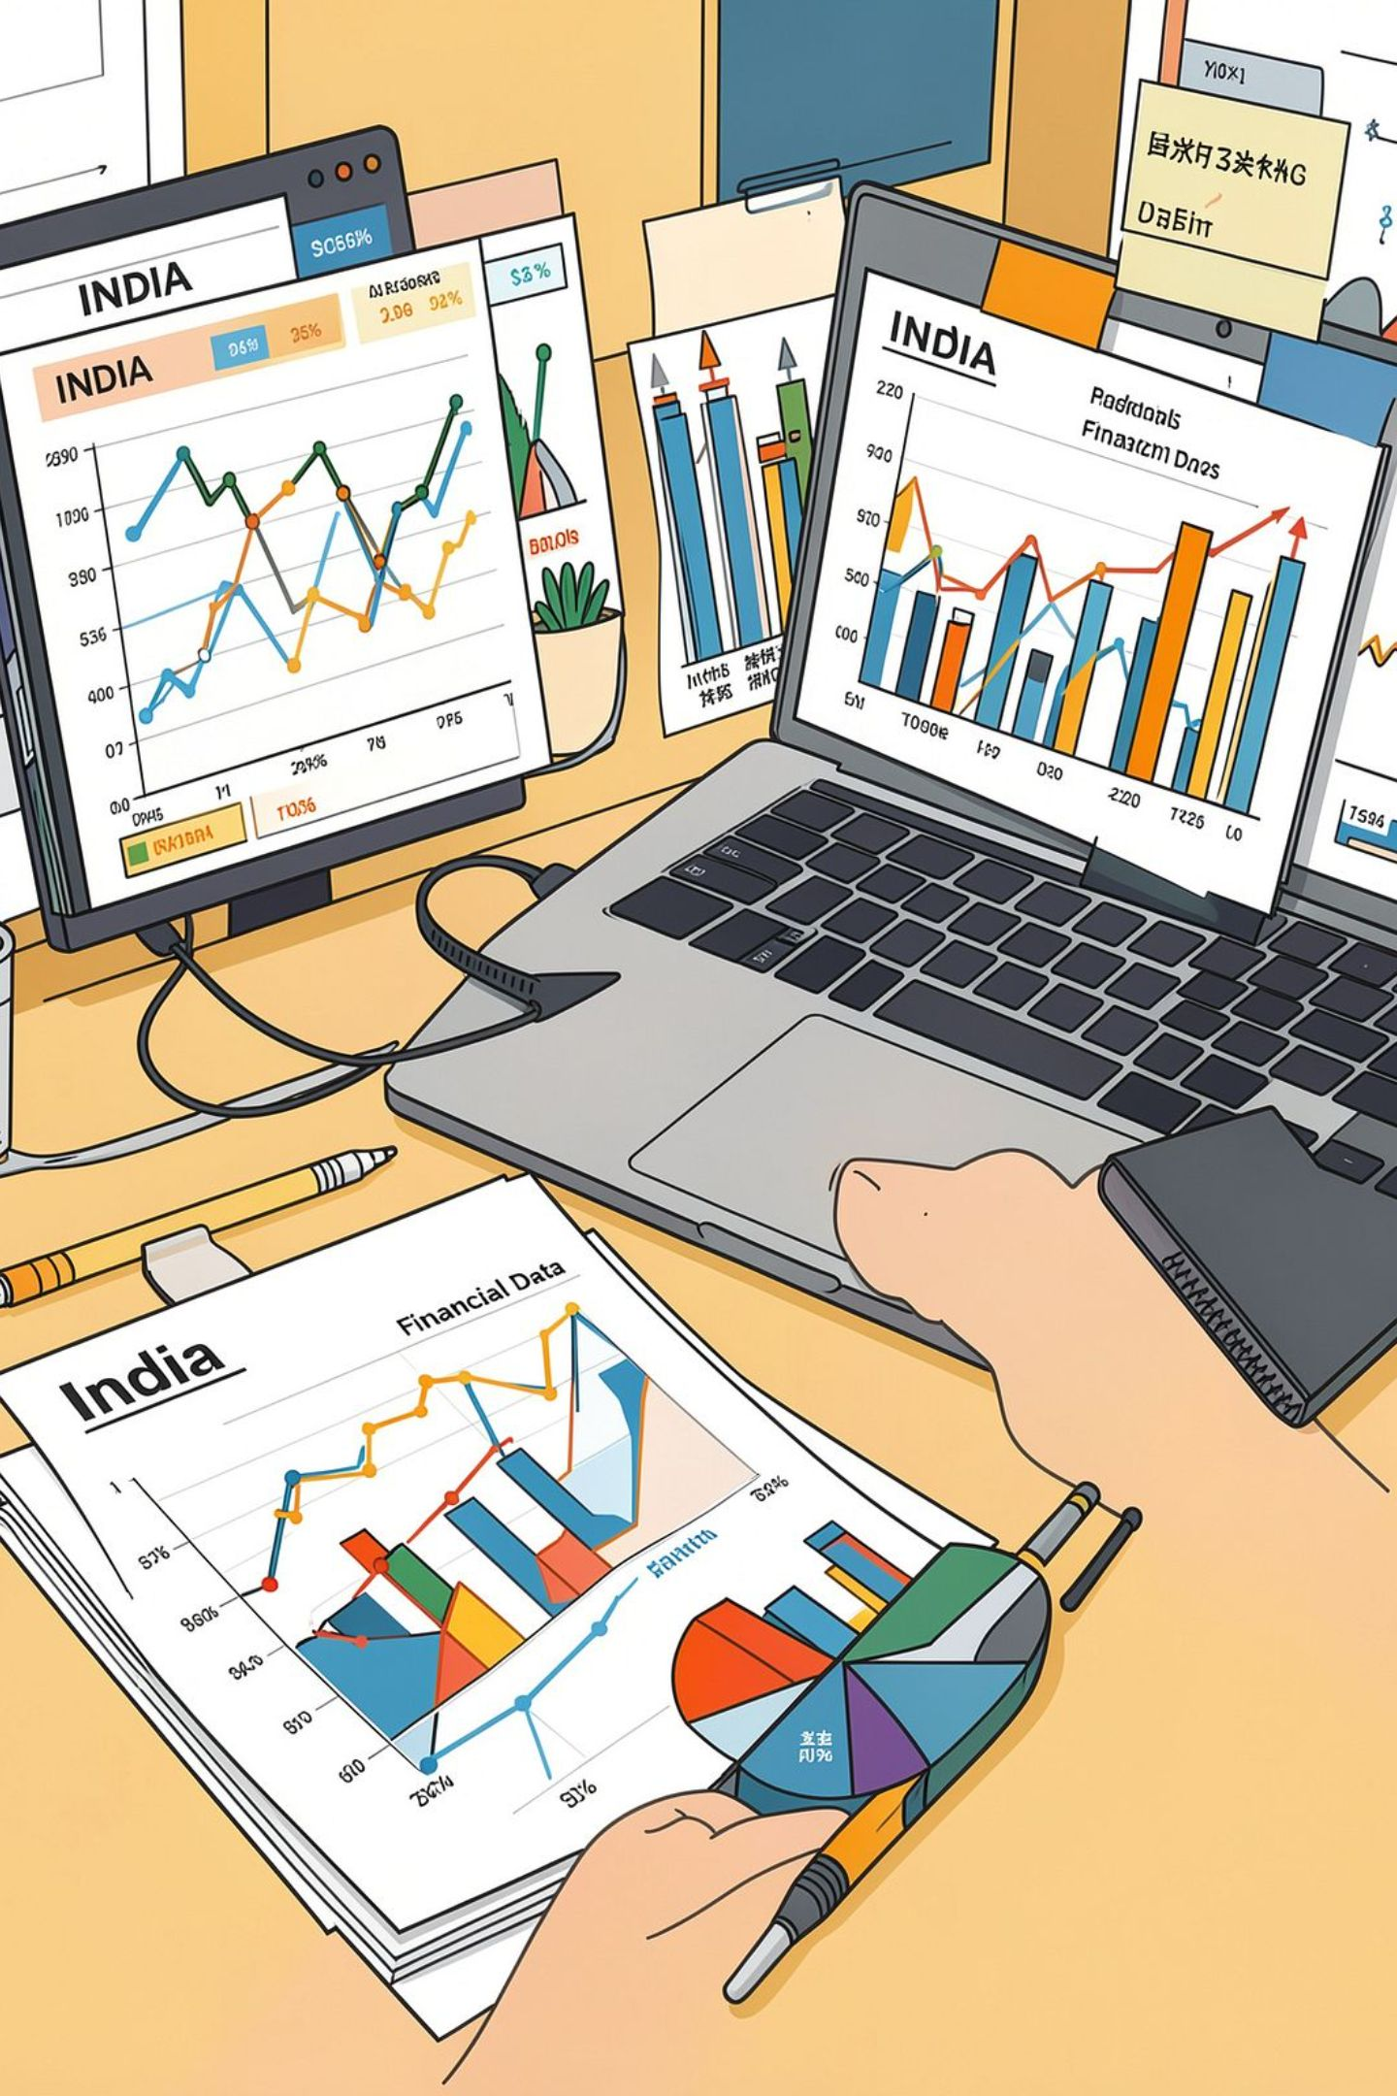
CPI INFLATION
Analytical Case Study
Jan 2013 – May 2023 · Rural, Urban, Rural+Urban · 27 categories
Built end-to-end in Excel — cleaning, imputation, analytics, executive summary
Coding Ninjas · Data Analytics Case Study
Built By Jayesh — Data Analyst Linkedin · Portfolio / Github
Notes: This is a formula-driven workbook, not a static report — every number is reproducible from the raw GOI CSV.

Slide 2
The Brief
Five questions to answer
1
Which broader bucket contributes most to the CPI basket?
2
Which year since 2017 had the highest inflation — and why?
3
How did food prices move over the last 12 months?
4
How did COVID-19 change inflation in health, food and essential services?
5
Which bucket is most sensitive to imported crude oil?
Notes: The workbook is organised one sheet per question, plus methodology, clean data and a one-page summary.

Slide 3
Data, Method & Data Quality
How the numbers were built — and cleaned
Method
Data quality
125 monthly observations · 27 categories · 3 sectors
Equal weights per category; bucket index = average of member categories
Published aggregates (Food & beverages, Clothing & footwear, Miscellaneous, General) excluded — no double counting
MoM % = (CPIt / CPIt-1 − 1) × 100 · YoY % = (CPIt / CPIt-12 − 1) × 100
NA and - → trailing 3-month moving average; linear interpolation for isolated gaps
Rural Housing unpublished → Rural+Urban housing as a flagged proxy
NSO suspended field collection Apr–May 2020 → imputed and logged cell by cell
Colour code: blue = input · black = formula · green = cross-sheet link
Notes: Two design decisions matter most — excluding published aggregates (otherwise every bucket share inflates), and logging every imputed cell so a reviewer can audit the workbook. CPI is an index, not a price, so it is never summed across months.

Slide 4
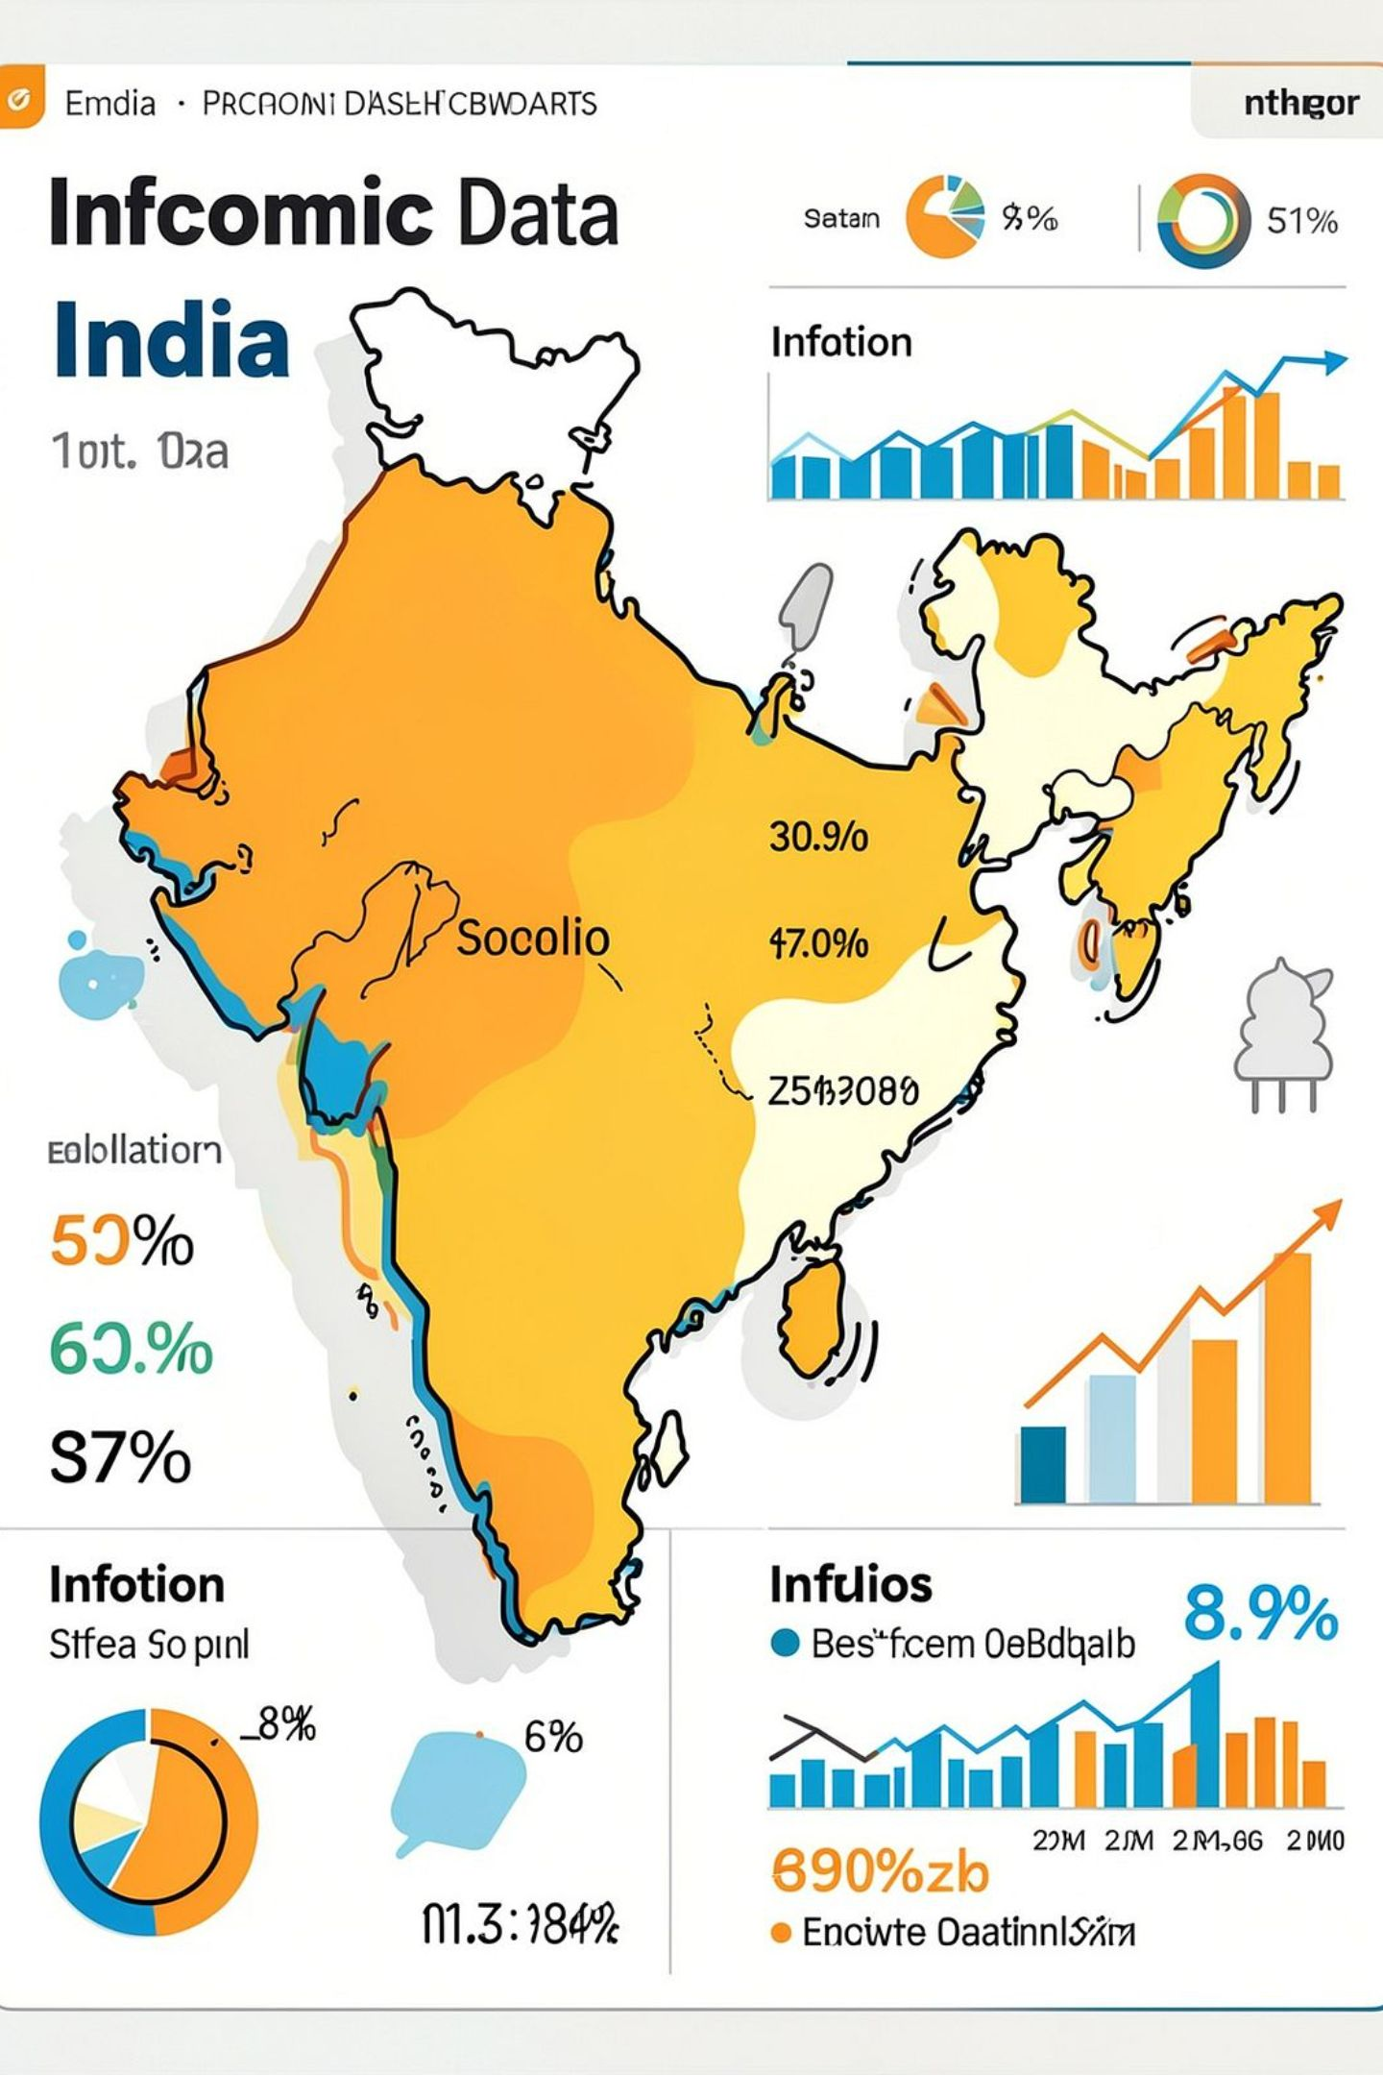
Headline Numbers
Where India stood in May 2023
179.1
General Index (R+U)
4.31%
YoY Inflation
6.62%
Peak Inflation Year
2022 average
56.6%
Top Bucket by Weight
Food
Notes: 4.31% is back inside the RBI's 2–6% tolerance band after the 2022 spike.

Slide 5
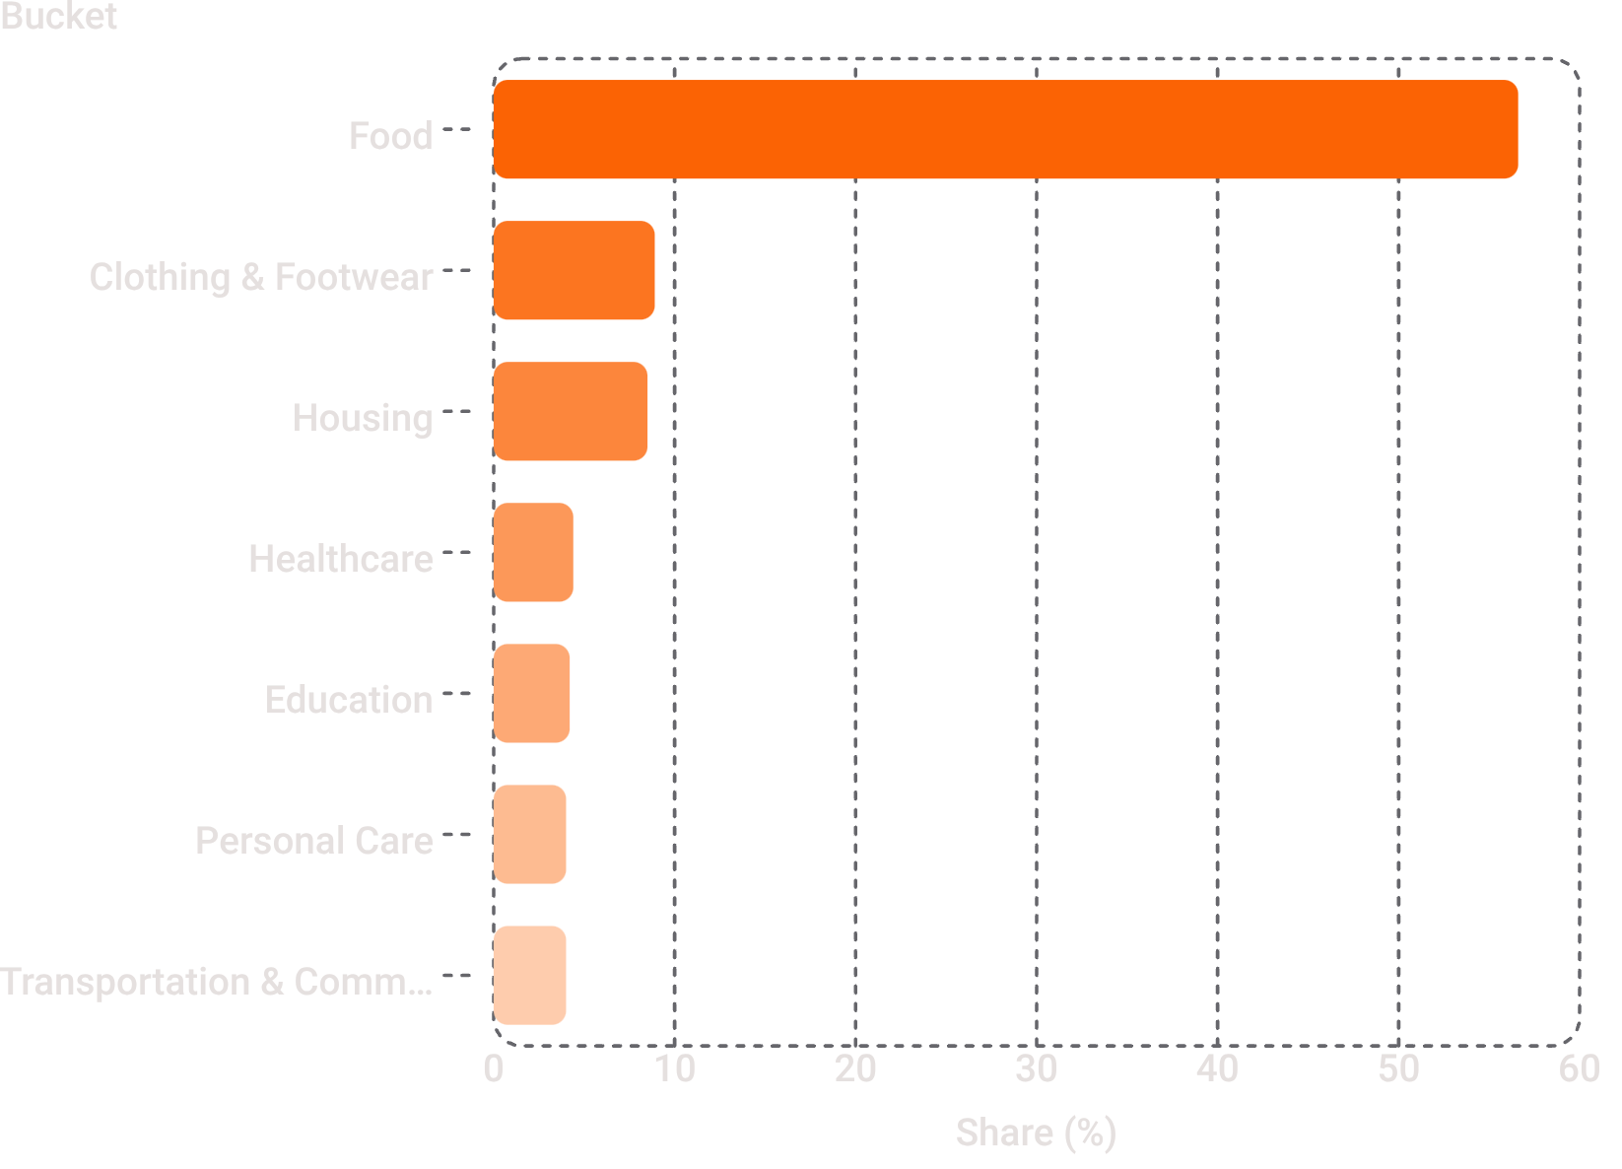
Q1: Basket Contribution
Food is over half the basket — 56.6%
Food 56.6% · Clothing & Footwear 8.9% · Housing 8.5%
Healthcare, Education, Personal Care ≈ 4.0–4.4% each
Smallest: Transportation & Communication, 4.0%
Food holds 13 of 23 categories and sits above the basket mean index (179.1)
Shares sum to exactly 100% by construction
Notes: Under equal weights, a bucket's share is driven by how many categories it holds and how high those indices sit.

Slide 6
Q2: Peak Year
2022 was the worst year — 6.62% average YoY
Peak month 7.79%; lowest year 2017 at 3.33%
Brent crude averaged ~USD 100/bbl after the Russia–Ukraine war
Edible oil and fertiliser imports repriced
March heatwave cut wheat output
Weak rupee amplified every imported input
RBI response: 225 bps of repo hikes
Notes: 2022 was cost-push and largely imported — not demand-driven.

Slide 7
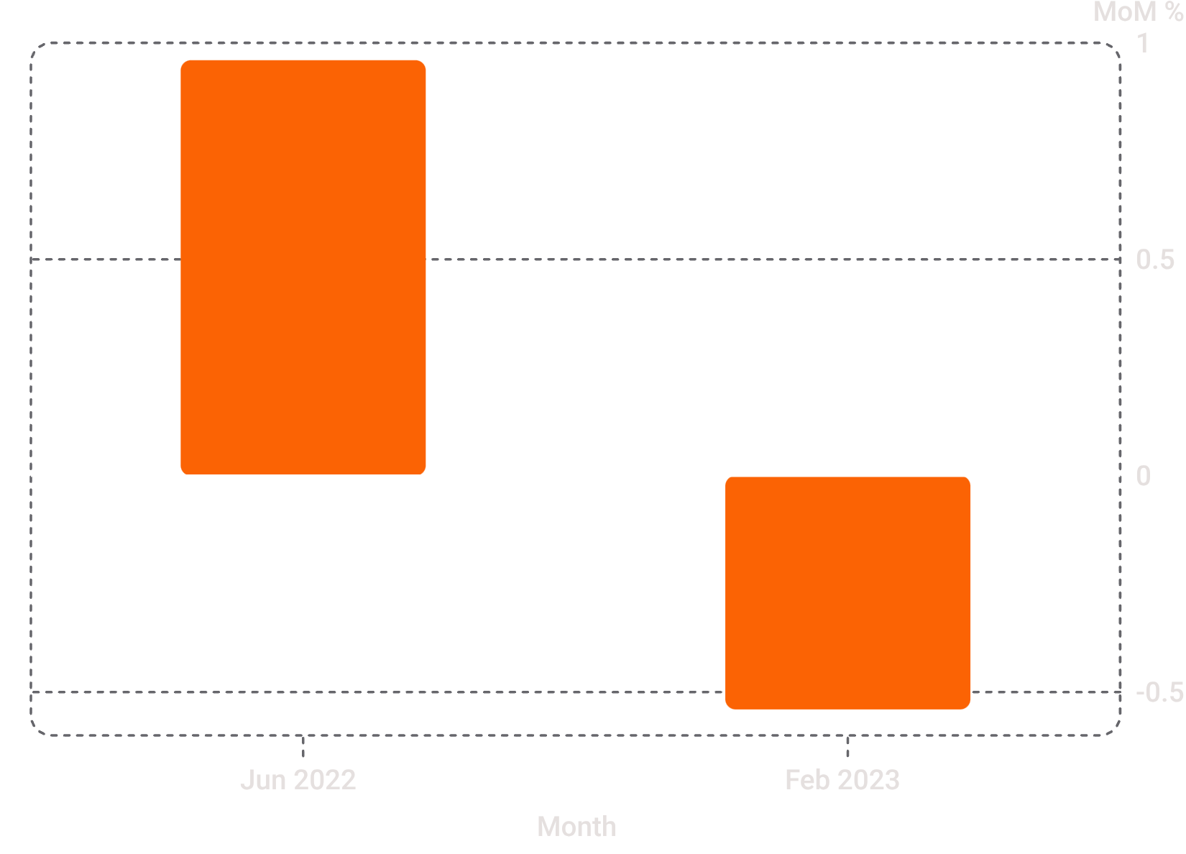
Q3: Food Deep Dive
12 months to May-2023: food inflation 3.06%
Key Movements
Food bucket 173.82 → 179.14 = +5.32 index points
Highest MoM: June-2022, +0.96%
Lowest MoM: February-2023, −0.54%
Biggest driver: Spices, +33.10 pts = 28.0% of the entire rise
Weakest: Oils and fats, −32.40 pts
Notes: Falling edible-oil prices offset the spice and cereal spike — which is why headline food inflation looks calm while individual items were violent.

Slide 8
Q4: COVID Impact
The lockdown reshaped the mix, not just the level
Group
Pre Mar-2020
Post Mar-2020
Change
Food
2.85%
7.48%
+4.63 pp
Essential services
4.45%
5.82%
+1.37 pp
Healthcare
6.72%
6.23%
−0.48 pp
Food
Services
Healthcare
Mandis shut, inter-state trucking stopped — food YoY topped 10% in Apr-2020
Record fuel excise duty in May-2020, even as global crude crashed
Already fastest-inflating pre-COVID; peaked 9.39% in the Delta wave (May-2021)
Notes: Largest structural break: food. Healthcare's problem is structural, not pandemic-created.

Slide 9
Q5: Crude Oil Sensitivity
Energy & Utilities is the most crude-sensitive bucket
Pearson correlation (R) of MoM crude change vs MoM bucket inflation, 2021–2023:
Bucket
R
Energy & Utilities
+0.113
Transportation & Communication
+0.107
Housing
+0.104
Healthcare
+0.084
Food
+0.074
Education
−0.117
Notes: R ranges −1 to +1 and measures direction and tightness of co-movement, not magnitude. All values are low because Indian pass-through is lagged one to two months and buffered by excise duty and LPG subsidy changes. Education's negative R reflects annually administered fees.

Slide 10
Takeaways, Skills & Thank You
Four takeaways
1
Managing headline CPI in India is managing food supply
2
Crude is the second lever
Buffer stocks, export curbs, mandi logistics
A 10% crude move reaches transport and food in one to two months
3
Healthcare runs above headline inflation in both windows
4
Rural and urban baskets diverge
A structural affordability problem
Rural food-led, urban services-led
Skills demonstrated
Cleaning & imputation · Audit-ready workbook design · Index vs price reasoning · MoM/YoY/absolute change · Contribution decomposition · CORREL sensitivity analysis · INDEX/MATCH, SUMPRODUCT, AVERAGEIFS · Executive communication
Honest limitations
Equal weights are a case-study simplification
Apr–May 2020 imputed
Rural Housing proxied
Correlation is contemporaneous, not lagged or causal

