Slide 1

Customer Churn Intelligence Platform
End-to-End Customer Churn Analysis using Python, SQL, SQLite and Data Analytics
Jayesh Suthar — Data Analytics Enthusiast
Outcome
Deliverables
Actionable insights to reduce churn and increase CLTV
EDA, CLTV analysis, CSAT assessment, reproducible code & visuals

Slide 2
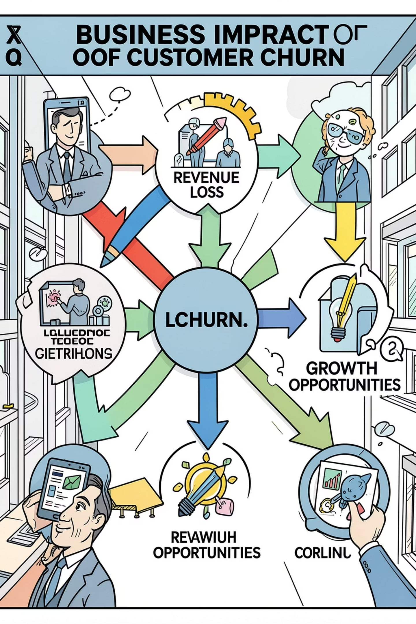
Business Problem — Why Churn Matters
Customer churn reduces recurring revenue, increases acquisition costs, and erodes lifetime value. For subscription businesses, improving retention by a few percentage points delivers outsized ROI.
1
Business impact
Revenue erosion, lower CLTV, higher CAC
2
Primary objectives
Identify at-risk customers, quantify CLTV, generate retention actions
3
Stakeholder value
Direct recommendations for marketing, product, and support teams

Slide 3
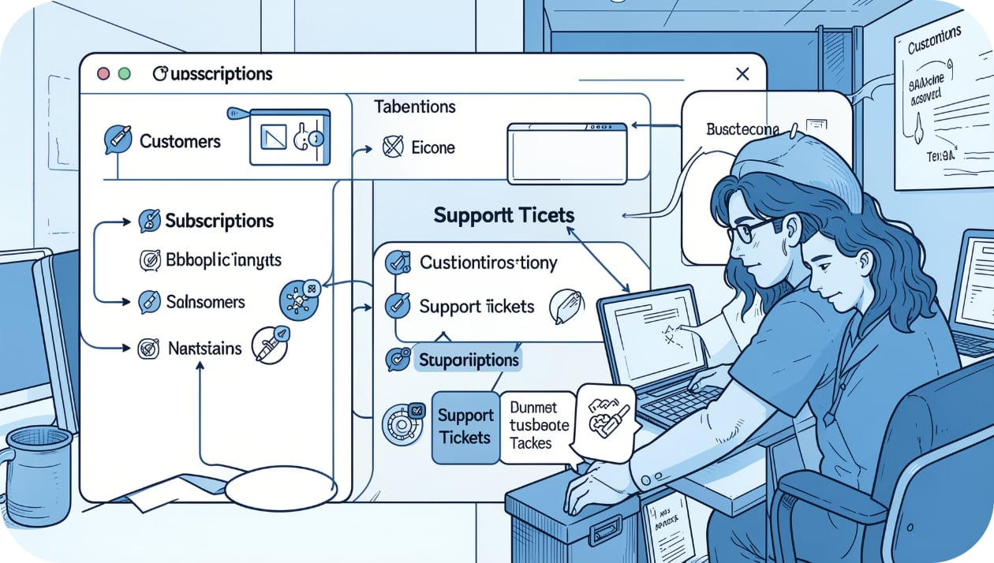
Dataset Overview
Three integrated tables
Customer Table — demographics, signup dates
Subscription Table — plan, charges, tenure
Support Table — CSAT, tickets, resolution time
Data combined into a single analytical dataset via SQLite joins to enable cohort-level and individual customer analysis.

Slide 4




Technology Stack
Python
SQLite & SQL
Pandas, NumPy, Matplotlib for ETL and visualization
Database integration, joins, aggregations, reproducible queries
Jupyter & VS Code
GitHub
Exploration, analysis notebooks, and reproducible code
Version control and portfolio hosting

Slide 5

Project Workflow
Raw Dataset
SQLite DB
SQL Queries
Data Cleaning
Feature Eng
Reproducible pipeline from raw files to documented insights. Each stage includes unit-tested SQL or Python artifacts stored in Git.

Slide 6
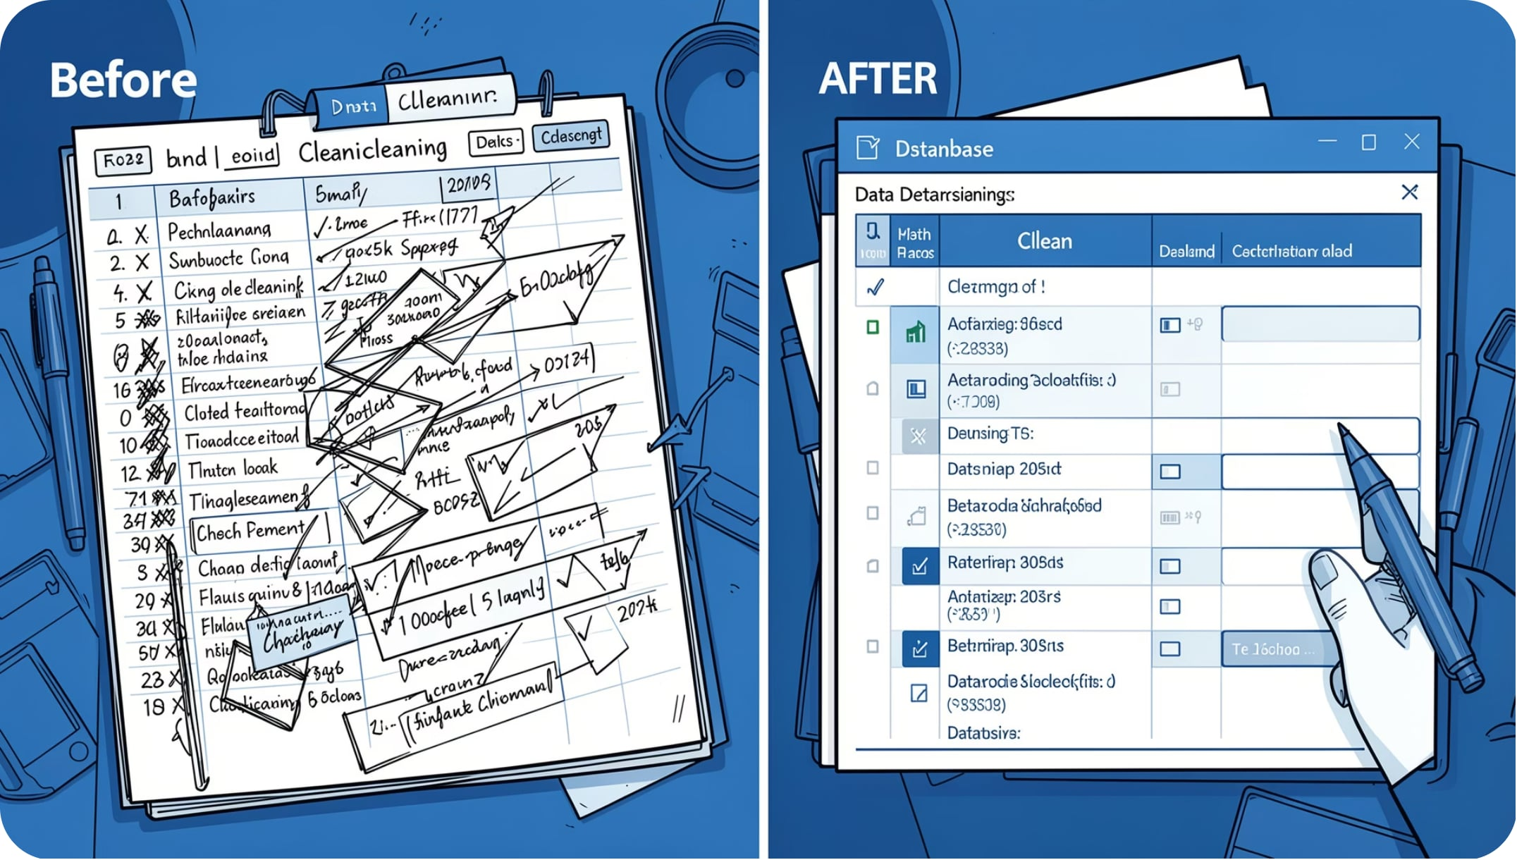
Data Cleaning & Feature Engineering
Cleaning steps
Removed duplicates and invalid records
Handled missing values with rule-based imputation
Standardized gender values and date formats
Engineered features
Customer Age (derived from DOB)
Customer Tenure (days/months active)
CSAT Category (Low / Medium / High)
Churn Status (binary flag)

Slide 7
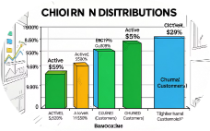
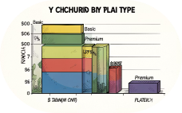
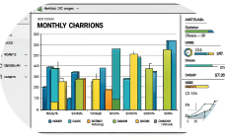
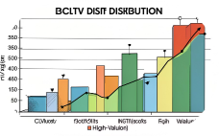
Exploratory Data Analysis — Key Visuals
Churn Distribution
Churn by Plan Type
Monthly Charges
CLTV Distribution
Active customers outnumber churned customers — opportunity to improve retention for specific plans.
Basic plan exhibits the highest churn rate; Premium & Standard show stronger retention.
Skewed distribution with a concentration of low-charge customers—a segment at higher churn risk.
Top decile of customers account for a materially larger share of expected revenue.

Slide 8

Correlation Analysis
Churn Score
Strong +
Neutral
Focus: Retention
Tenure
Strong −
CLTV
Strong positive correlation: tenure & CLTV. Strong negative correlation: churn score & CLTV. These relationships guide prioritization of retention interventions.

Slide 9
Business Insights — Executive Summary
Insight 1
Insight 2
Basic plan customers have disproportionate churn—target for retention campaigns.
Higher CLTV concentrated in long-tenure customers — invest in tenure-driven loyalty.
Insight 3
Insight 4
Low CSAT correlates with elevated churn probability — improve support responsiveness.
Geographic variation suggests tailored regional retention strategies.

Slide 10




Recommendations & Next Steps
Future Scope
Deploy ML churn prediction (binary classifier + explainability)
Interactive Power BI dashboard for stakeholders
Streamlit web app for operational intervention lists
Near real-time data pipeline & automated reporting
Retention Campaigns
Personalized offers for Basic plan customers and high-risk segments.
Repository & Contact
GitHub: github.com/jayesh-suthar (portfolio)
Email: sutharjayesh607@gmail.com
Support Improvements
Faster response SLAs and CSAT-driven follow-ups to reduce churn triggers.
Loyalty & CLTV
Tiered rewards for longevity to protect high-CLTV cohorts.
Product Roadmap
Build predictive churn models; deploy Power BI & Streamlit dashboards for operations.

