Slide 1
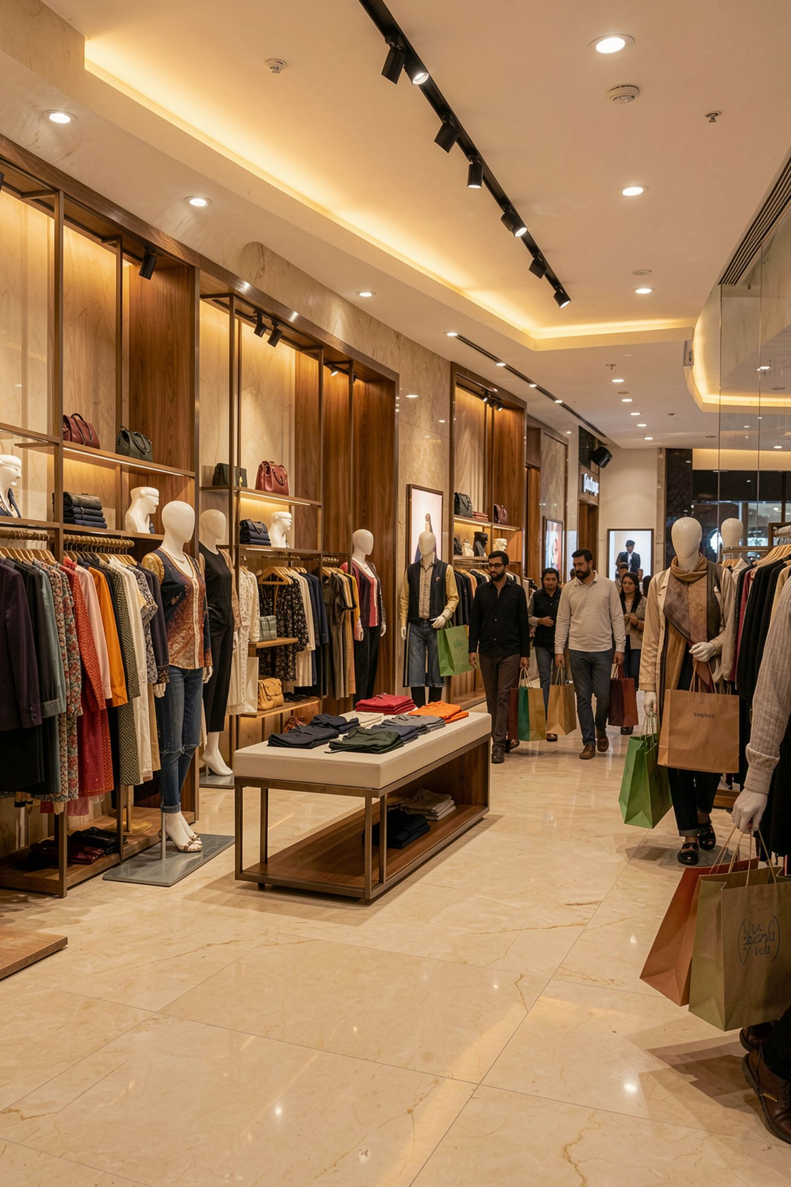

Customer Shopping Behavior Analysis
Turning 3,900 retail transactions into pricing, loyalty and marketing decisions
Jayesh · Data Analyst | Python · MySQL · Power BI
One dataset, three tools, five decisions the business can act on this quarter.

Slide 2
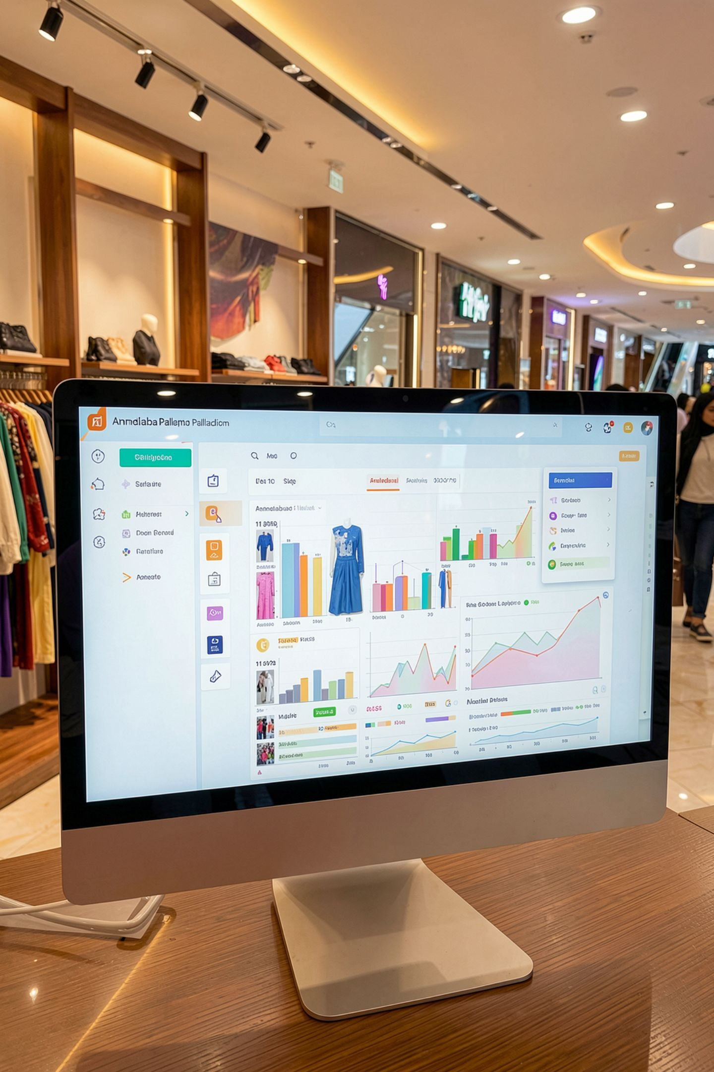
The Business Problem
A US apparel retailer could see revenue — but not what moved it.
Shifting Patterns
Purchasing patterns shifting across demographics, categories and channels
Multiple Levers
Discounts, subscriptions and shipping upgrades all running at once
No Visibility
No view of which lever was actually paying for itself
The question: How can the company use consumer shopping data to identify trends, improve engagement, and optimise marketing and product strategy?

Slide 3
The Data
3,900
18
$233K
Transactions
Columns
Total Revenue
18 raw → 19 after cleaning
$233,081
$59.76
3.75
Average Order Value
Average Review Rating
out of 5
Coverage
Data Types
50 US states · 4 categories · 25 products
Demographics · purchase details · behaviour (discounts, subscriptions, shipping, loyalty)

Slide 4
Approach
Python (pandas)
MySQL
Cleaning, missing-value treatment, feature engineering
Structured table + 10 business queries (CTEs, window functions)
Power BI
Report
One-page interactive dashboard with KPI cards and slicers
Findings translated into recommendations
Key Prep Decisions
1
Missing Ratings
2
Duplicate Column
3
Feature Engineering
37 missing ratings filled with category medians (no rows dropped)
Promo Code Used proved to be an exact duplicate of Discount Applied → removed
Engineered age_group (quartiles) and purchase_frequency_days

Slide 5
Finding 1: Discounts Aren't Working
43% of orders (1,677) carry a discount.
Average Order Value
What This Means
Discounted: $59.28
Full price: $60.13
Discounted customers spend less, not more.
The programme transfers margin without lifting basket size.

Slide 6
Finding 2: Half the Base Is Untouched
Every discount and every active subscription in this dataset belongs to a male customer.
Male Customers
Female Customers
Female Revenue
63.2% discounted · 39.7% subscribed
0% on both
Female customers still generate $75,191 at a higher AOV ($60.25 vs. $59.54)
An entire segment is buying at full price without ever being targeted.

Slide 7
Finding 3: Loyalty Without Subscription
Segment
Customers
Loyal (11+ prior orders)
3,116 (79.9%)
Returning (2–10)
701
New (1)
83
Among repeat buyers with 5+ prior purchases, only 27.6% subscribe.
The repeat behaviour a subscription is meant to create has already happened — it just isn't being converted.

Slide 8
Finding 4: The Flat Segments
Almost every "obvious" way to slice this business is flat:
Season
Age Quartiles
Payment Methods
7.6% spread ($55,777 Summer → $60,018 Fall)
23.9% – 26.7% revenue share each
All six within 1% of each other
Shipping
Category
$2.27 AOV spread across six options
Revenue driven by order volume, not basket size (AOV $57.17 – $60.26)
Best-selling ≠ best-rated: Blouse, Shirt, Dress lead revenue; Gloves (3.86), Sandals (3.84), Boots (3.82) lead ratings.

Slide 9

Recommendations
Cap the discount programme
Reserve it for reactivation and first orders
Trigger a subscription offer at the 5th purchase
The loyalty already exists
Open discounts and subscriptions to female customers
Untouched, full-price segment
Bundle high-rated accessories with high-volume apparel
Lift baskets where discounts failed
Segment on behaviour, not season / age / payment method
The rest are cosmetic
Limitation: Single cross-sectional snapshot, no order dates — cohort retention and CLV need timestamps.

Slide 10
Thank You
Customer Shopping Behavior Analysis
Python · MySQL · Power BI
Jayesh — Data Analyst
Let's connect — I'm always open to discussing data, analytics, and new opportunities.
🔗 Portfolio & GitHub
💼 LinkedIn

