Slide 1


SATHYABAMA INSTITUE OF SCIENCE AND TECHNOLOGY
Modern Secured Digital E-Voting & Analysis –MSDEA
(e-Voting Application)
PRESENTED BY TEAM
Team Members
JAYESH BAIBHAV
JYOTISHMAN GHATAK

Slide 2
Introduction-
In these challenging COVID-19 times, the question on how to deal with the
upcoming elections while maintaining proper social distancing norms has already
been raised by several voices.
We have been listening since ages that e-Voting is the future of election but now we’re right
in that future, and that’s our need too.
So, we come up with an easy and secured system named
“Modern SecuredDigital e-Voting & Analysis” aka “MSDEA”.
MSDEA allows member to login with their credentials.
It can be access though any system which is connected though internet connectivity .
It can generate the result within seconds after Election .
This system promotes transparency in the voting system in comparison to the
traditional Voting System.

Slide 3
WORKING
      The system will be having two major parts-
      1. Admin Panel
      2. Voter’s Interface
      Admin Panel:
      Admin Panel is designed as such so that it can be used easily by Government
      Officials, from here the concerned authority can do the following tasks-
      Add Candidate/View Candidate List
      View Voter List
      Validate or delete the newly registered Voters.
      View real-time Vote Count, and Final Vote Count

Slide 4
Voter’s Interface:
Voter’s Interface is designed as such that it can be used with very ease by a wide
class of people, the only thing the Voter needs to cast their vote is either of
Mobile, Tablet or Computer System and a working internet connection’s.
At the login panel of Voter’s Interface Voter needs to login with their unique credential, and thereafter successful login they can cast their vote to candidates of their choice. These casted votes are accepted by the system at the server database.
This Voter’s Interface come with the following security layers-
Authentication of Voter’s login credential from the database.
Checks for duplicate doting i.e. same Voter can’t cast their vote twice
For new voter there is an option of real-time Registration at Voter’s
Interface, which is later validated by the concerned authority that the
registered voter is eligible to vote or not.

Slide 5
OBJECTIVE
Modern Secured Digital e-Voting & Analysis aka MSDEA has been
developed by keeping the following objective into an account :
Authenticity: This means that only selected voters can vote and the voting system
must ensure that the use of appropriate authentication mechanisms that a
selected voter is the one that cast the vote.
Freedom: The voting system must provide the ability to all selected voters to vote
for whatever candidate they wish, or none for an election process.
Eligibility: Only eligible voters are permitted to vote.
Practicability: No extra skills are required to vote and no additional equipment is
required.
Security: During an election process the voting system must maintain vote
integrity, voter anonymity when casting the vote.
Uniqueness: The voting system must provide appropriate mechanisms that
ensure that voters are uniquely identified for an election process and vote only
once.
Verifiability: The voting system must provide the voter a proof receipt that
his/her vote drop at the server has been was acknowledged.

Slide 6
Fairness: The voting system must not provide any information about the out come of vote count during the election process.
Democracy: All votes are equal and have the same weight,
The principle: “One Voter- one Vote” must be sustained by the voting system during the election process.
Privacy (anonymity): When the votes are being verified by the election
committee, the voting system must provide anonymity mechanisms so that the
voter cannot be traced back by his/her vote. The voter remains anonymous.
Accuracy: All valid votes are counted correctly. The voting system must count all
votes and must count them as cast. A voter’s vote cannot be altered, duplicated,
or removed.
Accessibility: The electronic voting system must be accessible to voters regardless
of their geographical location or electronic equipment they use, so everybody can
access this electronic voting system.
Availability: During a voting process, the electronic voting system must maintain
the same availability response for all voters.

Slide 7

TECHNOLOGIES USED
It is a web-based application. So, fundamental features related with web based technologies such as client server and database properties determine the software requirement of this system.
Frontend:
HTML, CSS, JavaScript
Backend:
Flask (web framework written in Python), SQLAlchemy (Python SQL toolkit and Object
Relational Mapper)
Database:
MySQL (an open-source relational database management system)

Slide 8
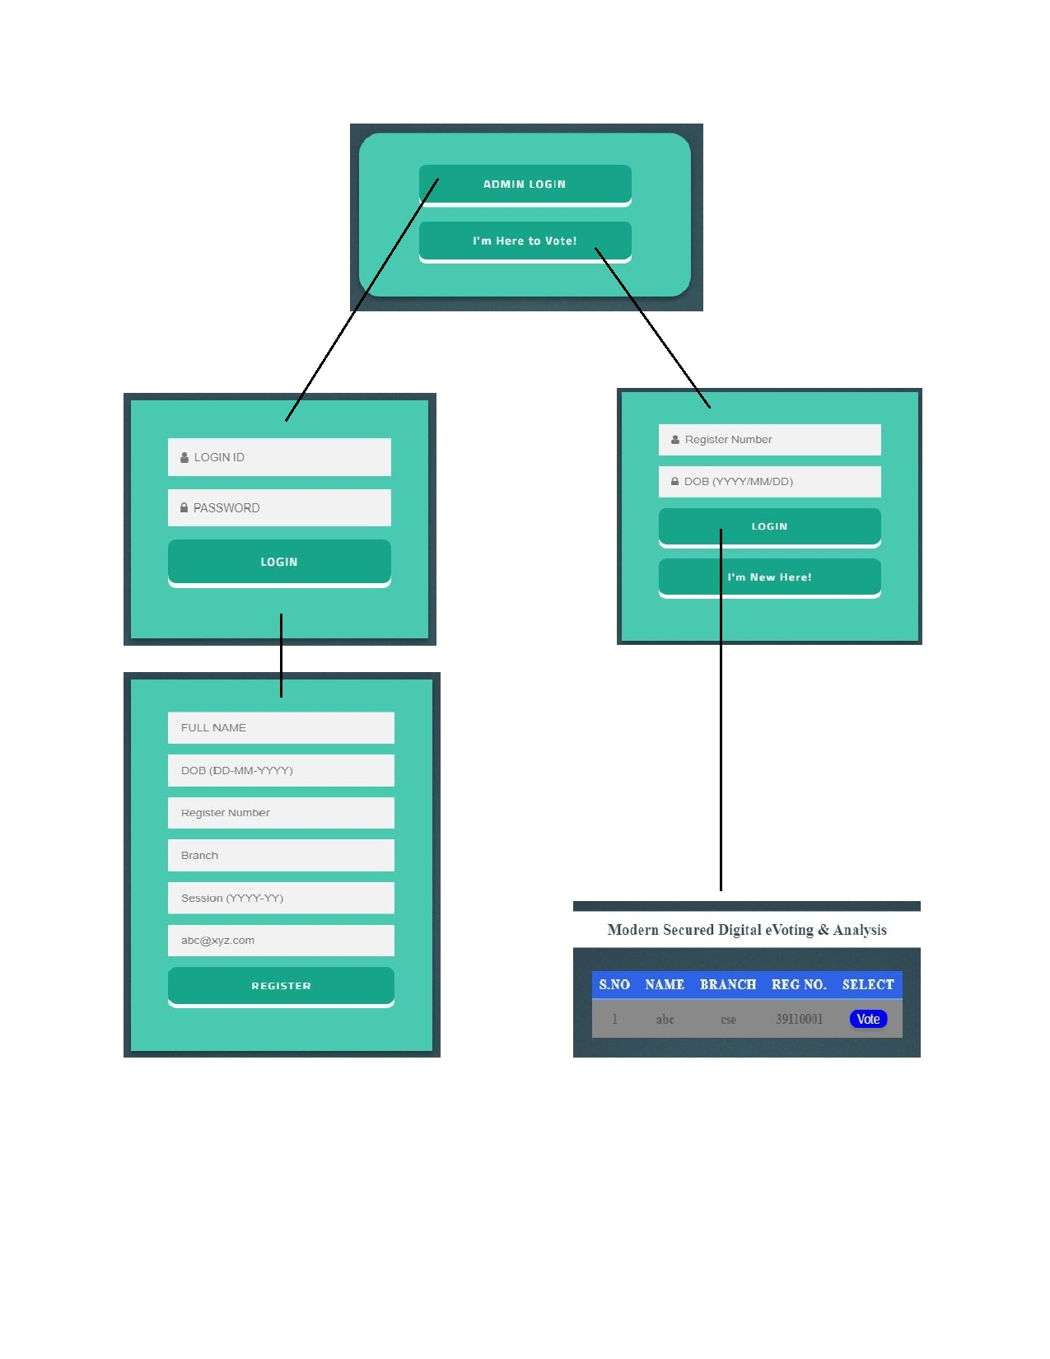
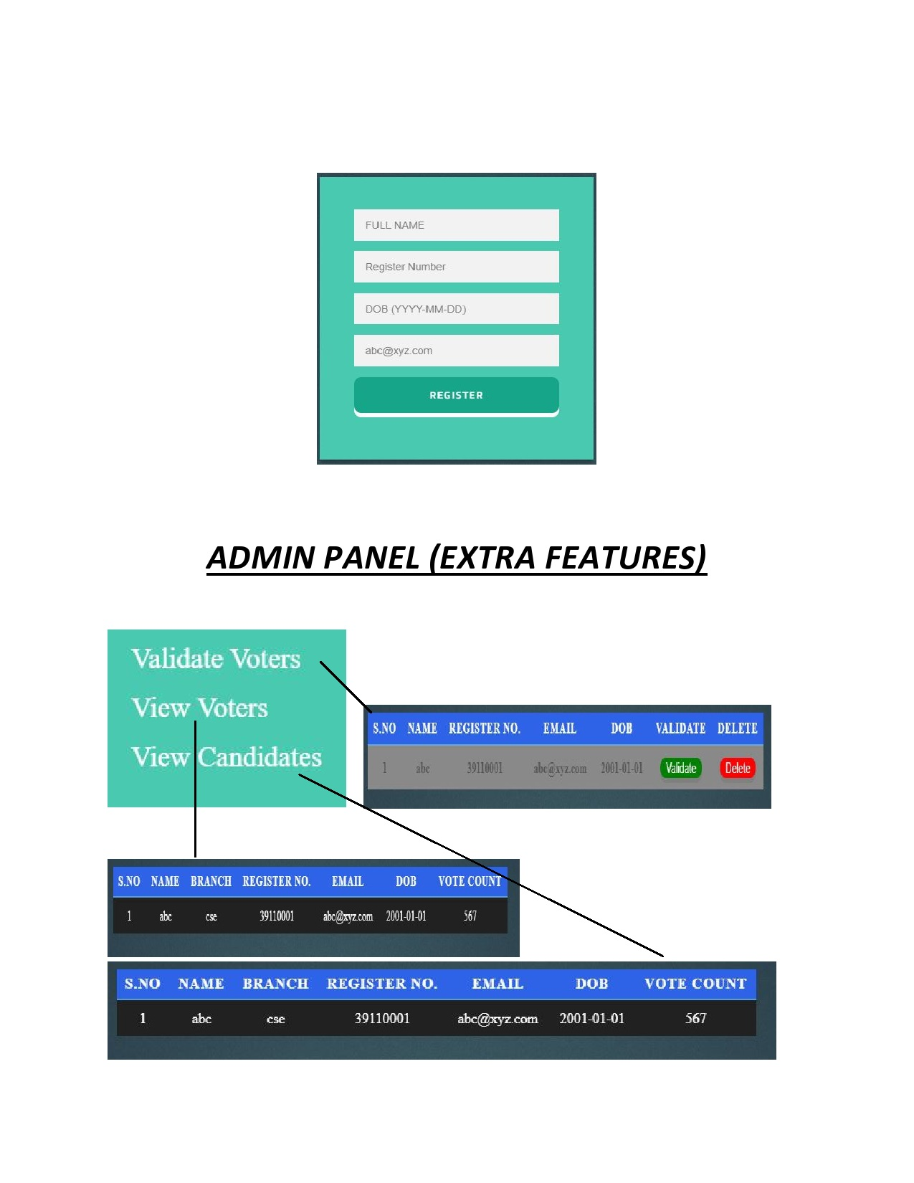
Interface

Slide 9
ADVANTAGES
Advantages for the Voters
MSDEA will speeds up the voting process, especially where advance
voting is concerned. Voters no longer have to go to the polling booths to cast
their vote, votes can be casted sitting anywhere with a working internet
connection.
MSDEA will also increase the security and reliability of elections.
Further, in MSDEA it is not possible to make voting errors by mistake, because the
identification information of the chosen candidate will appear on the screen
before the vote is confirmed.
Another advantage for the voter is that there is no ambiguity in interpreting
an electronic vote.
Advantages for the Authorities
MSDEA reduces and simplifies the work of the authorities significantly.
MSDEA leads to notable cost savings through reduced personnel, especially in the
advance voting.
MSDEA will deliver also other cost savings. For example, various envelopes, forms
and documents are no longer needed.
Votes casted on MSDEA can be counted by just one click, and the result of the
vote will be declared immediately.

Slide 10
FUTURE DEVELOPMENT
For enhancing the security in this e-Voting, we can add face recognition system using ML and AI. Further, we can add biometric too as an extra layer of security.
Some extra features like voice assistance support and multi-language
feature can be added, so that it can help in the casting of vote to the blind
and people belonging to less educated background.
Some more security enhancement can be done to make the election process smooth and transparent for both voter as well as for the candidates who are contesting the elections.

Slide 11

MSDEA presents numerous advantages over traditional voting system. In the initial stage there will be of course a little cost for planning and introduction.
But, in the long run and with a widespread introduction, this e-Voting system will lead to a new revolution in elections, and many cost savings too.
Thank You!

