Slide 1

Smart Track
[ Arduino (RFID) based student attendance tracker ]

Slide 2
Team Members
Joel Aaron John Dsouza
Jayesh Sanjay Kambali
Avinash K Mahato
Levon Mario Rodrigues
Gaspar Fernandes
Harehan Hassim Shaikh
Ashton Joaquim Dias
Ian James Lobo
Pratik Prashant Amonkar

Slide 3
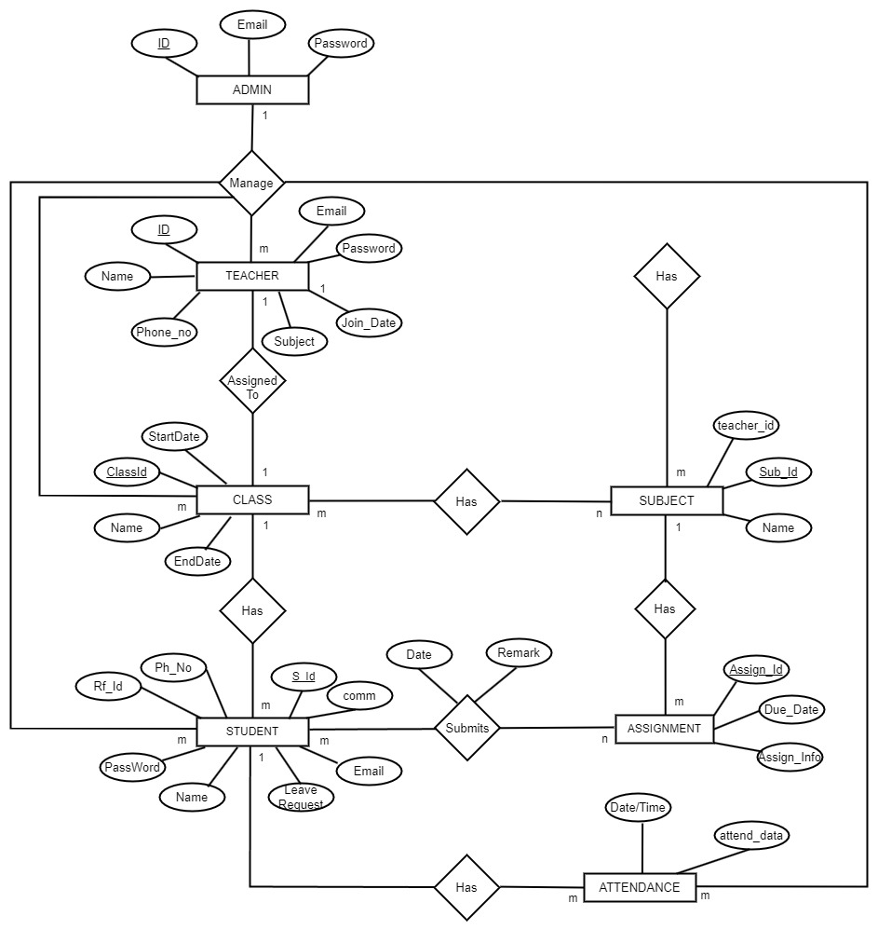
ENTITY RELATIONSHIP DIAGRAM

Slide 4
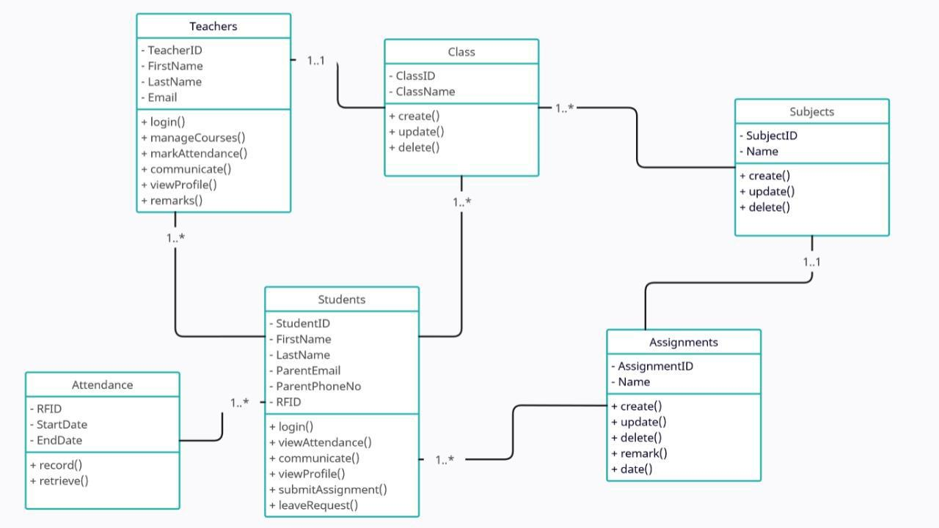
Class Diagram

Slide 5
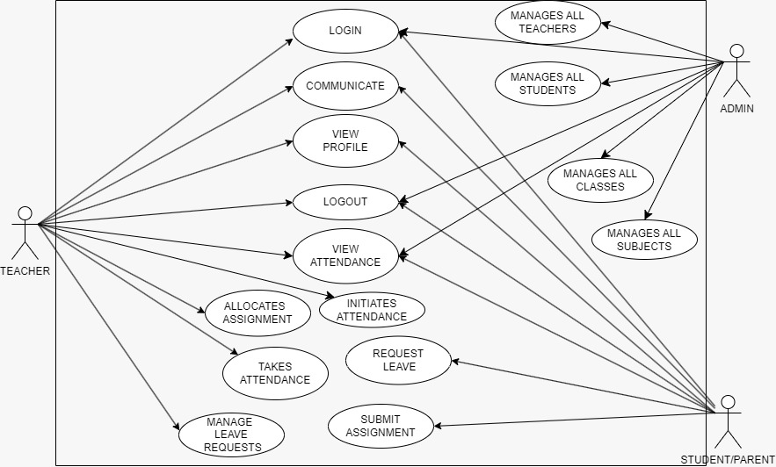
Use Case Diagram

Slide 6
Activity Diagrams

Slide 7
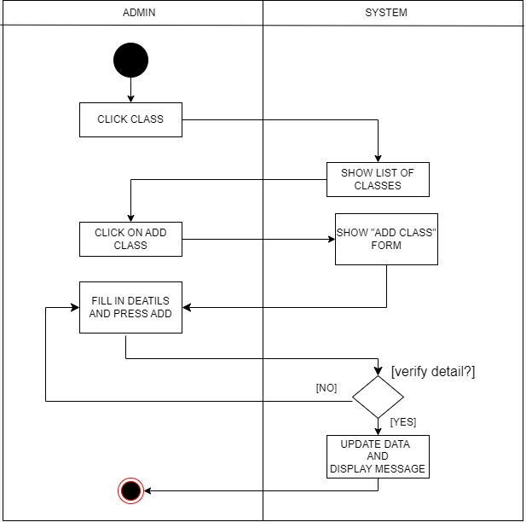
1) Add Class Activity

Slide 8
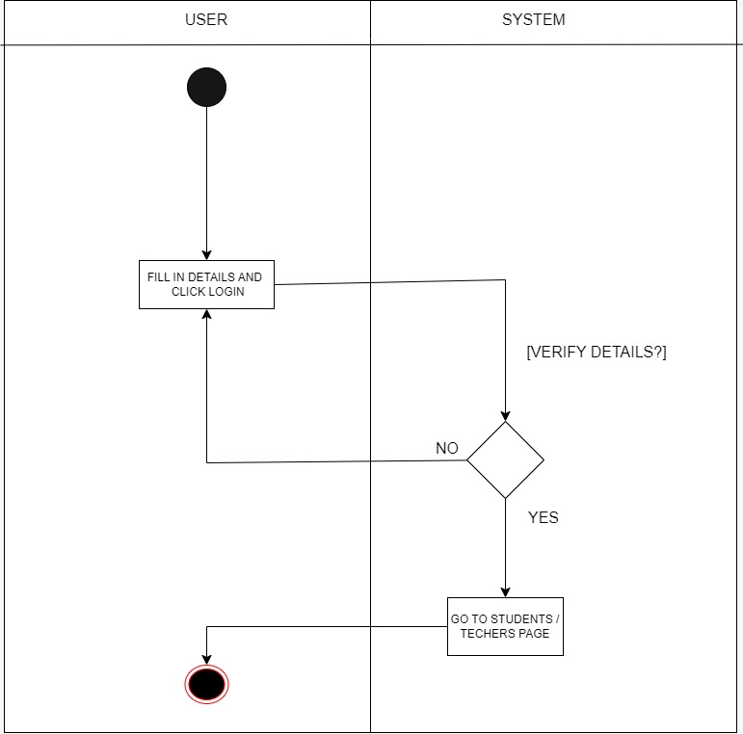
2) Login Activity

Slide 9
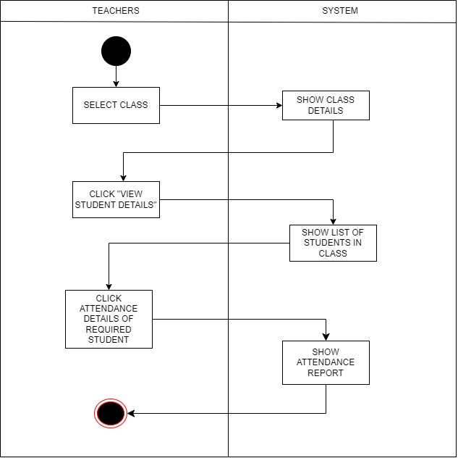
3) Attendance Report Activity

Slide 10
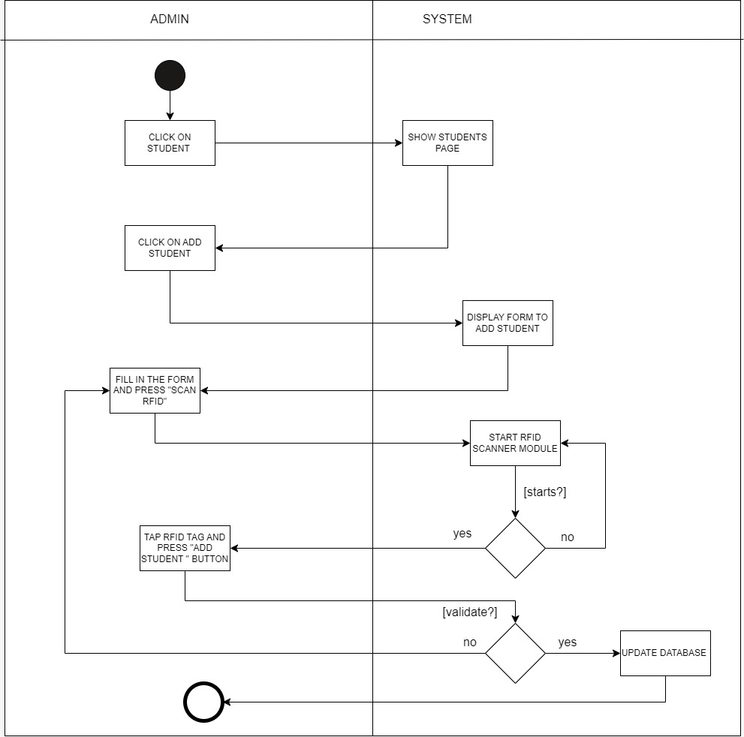
4) Add Student Activity

Slide 11
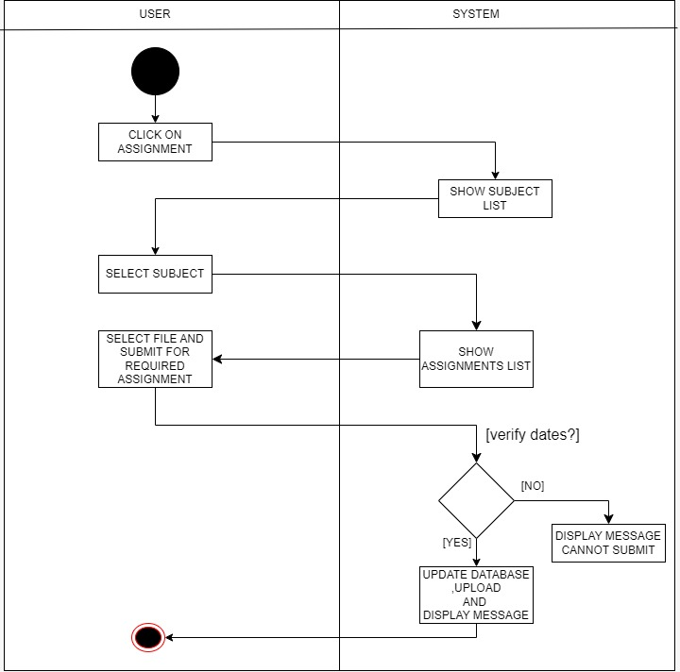
5) Submit Assignment Activity

Slide 12
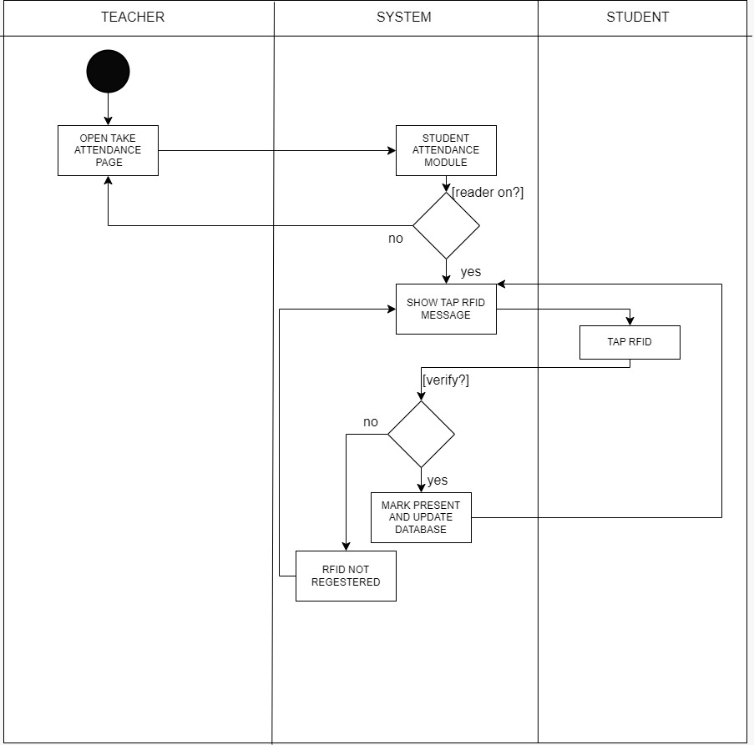
6) Mark Attendance Activity

Slide 13
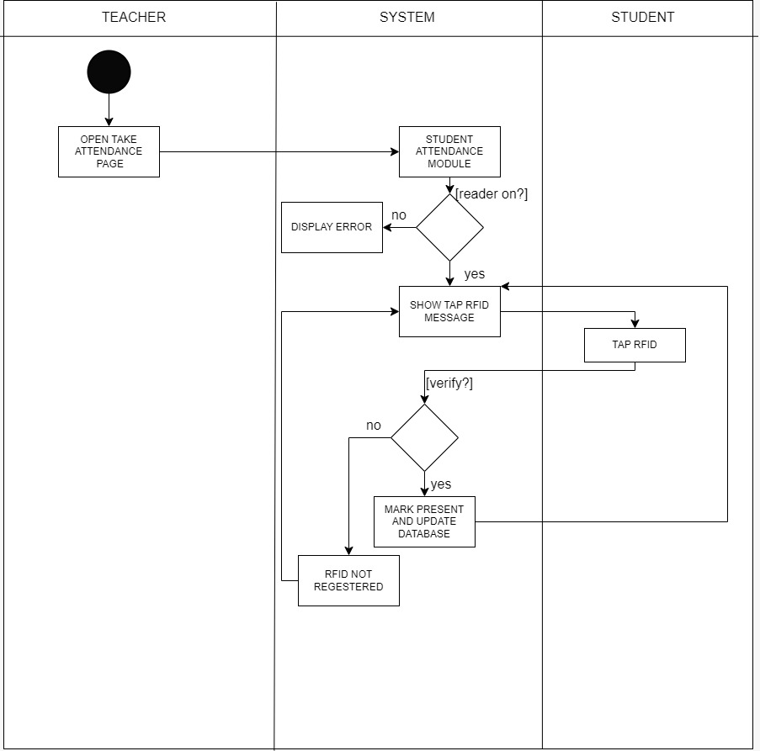
6) Mark Attendance Activity

Slide 14
HARDWARE SETUP

Slide 15
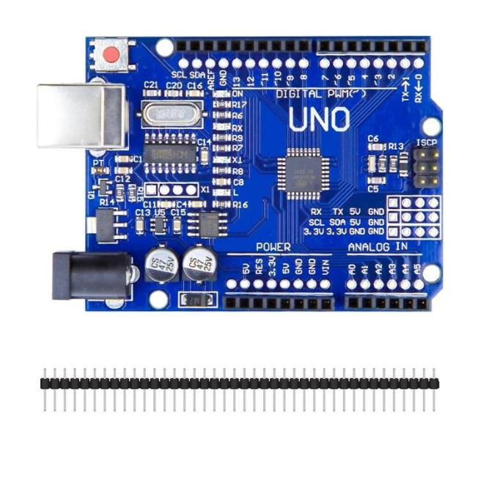
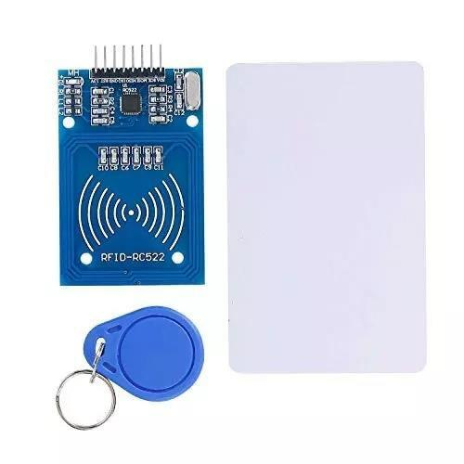
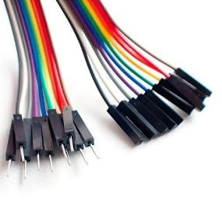
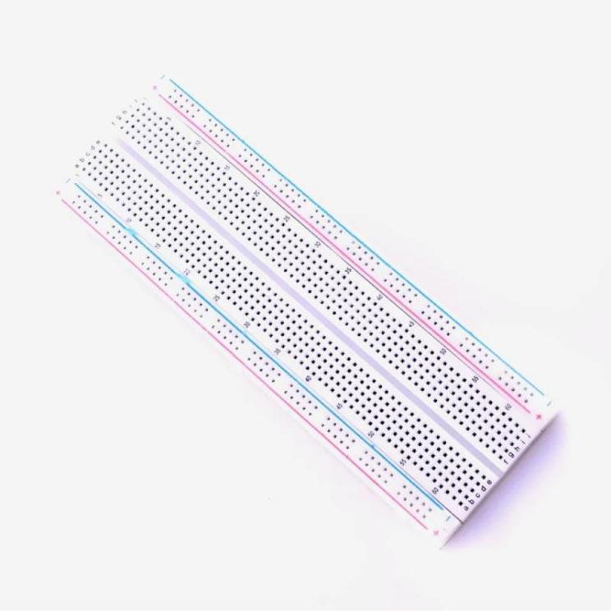
Hardware Requirements
Arduino UNO Board
R305/R307 RFID Sensor
Breadboard
Connecting Wires

Slide 16
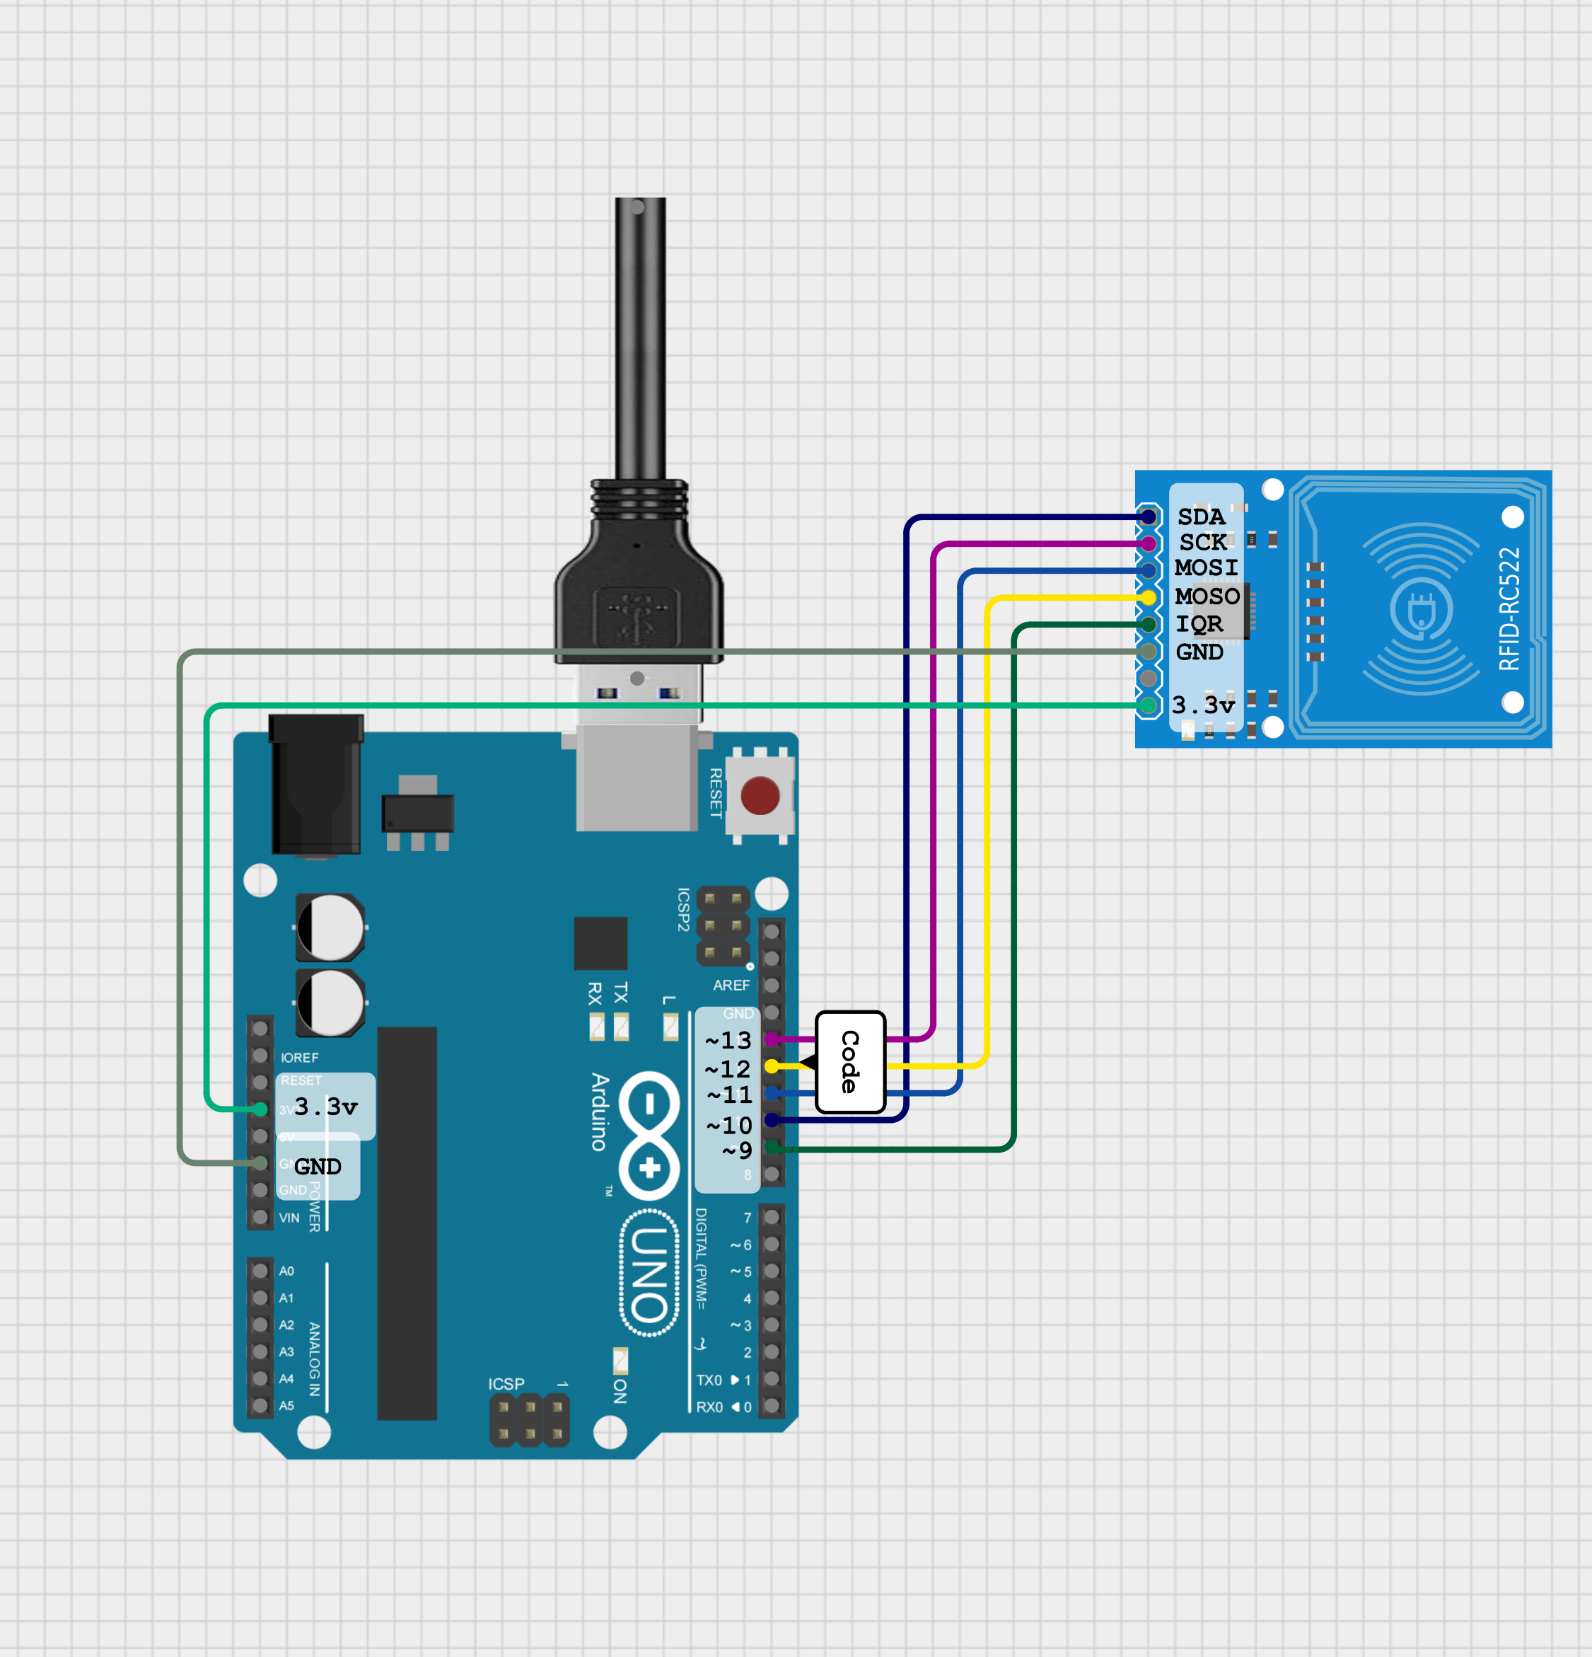
Circuit Diagram

Slide 17
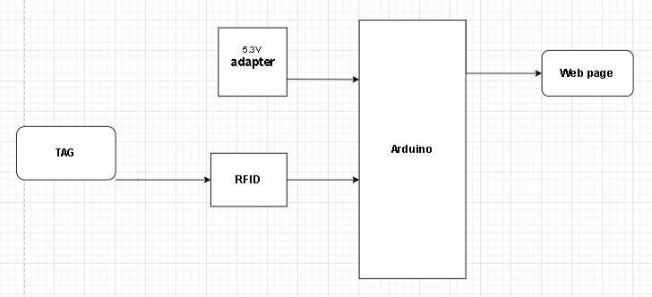
Block Diagram

Slide 18
DEMO

