Slide 1
Field Service Tool Management (FSTM)
Presenter Name: Balakrishnan K
Date: Apr 2017
Notes:
1

Slide 2
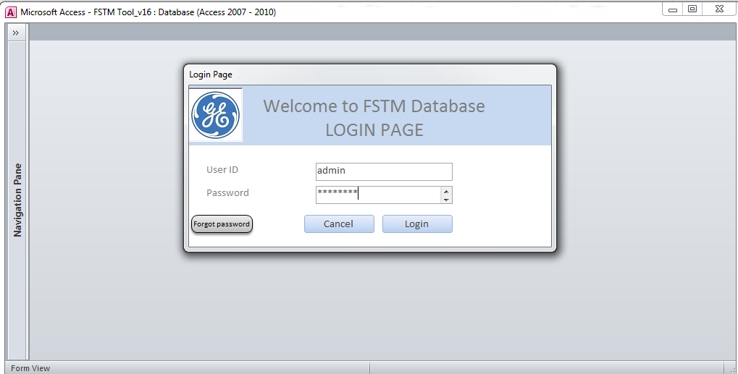
FSTM Login Page
1. Need a dummy Credential Page, something similar to below.
Create 2 dummy credentials. One for Admin and other for Tool User
Notes:
1. Need a dummy Credential Page

Slide 3
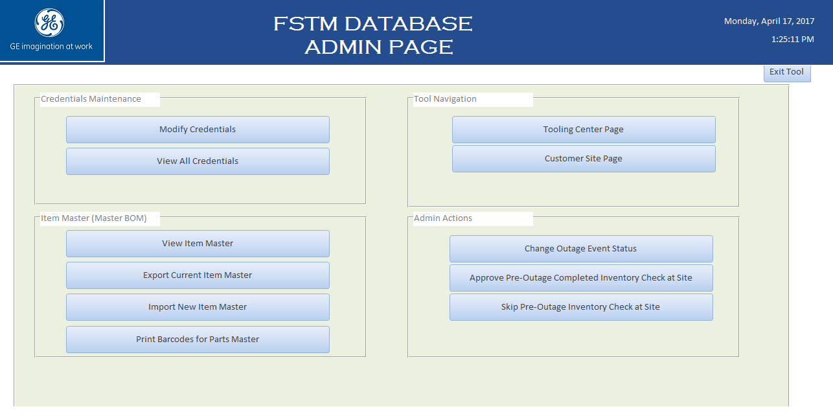
Admin Page
2. Admin page should be created something like below
Two important buttons are Tooling Center Page and Customer Site page. Most of the other buttons would be
dummy in this page. Modifications can be done during development. Once Tooling Center Page is clicked,
Next screen should appear.

Slide 4
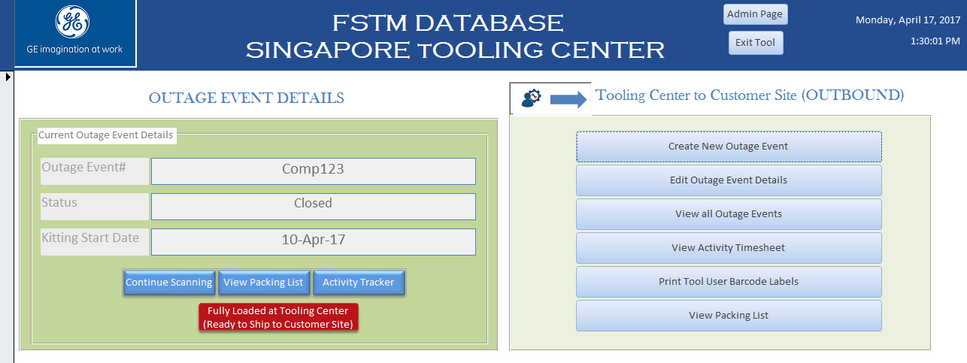
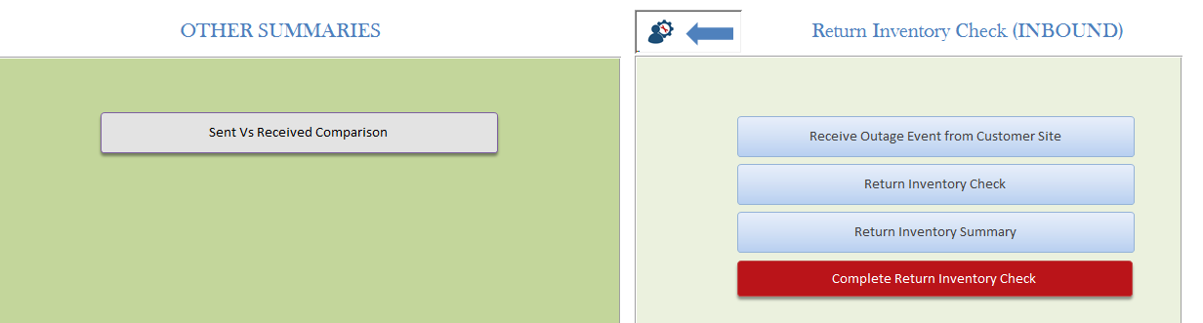
Tooling Center Page

Slide 5
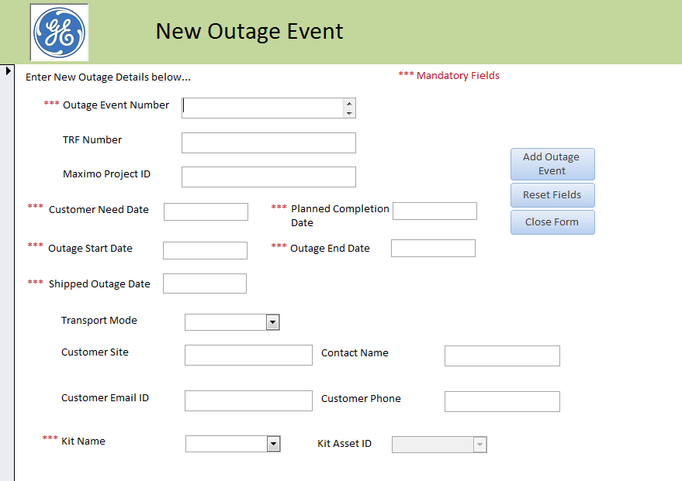
Tooling Center Page – Details
Similar page as shown above should be developed. Once “Create New Outage Event” button is clicked
Below screen should open where it will enable users to fill in the details of New Outage Events.
Once all the details are entered and Click on “Add Outage Event” button, all the details should be saved in the
Backend database

Slide 6
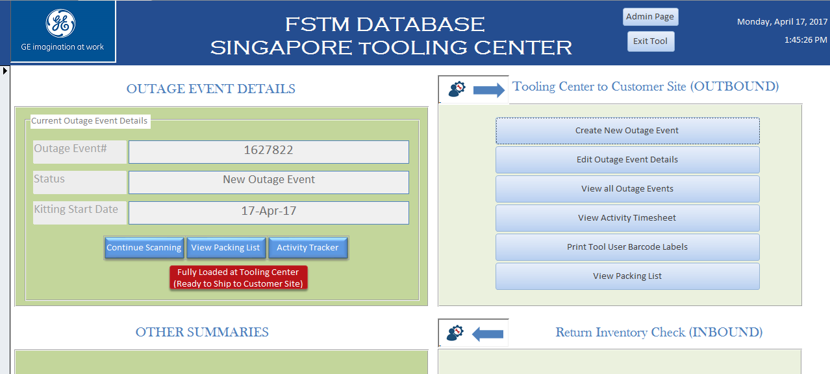
The New Outage Event details should be auto-populated in Main Tooling Center Page as shown above.
Once we click on Continue Scanning, a new page should open as shown below where the users can start scanning the tools using barcode scanner.

Slide 7
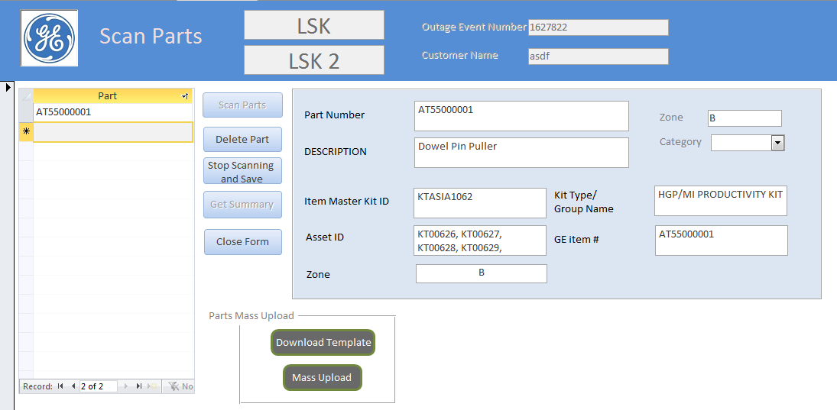
Barcode Scanning
This Scanning page can be modified as per convenience. The basic concept is that as and when we scan the parts, the details of the PN and desc. etc., should be auto populated. Should look something similar to a Supermarket billing page.
Once all the parts are scanned, it should get saved in the data base.

Slide 8
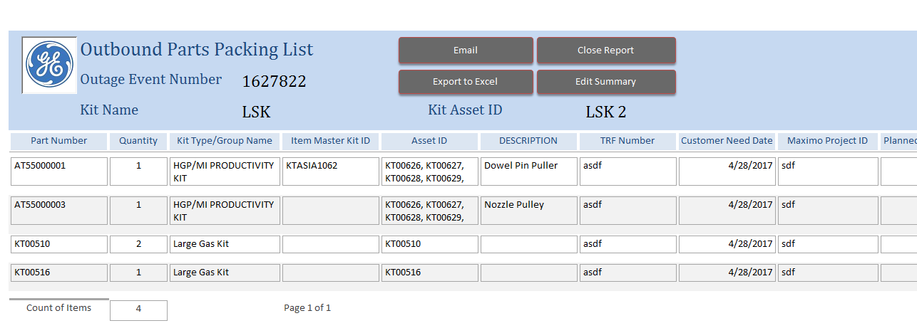
Summary Page
Details of all Scanned parts should be displayed as summary as shown above

Slide 9
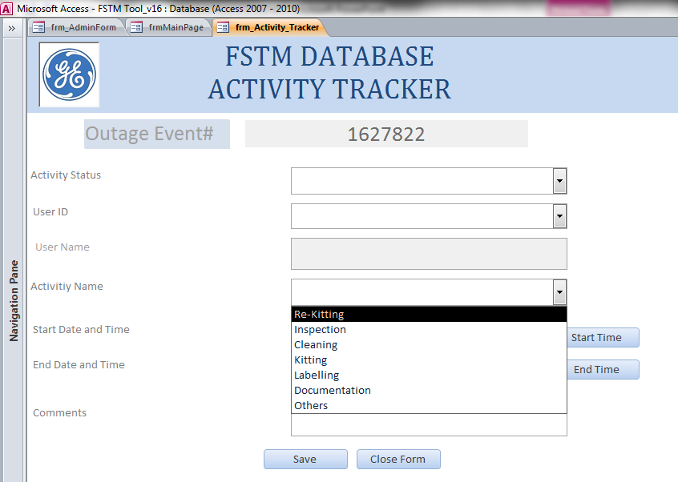
Activity Page
Once Activity Tracker” button is clicked on the Tool Center Main Page, this page should open we can enter various activities as shown in the dropdown.
Start and End time should be captured in this tracker and all the data should be saved in the backend.

Slide 10
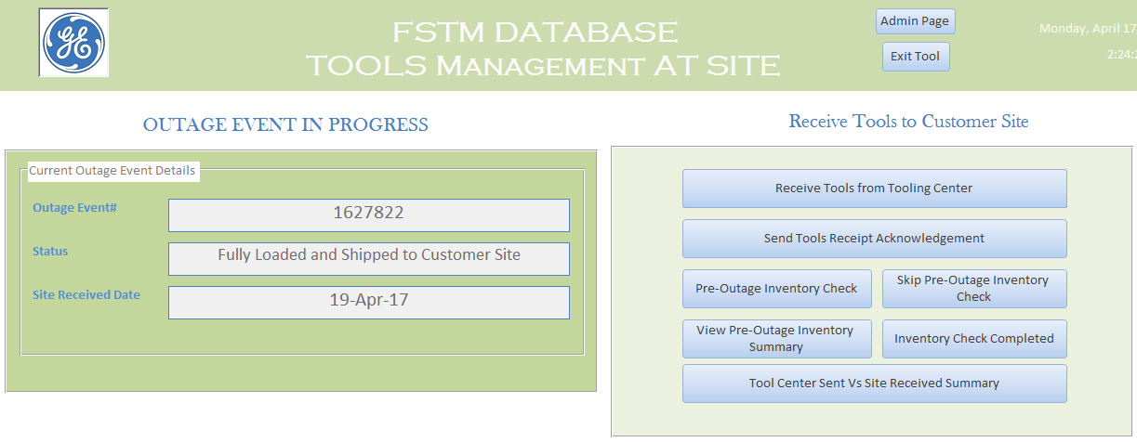
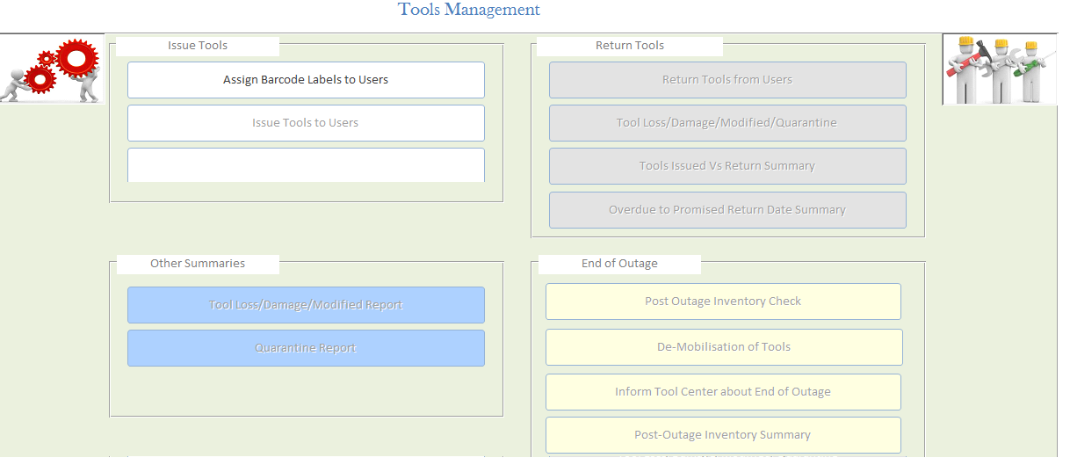
Customer Site Page
In the Admin page, there is another button called “Customer Site Page”. Once it is clicked, below should open. Once “Receive Tools From Tooling Center” button is clicked, Next slide screenshot should open

Slide 11
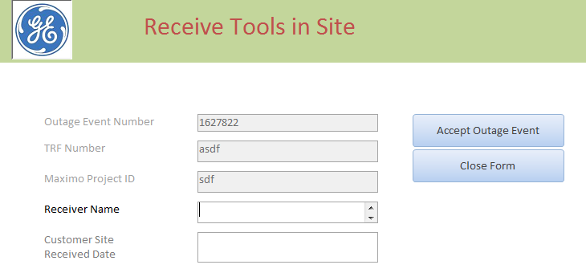
Receive Tools in Site
Enter details and “Click on Accept Outage Event” to save the Outage Event details.

Slide 12
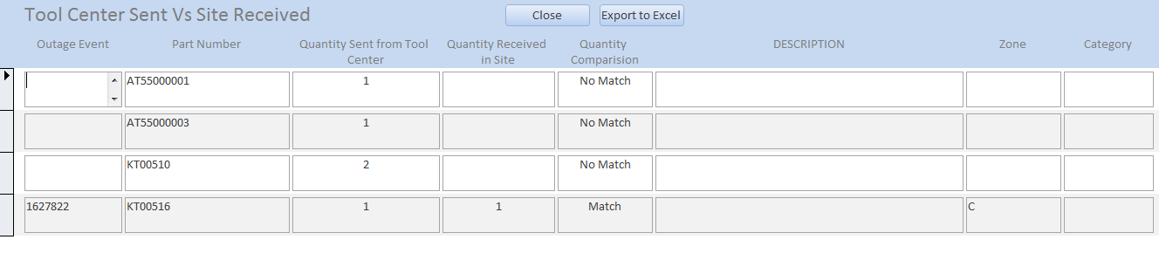
Inventory Check in Site
The Inventory Check in Site page will be similar to the page that is built in Tooling Center page.
Once Parts are scanned and saved in Customer site page, a below comparison summary should be generated.

Slide 13
Balakrishnan.k@genpact.com

