Slide 1
Transmission Level Analysis by Street on Node MC187
Use Case - 1
~99.7%
~68%
~95%
~99.7%
~68%
~95%
Notes:
Descriptive analysis of Node MC187 data is given above.
We grouped the data on each street to derive below insights. Each color here represents unique street with its respective receiver and transmitter signal strengths.
Receiver signal strength mean value is 33.2934 and Standard deviation is 1.7472.
In statistical terms using Chebyshev's theorem we can infer following thresholds -
68% receiver signals should lie between 31.5462 to 35.0406
95% receiver signals should lie between 29.799 to 36.7878
99.7% receiver signals should lie between 35.0406 to 28.0518
Similarly for Transmit Signal mean = 43.4295 and Std. Deviation = 5.0498
68% receiver signals should lie between 38.3797 to 48.4793
95% receiver signals should lie between 33.3299 to 53.5291
99.7% receiver signals should lie between 28.2801 to 58.5789
These thresholds can be used to define the upper and lower limit in raising alerts.
Below 68% can be good range – indicating no concerns
Between 68 - 95% on both sides can be low alert range – indicating medium concerns
Above 95% on both sides can be high alert range – indicating greater concerns and attention

Slide 2
Detect Rx, Tx band-width signal drop
Use Case - 2
Alarm
No-Alarm
Statistical Techniques Used
Data Merging, Conversion and analysis for each customer and trend the same to detect the anomaly at given timestamp.
Feature selection - Rx Freq., Tx Freq., Signal to Noise Ratio, T3 & T4 Errors
Moving Average Window [Need larger data set for each customer]
Regression Model to fit line over each parameter over time
Rules to raise alerts
Forms of anomalies
Receive Level degrading without major change in Transmit level
Increasing noise causing increasing disturbance
Increasing T3 error over the period
Increasing T4 Error over the period
Notes:
This is predictive model based on timestamp bandwidth data.
An alarm\ notification will be sent pro-actively when Rx band-width is dropped below certain threshold (e.g., less than 70%) of the Tx frequency and persist for more than 30 minutes at any given node, street, hub, etc.

Slide 3
Pro-Active Alert Notification on Rx, Tx Signal Loss\Drop
Use Case - 2
Node file per timestamp
Alert on IP Address and time of the event, alerts categories are as below:
Rx Alert – If significant Receive level drop
Tx Alert – If significant Transmit level drop
T3e Alert – If significant T3 errors rise
T4e Alert – If significant T3 errors rise
Notes:
IP: 10.127.108.102
We identified and correlated Rx and Tx frequencies from the UNO tickets to trigger pro-active notification on the signal drop.
This will help the FS team to narrow down the issues at node\ street level and give the benefit to dispatch the ticket at right queue for quick diagnosis\ resolution.

Slide 4
Mock-up UI for Alarm Notification
Use Case - 2

Slide 5
Ticket Analysis Dashboard

Slide 6
Ticket Occurrences Analysis
Notes:
The above graph represent the time for which each ticket persists over one quarter of 2016. We have plotted the data from video ticket file, where the day of the first occurrence of a case in on x-axis and the delta between first occurrence and last occurrence of the same issue is plotted on y-axis.
Clearly there is no effect of seasonality [Jan to March ]on the re-occurrence of the number of tickets. These can be analyzed from holidays perspective further.
We could infer that majority of the issues persisted/re-occurred for as long 25 days. Few of them lasted for between 25-110.
Very few cases lasted for more then 300 days, this can be analyzed further to be classified into a special category to be targeted at a faster speed to reduce the resolution time and their reoccurrence. This may ultimately be beneficial in reducing business losses.

Slide 7
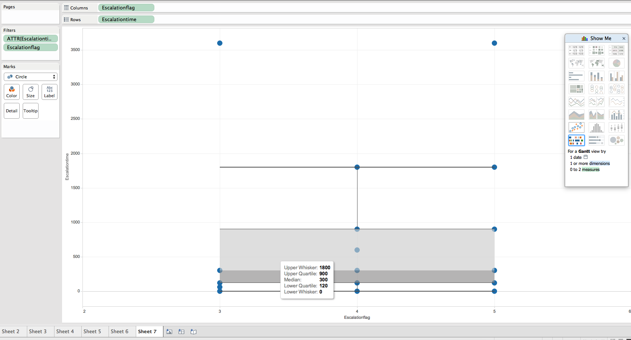
box-whisker plot of Escalation Time versus Escalation Flag
Notes:
The box-whisker plot of Escalation Time versus Escalation Flag is a good representation of distribution of tickets.
Majority cases lies within Escalation category of 3-5 indicating these categories of higher importance. Escalation flag with values 0, 2 and 6 are negligible.
From the graph we can conclude that:
50% times the ticket is resolved within 120-900 minutes (assuming unit of measurement for time is minutes).
25% chances are there to resolve a ticket within less than 120 minutes and 25% chances that NOC operator would take more 900-1800 minutes.
2 outlier points outside the whiskers indicates some error in data entry, issues with ticket handling, on an extra-ordinary cases which can be investigated further for better understanding.

Slide 8
Correlation cross-tab between Service Name(Service Type) and System Name (City)
Notes:
Correlation or cross-tab between Service Name(Video Service Type) and System Name (City)-
This gives us distribution of video service type across city.
The darker the color the more the customers for a service across the city.
Kansas, Atlanta, Omaha and Hampton Roads have top consumers for video services. And can be targeted for need based marketing to grow business.
VIDEO_METRO_HPC is the most popular service followed by VIDEO_METRO_INTERACTIVE and VIDEO_METRO_DIGITAL.
These services can be packaged with the lower popular ones with better offers for benefits.

Slide 10
Detection Alert Analytic
Multiple files at different timestamps from each node are joined to retrieve each customer (ip address / mac address) information over the time.
Receive Level, Transmit Level, Signal to Noise Ratio, T3 and T4 Errors are analyzed for each customer and trended to detect the timestamp where an anomaly is detected.
Algorithm Techniques Used
Data Merging, Conversion
Moving Average Window [Not applicable for given data set as only 10 timestamps for each customer is available]
Regression Model to fit line over each parameter over time
Rules to raise alerts
Anomaly could be of form-
Receive Level degrading without major change in Transmit level
Increasing noise causing increasing disturbance
Increasing T3 error over the period
Increasing T4 Error over the period

Slide 11
Detection Alert Analytic (contd…)
Input Files –
Node files per timestamp - CL187_T01.csv, CL187_T02.csv,…….
Filename mapped to Timestamp – TimeStamps.txt
Output File – TnC_Alert.xlsx with following parameters
IP Address – Issue raised for a customer at given ip address
Date Time – Time of the event
Receive Alert – TRUE for significant Receive level drop, FALSE otherwise
Transmit Alert – TRUE for significant Transmit level drop, FALSE otherwise
T3 Error Alert – TRUE for significant T3 error rise, FALSE otherwise
T4 Error Alert – TRUE for significant T3 error rise, FALSE otherwise
Code file - Detection_Alert_Analytic.m

