Slide 1

Apache Cassandra - Distributed Database Management System
Presented by
Jayesh Kawli

Slide 2
Introduction
Distributed database system with combination of technologies from Amazon Dynamo and Google BigTable
Roots lie in the NoSQL database requirement for Facebook Corporation.
Expected to be able to handle data spread across geographically diverse business servers
Scalable, decentralized and fault tolerant database management system
Stores business data in structured and indexed fashion for efficient querying using Cassandra query language (CQL)

Slide 3

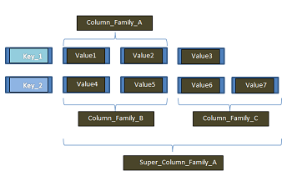
Structure and organization
Multidimensional table to store the values
Data columns, are grouped into column families and column families are further grouped into super column families
Access to single or multiple columns having distinct keys for bulk data access as atomic operations
Available APIs
insert (tablename, keyname, rowMutation)
get (table, key, columnName)
delete (table, key, columnName)

Slide 4
Cassandra Architecture
Cassandra provides incremental partitioning feature to handle the insertion of large amount of data into database
Responsible for providing high data availability by replicating data across remaining n replicas using quorum protocol
Uses gossip protocol to maintain membership among all system nodes
Implements more efficient probabilistic model to check if node is faulty
Provides tunable data consistency which offers persistence and protection
Offers replication and consistency facility with low down time during maintenance

Slide 5
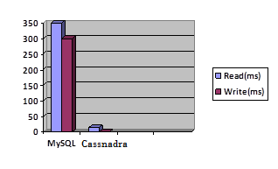
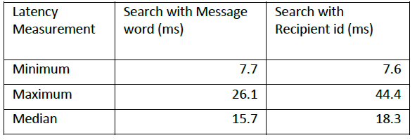
Cassandra - Performance testing
Tested against MySQL with production data of 100M users with size over 7 TB
Also tested with Facebook inbox data with more than 50 TB storage having total 150 Nodes spread evenly between east and west coast data center

Slide 6



Business corporations using Cassandra
Twitter
Main challenges with applications are scalability, diversity and consistency across geographically diverse applications
Digg
Due to large volume of users posting their feedbacks Digg has expected problem of handling and managing large volume of data. Cassandra provides highly scalable architecture with no single point of failure and recovery
Formspring
Cassandra is utilized by Formspring technical team to count number of responses and active users e.g. followers and following

Slide 7
References
http://cassandra.apache.org
http://www.quora.com/Cassandra-database
http://www.odbms.org/download/WP-DataStax-Cassandra.pdf
Avinash Lakshman, Prashant Malik Cassandra-A Decentralized Structured Storage System, ACM SIGOPS Operating Systems Review archive, Volume 44 Issue 2, April 2010
Sanjay Ghemawat, Howard Gobioff, Shun-Tak Leung - The Google File system, ACM SIGOPS Operating Systems Review - SOSP '03 Homepage Volume 37 Issue 5, December 2003

Slide 8
Thank you

