Slide 1
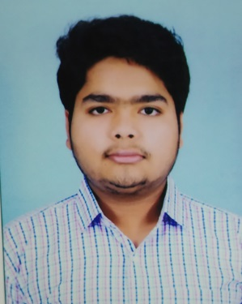
Core Competencies
Programming Languages: Java
Technologies: Micro-service, REST, Java8, JPA, Hibernate, Jasper
Frameworks: Springboot, SpringCloud
Web/Application Server: Tomcat
Operating System: Windows, Linux
Database: MySQL
Tools: Eclipse/STS, VSCode, Git, Docker, Maven, Postman, MySQLWorkBench
Project completed in training period-
Product-Review Management System-
https://github.com/ojhasanchit0725/CTSProductReviewSystem
Worked on Product- Review management system followed by spring-boot based micro-service architecture. Bank Management System-
https://github.com/jayesh24/BMSCTS
A bank application for customer where a customer can add ,view his/her account and invest in mutual fund.
Stock-Market-
https://github.com/jayesh24/StockMarketFSEIIHT
Worked on a Stock-Market based project enhancing all full-stack technologies.
Jayesh Sharma
844193
Profile Summary
Completed training based on technology such as Spring Boot ,Spring Cloud, Microservices , Core Java ,Java8 REST, SQL,Jasper.

