Slide 1

ICBP 2.0
Neural Style Transfer & High-Resolution Image Upscaling
Your Name : Jayesh Yadav
Project GitHub Link:https: //github.com/jayesh2708/ICBP-Project

Slide 2
Content
Problem Statement
Objective
Dataset
Model Selection
Model Architecture (For Deep Learning Projects)
Training & Evaluation
Results
Conclusion & Future Work
References
Notes:
Here we are going to learn,
Text classification involves assigning categories to text, commonly applied in spam detection. It requires preprocessing (tokenization, stopword removal) and vectorization (e.g., TF-IDF). Models like Naive Bayes or Logistic Regression are trained and evaluated using metrics like accuracy and F1-score.

Slide 3
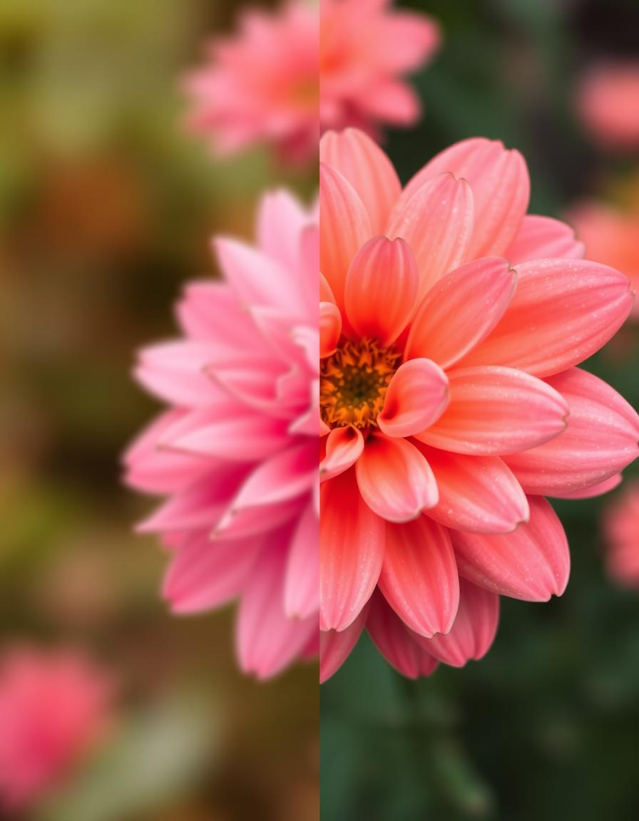
Problem Statement
There’s a need for an automated solution that preserves content and style while
enabling high-resolution outputs.
Similarly, enhancing image resolution to large printable sizes (A0, A1, 4ft x 4ft) without
losing detail is a significant challenge.
In creative industries, transforming photos into artistic paintings manually is tim -consuming.
Notes:
Need to discuss about :
What problem are you solving?
Why is it important?

Slide 4
Objective
✅ Apply Neural Style Transfer (NST) to create oil painting-style images.
✅ Maintain style consistency across different content types (portraits, landscapes).
✅ Use Real-ESRGAN to upscale images to high resolution (4× or more) while preserving texture fidelity.
✅ Ensure clarity and quality at print-ready sizes.
Notes:
Need to discuss about :
Clear goals of the project
What you aim to achieve with AI/ML/DL

Slide 5
Dataset
📌 Input images are user-uploaded (no fixed dataset):
Content Image: A regular photograph
Style Image: A painting or stylized texture
Output: Stylized and upscaled image
🛠️ Images handled via interactive upload in Google Colab.
Notes:
Need to discuss about :
Source of data
Size, features, any preprocessing
Tools used for cleaning

Slide 6
Model Selection
Task | Model
Style Transfer | Pretrained VGG19 (feature extraction)
Upscaling | Real-ESRGAN (scale=4)
✅ VGG19 helps in extracting content and style representations
✅ Real-ESRGAN provides enhanced resolution with photo-realistic fidelity
Notes:
Need to discuss about :
Which algorithms/models did you try? (e.g., CNN, RNN, Random Forest)
Justify your choices (especially in DL projects)

Slide 7
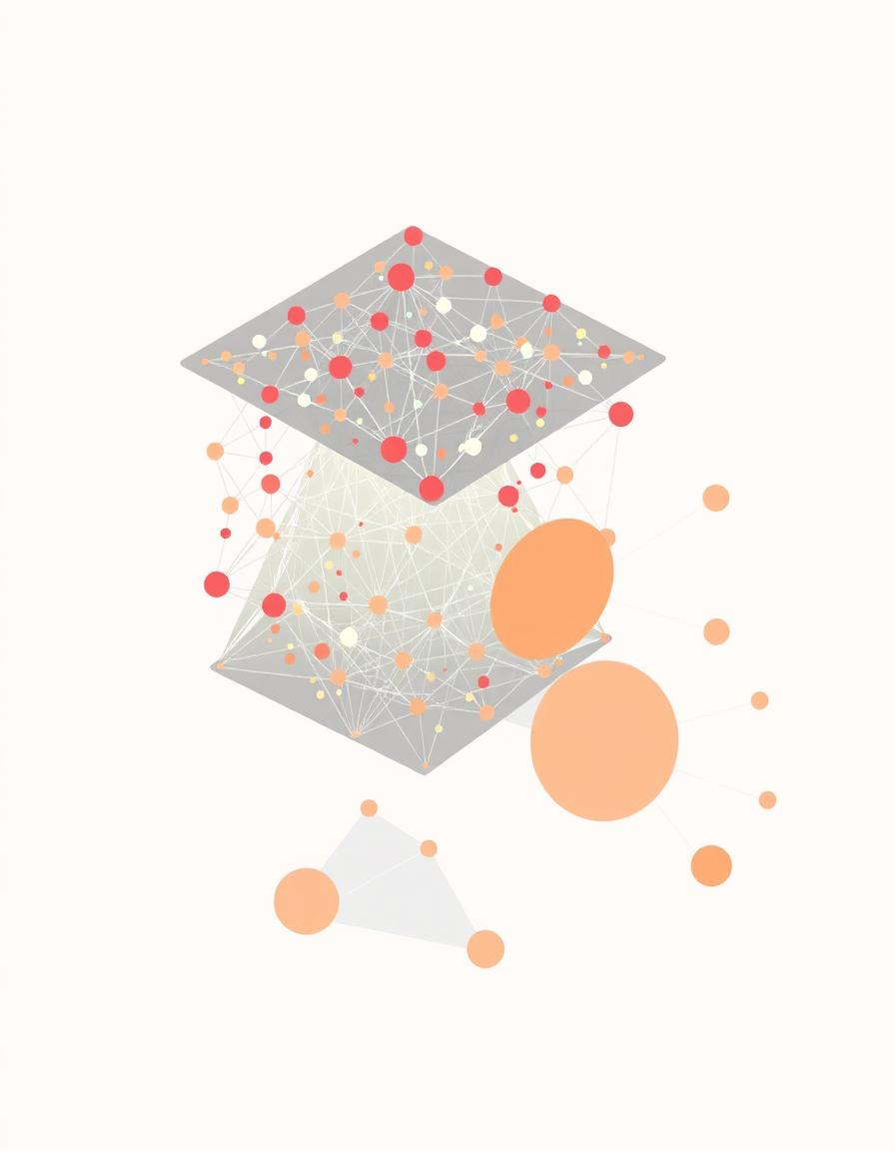
Model Architecture (For Deep Learning Projects) - optional
Style Transfer
🧠 VGG19-based Feature Extraction:
Extracts intermediate features (layers 0, 5, 10, 19)
Computes Content Loss and Style Loss (Gram Matrix)
🎨 StyleTransferLoss:
Total Loss = α × Content Loss + β × Style Loss
Style weight (β) = 1e6 to preserve stylization
Notes:
Need to discuss about :
Layers used (Conv, Pool, Dense, Dropout)
Diagram of architecture
Parameters/Hyperparameters

Slide 8
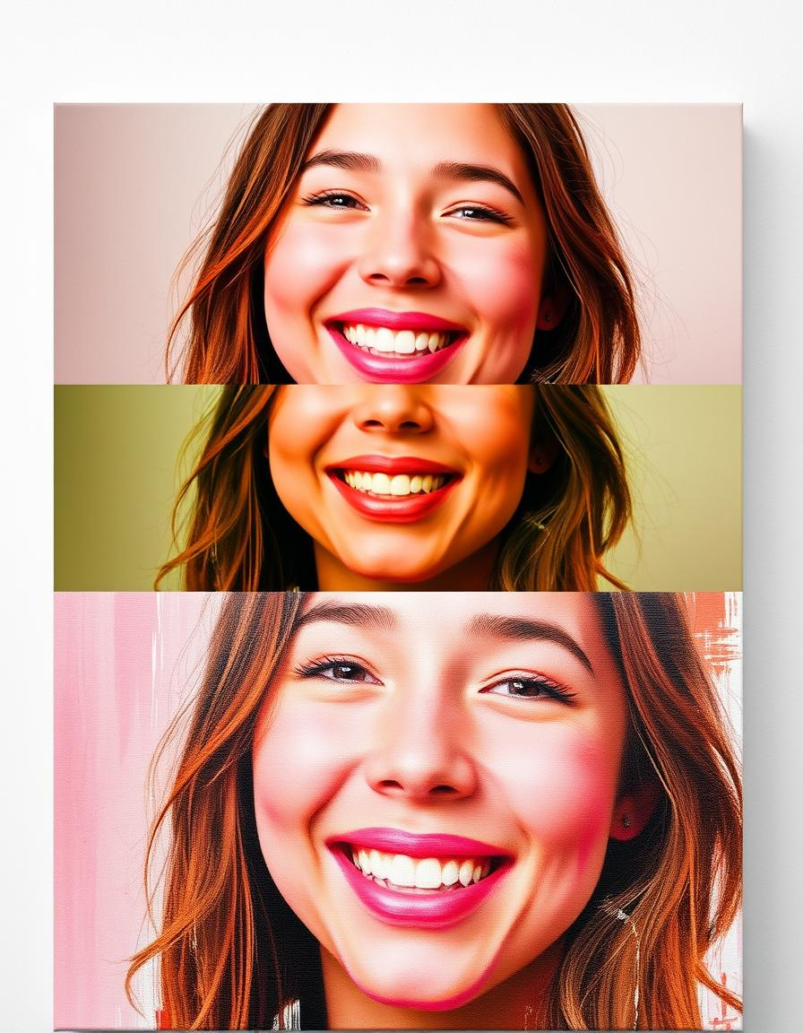
Model Architecture (For Deep Learning Projects) - optional
Real-ESRGAN Architecture (Upscaling)
🖼️ Uses RRDBNet Backbone
Residual-in-Residual Dense Blocks
Deeper network with no Batch Norm for stability
Handles real-world degraded images
Scales image by 4×
⚙️ Model weights: RealESRGAN_x4.pth
Notes:
Need to discuss about :
Layers used (Conv, Pool, Dense, Dropout)
Diagram of architecture
Parameters/Hyperparameters

Slide 9
Training & Evaluation
🔧 Style Transfer:
Optimizer: Adam
Learning Rate: 0.003
Epochs: 300
Image size: 512×512
Loss printed every 50 steps
📈 Evaluation:
Visual quality
Content preservation
Artistic texture fidelity
Notes:
Need to discuss about :
Training strategy
Loss function & optimizer
Accuracy, precision, recall, F1 score, confusion matrix

Slide 10
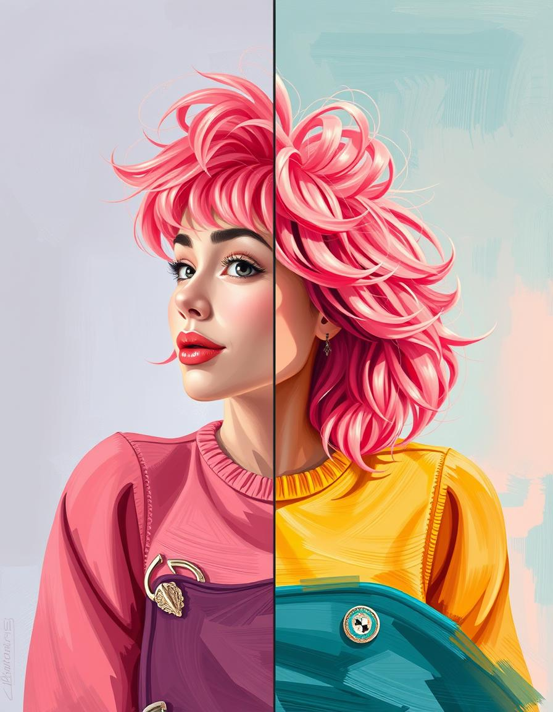
Results
🖼️ Sample Outputs:
Content Image → Stylized Image
Stylized Image → Real-ESRGAN Upscaled Image
Final Result: ✅ High-resolution, stylized, printable artwork
Notes:
Need to discuss about :
Visuals (graphs, images, etc.)
Comparison with baseline models (if any)
Inference speed, model size (for DL)

Slide 11
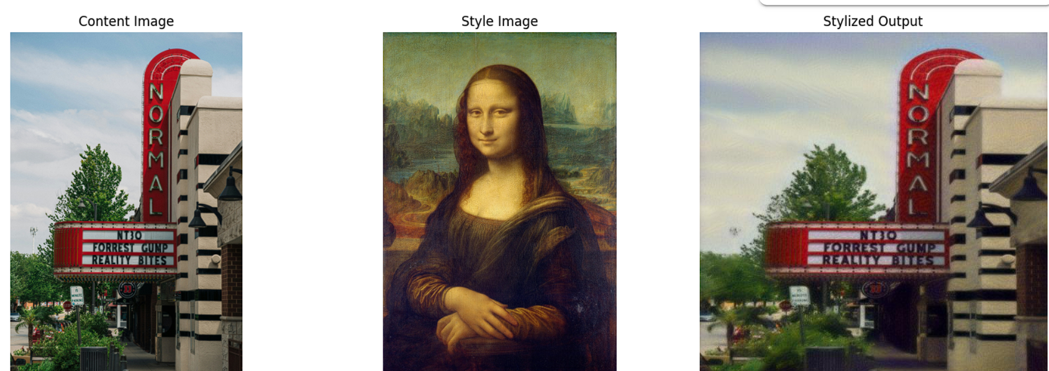
Training & Evaluation
Content Image- Image uploaded locally
Style Image- Oil painted image uploaded locally
Stylized Output- Is the result image after the operation
Notes:
Need to discuss about :
Training strategy
Loss function & optimizer
Accuracy, precision, recall, F1 score, confusion matrix

Slide 12
Conclusion & Future Work
✅ Successfully applied oil painting style using Neural Style Transfer
✅ Maintained content consistency
✅ Upscaled results suitable for A0/A1 printing
✅ Easily deployable in Colab with interactive uploads
Notes:
Need to discuss about :
Final thoughts
How the model can be improved or scaled

Slide 13
References
Gatys et al., “A Neural Algorithm of Artistic Style,” 2015
ESRGAN: Wang et al., “ESRGAN: Enhanced SR GAN,” 2018
Real-ESRGAN GitHub: https://github.com/xinntao/Real-ESRGAN
PyTorch Documentation
Google Colab Platform
Notes:
Need to discuss about :
Papers, datasets, collaborators, tools used

Slide 14
Thank You

